Slide 1
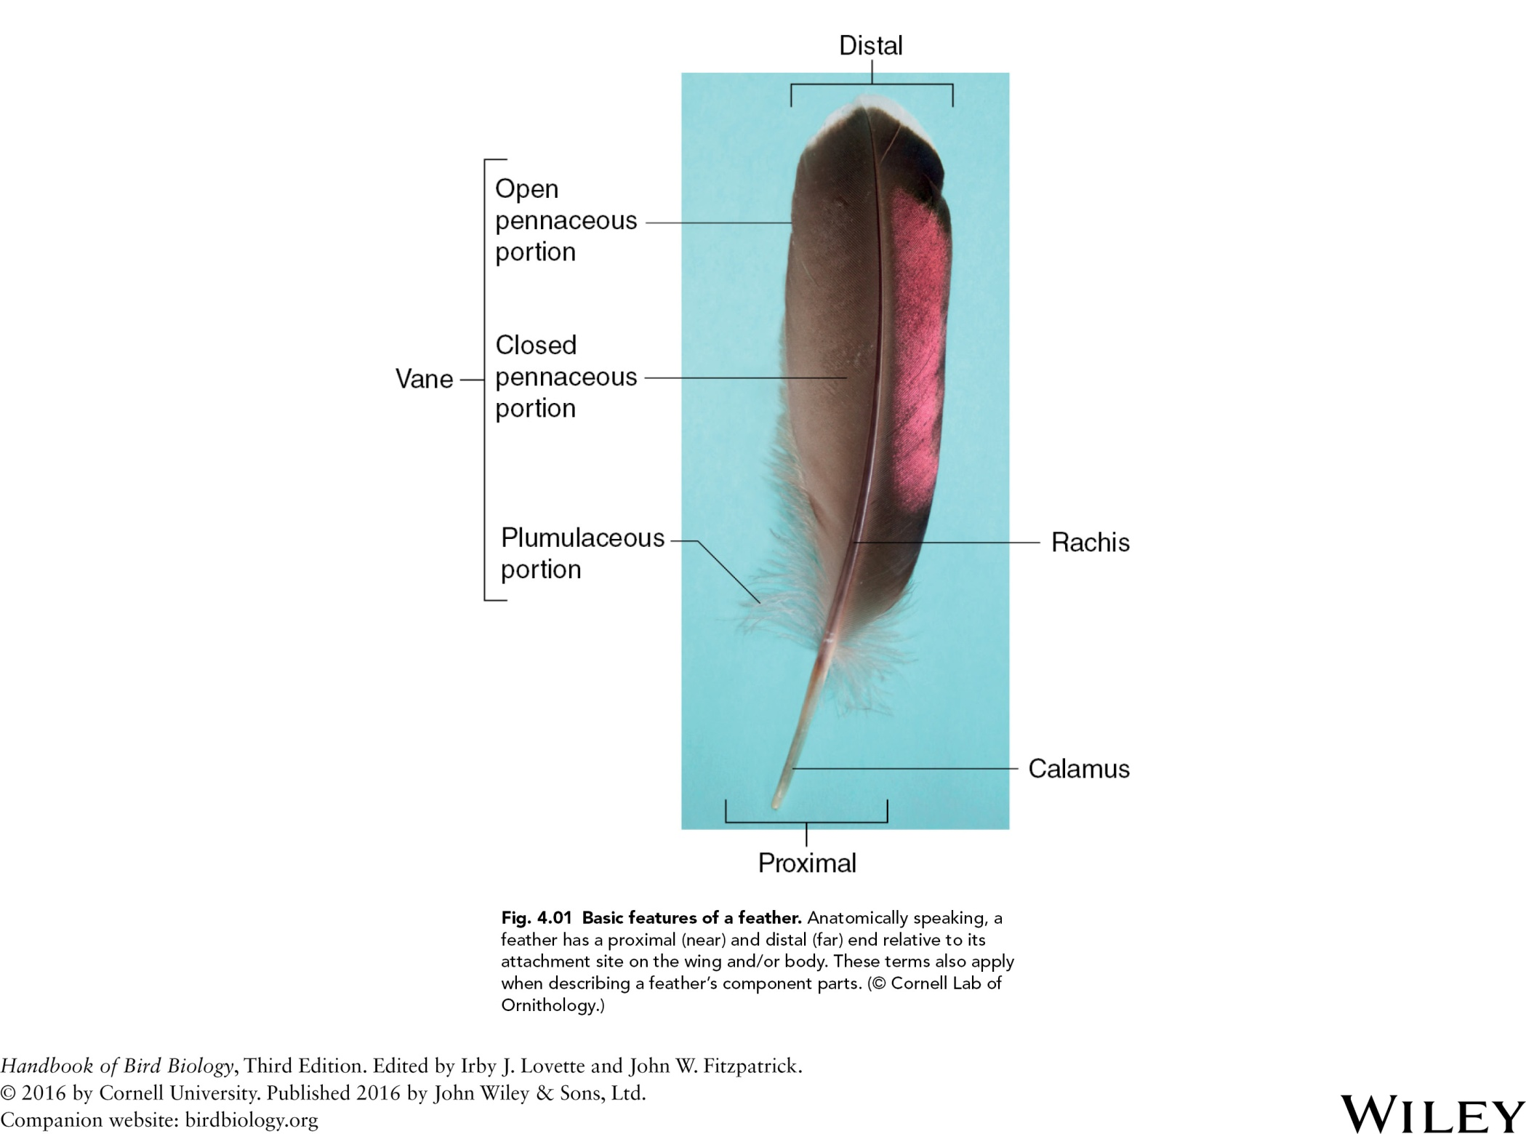

Slide 2
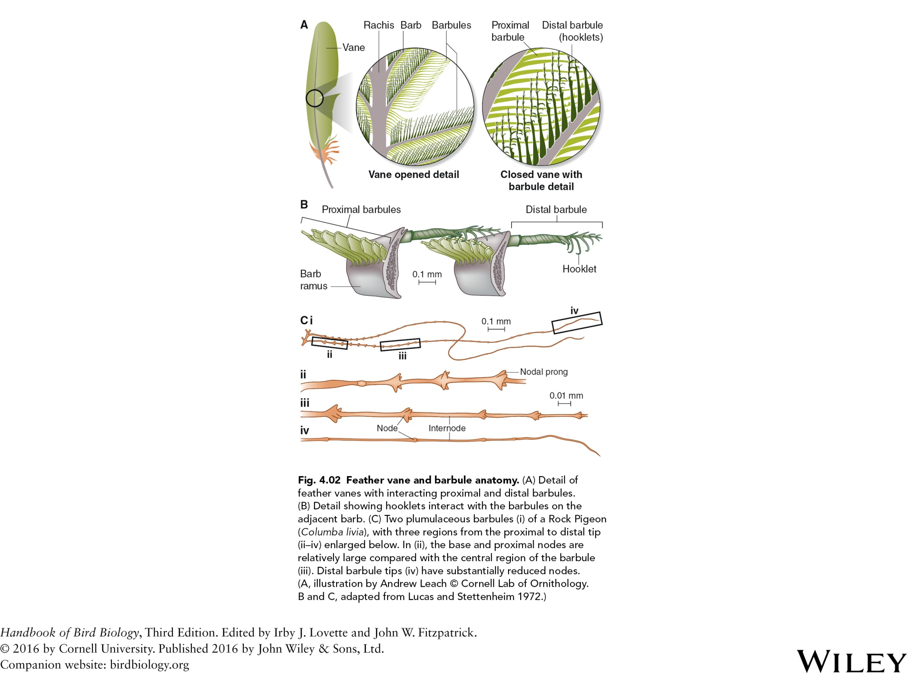
Fig. 4.02 Feather vane and barbule anatomy. (A) Detail of
feather vanes with interacting proximal and distal barbules.
(B) Detail showing how hooklets interact with the barbules on the
adjacent barb. (C) Two plumulaceous barbules (i) of a Rock Pigeon
(Columba livia), with three regions from the proximal to distal tip
(ii–iv) enlarged below. In (ii), the base and proximal nodes are
relatively large compared with the central region of the barbule
(iii). Distal barbule tips (iv) have substantially reduced nodes.
(A, illustration by Andrew Leach c Cornell Lab of Ornithology.
B and C, adapted from Lucas and Stettenheim 1972.)

Slide 3
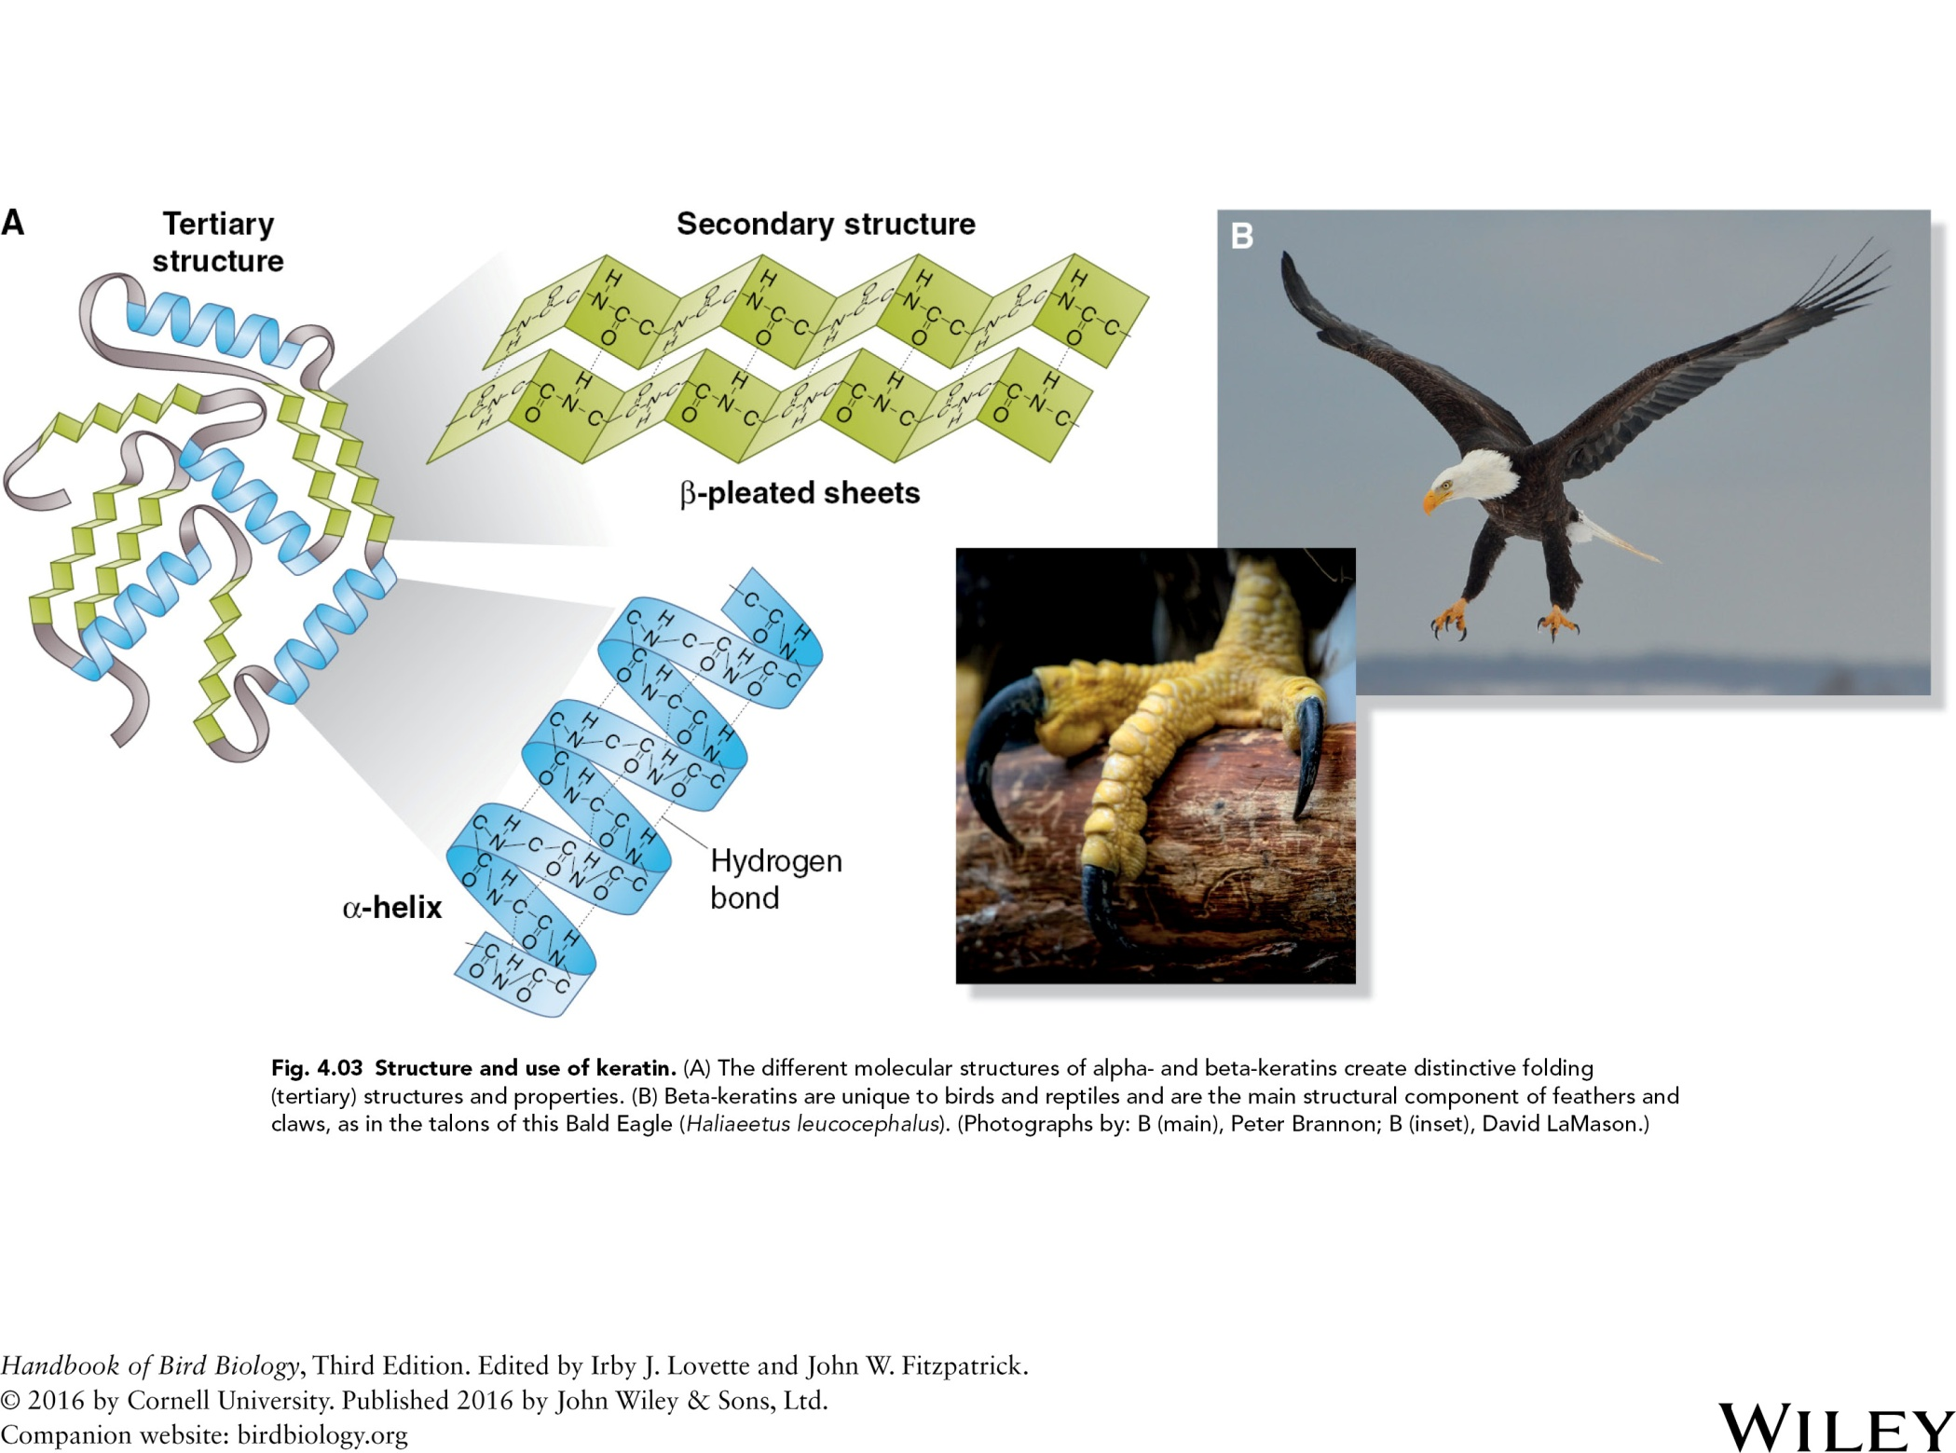

Slide 4
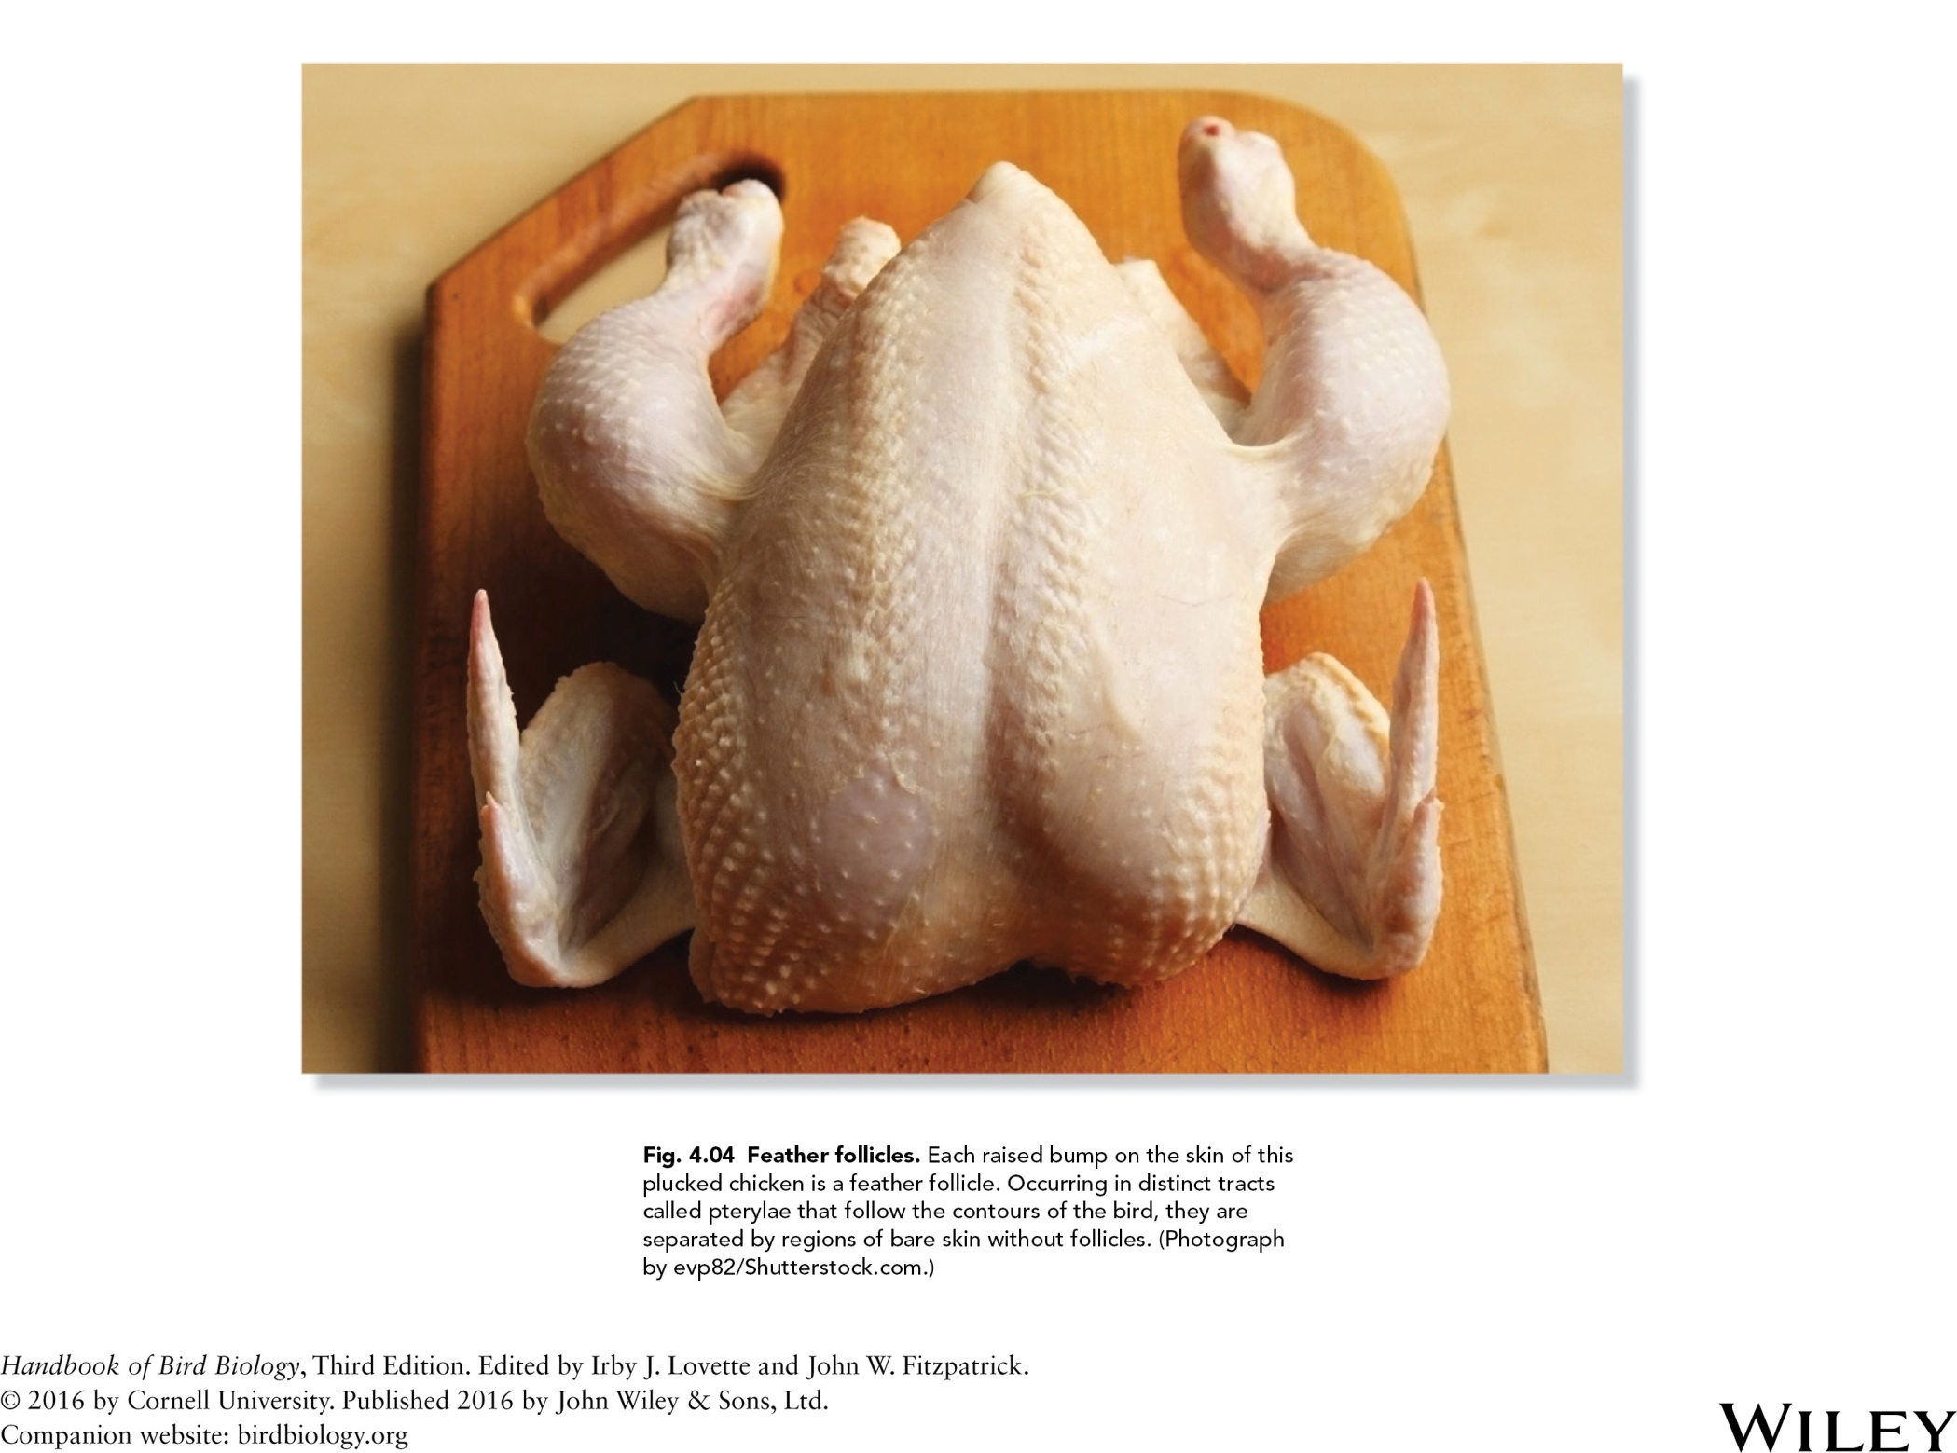

Slide 5
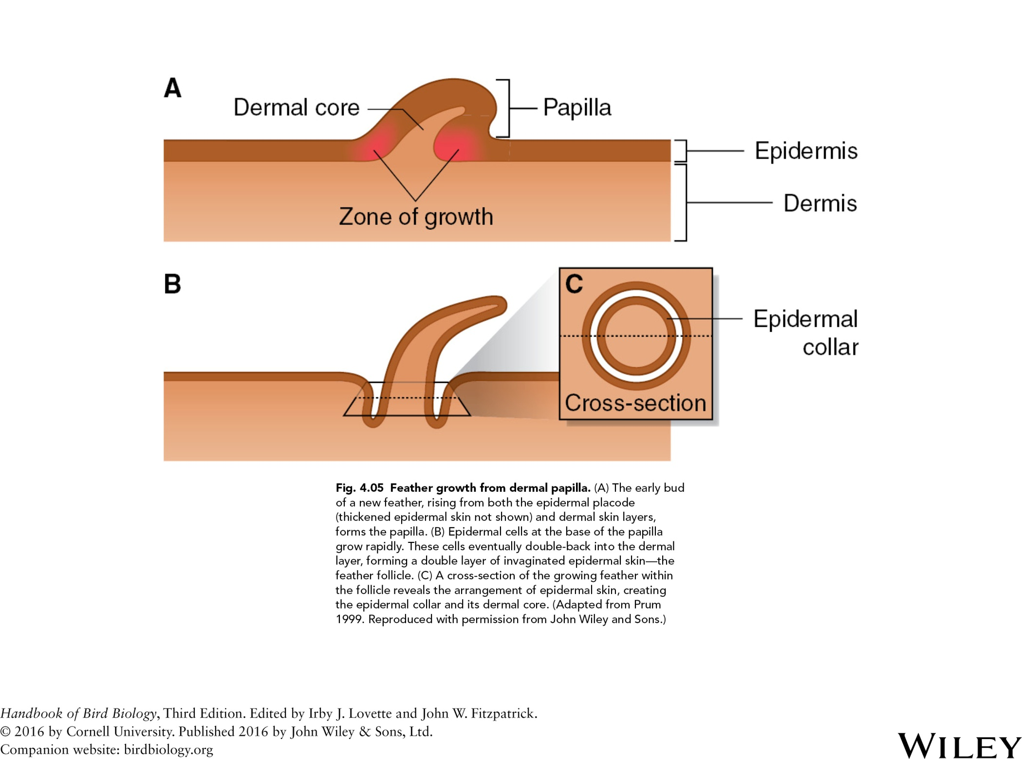

Slide 6
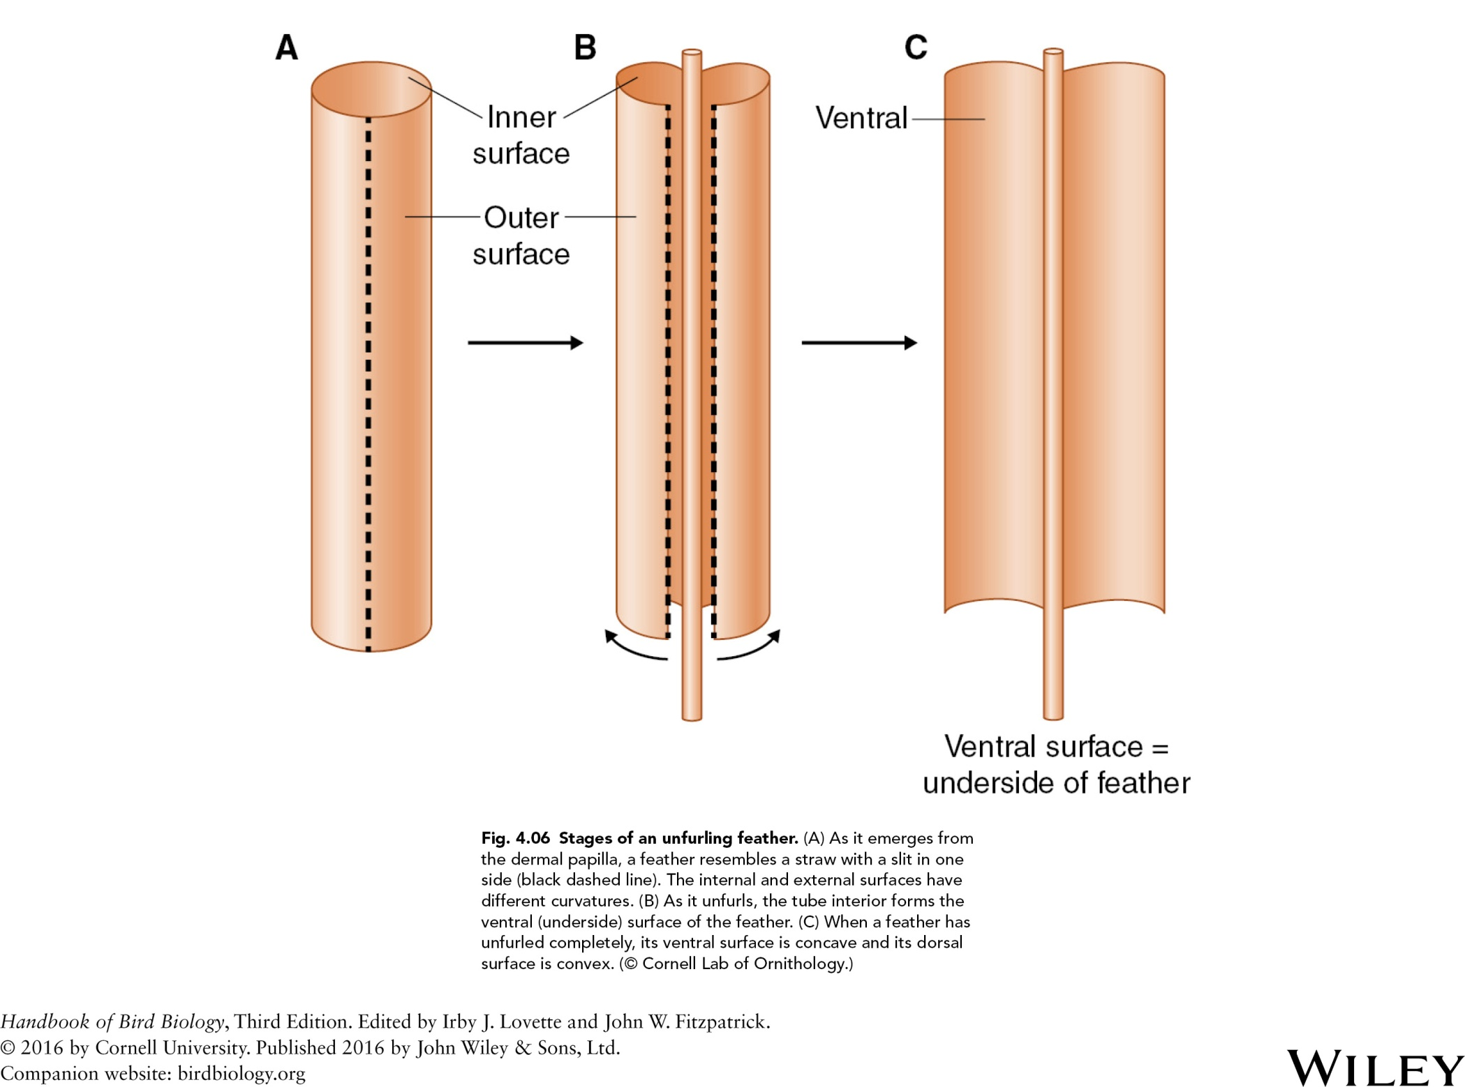

Slide 7
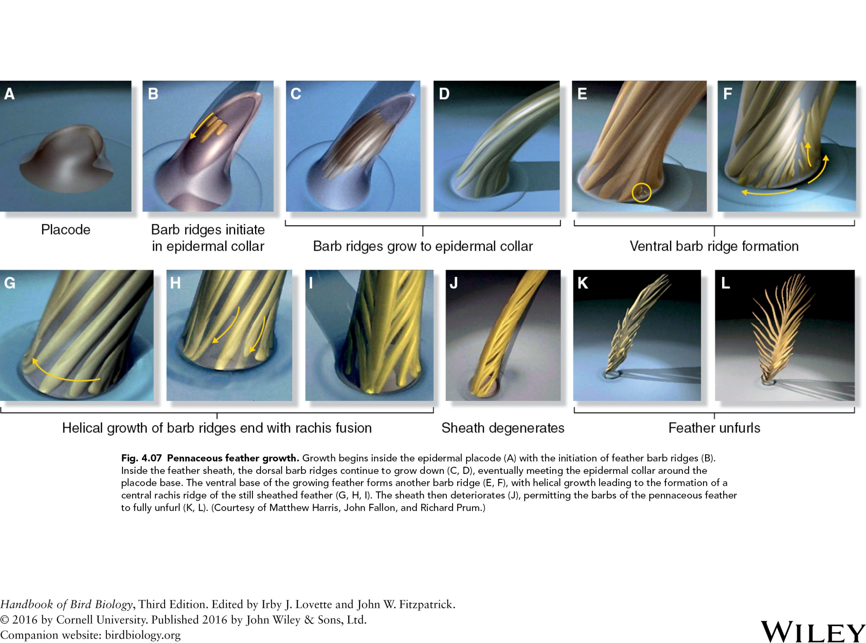

Slide 8
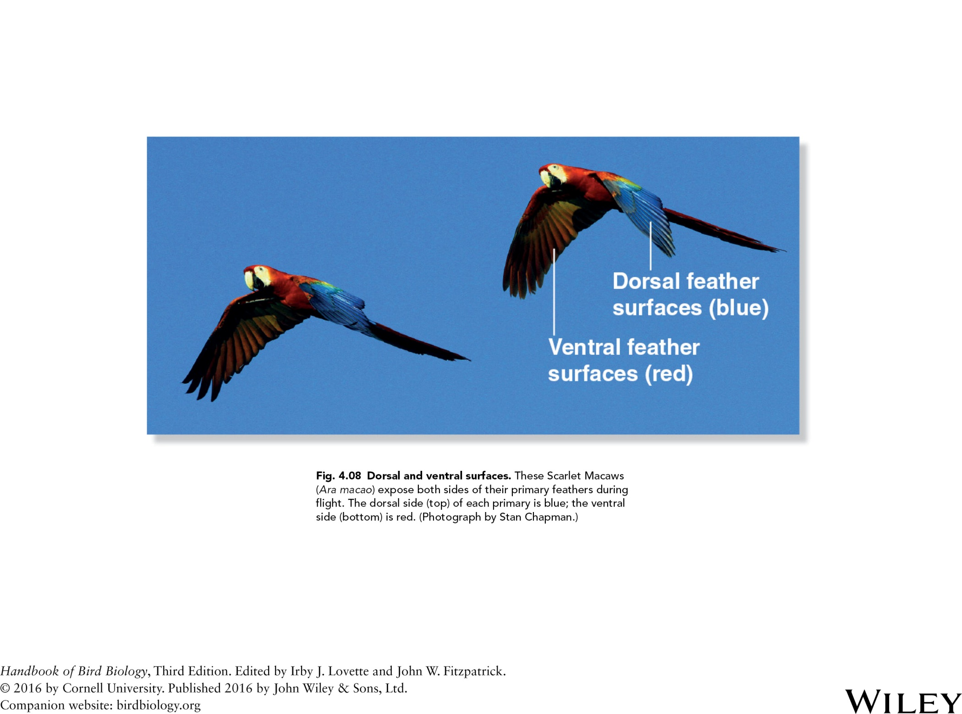

Slide 9
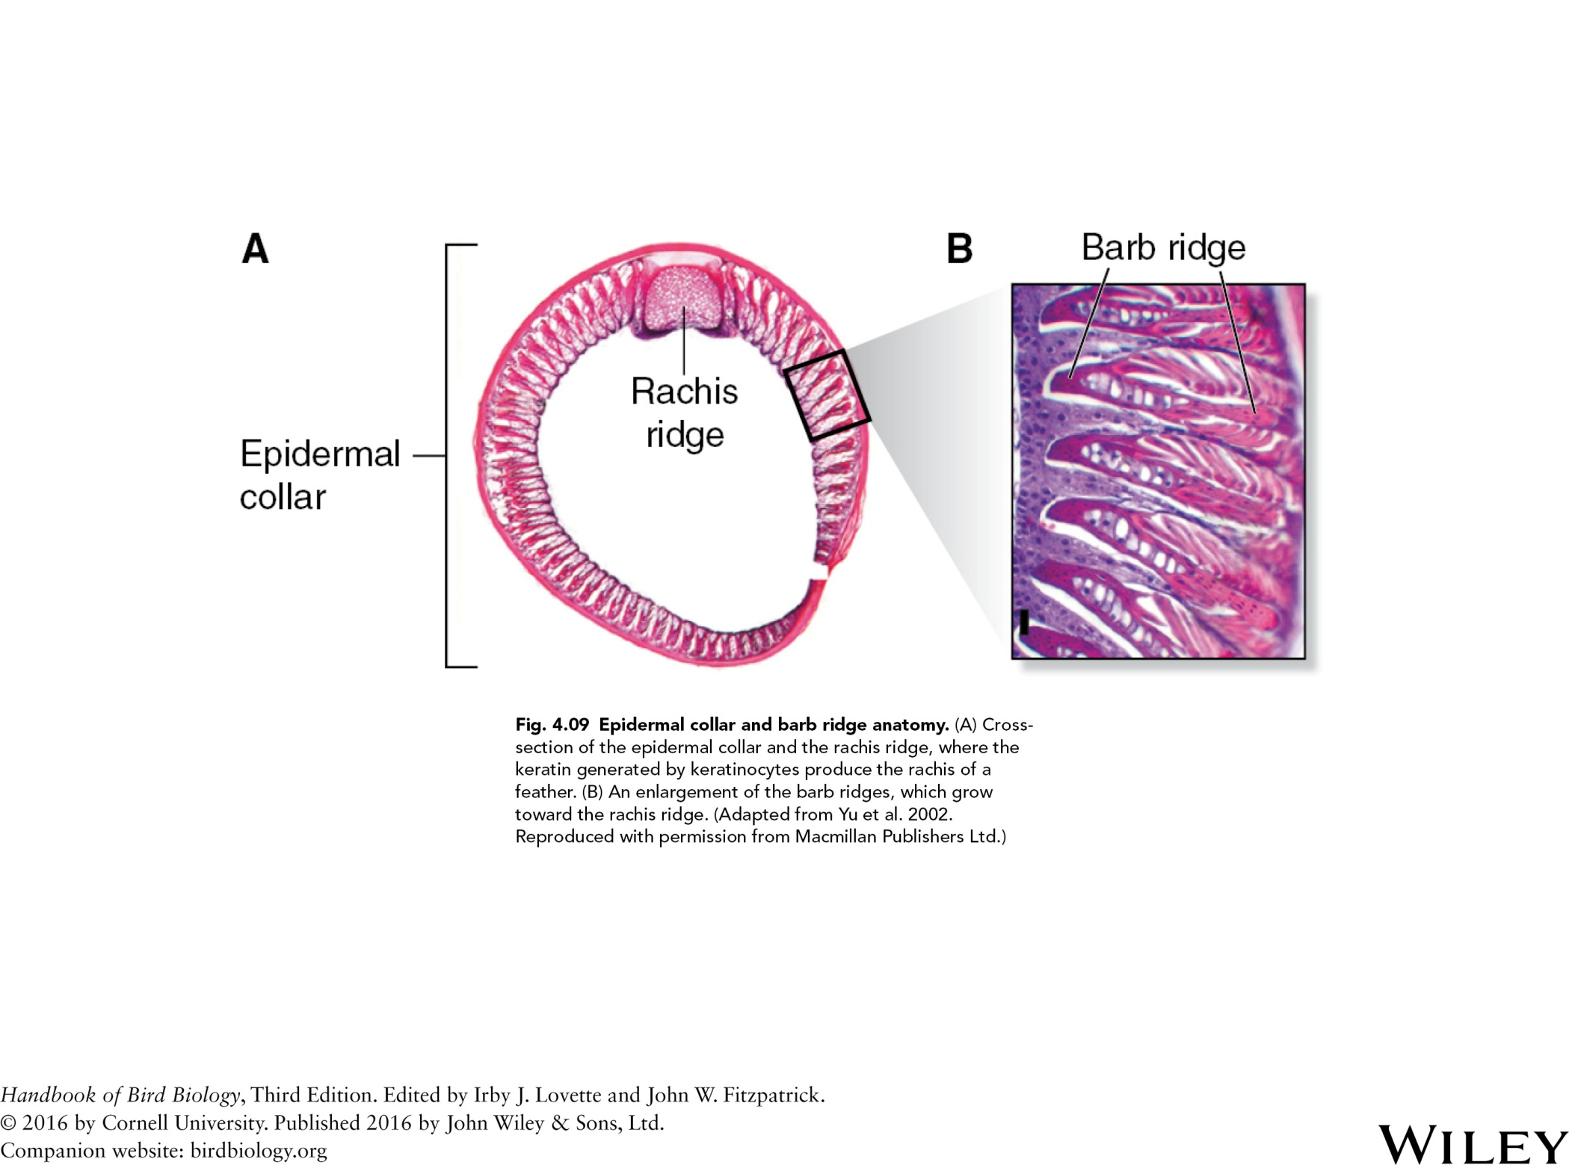

Slide 10
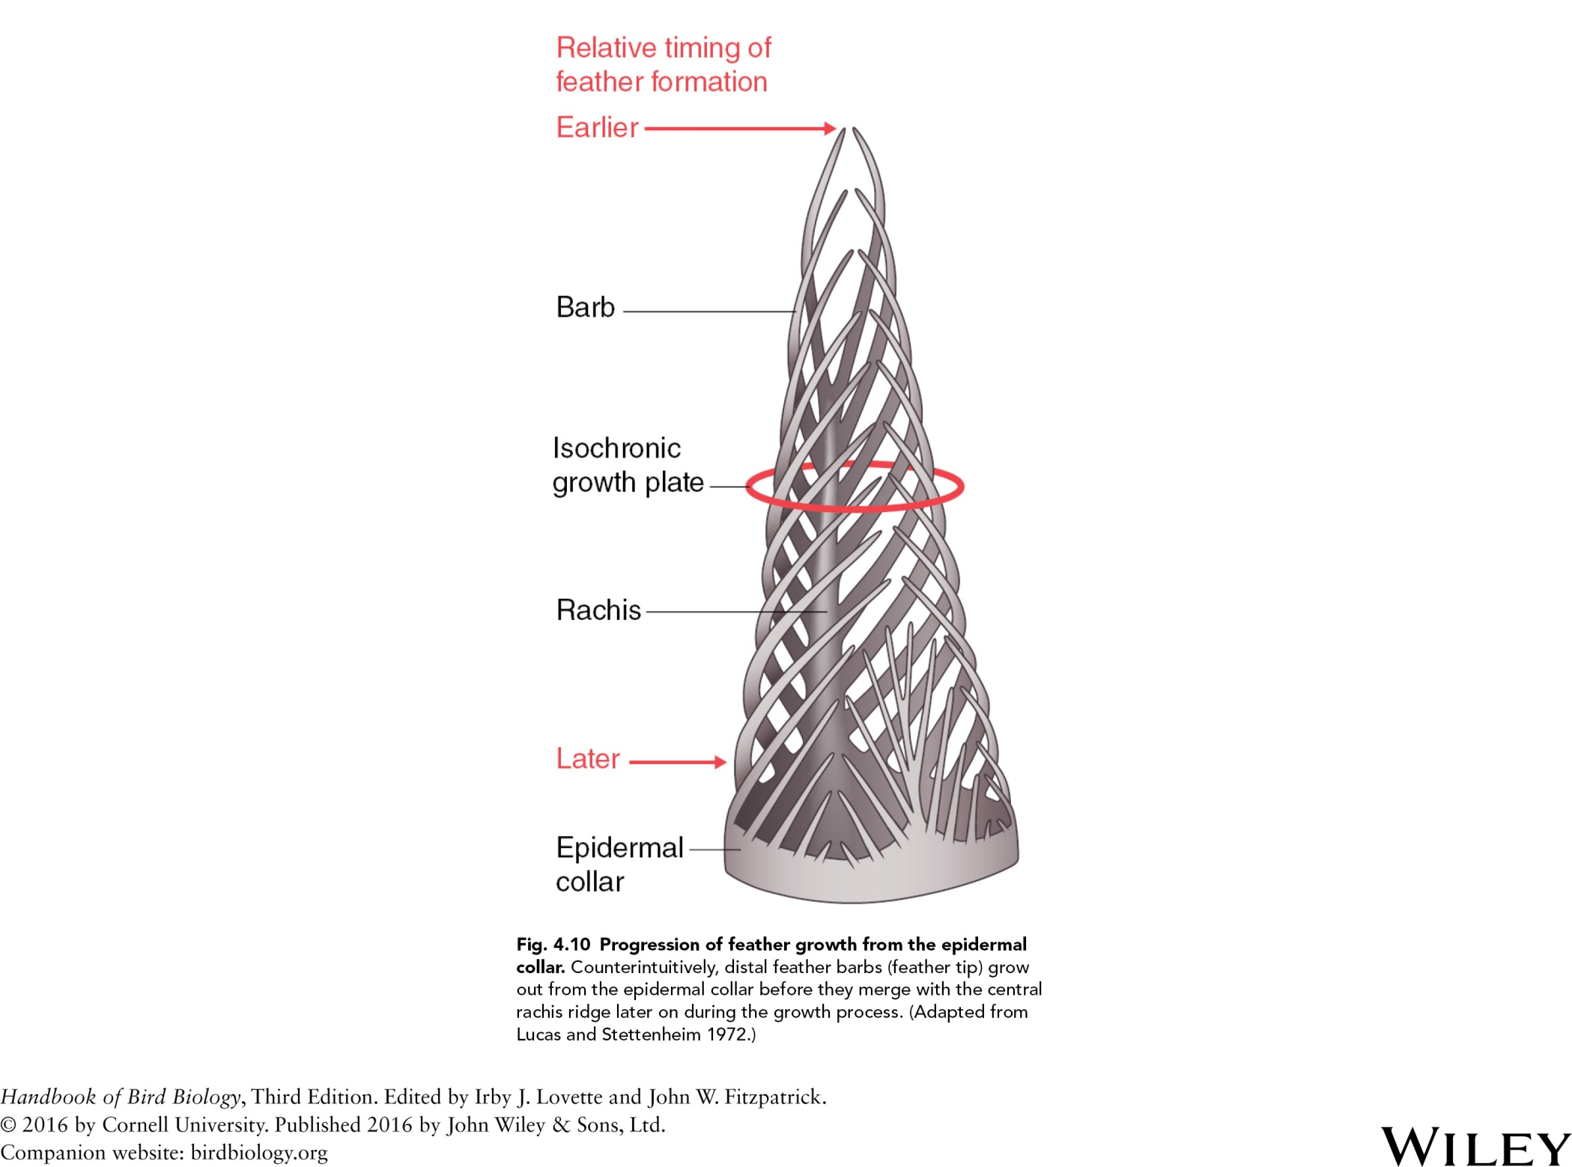

Slide 11
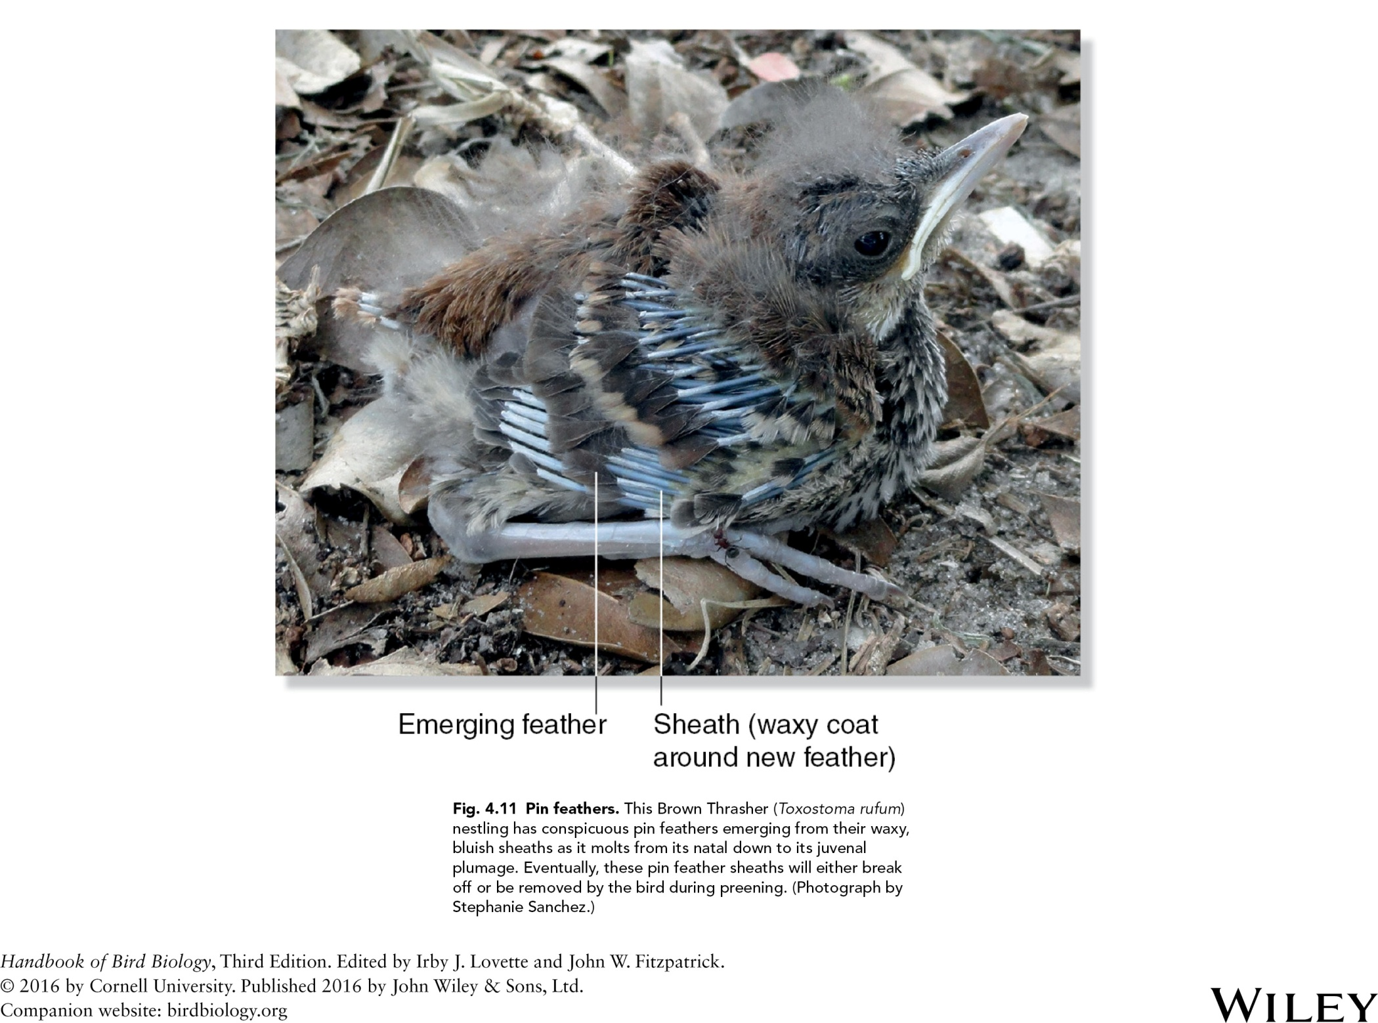

Slide 12
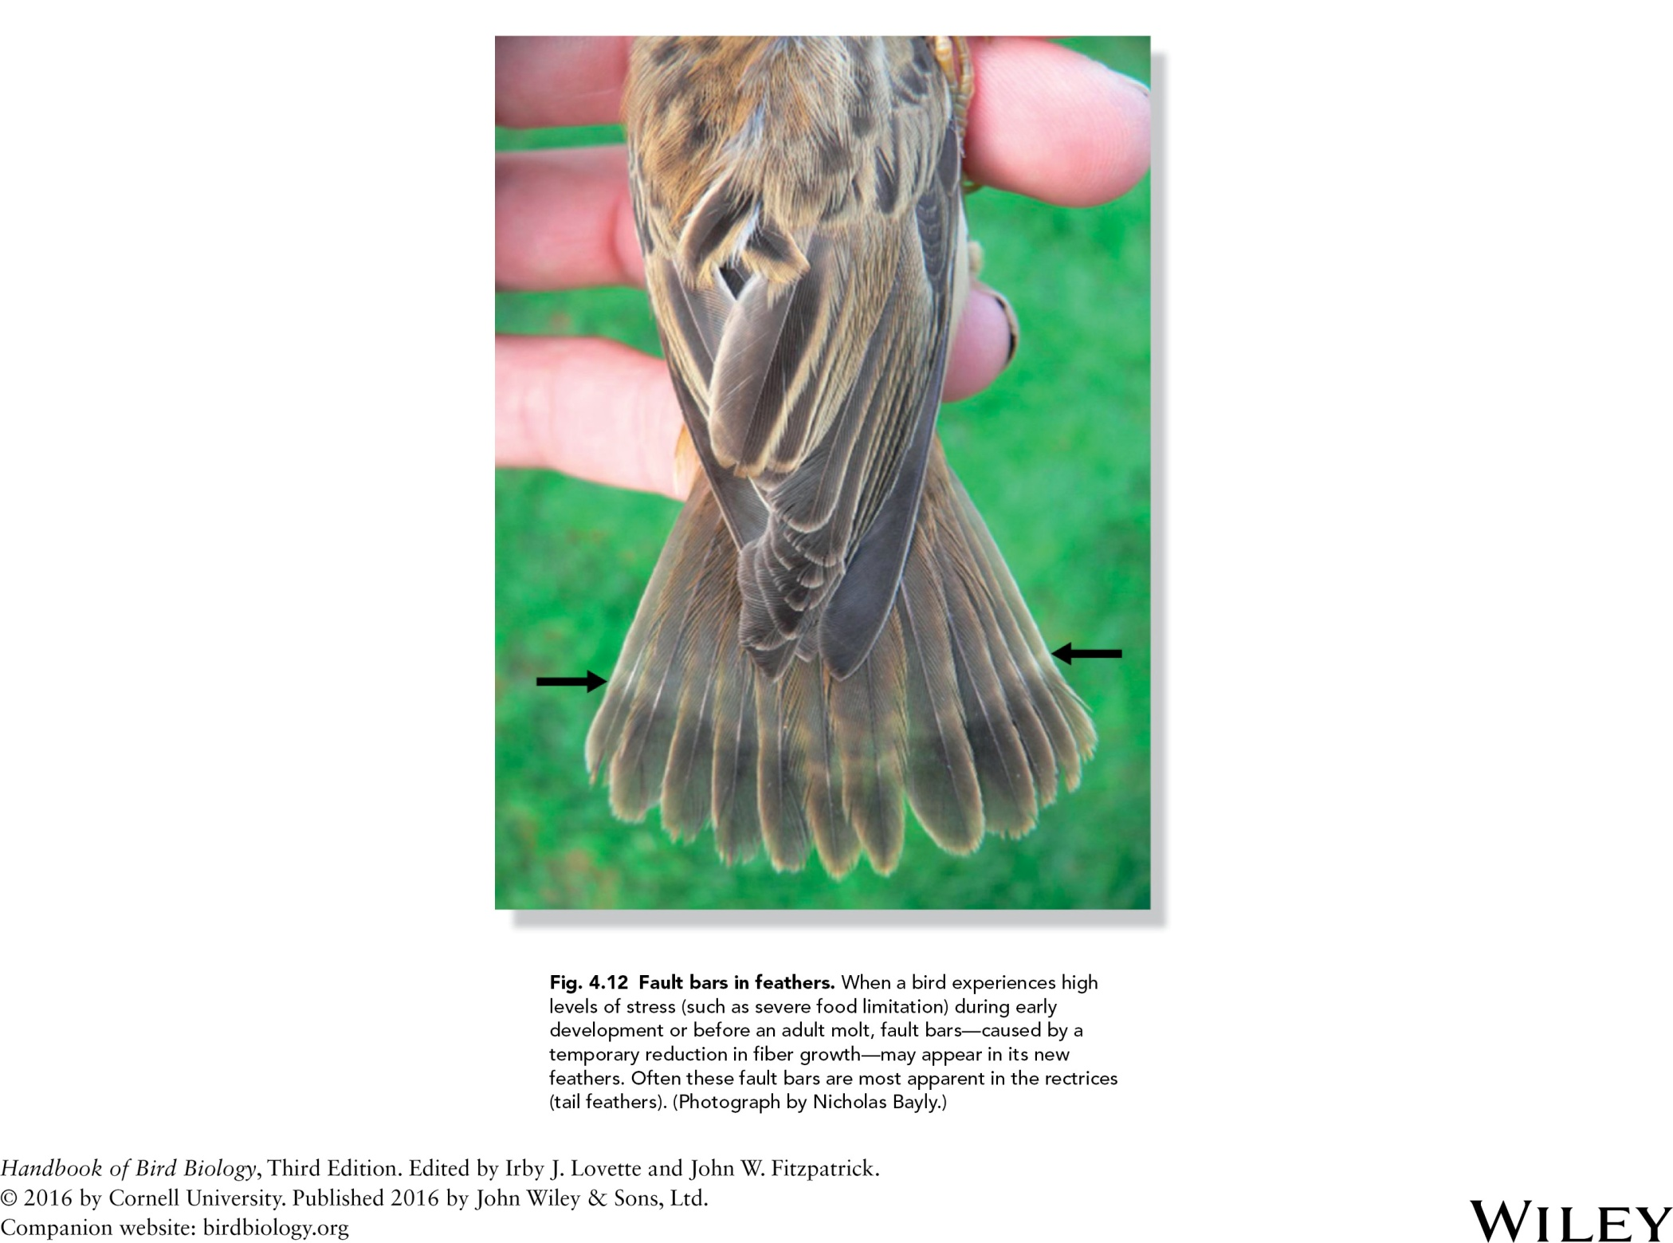

Slide 13
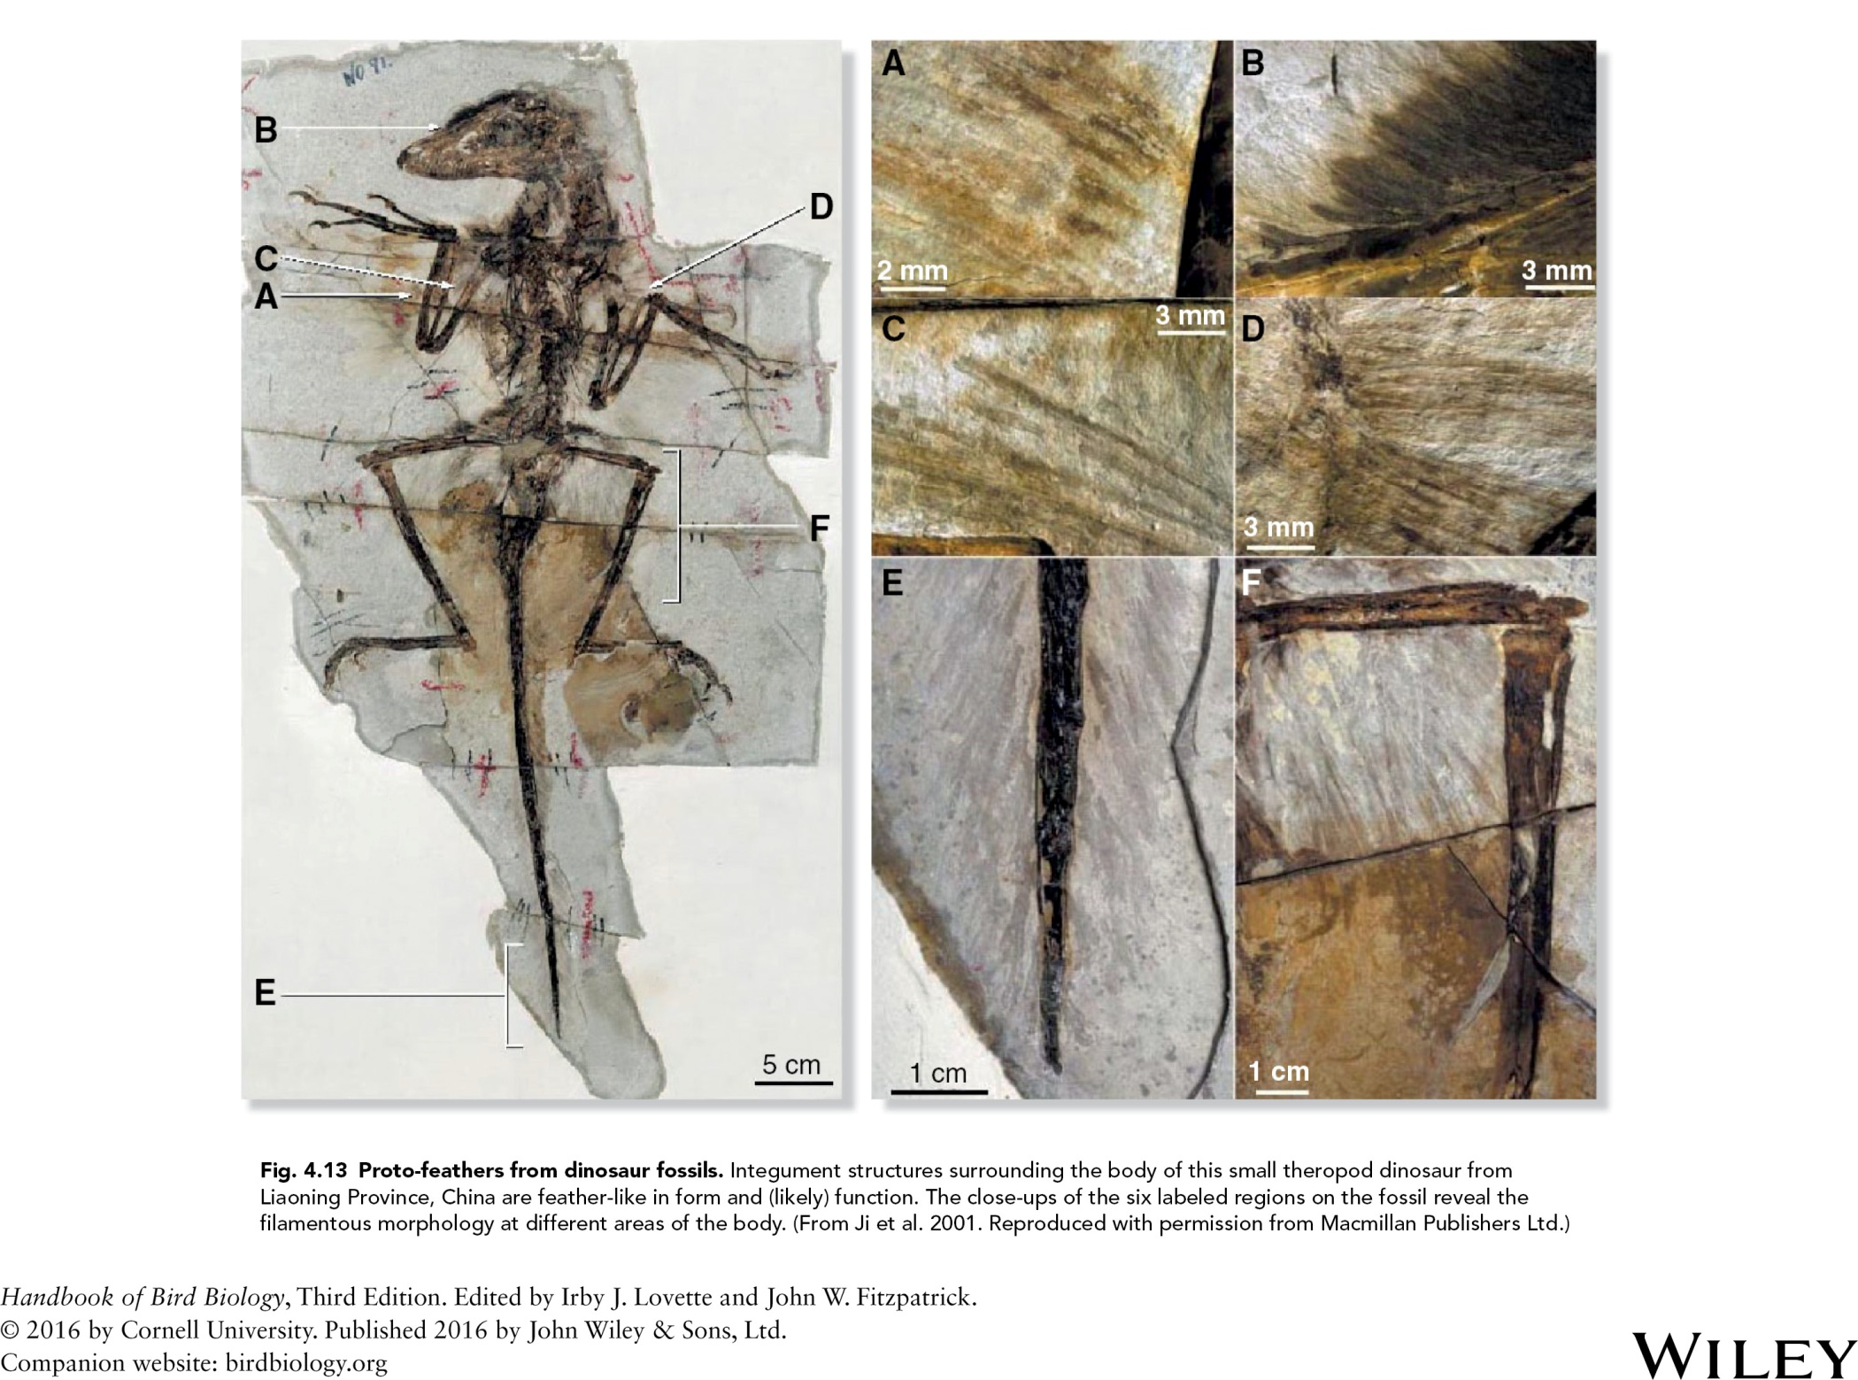

Slide 14
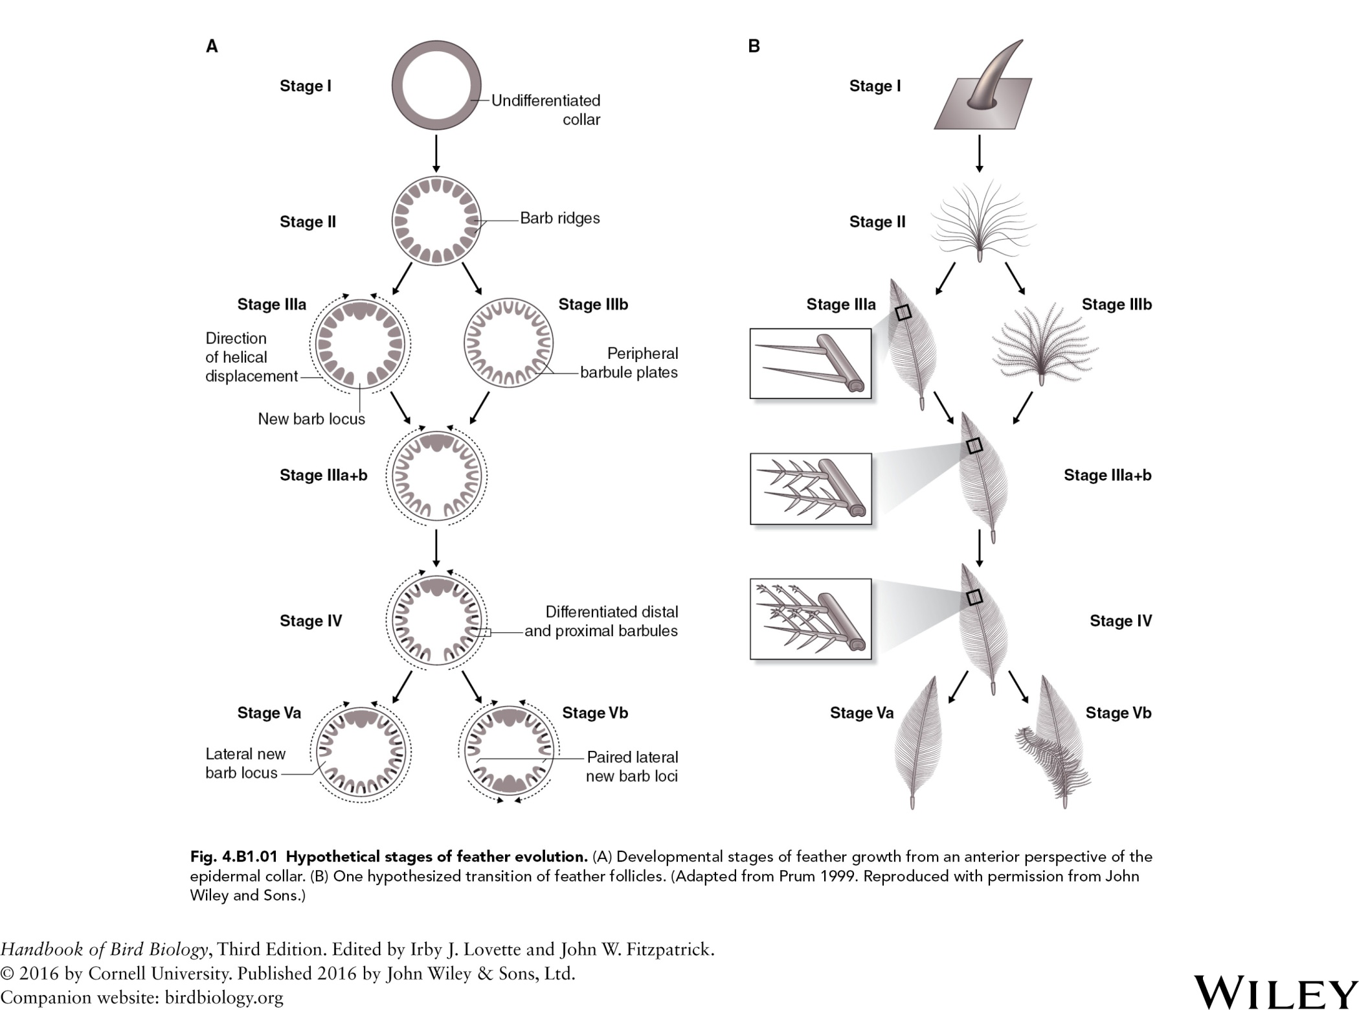

Slide 15
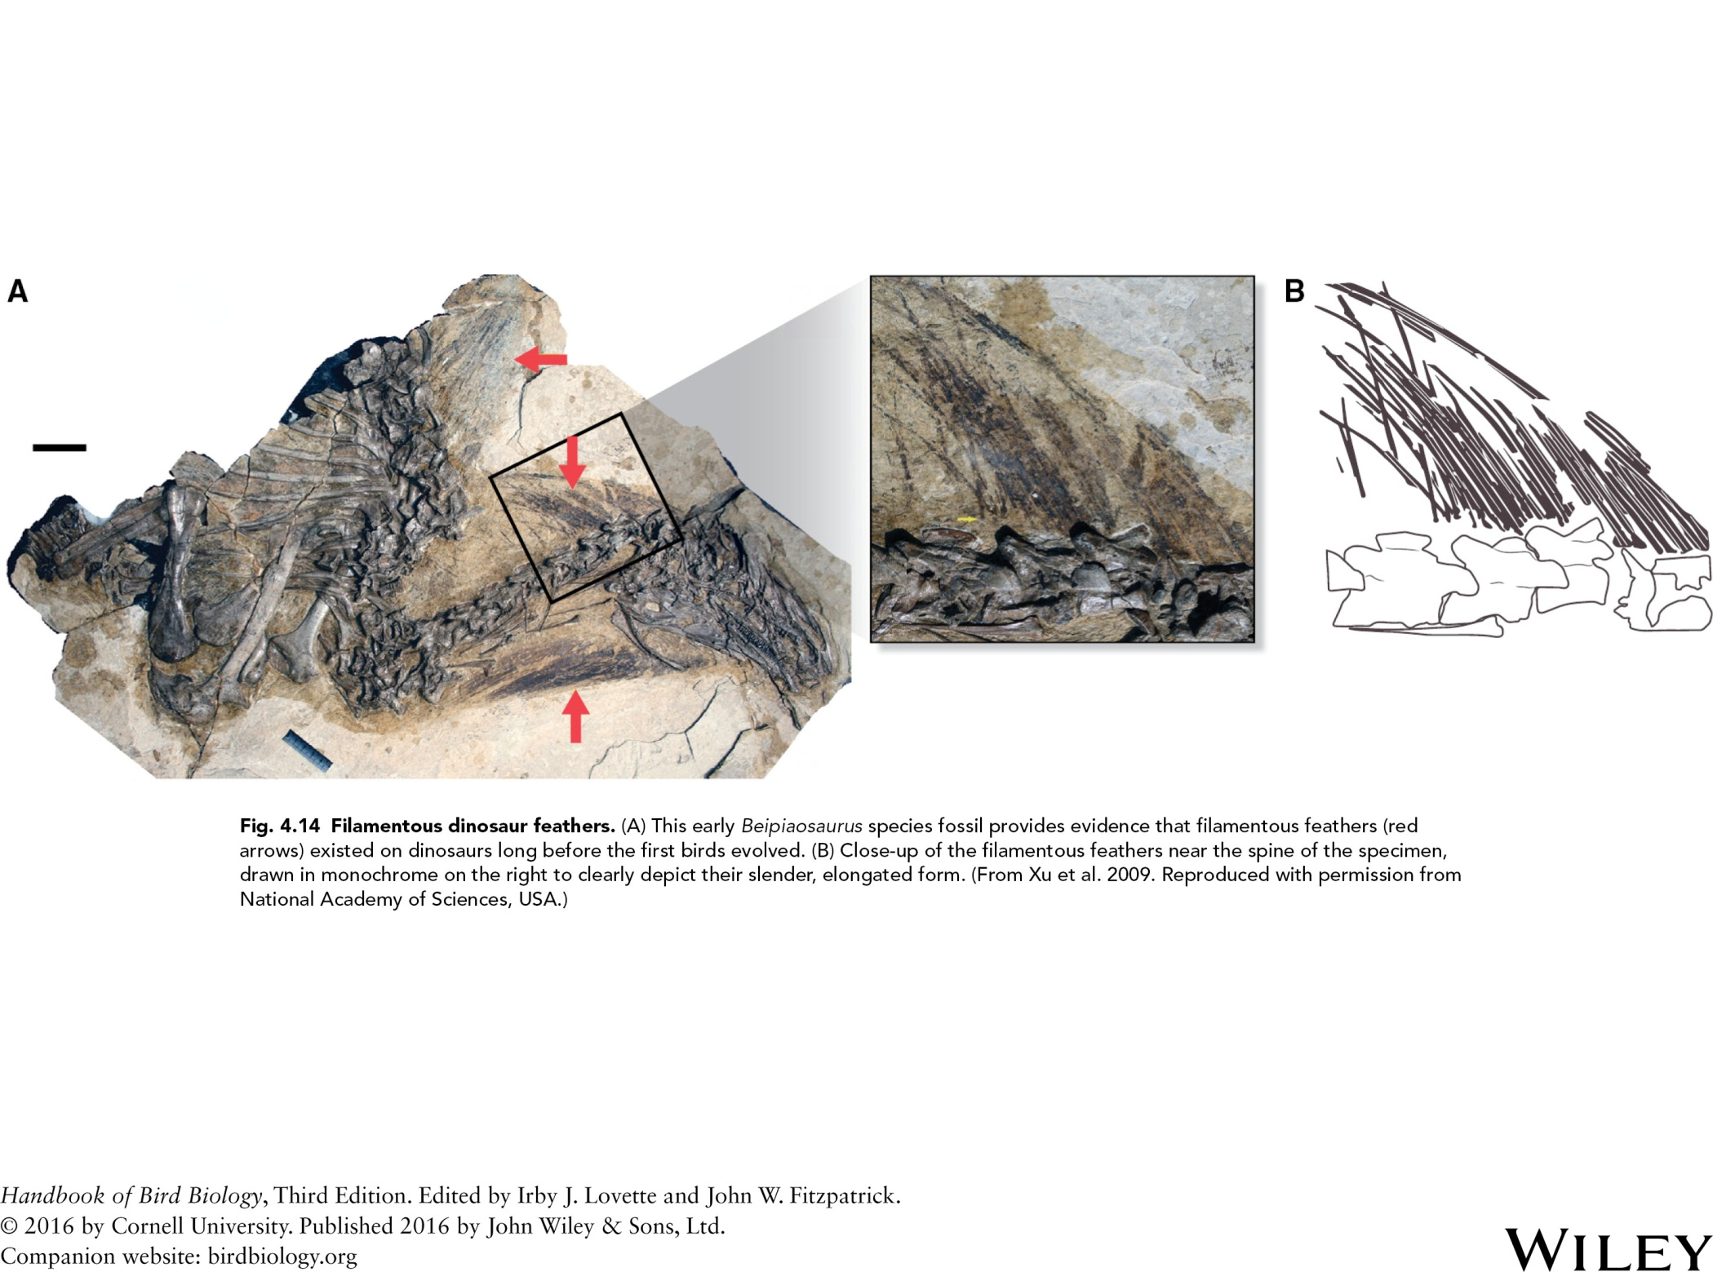

Slide 16
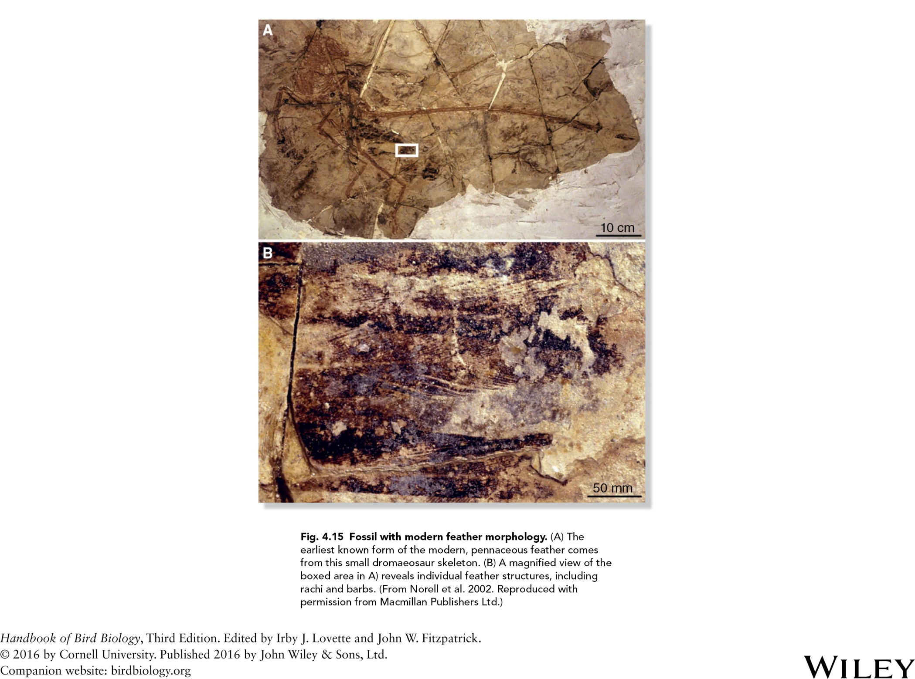

Slide 17
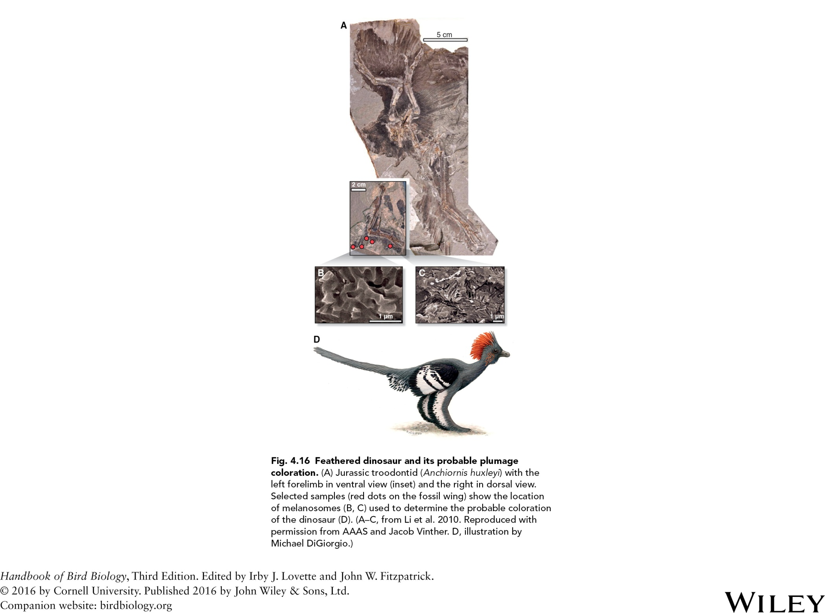

Slide 18
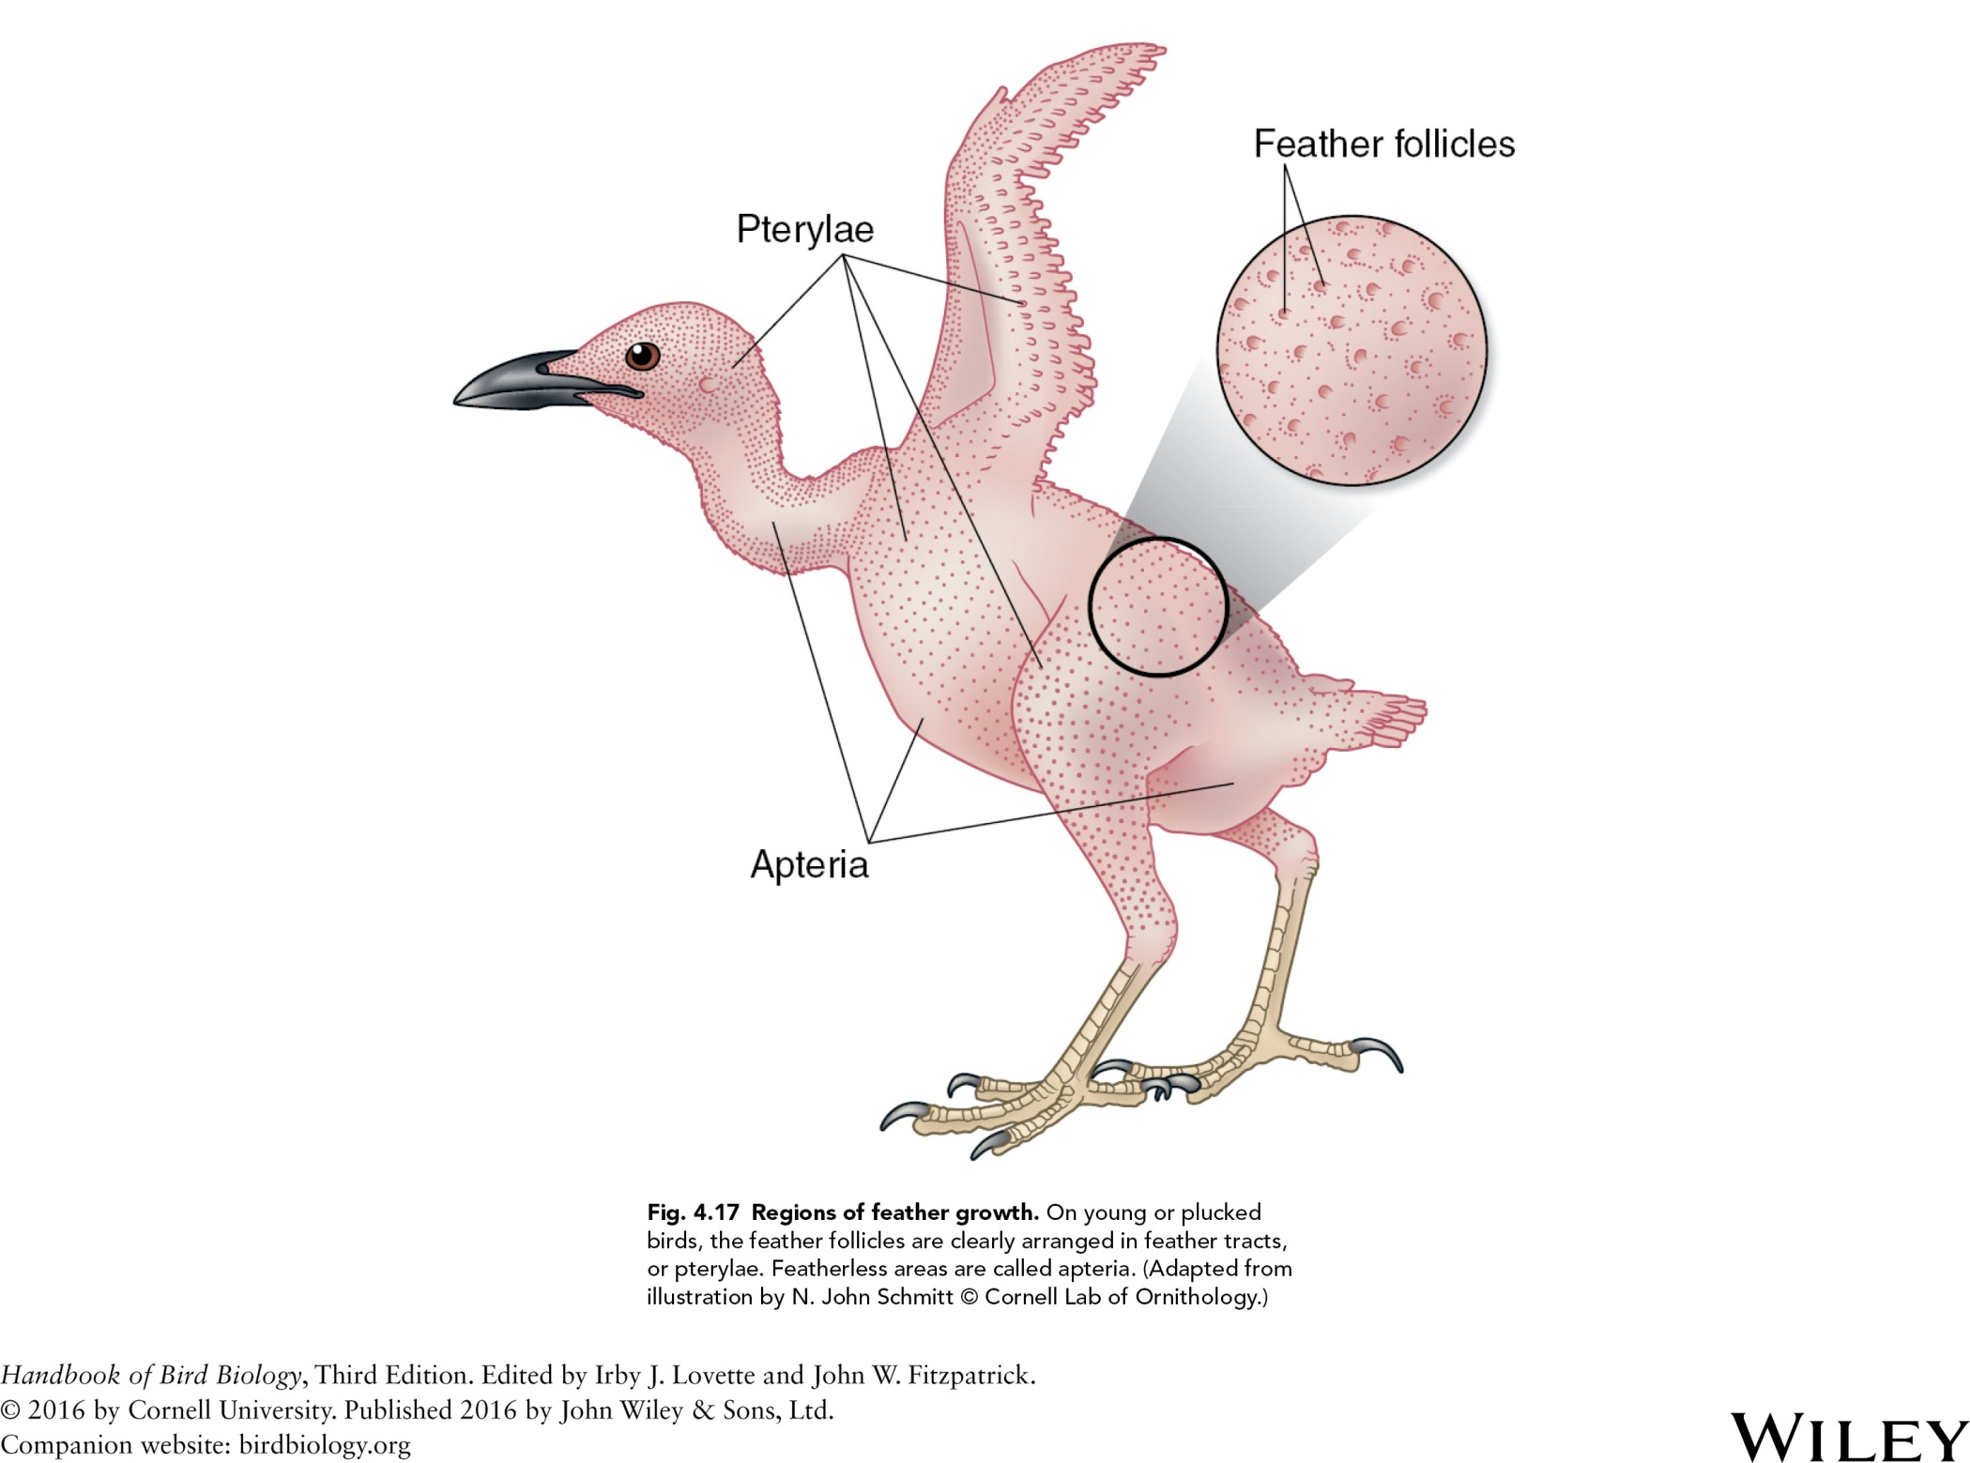

Slide 19
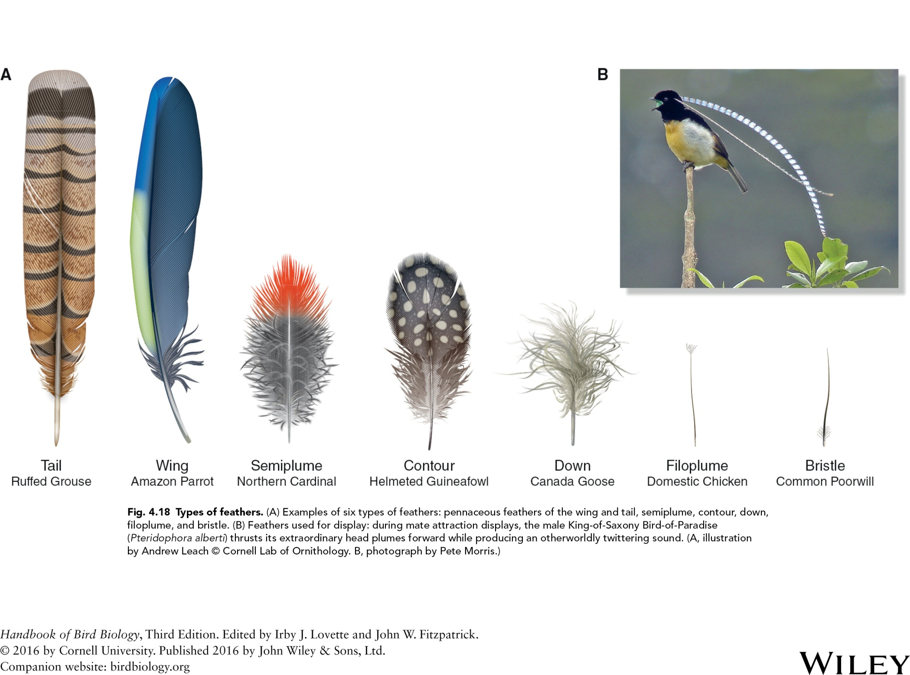

Slide 20
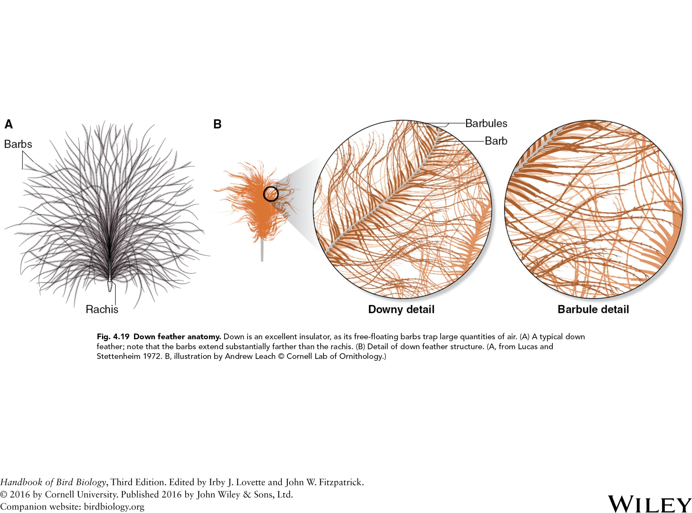

Slide 21
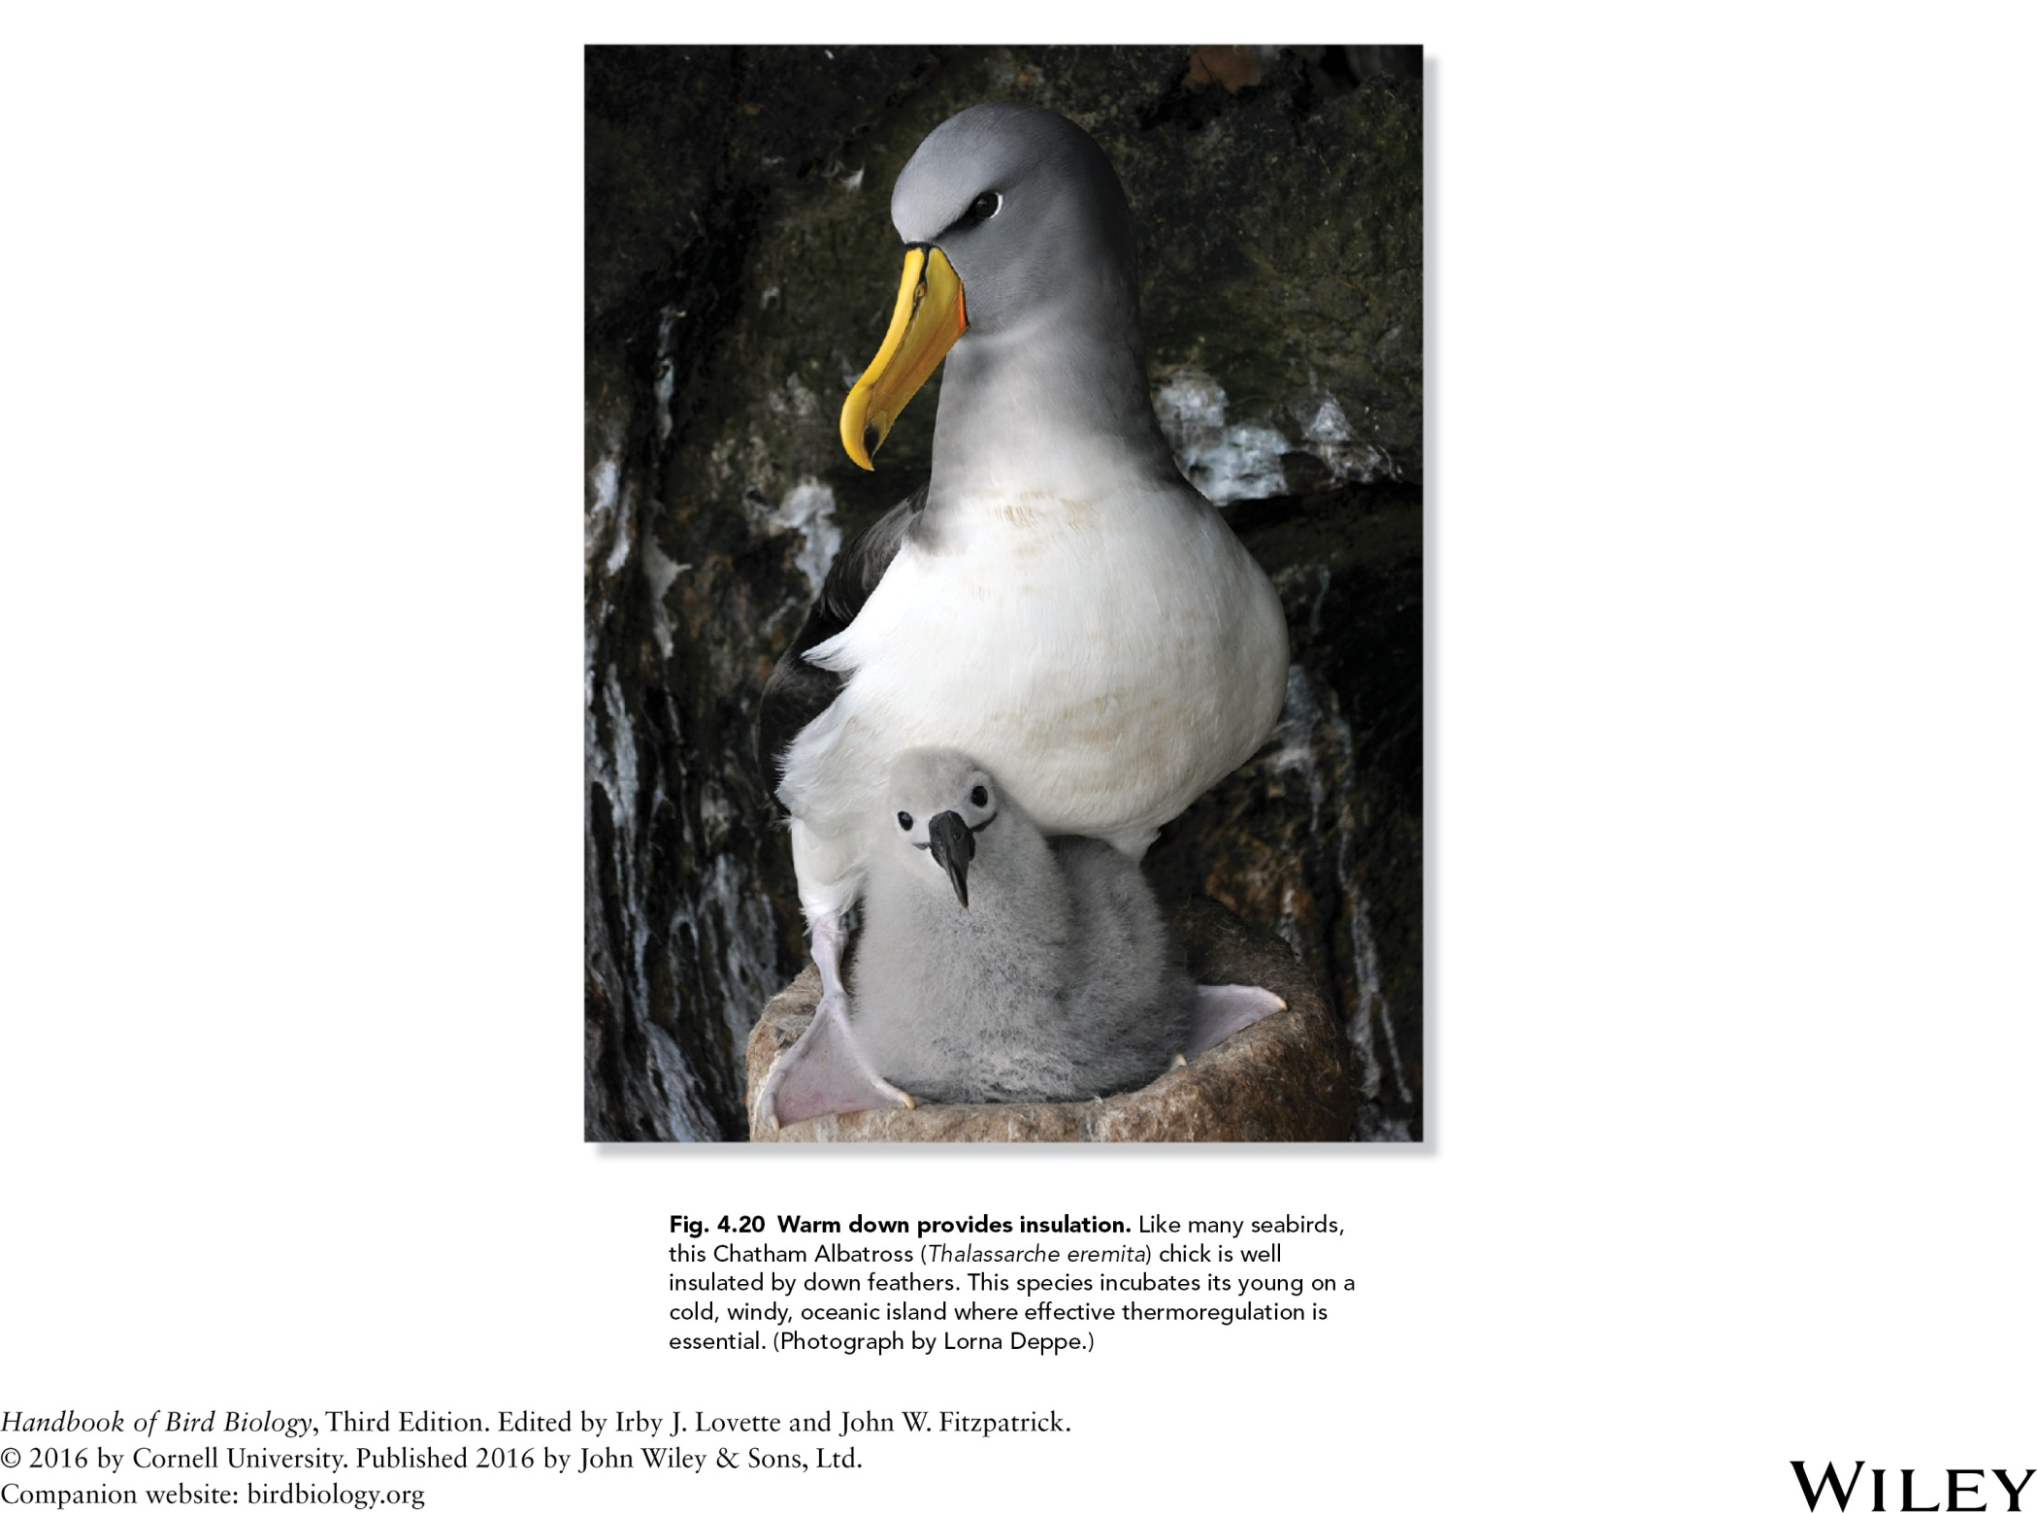

Slide 22
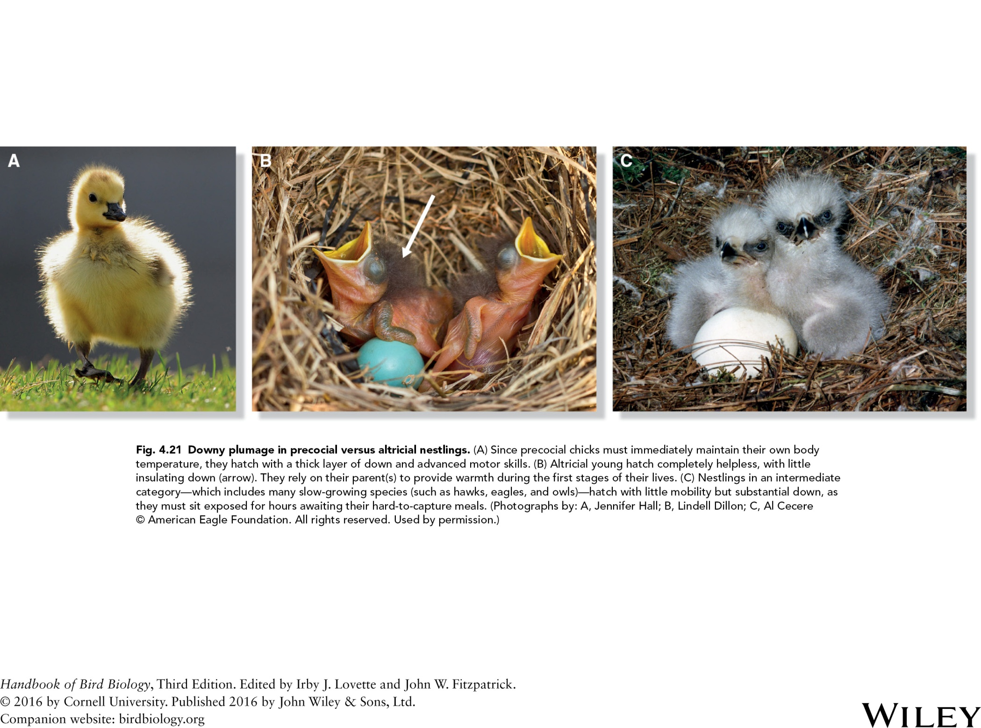

Slide 23
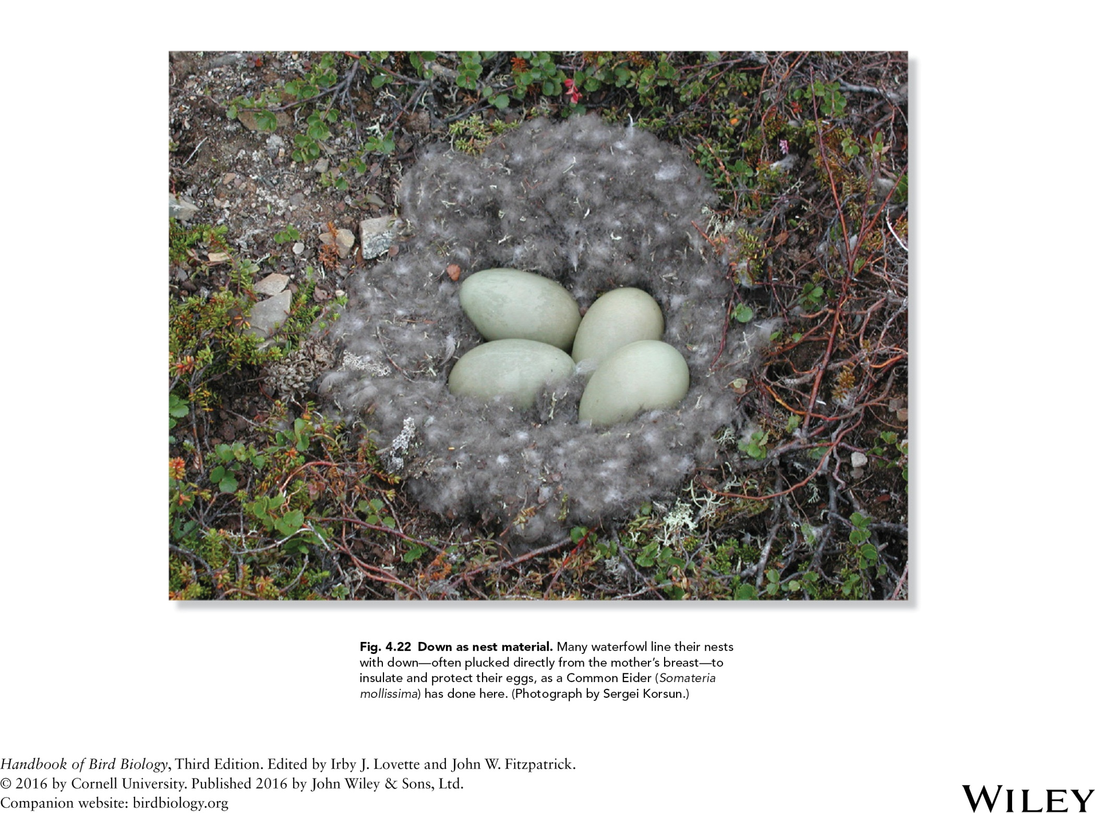

Slide 24
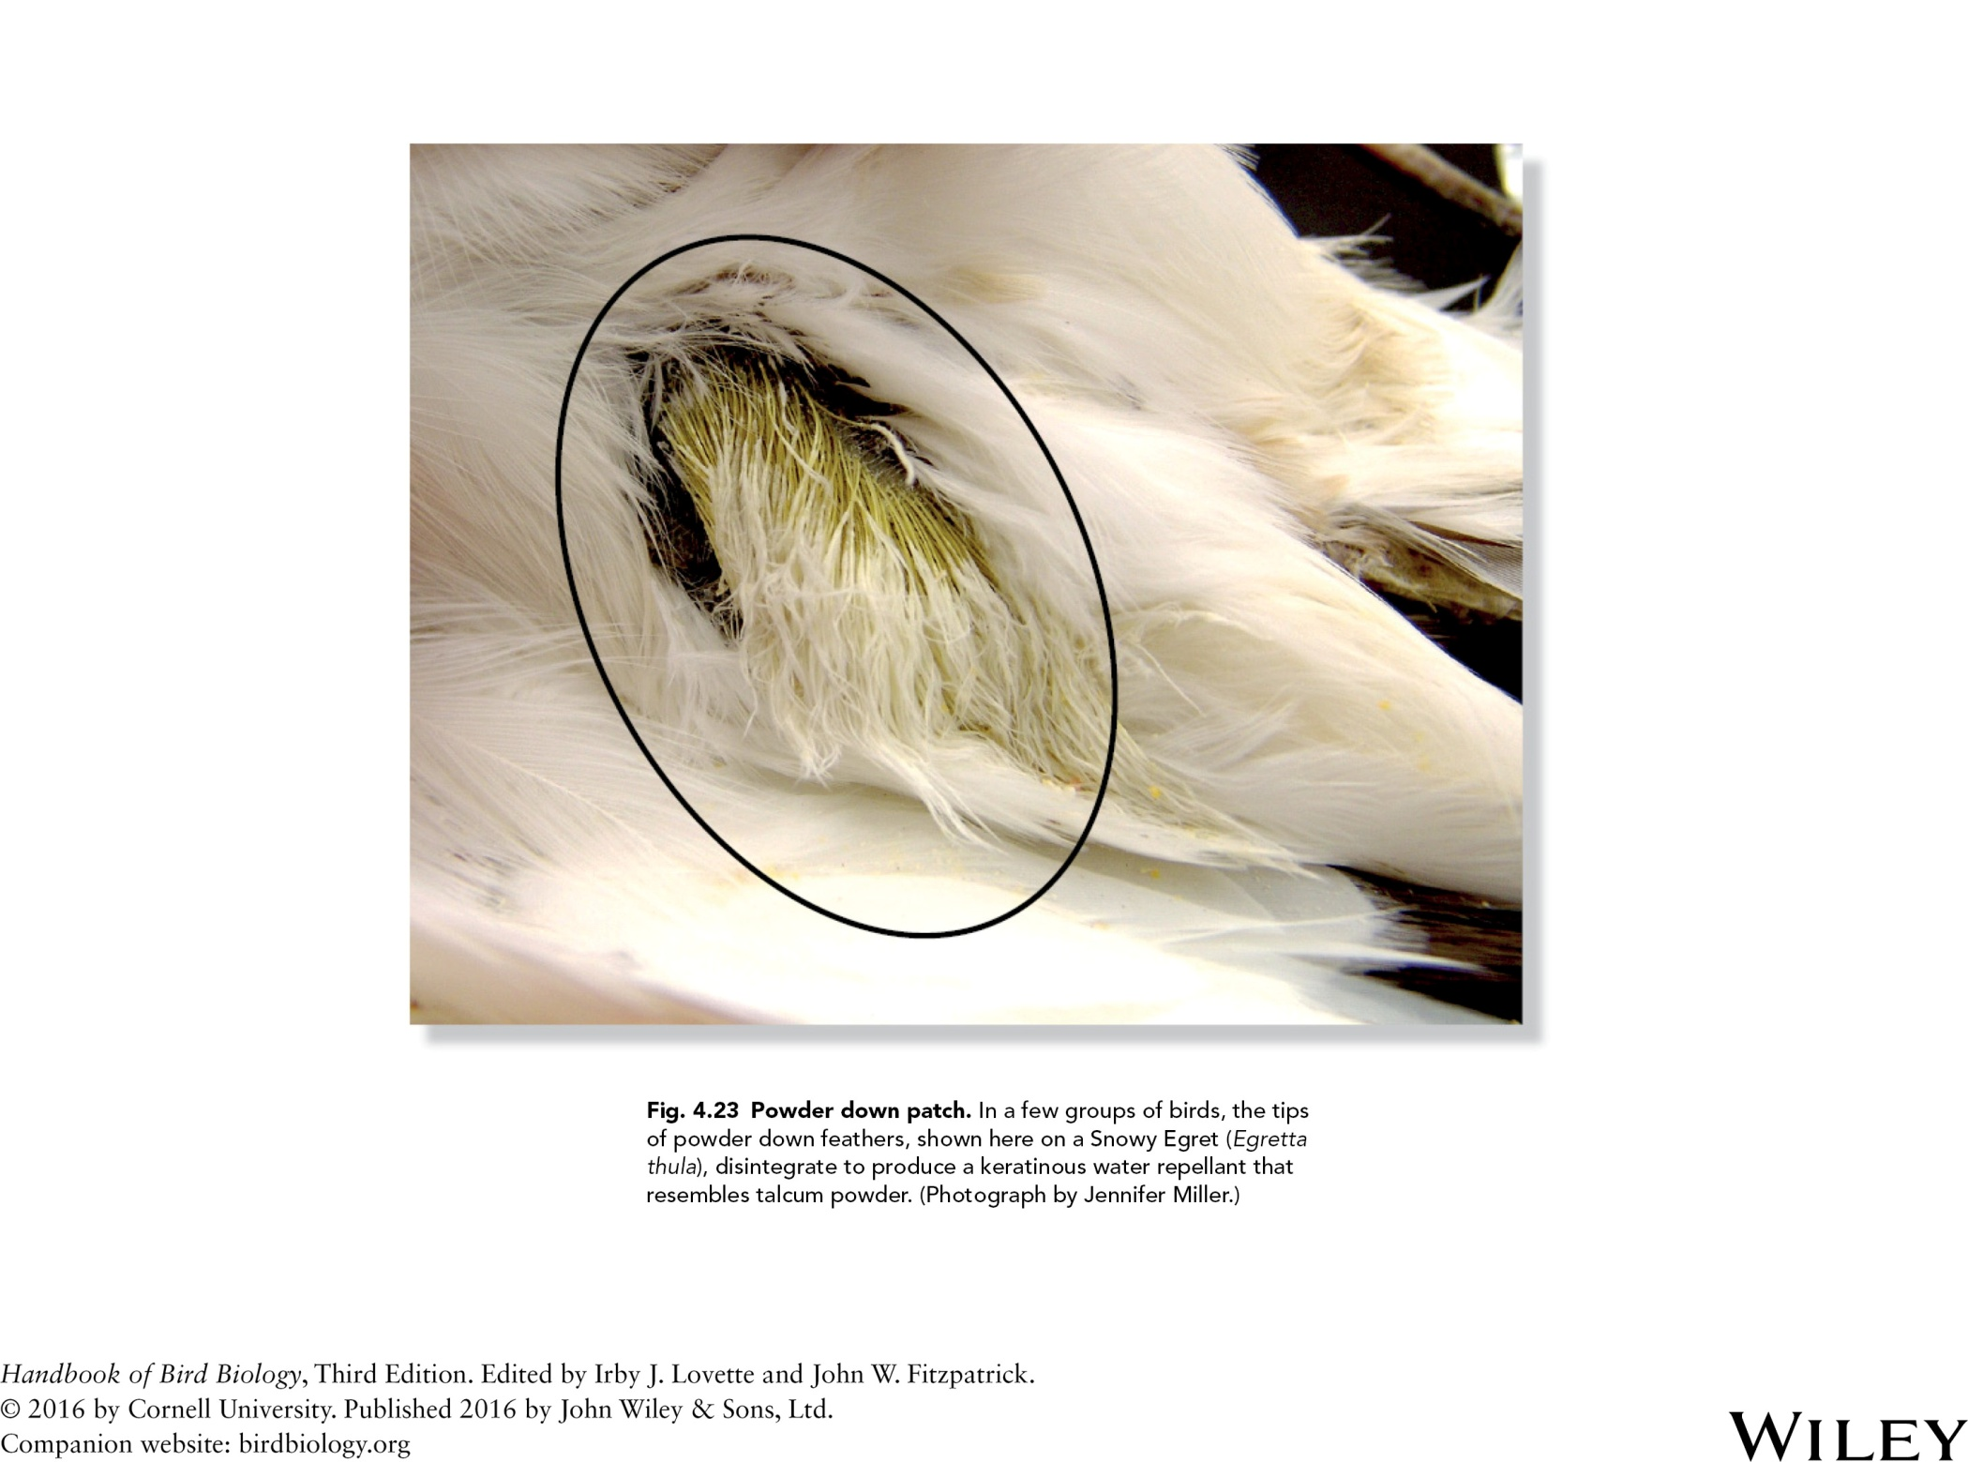

Slide 25
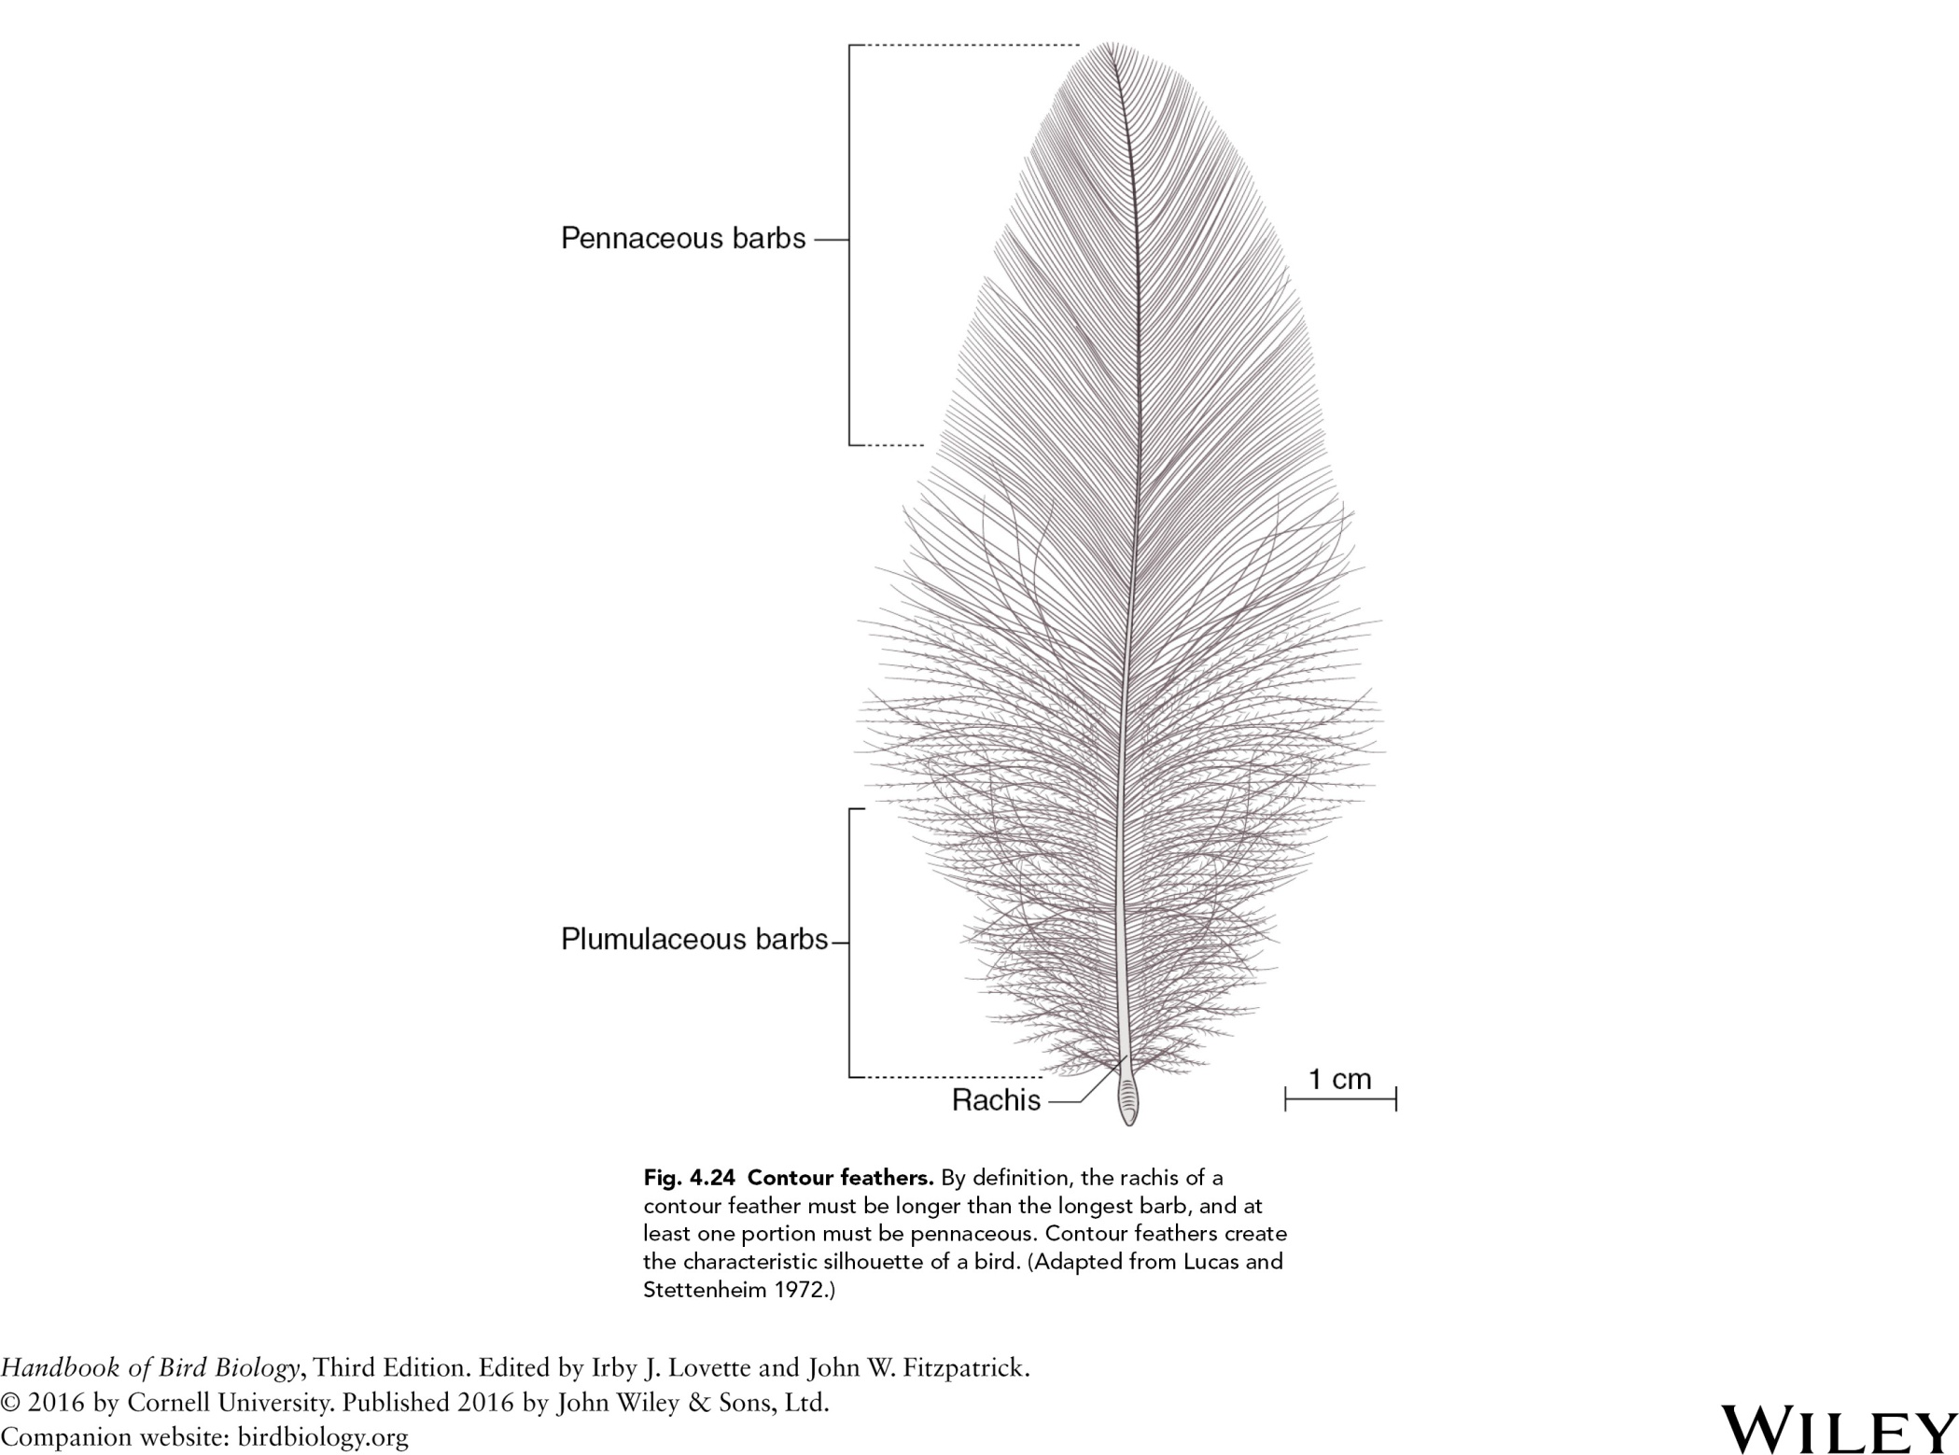

Slide 26
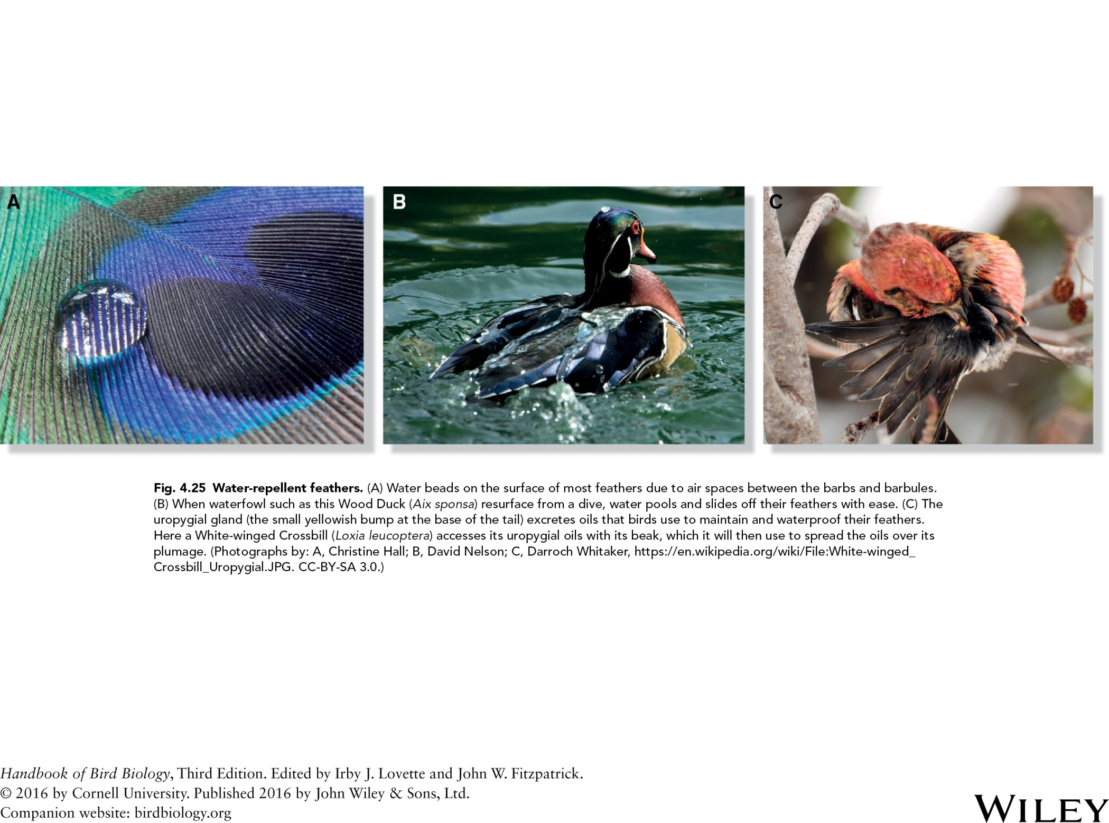

Slide 27
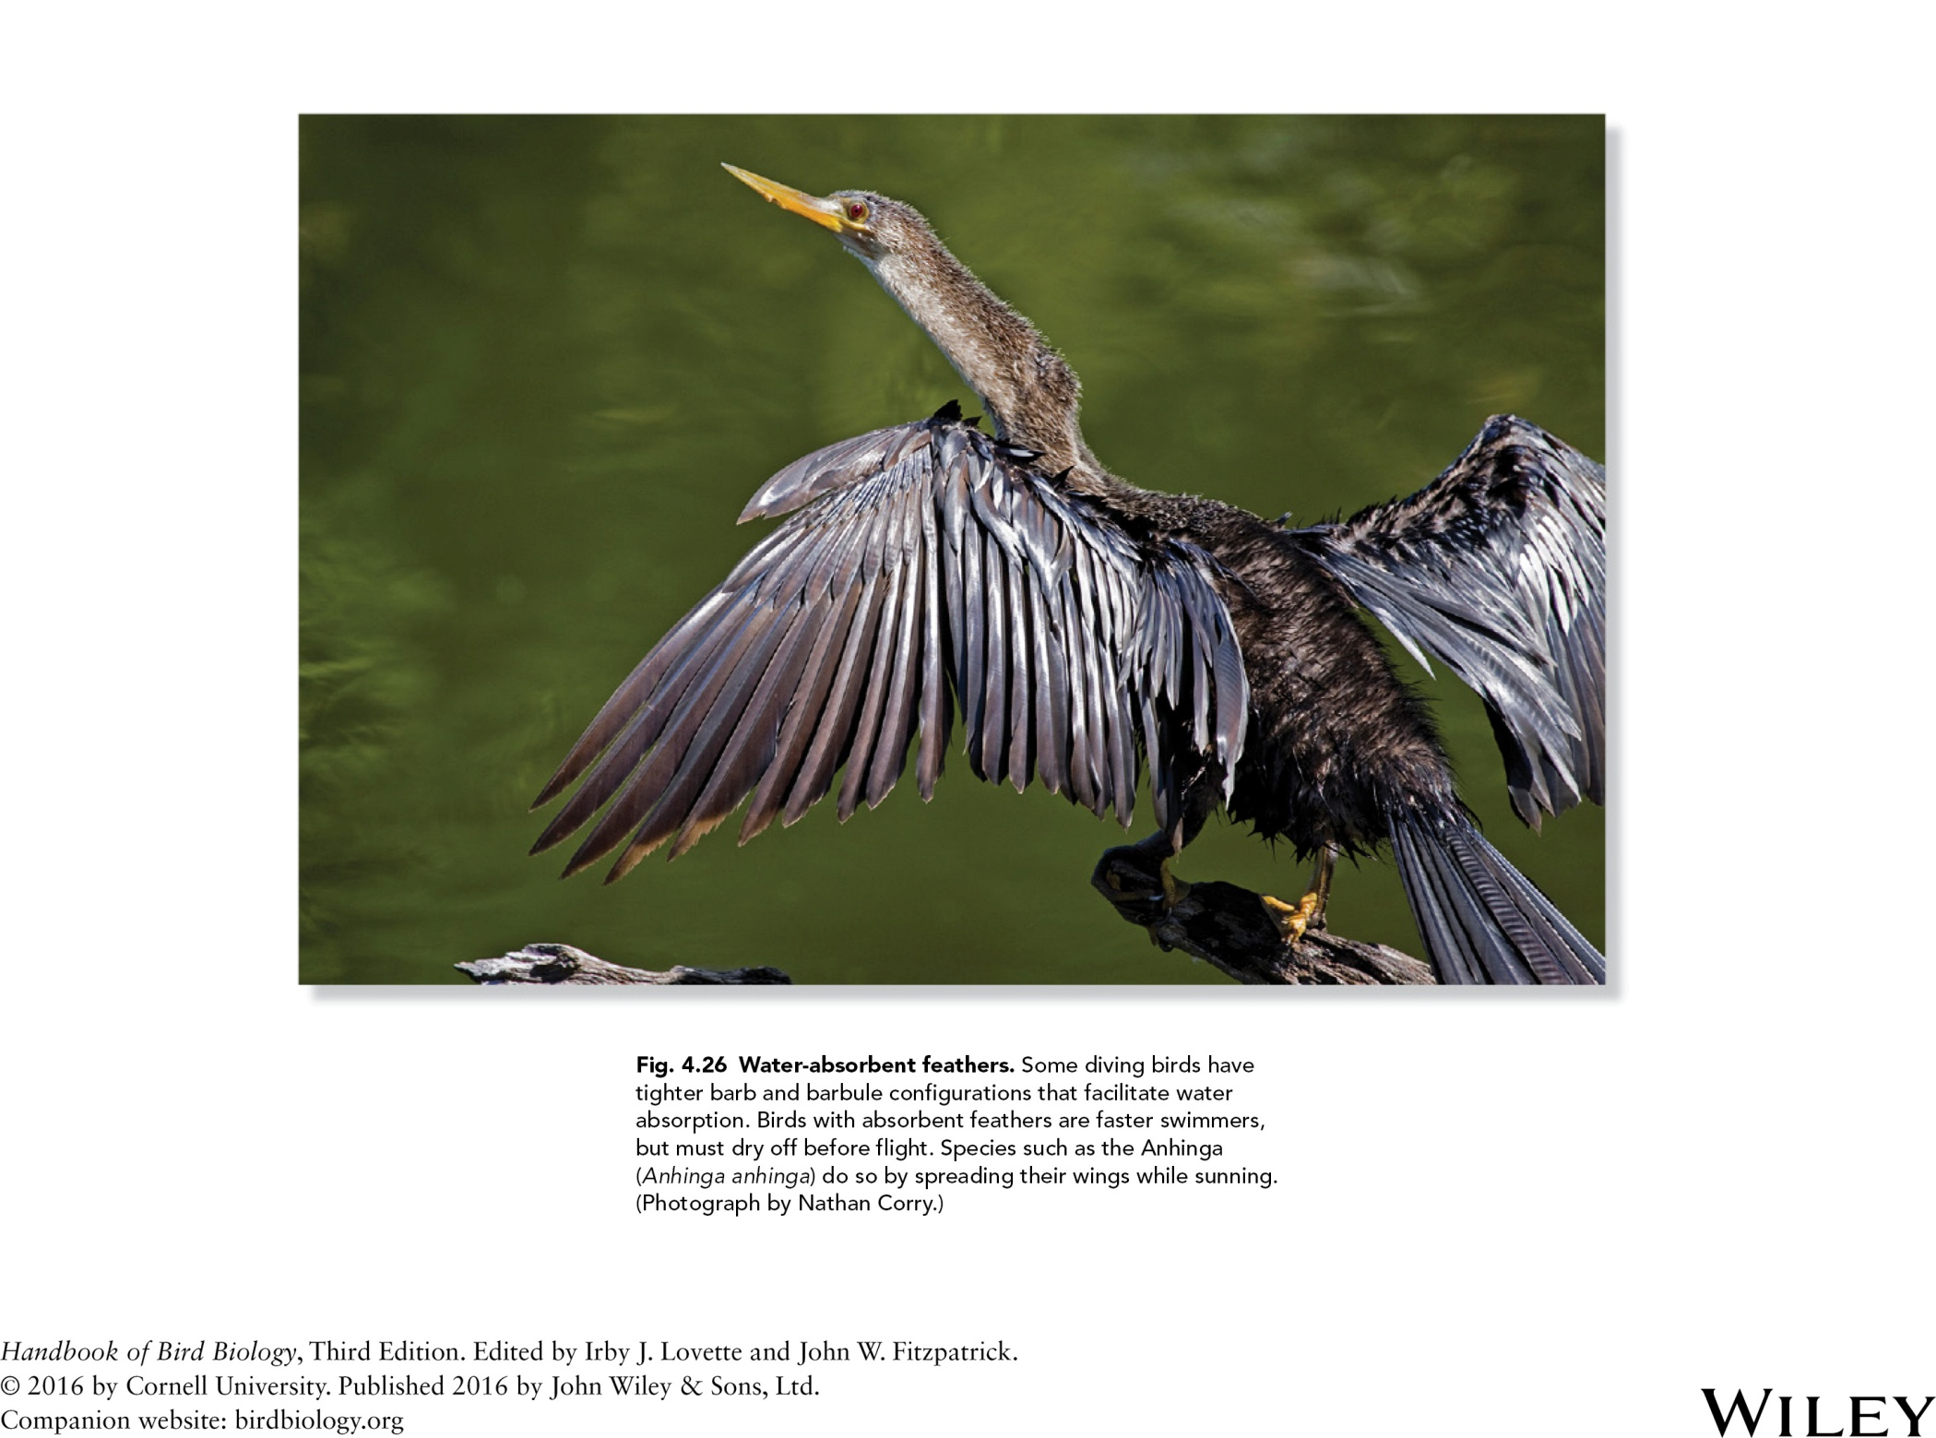

Slide 28
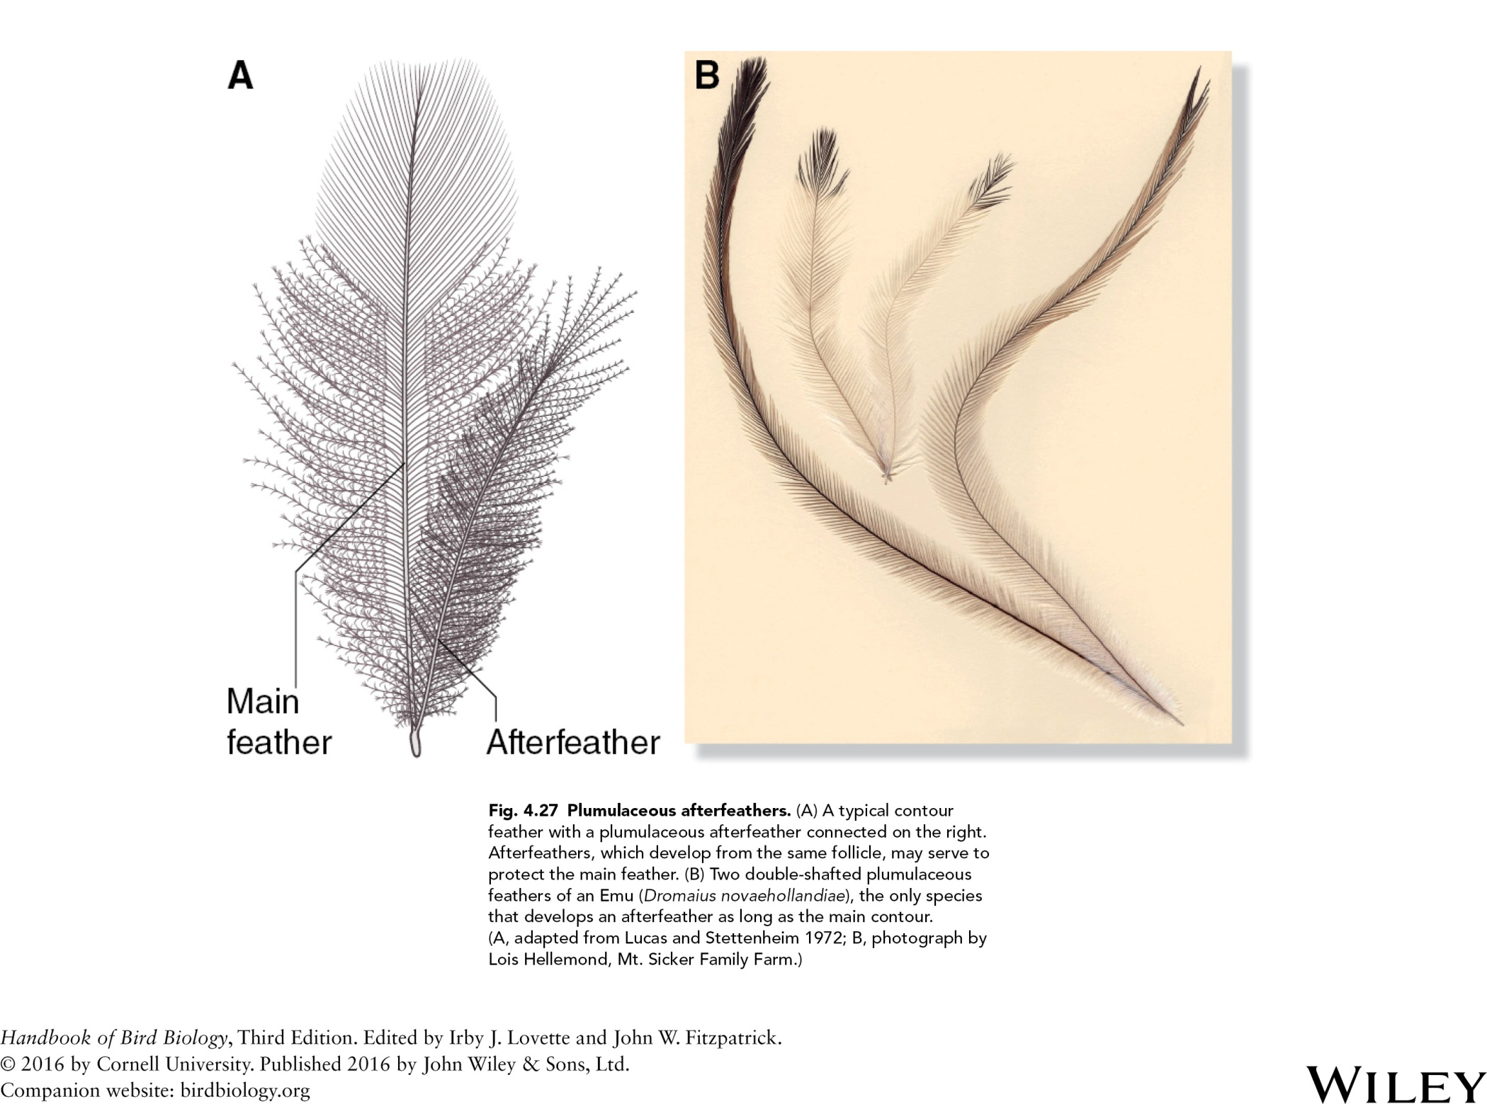

Slide 29
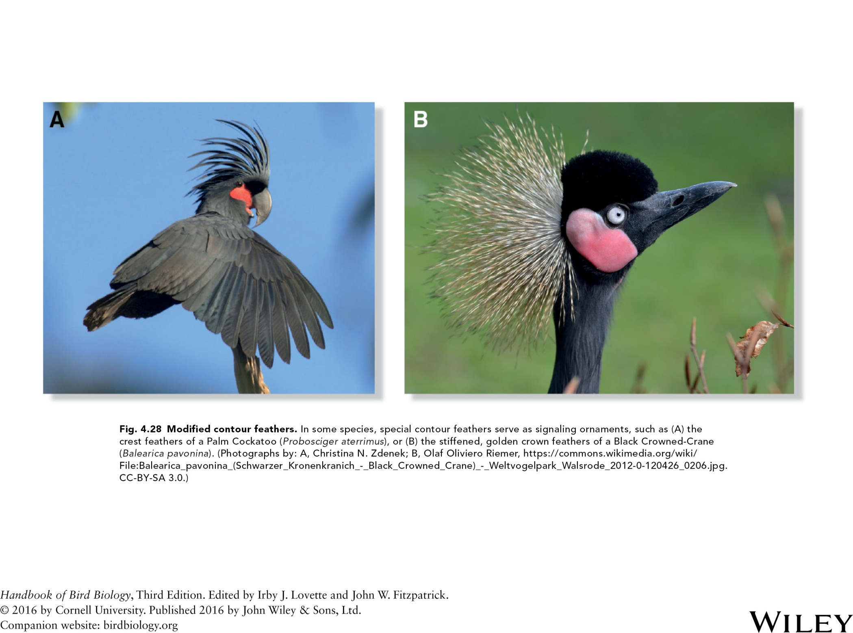

Slide 30
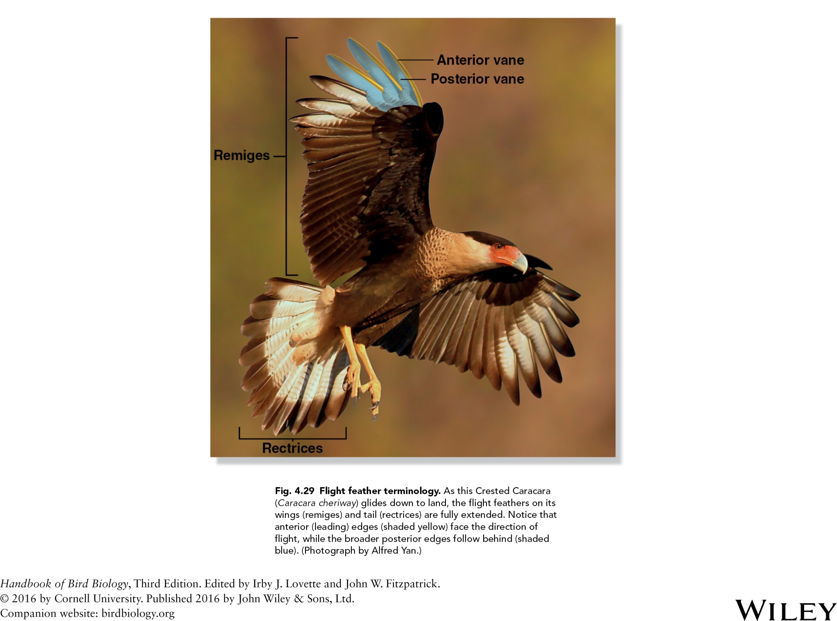

Slide 31
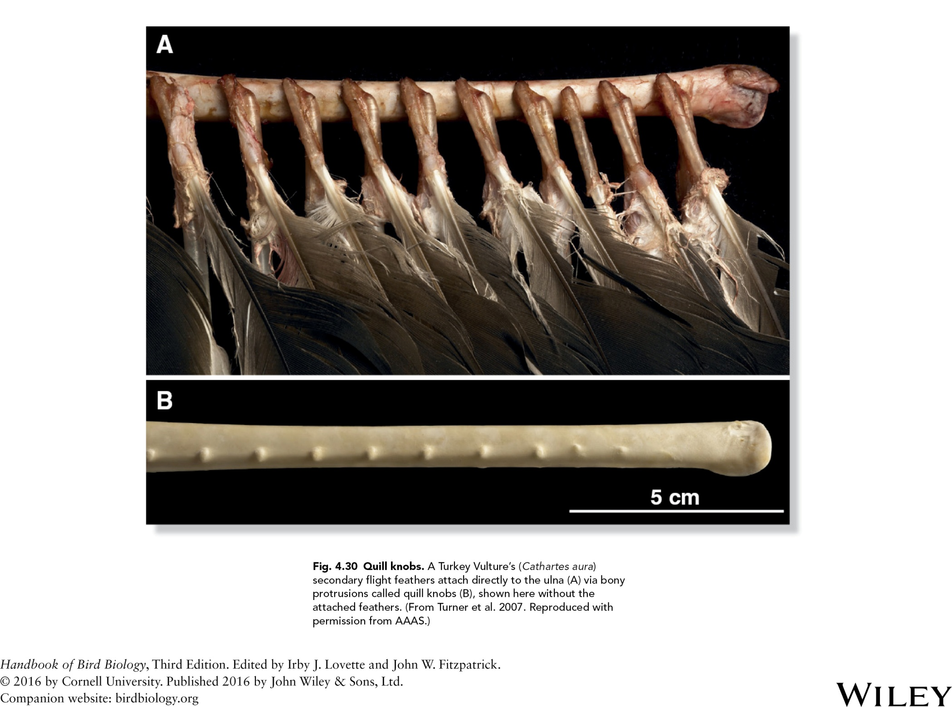

Slide 32
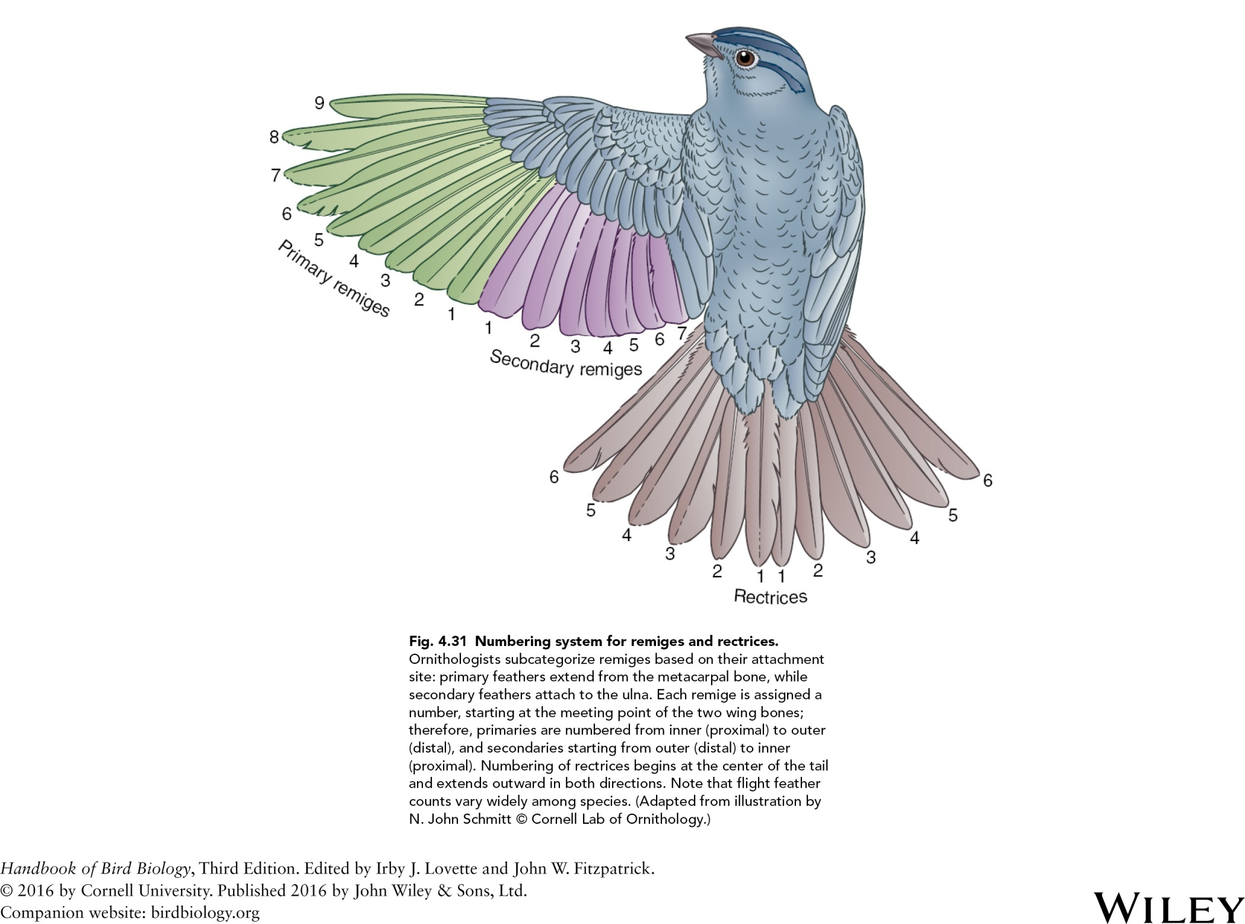

Slide 33
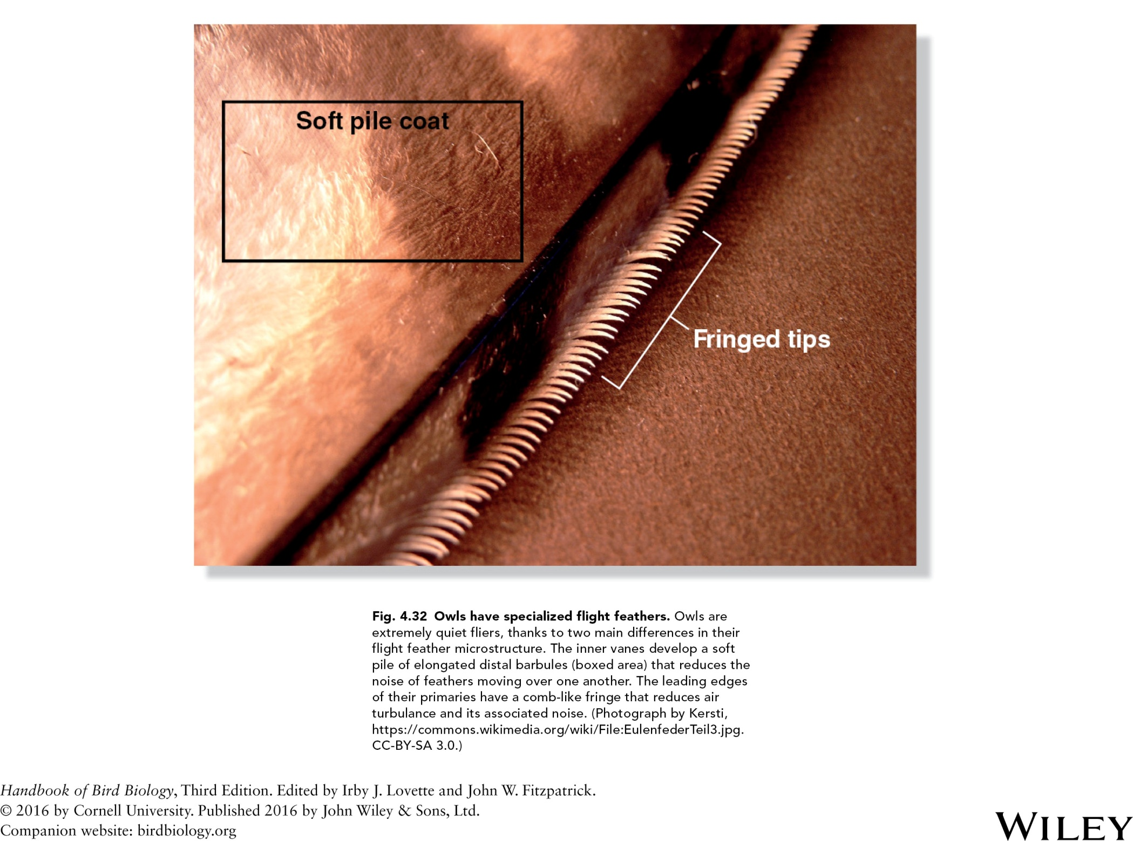

Slide 34
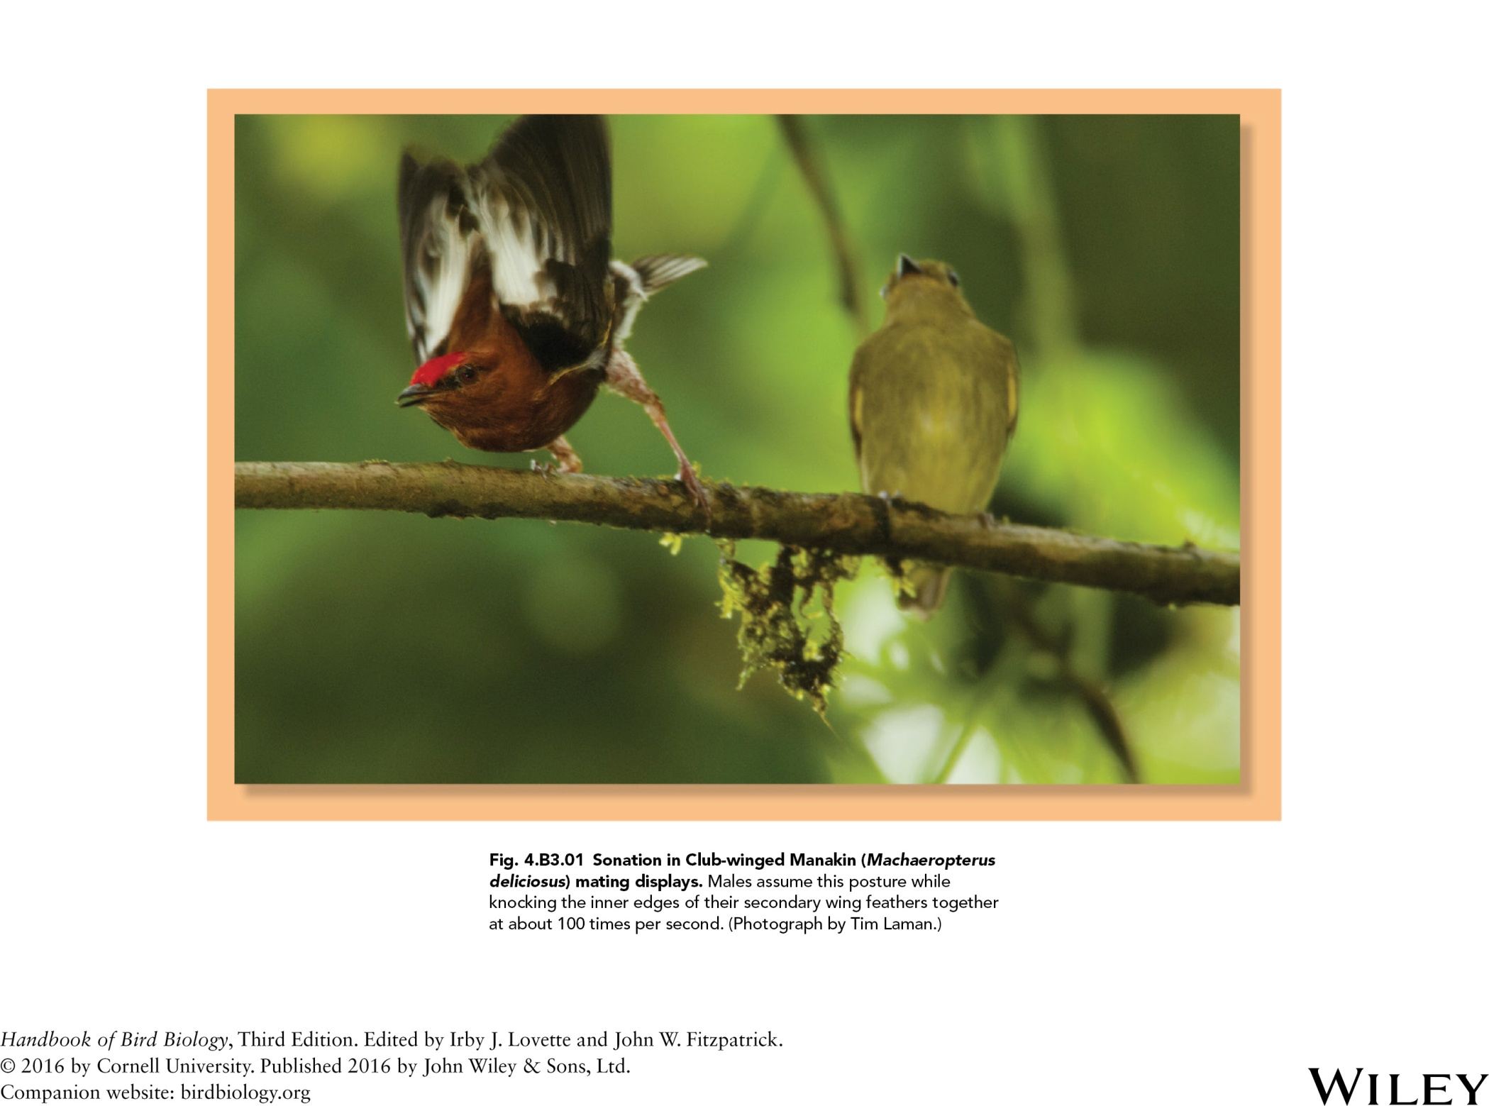

Slide 35
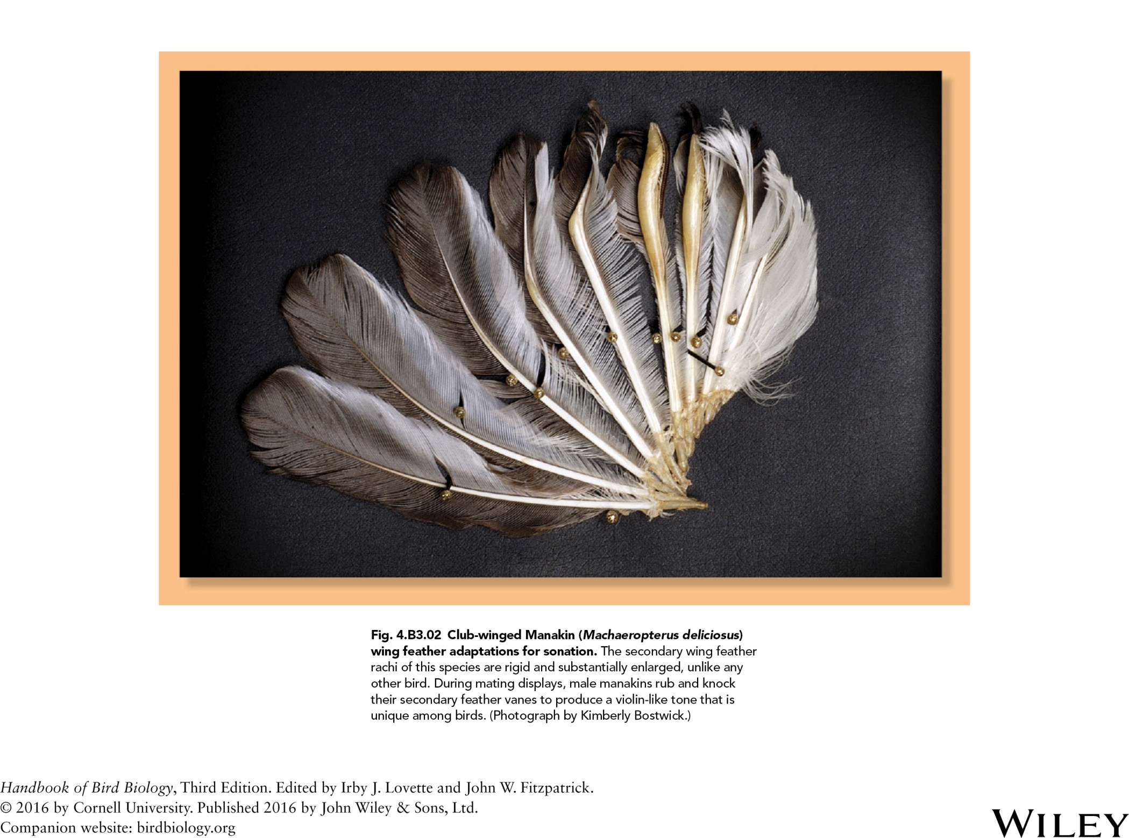

Slide 36
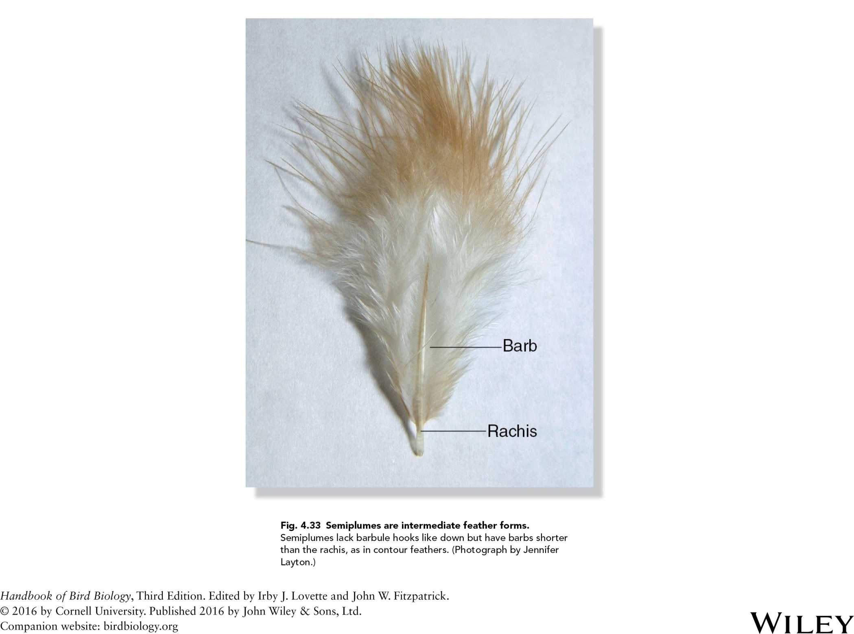

Slide 37
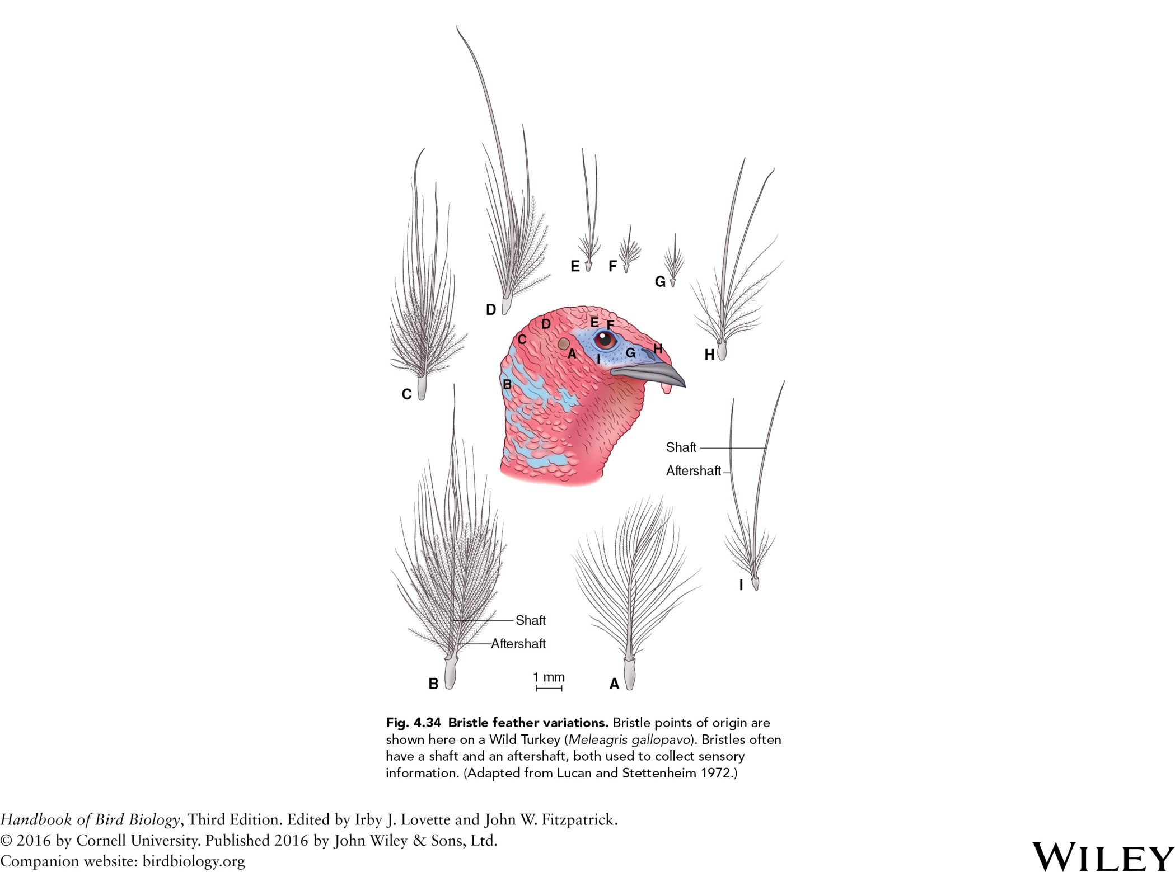

Slide 38
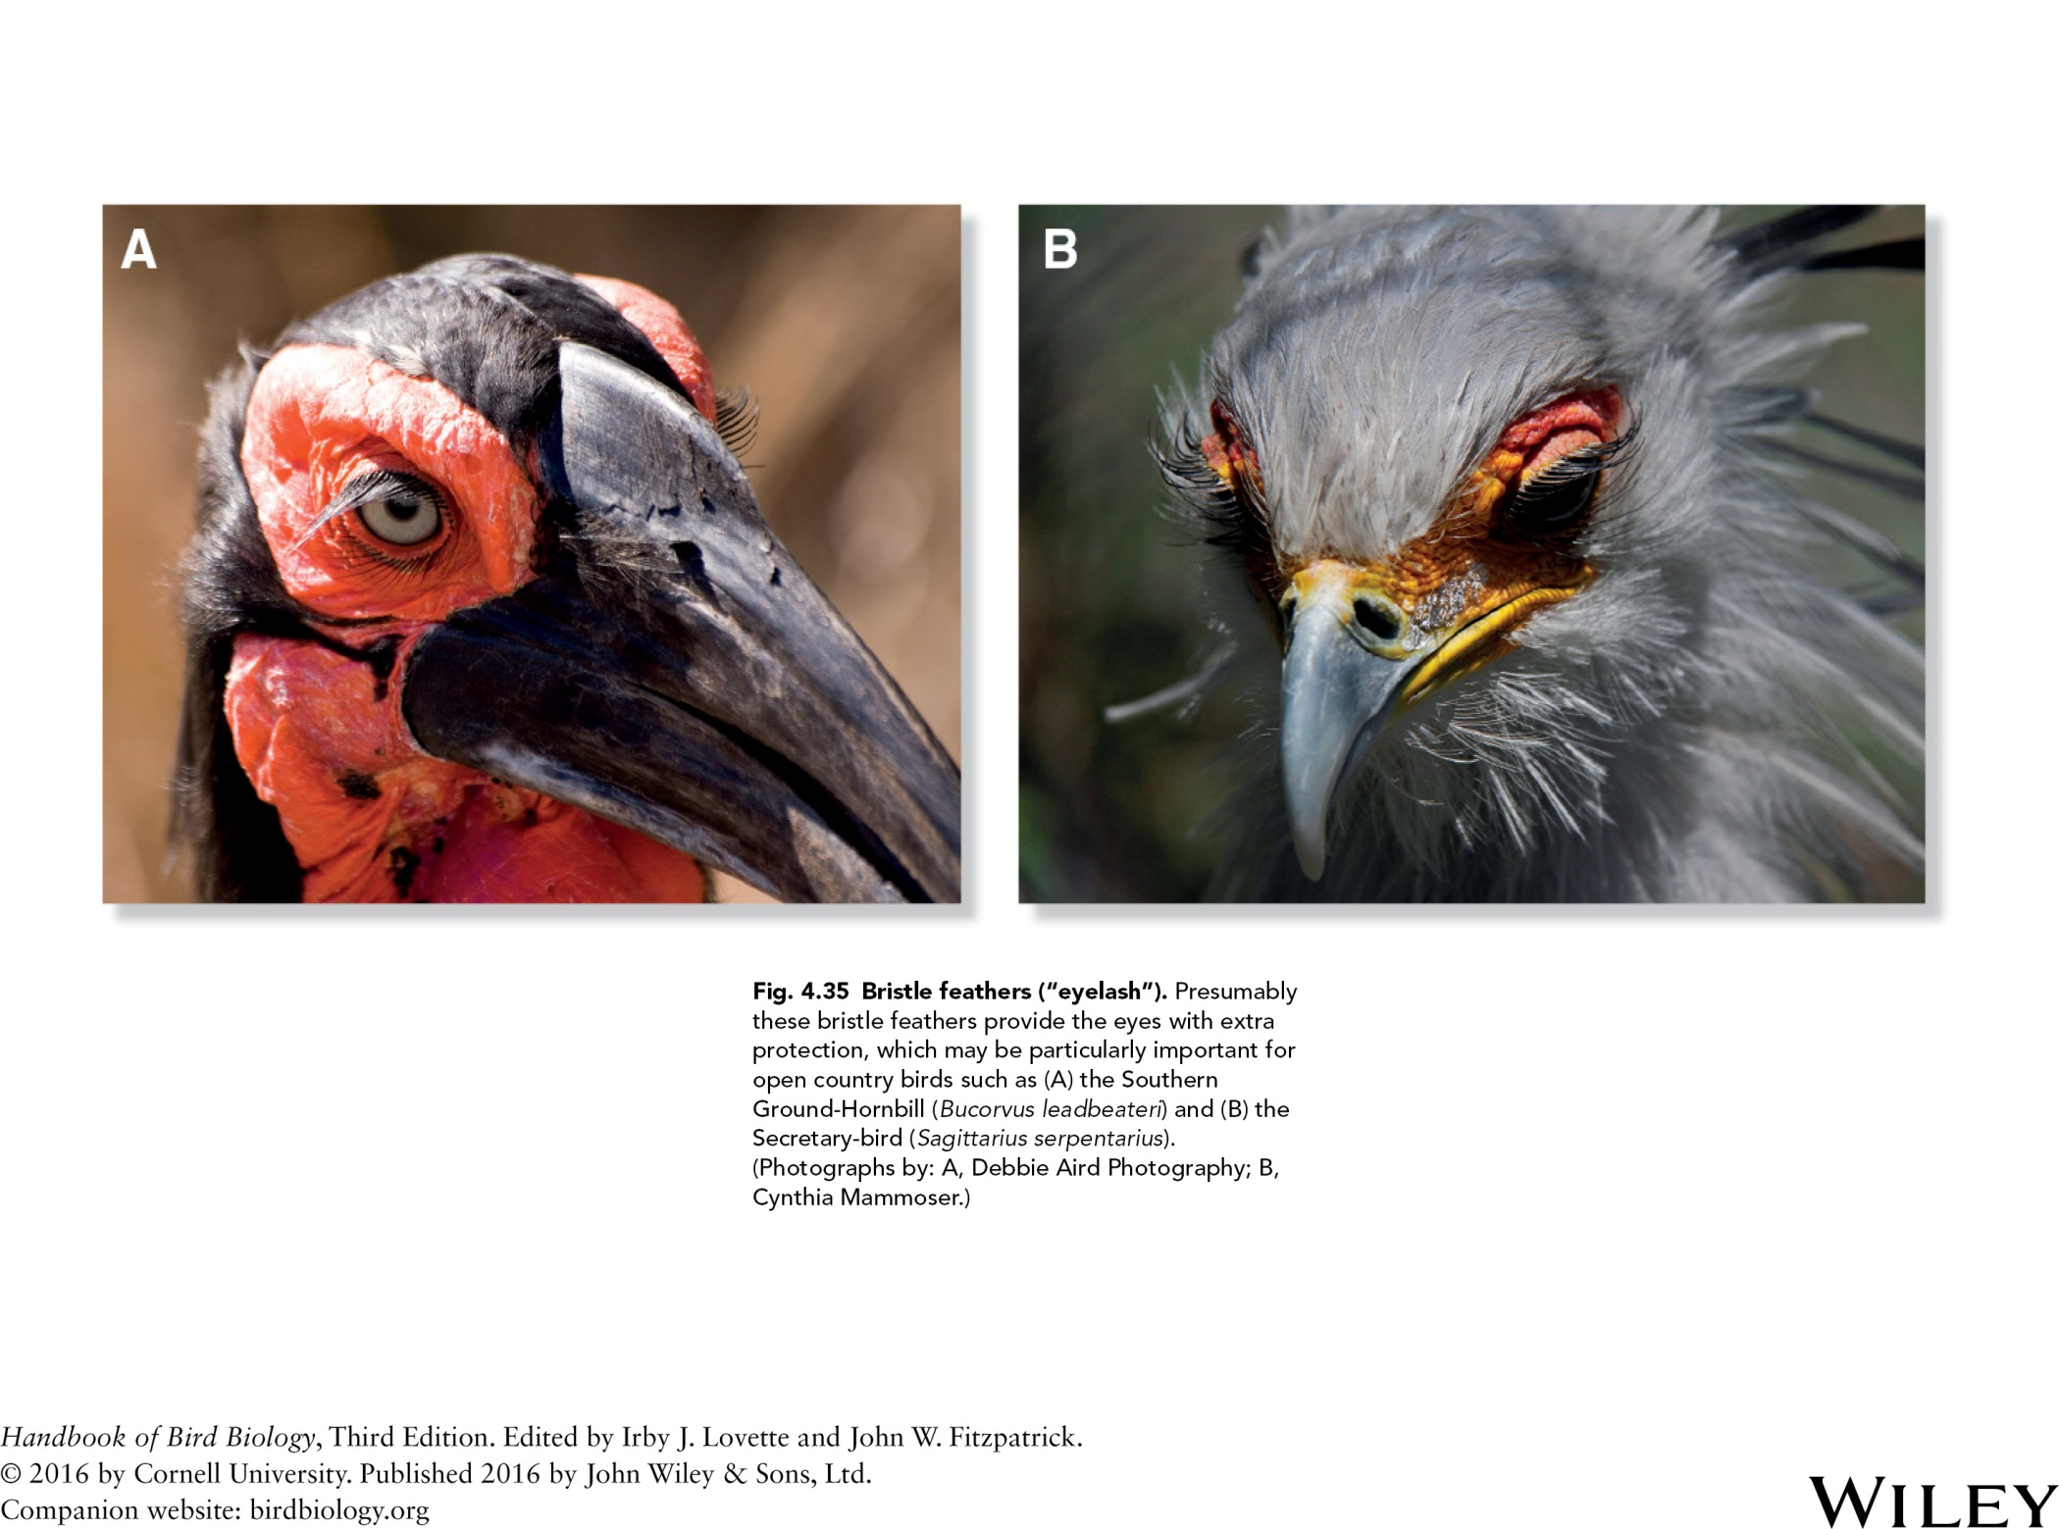

Slide 39
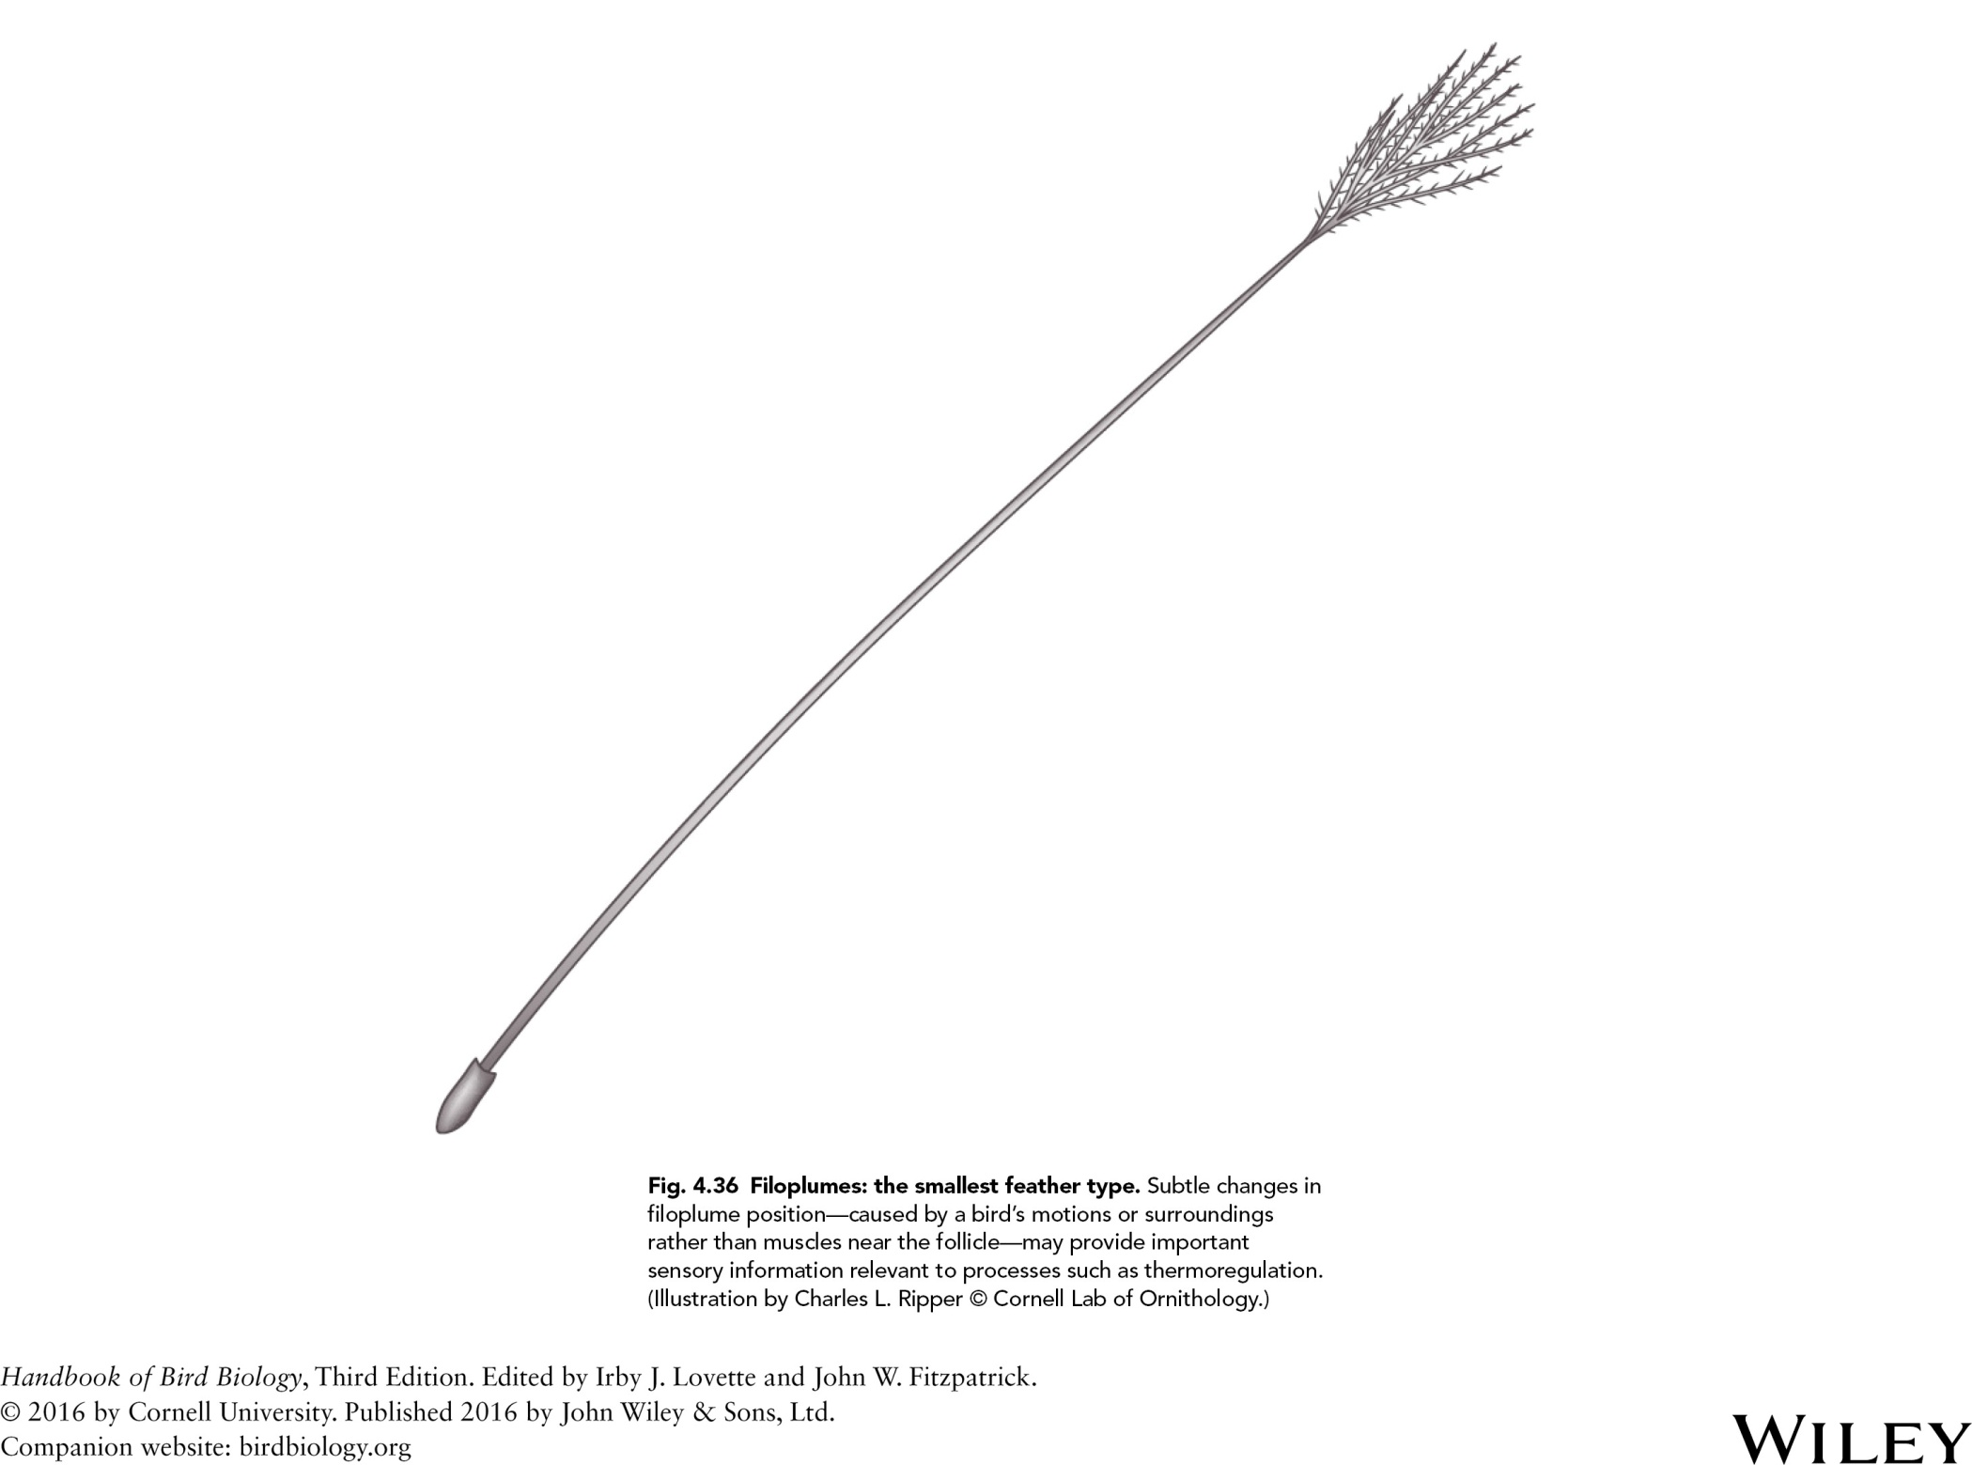

Slide 40
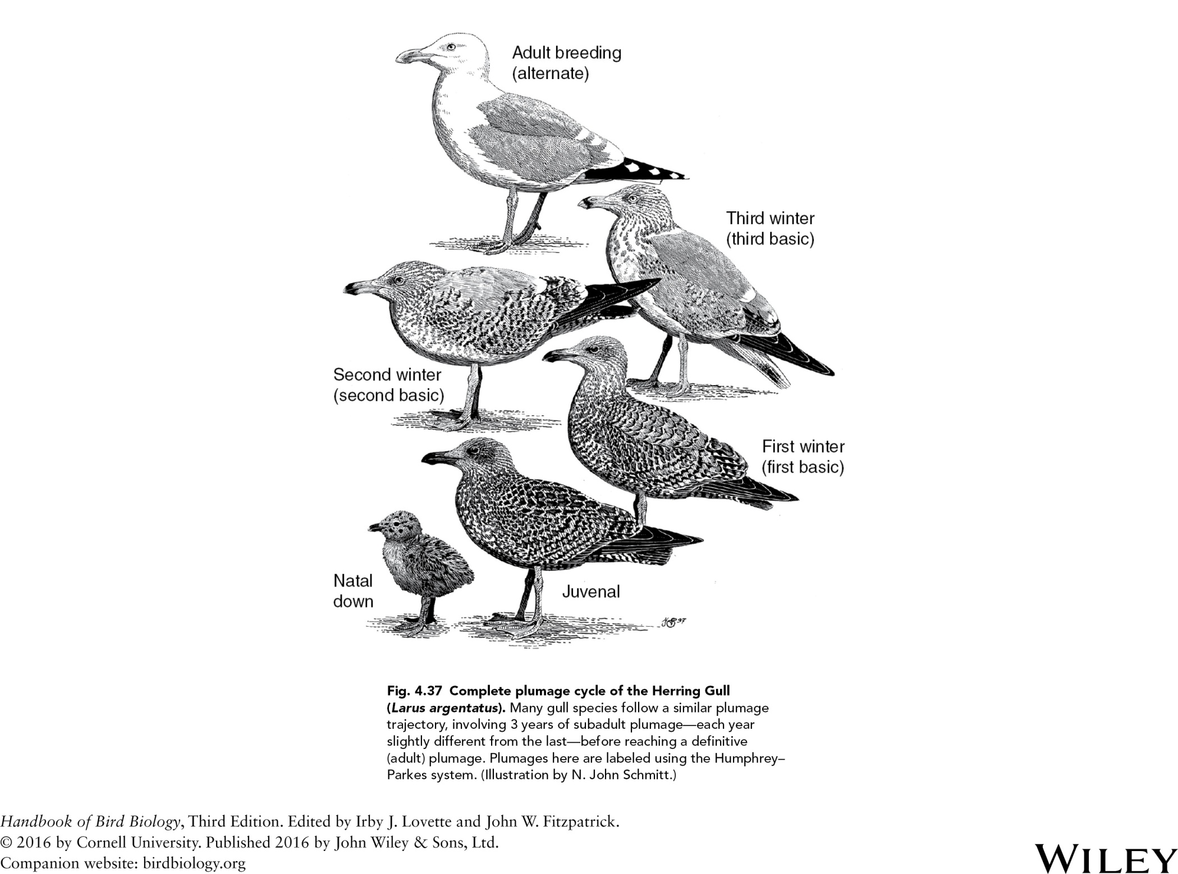

Slide 41
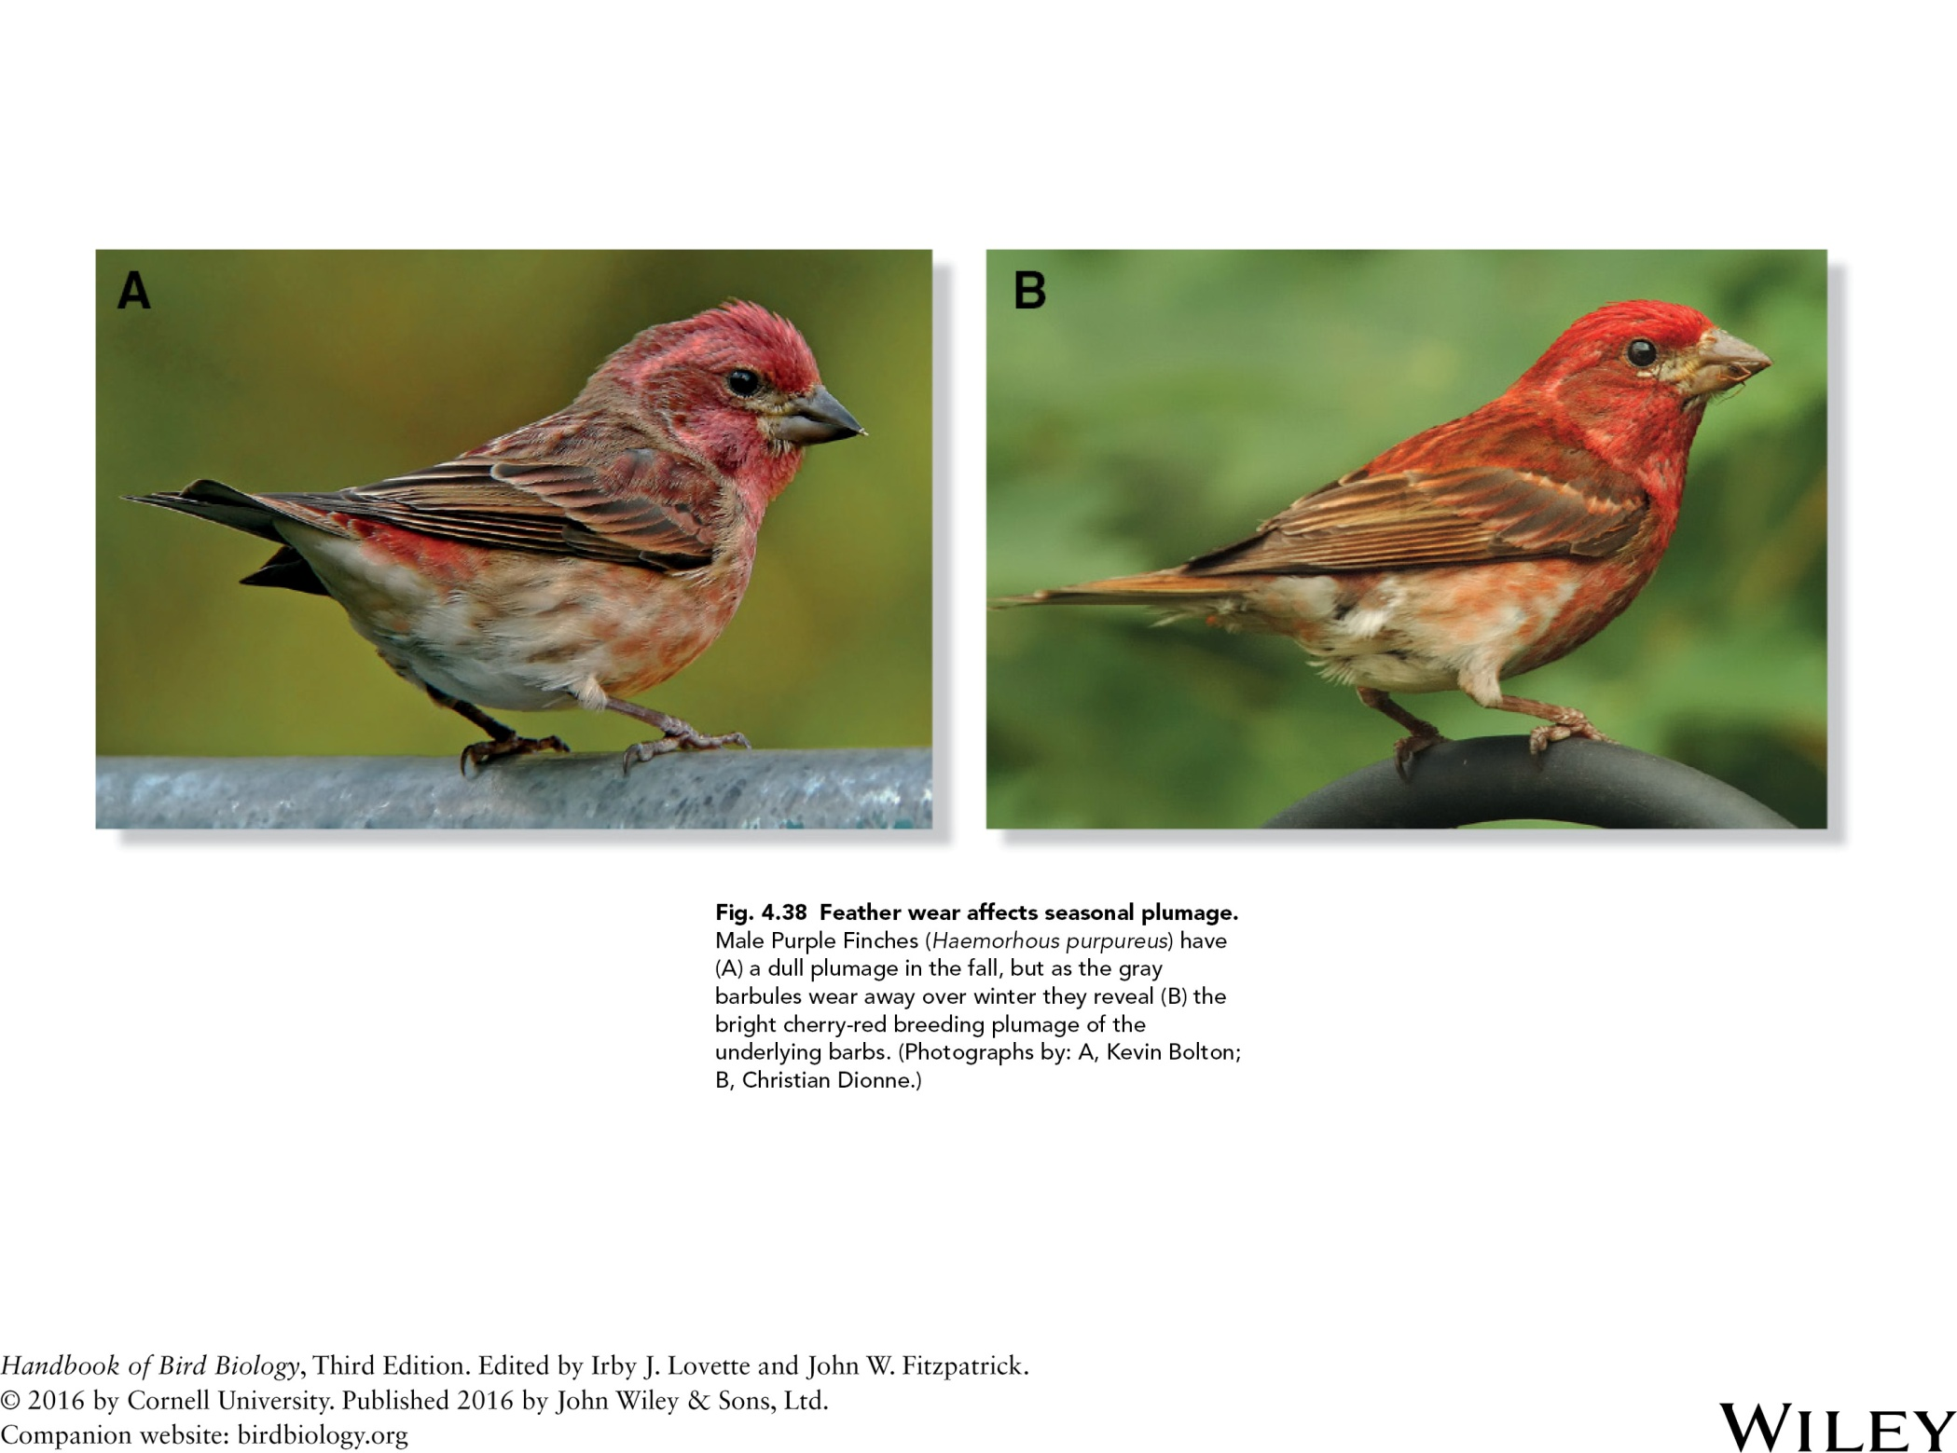

Slide 42
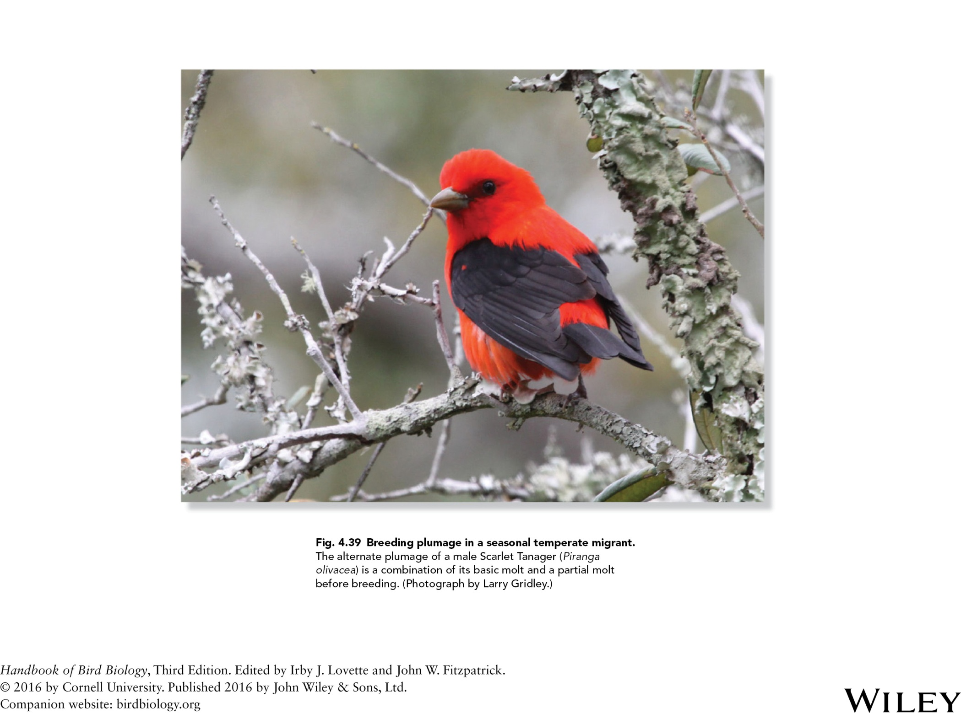

Slide 43
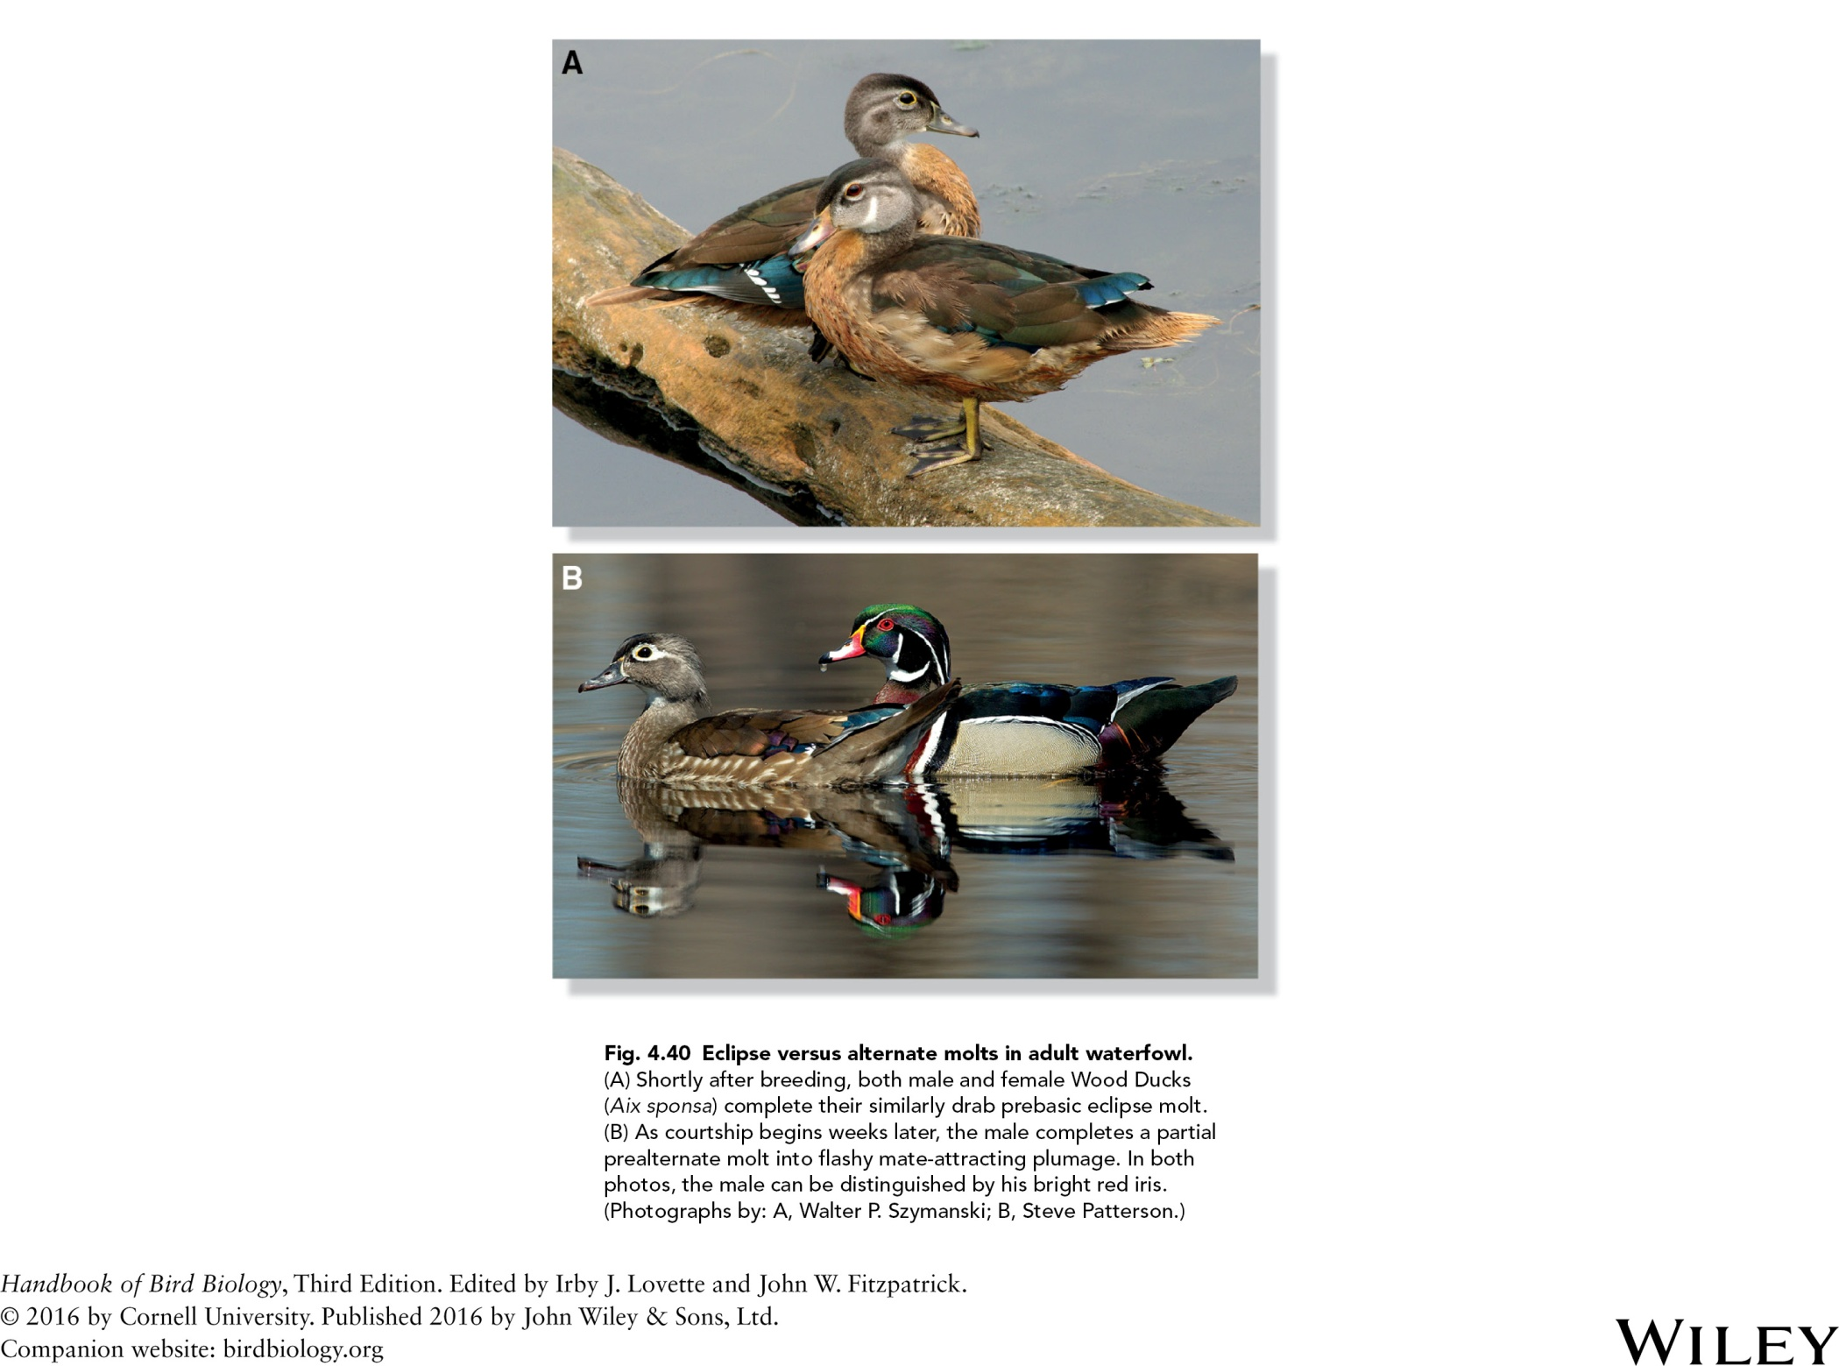

Slide 44
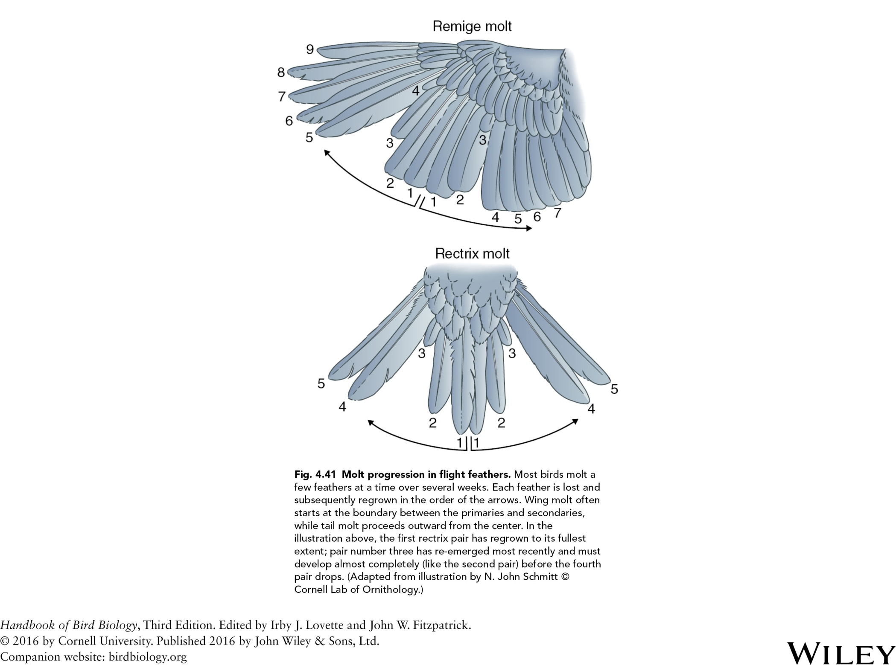

Slide 45
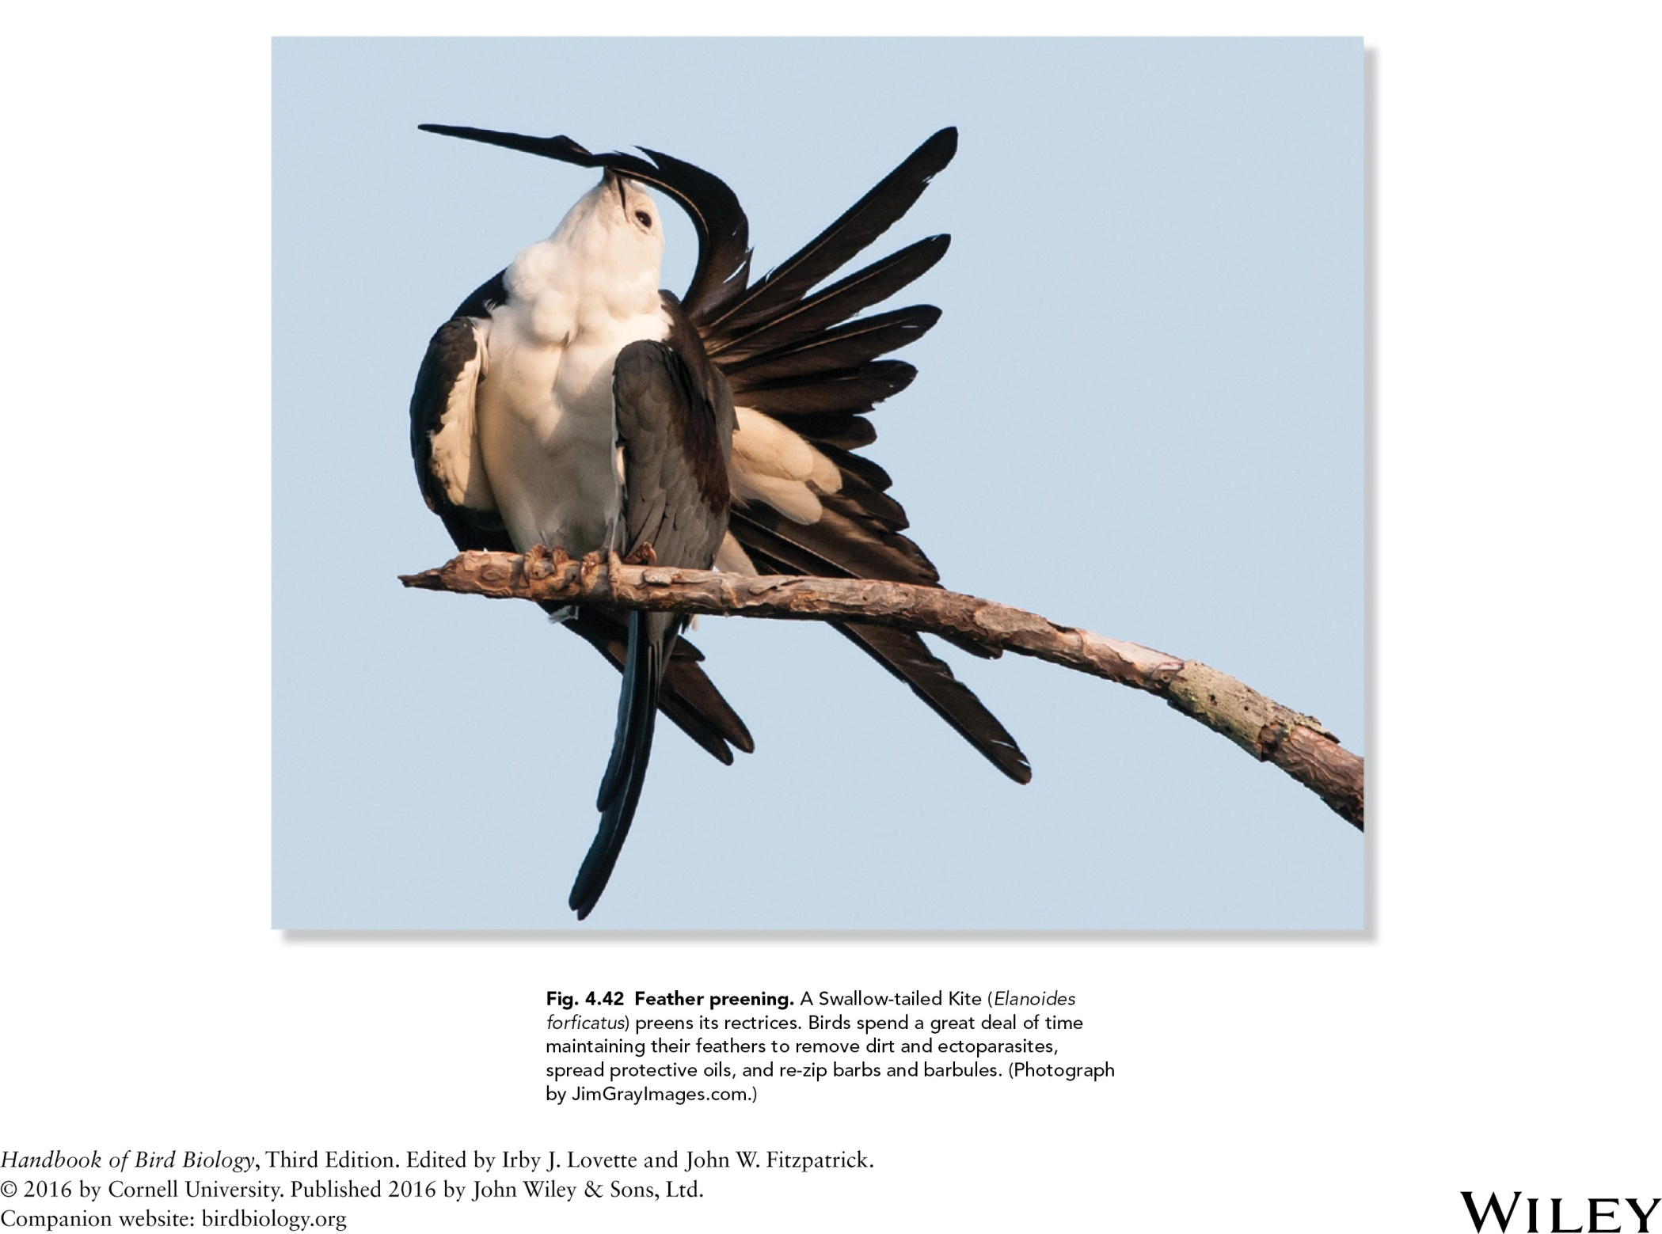

Slide 46
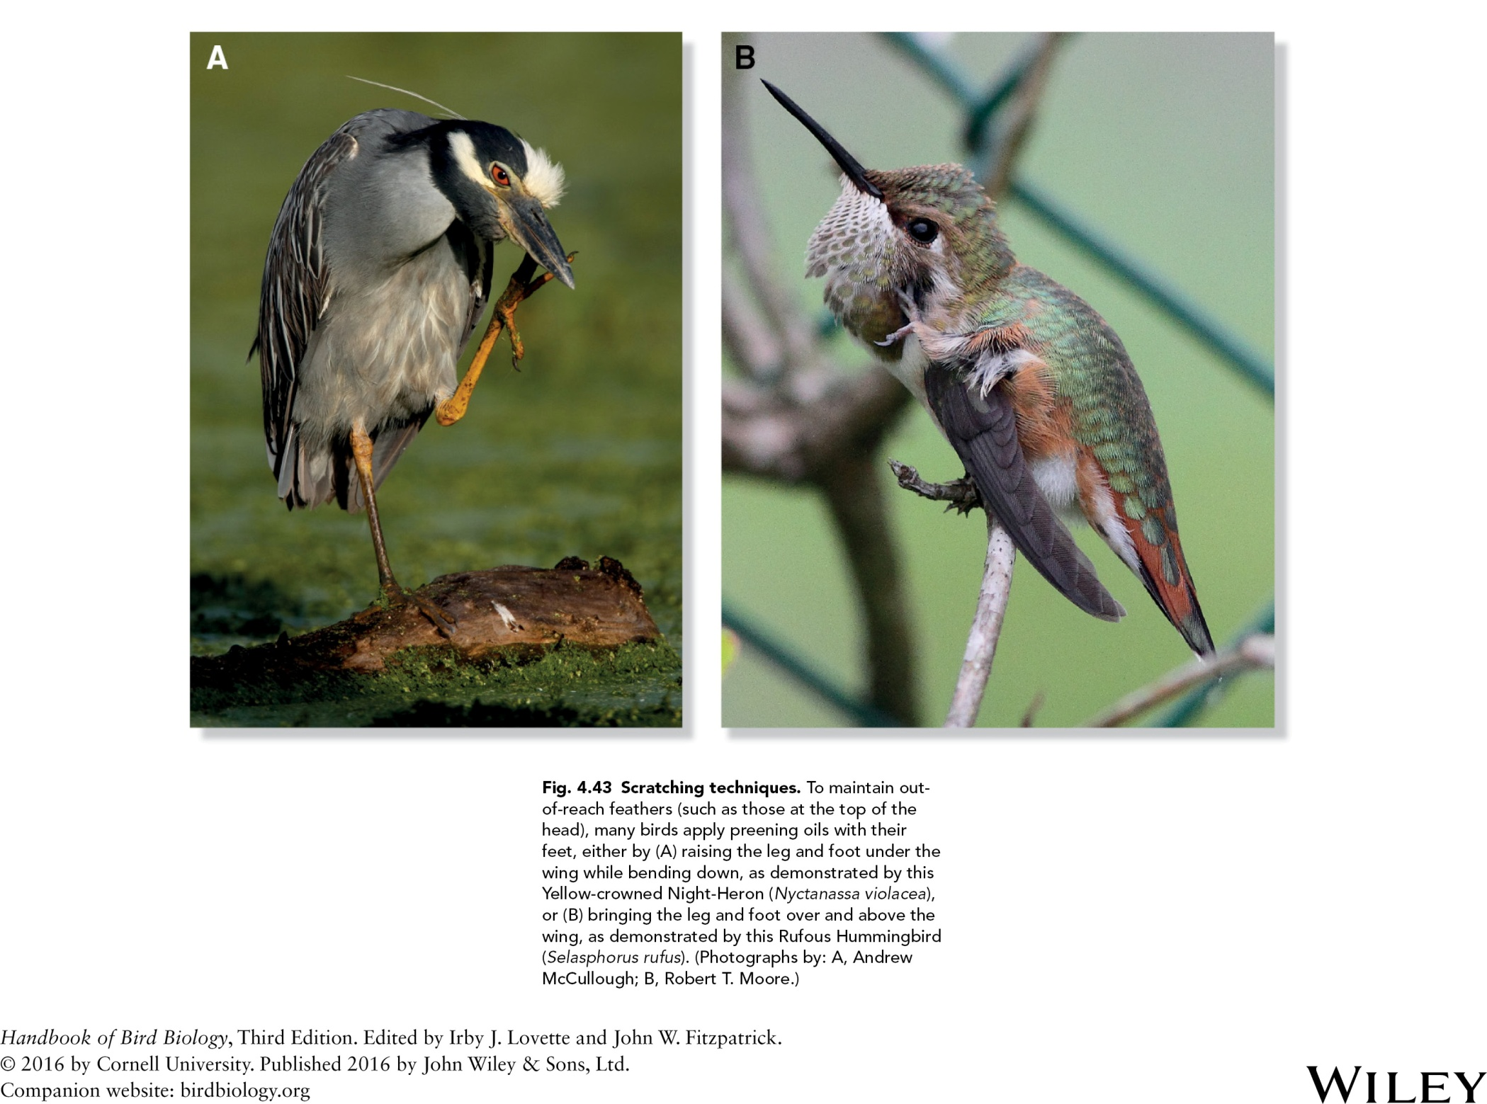

Slide 47
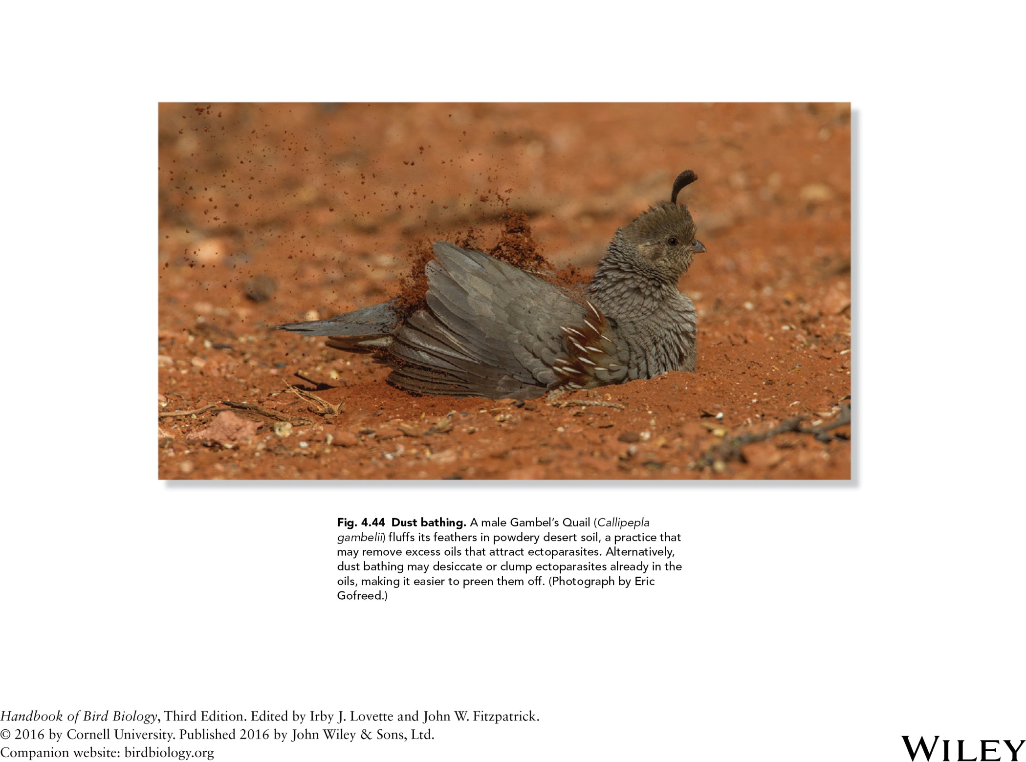
Fig. 4.44 Dust bathing. A female Gambel’s Quail (Callipepla
gambelii) fluffs its feathers in powdery desert soil, a practice that
may remove excess oils that attract ectoparasites. Alternatively,
dust bathing may desiccate or clump ectoparasites already in the
oils, making it easier to preen them off. (Photograph by Eric
Gofreed.)

Slide 48
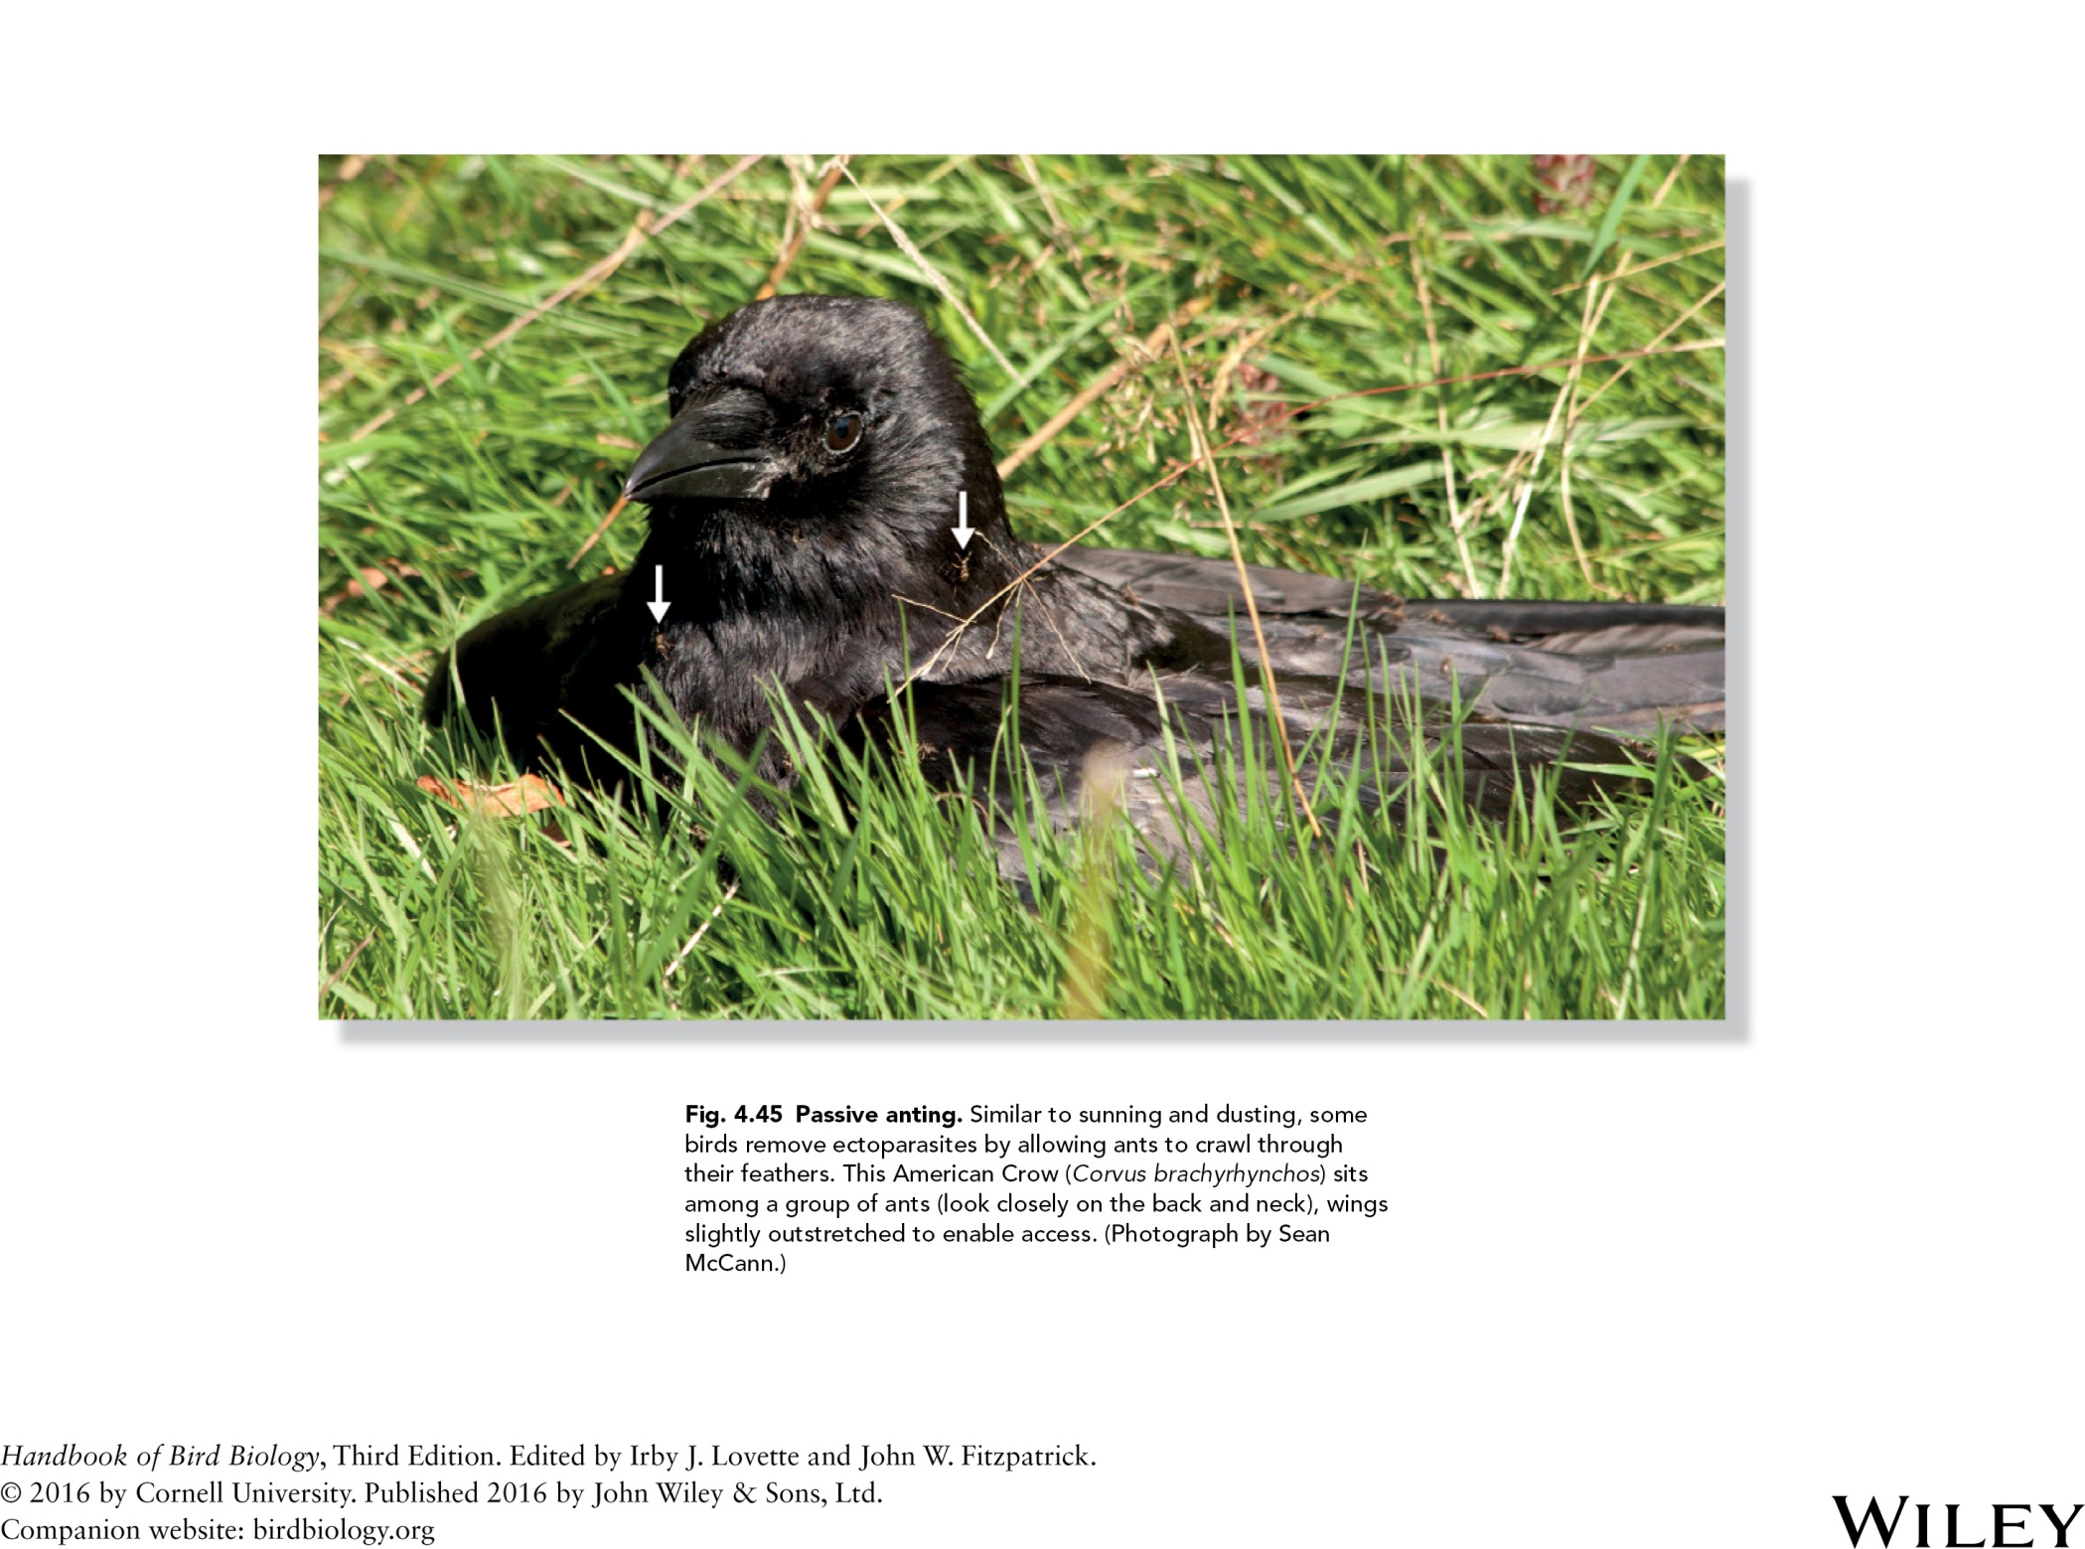

Slide 49
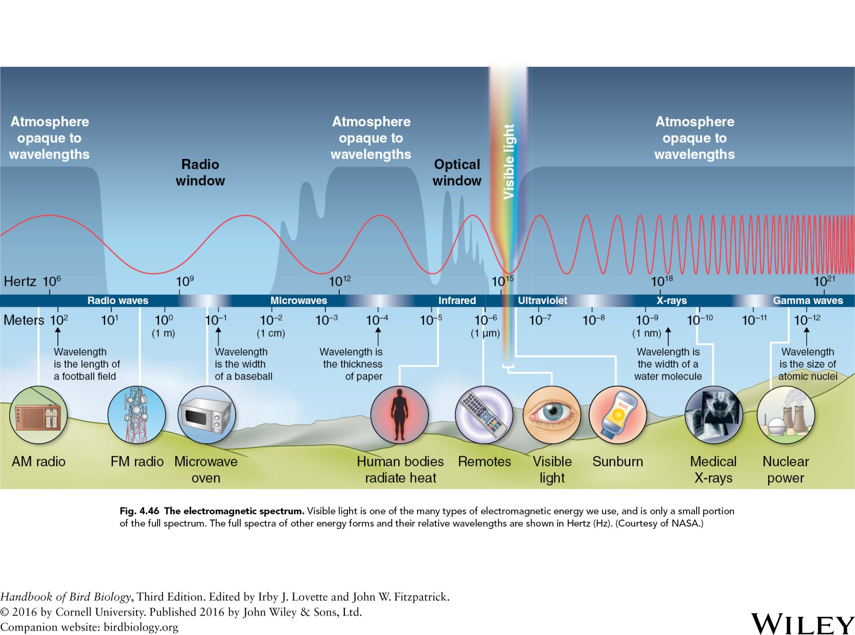

Slide 50
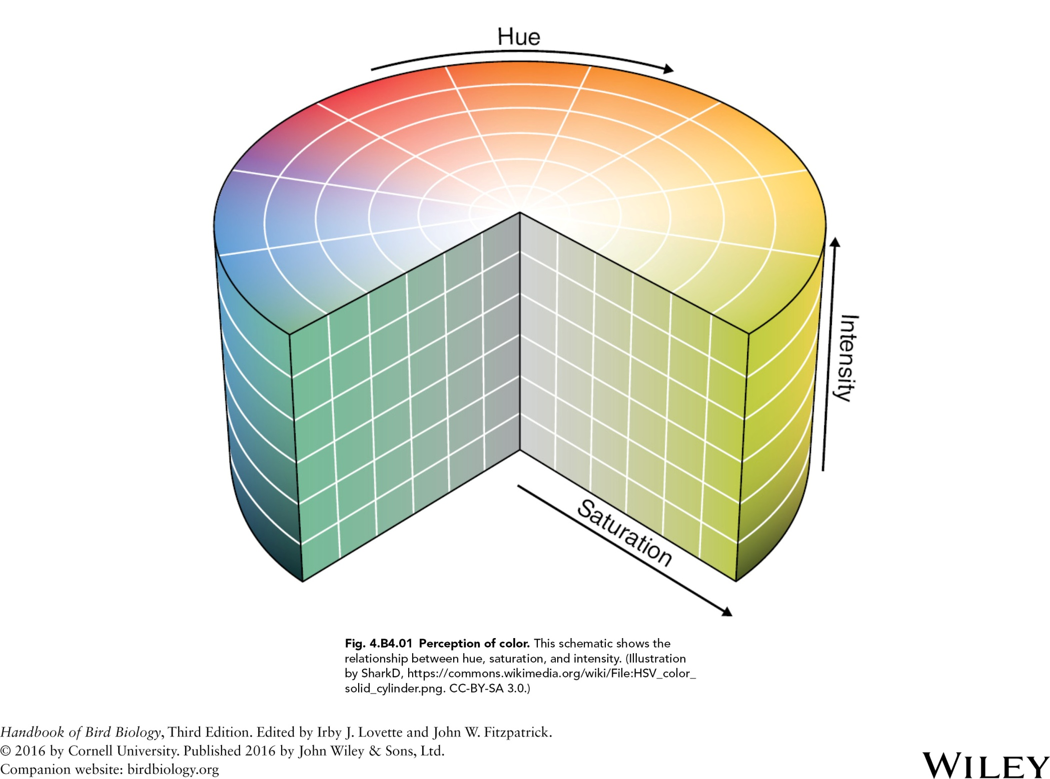

Slide 51


Slide 52


Slide 53


Slide 54


Slide 55


Slide 56


Slide 57


Slide 58


Slide 59


Slide 60


Slide 61


Slide 62


Slide 63


Slide 64


Slide 65


Slide 66


