Slide 1
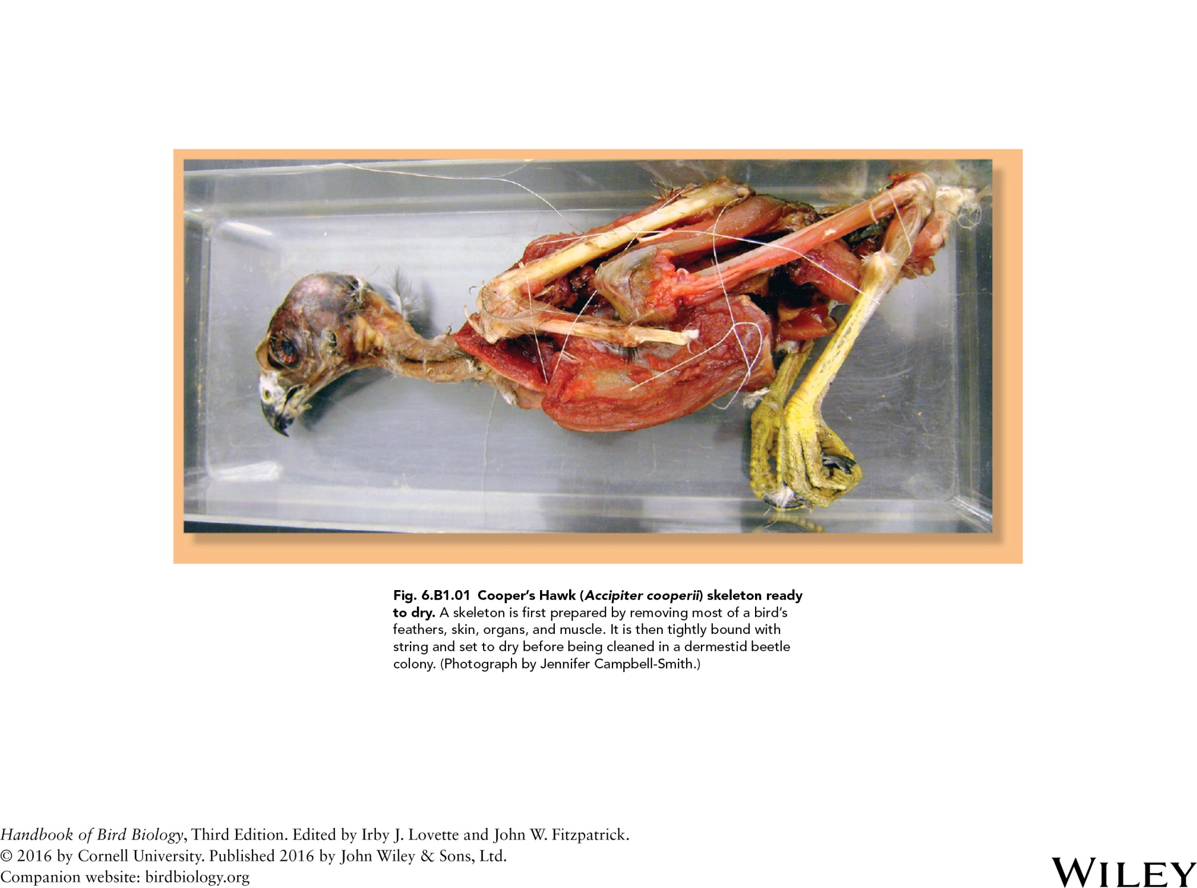

Slide 2
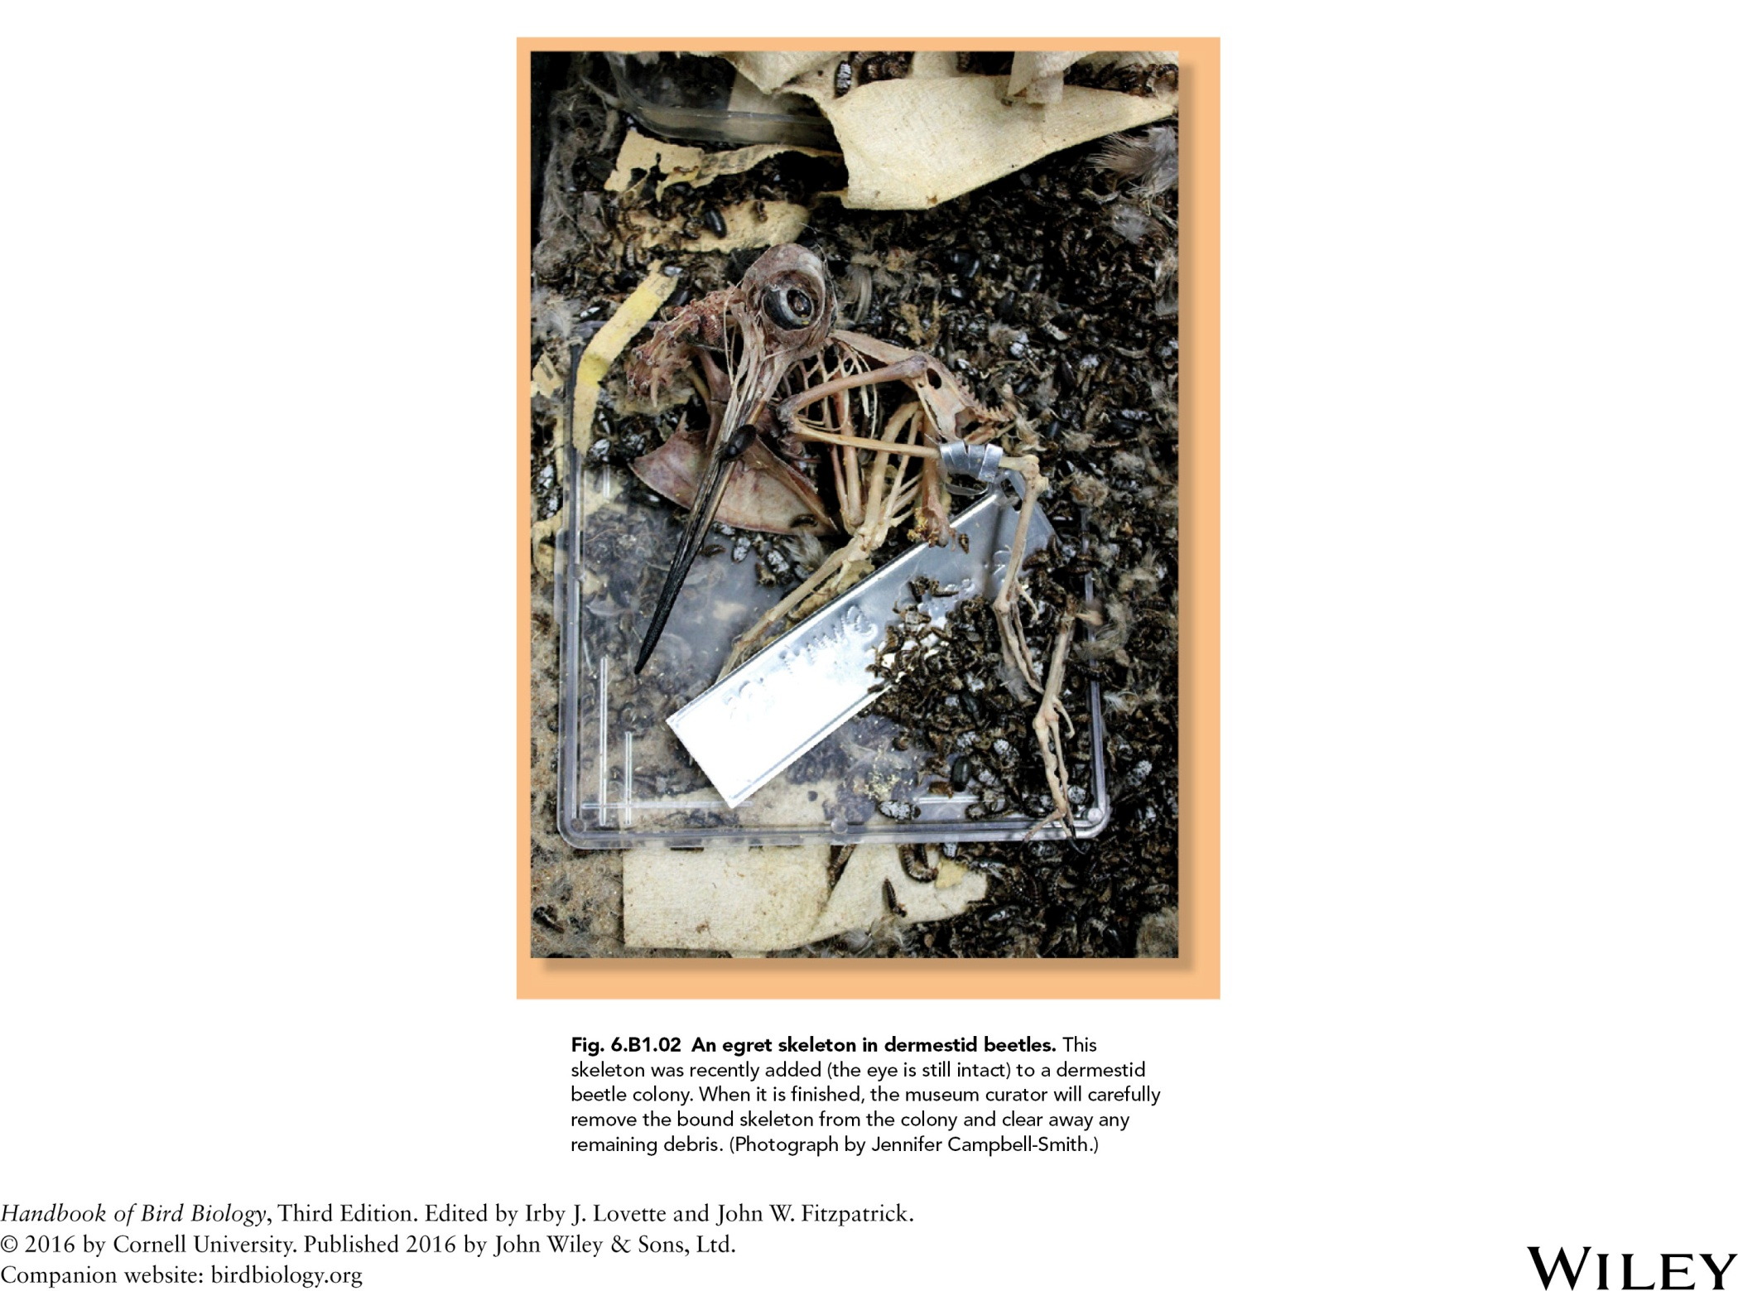

Slide 3
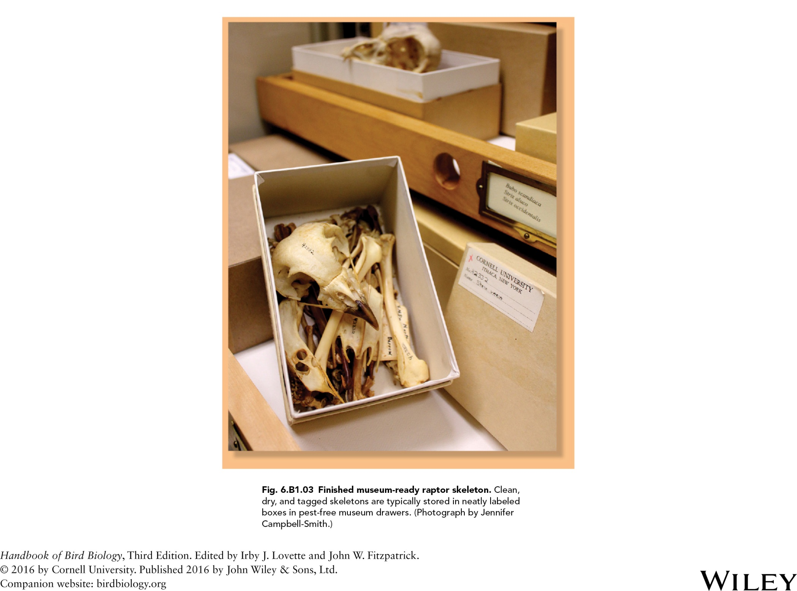

Slide 4
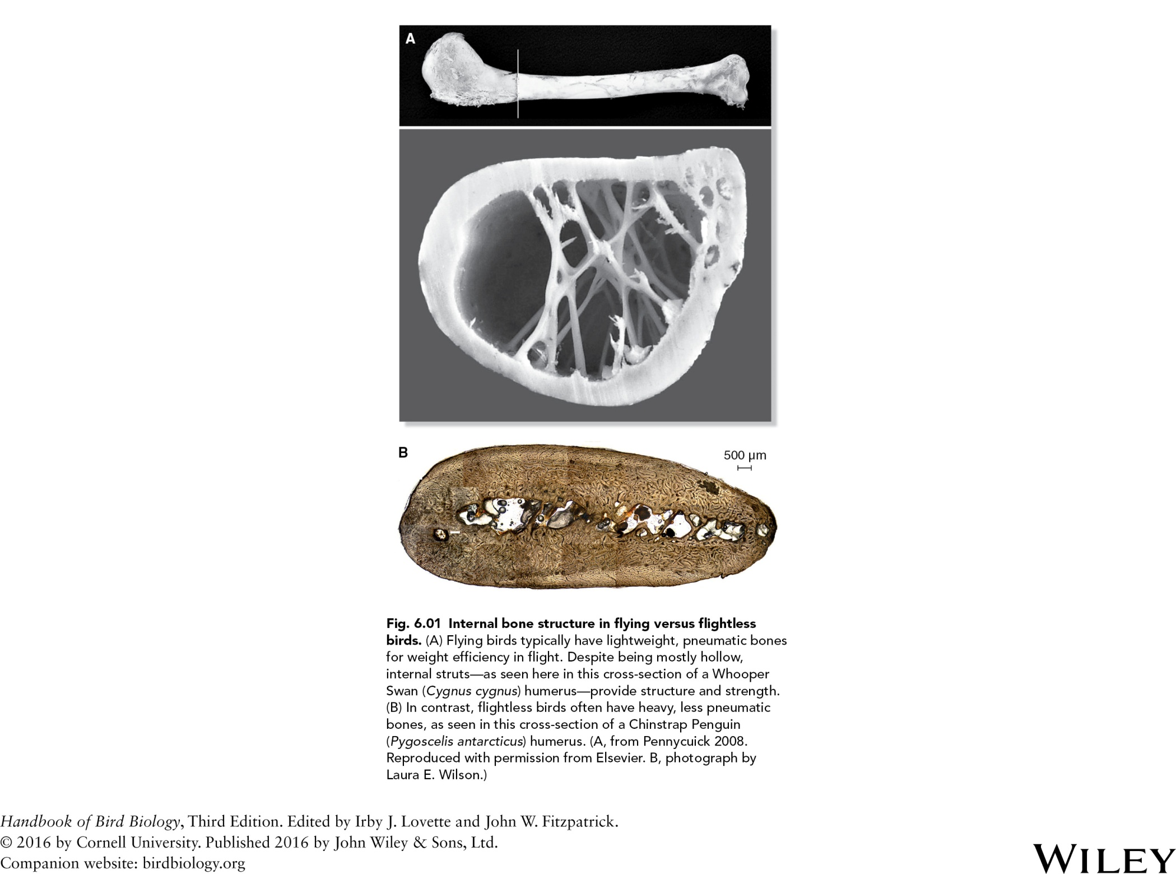

Slide 5
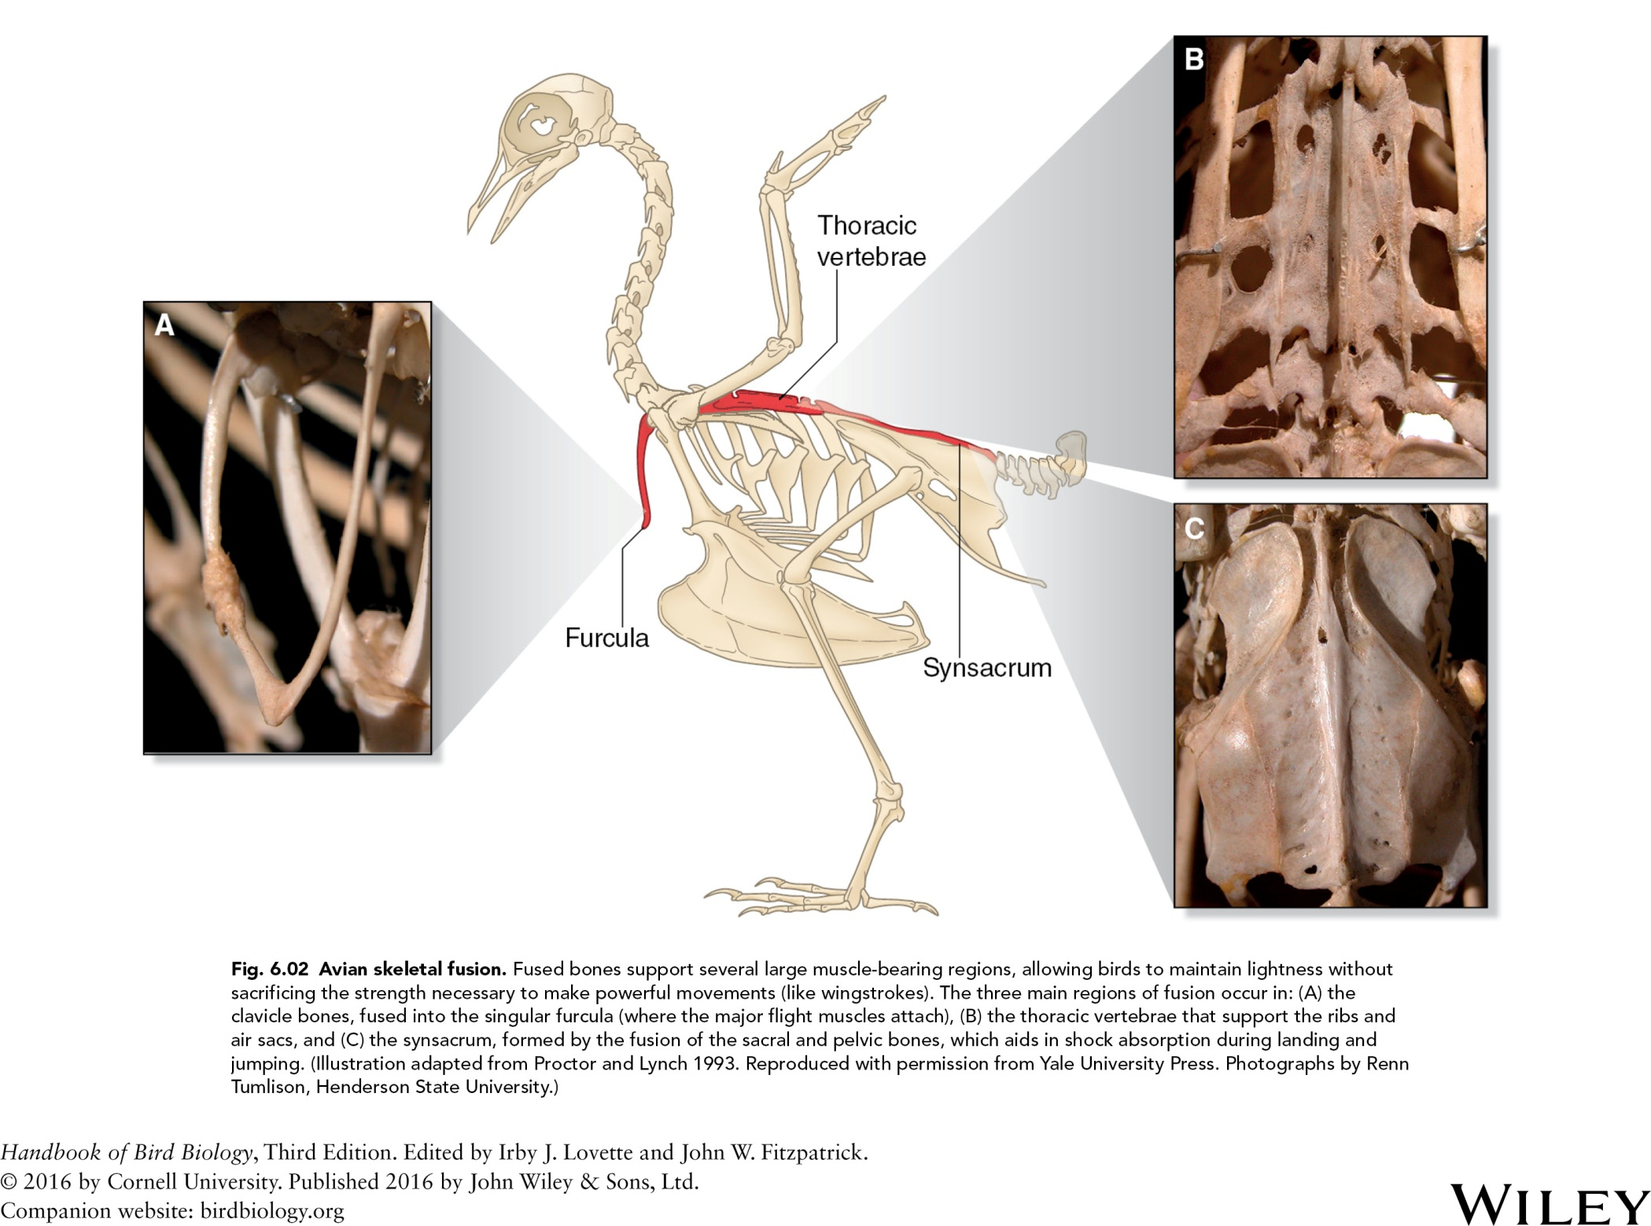

Slide 6
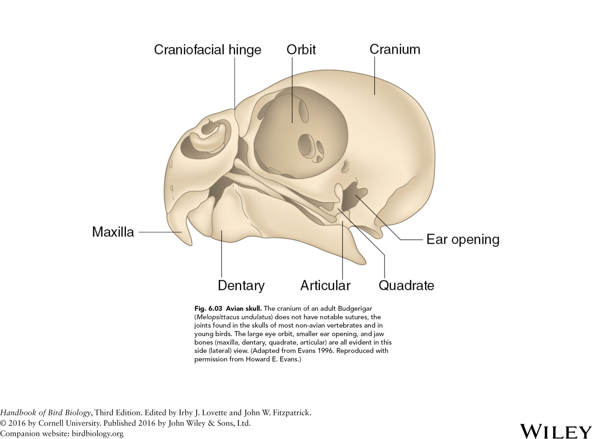

Slide 7
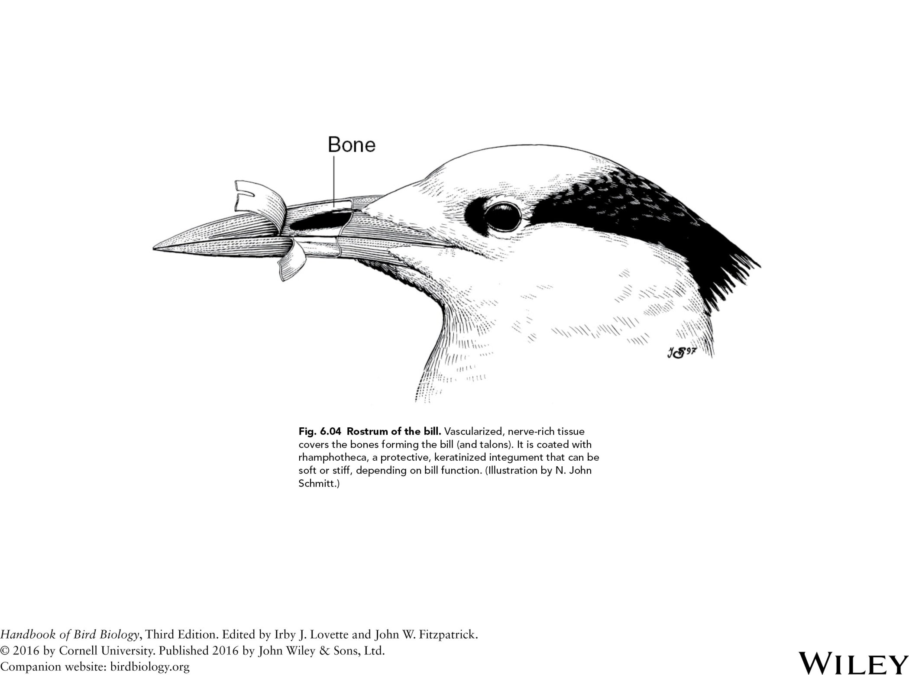

Slide 8
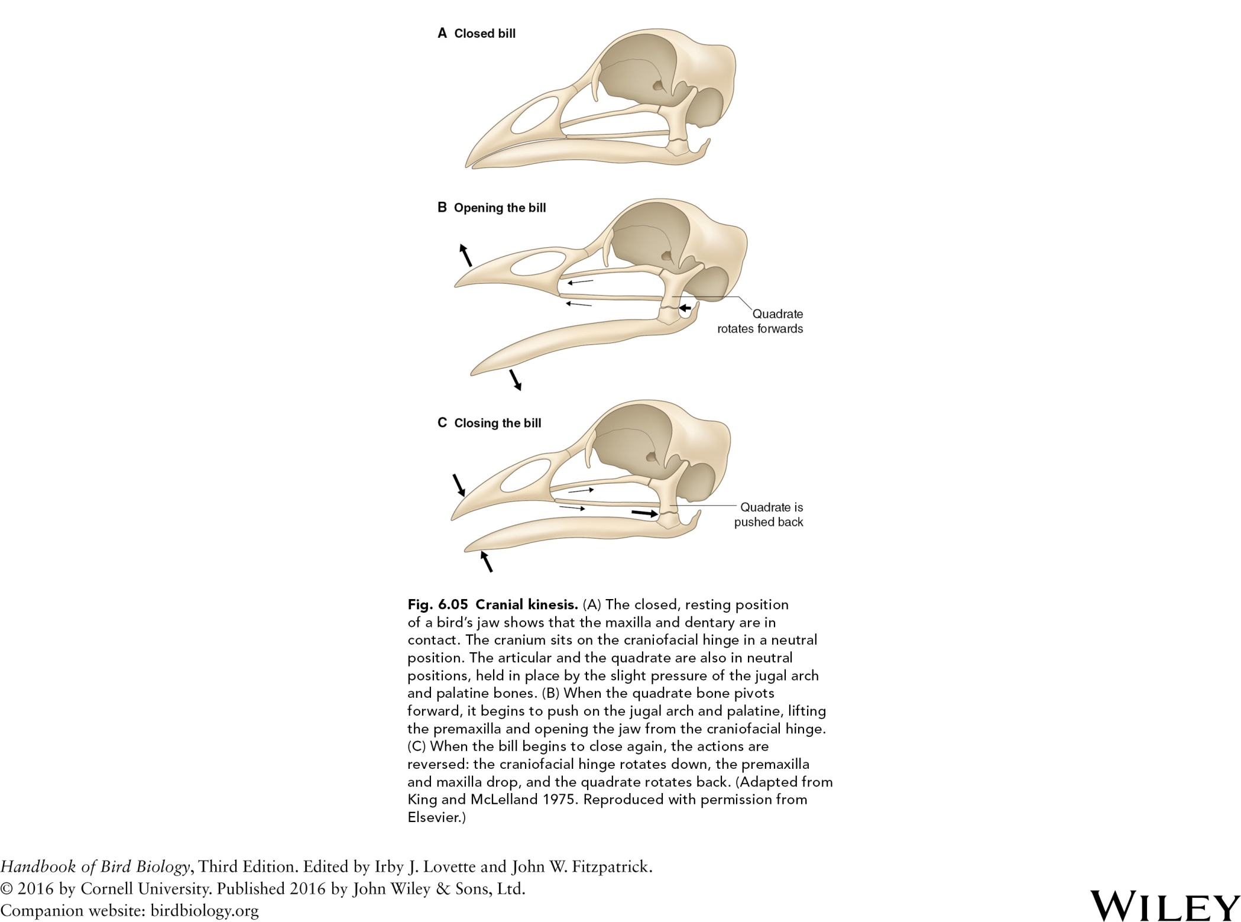

Slide 9
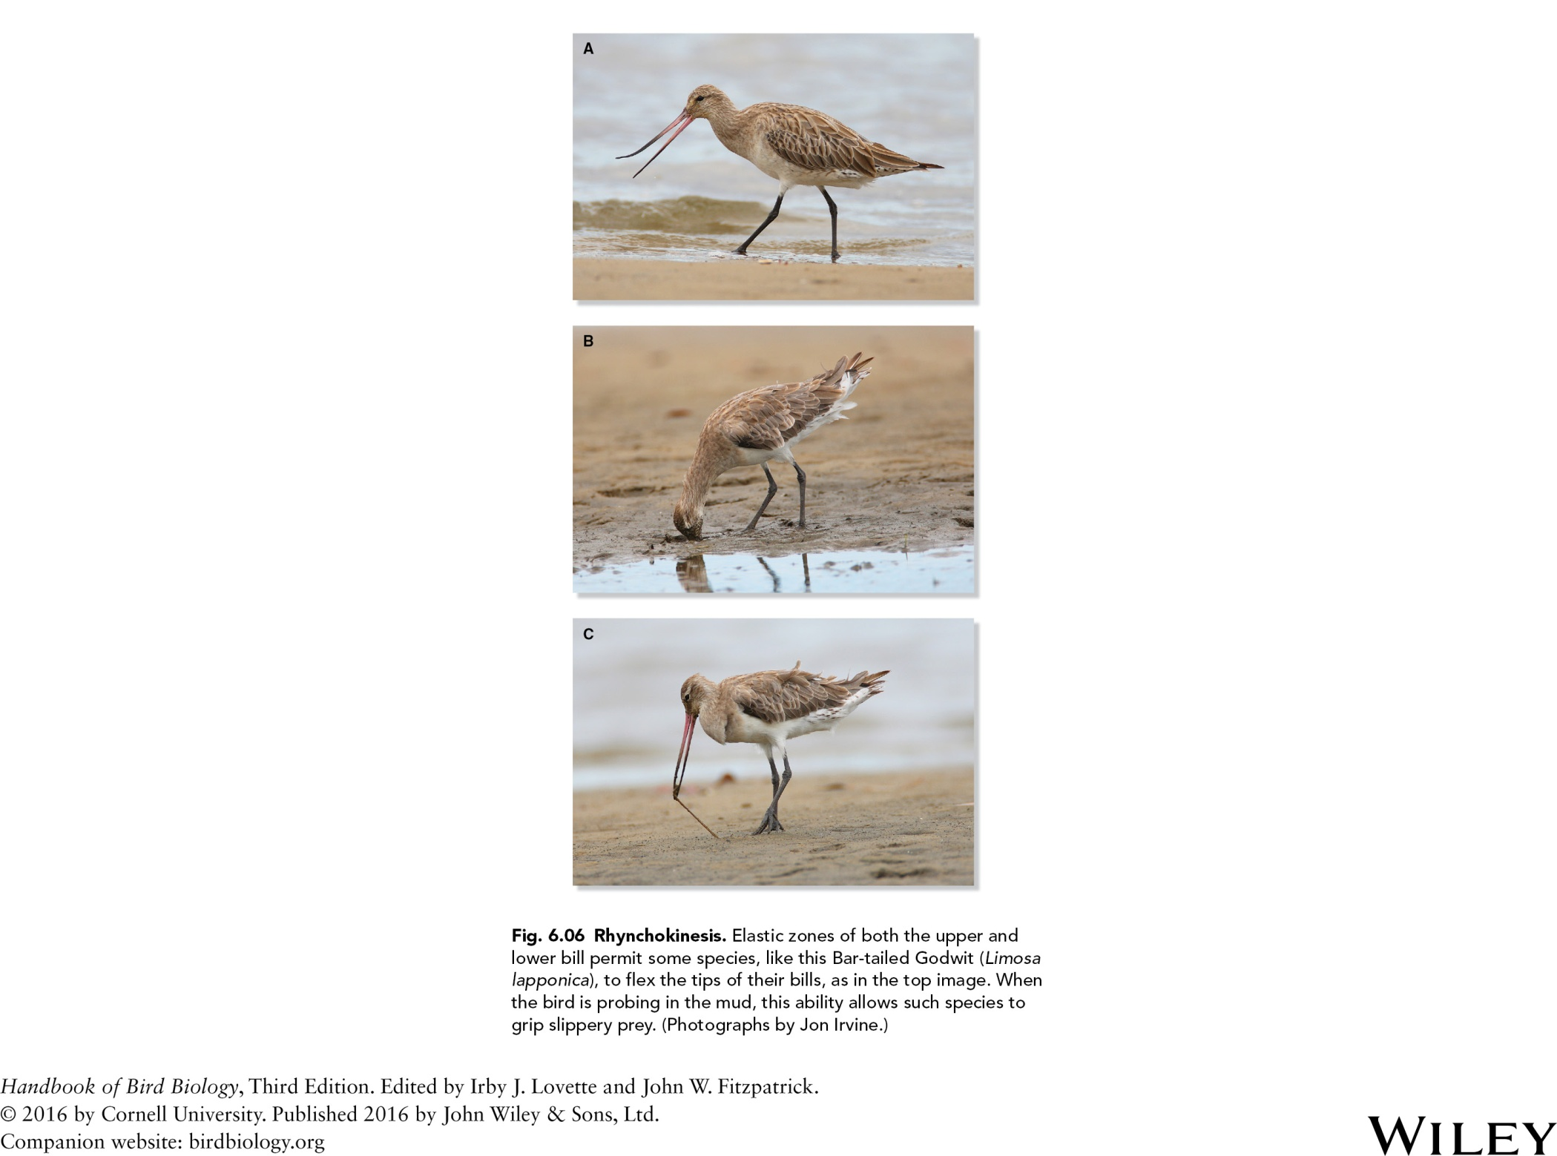

Slide 10
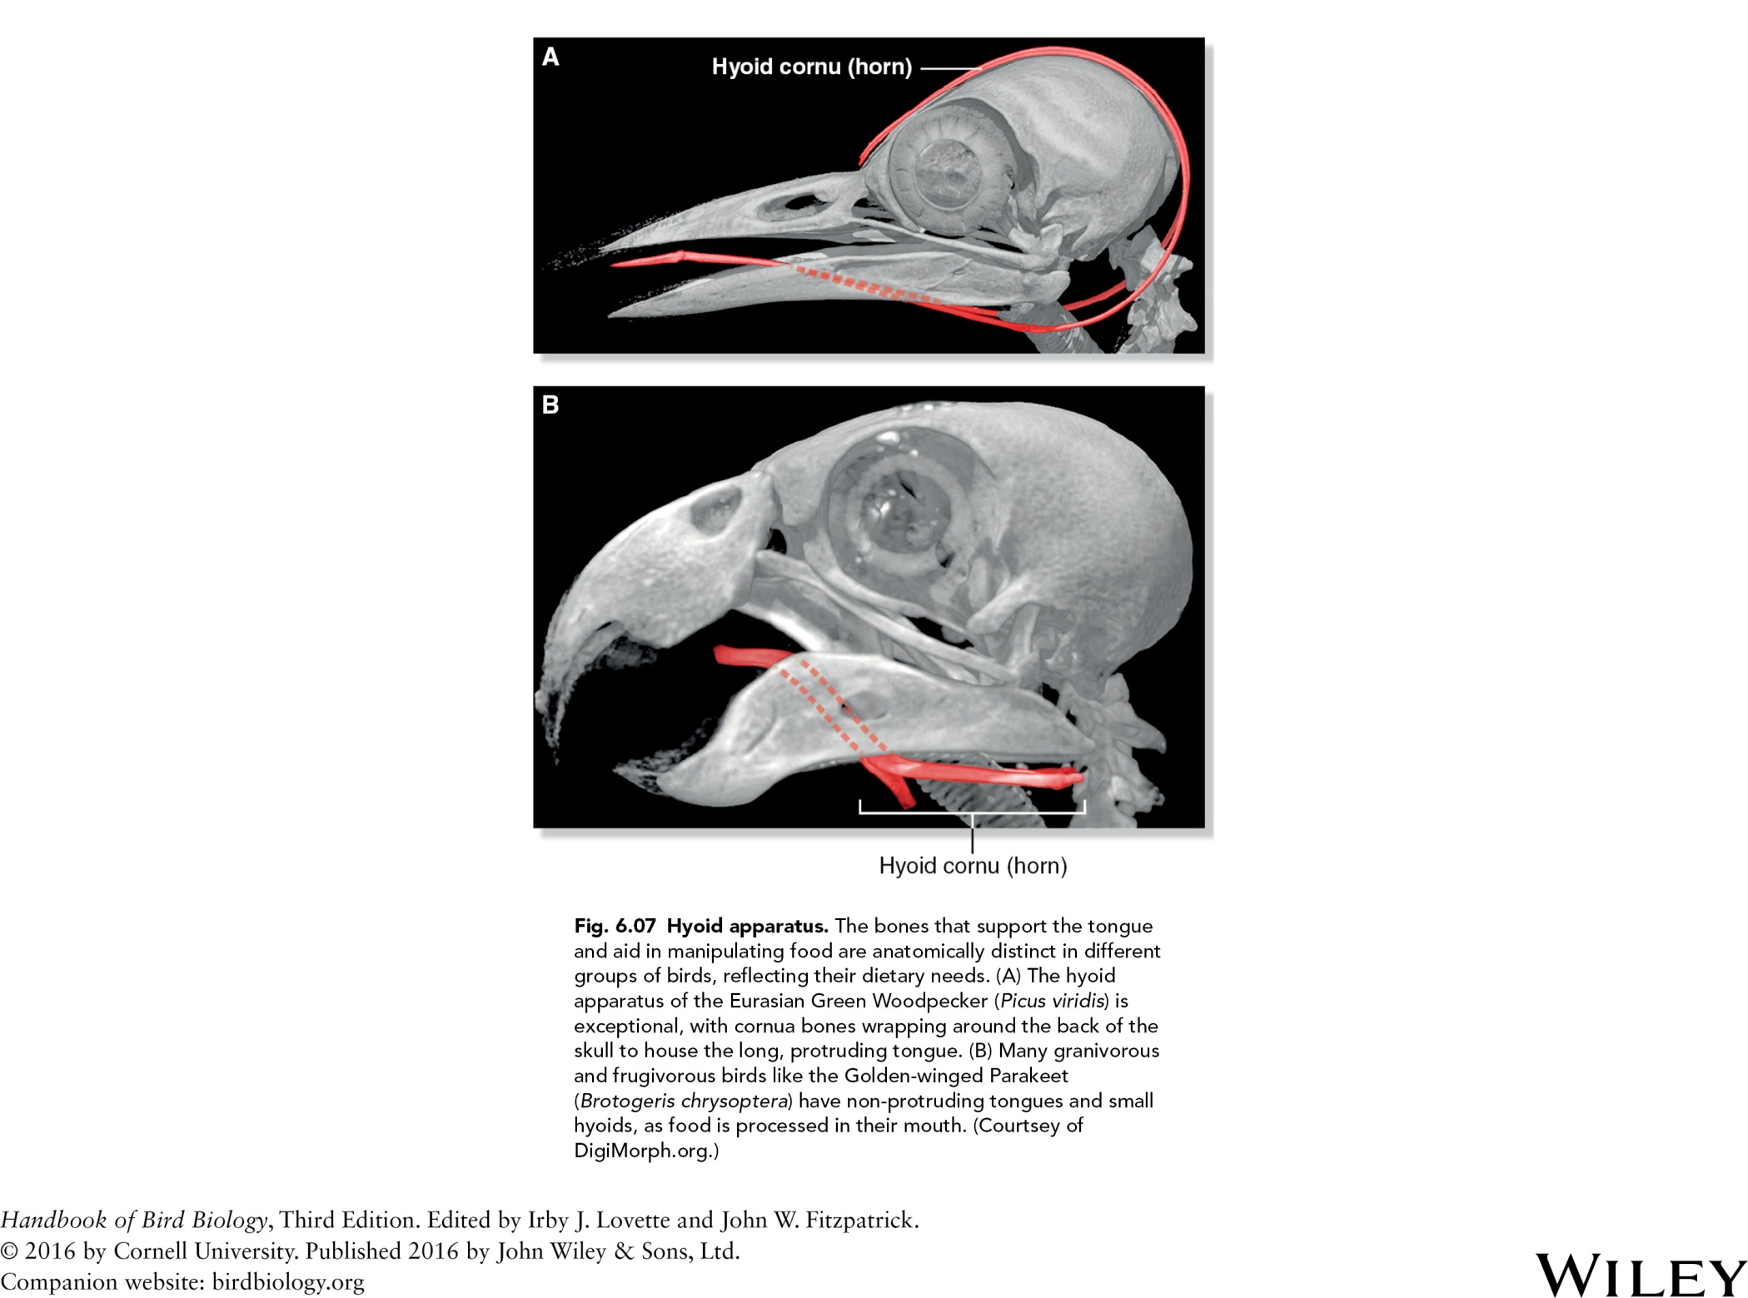

Slide 11
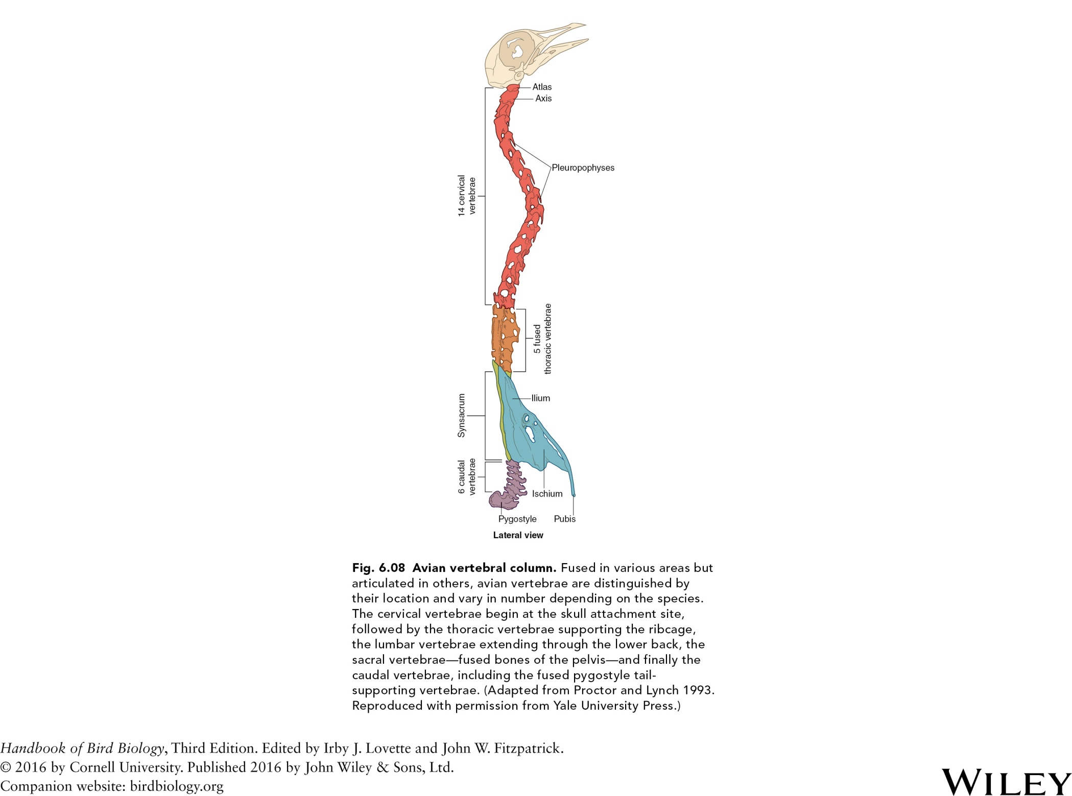

Slide 12
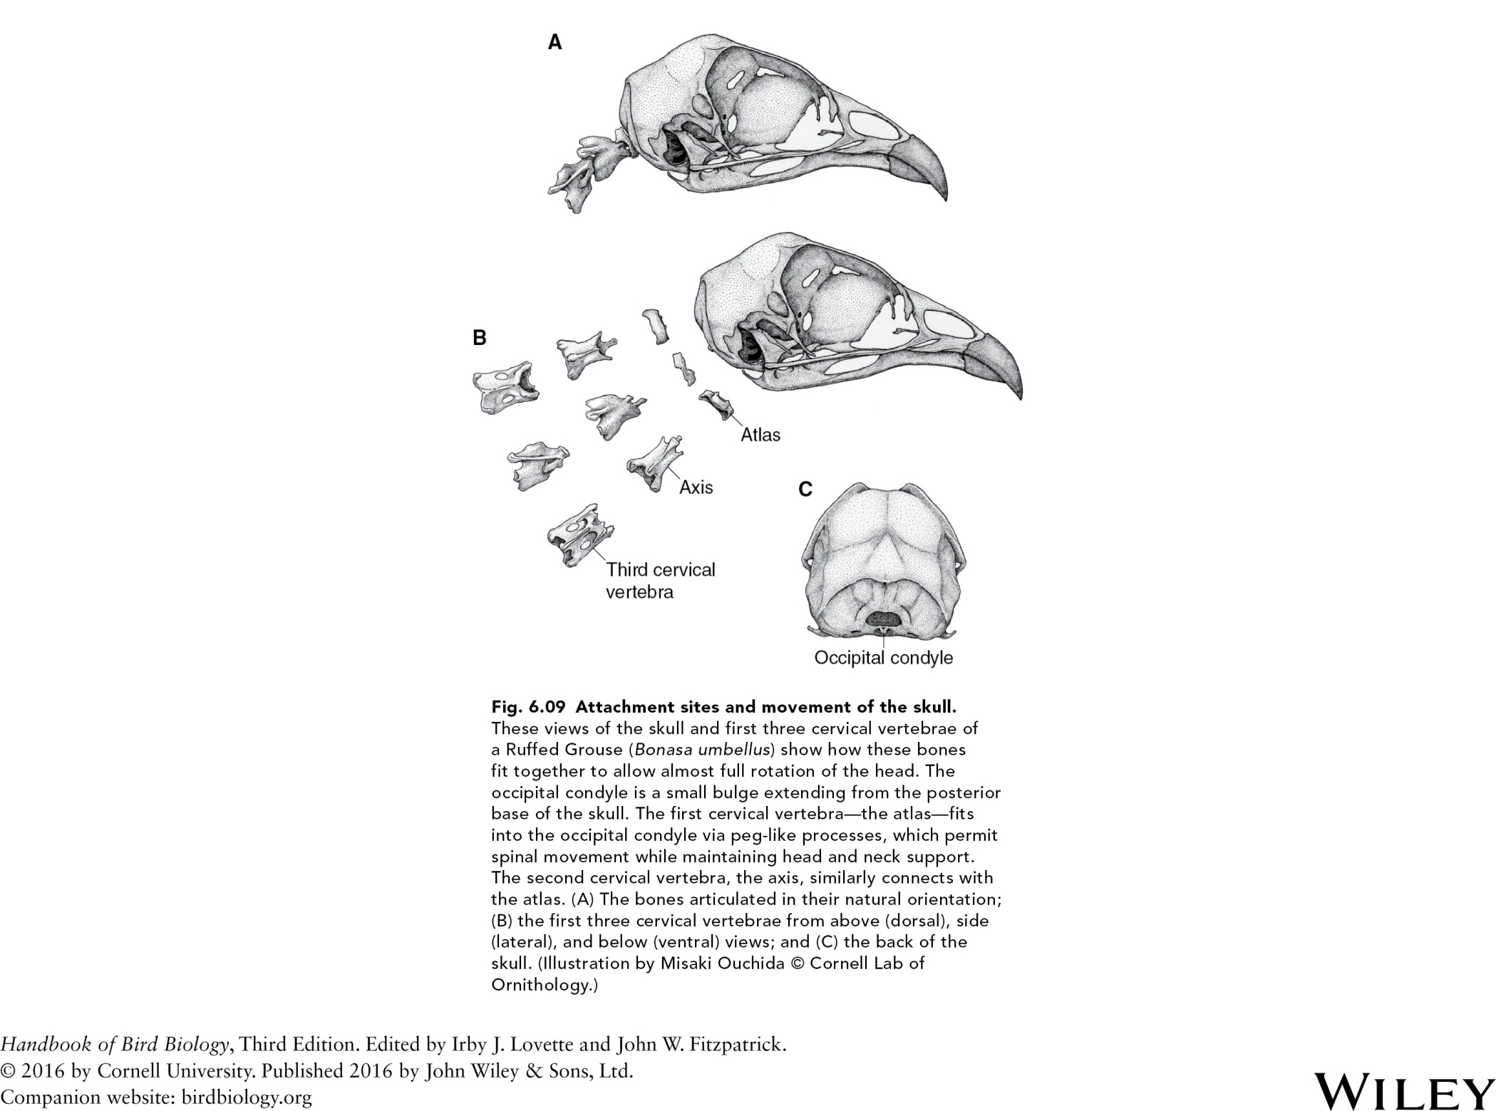

Slide 13
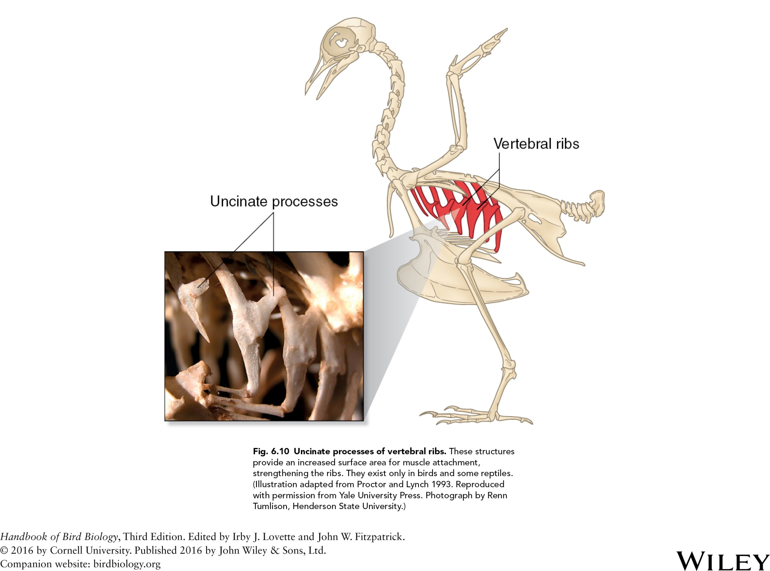

Slide 14
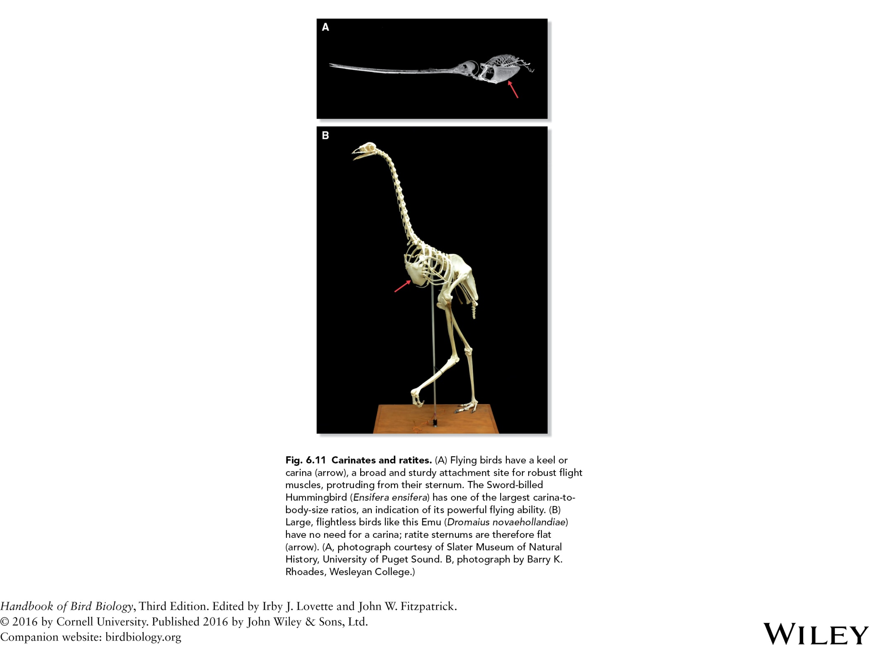

Slide 15
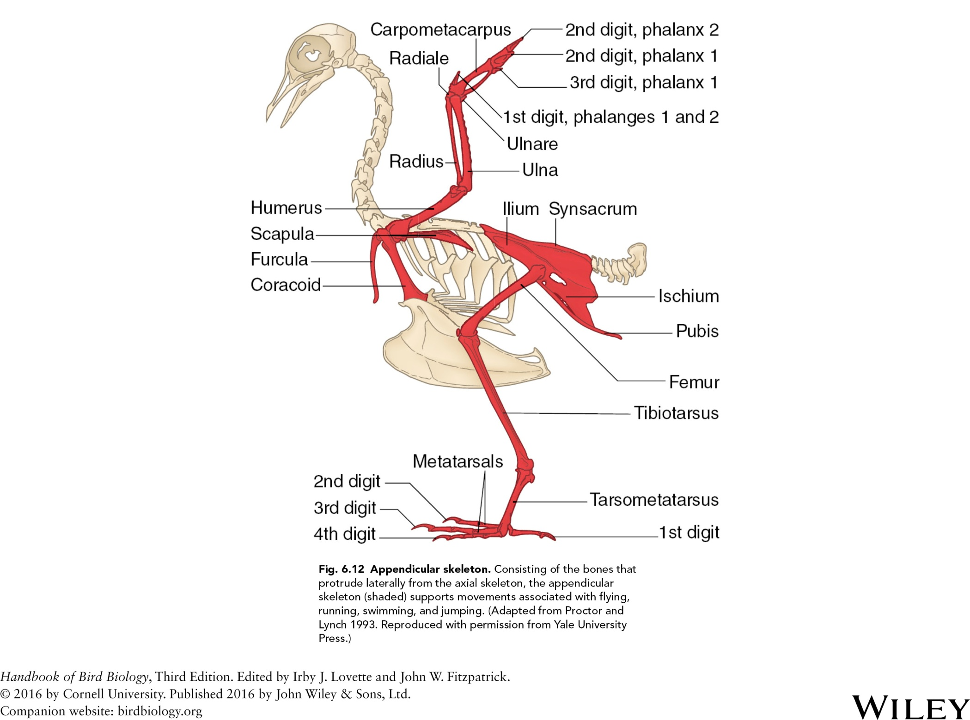

Slide 16
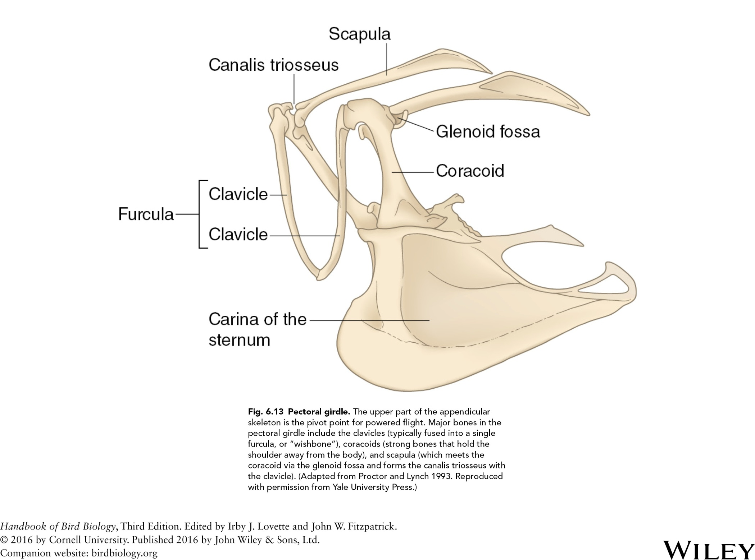

Slide 17
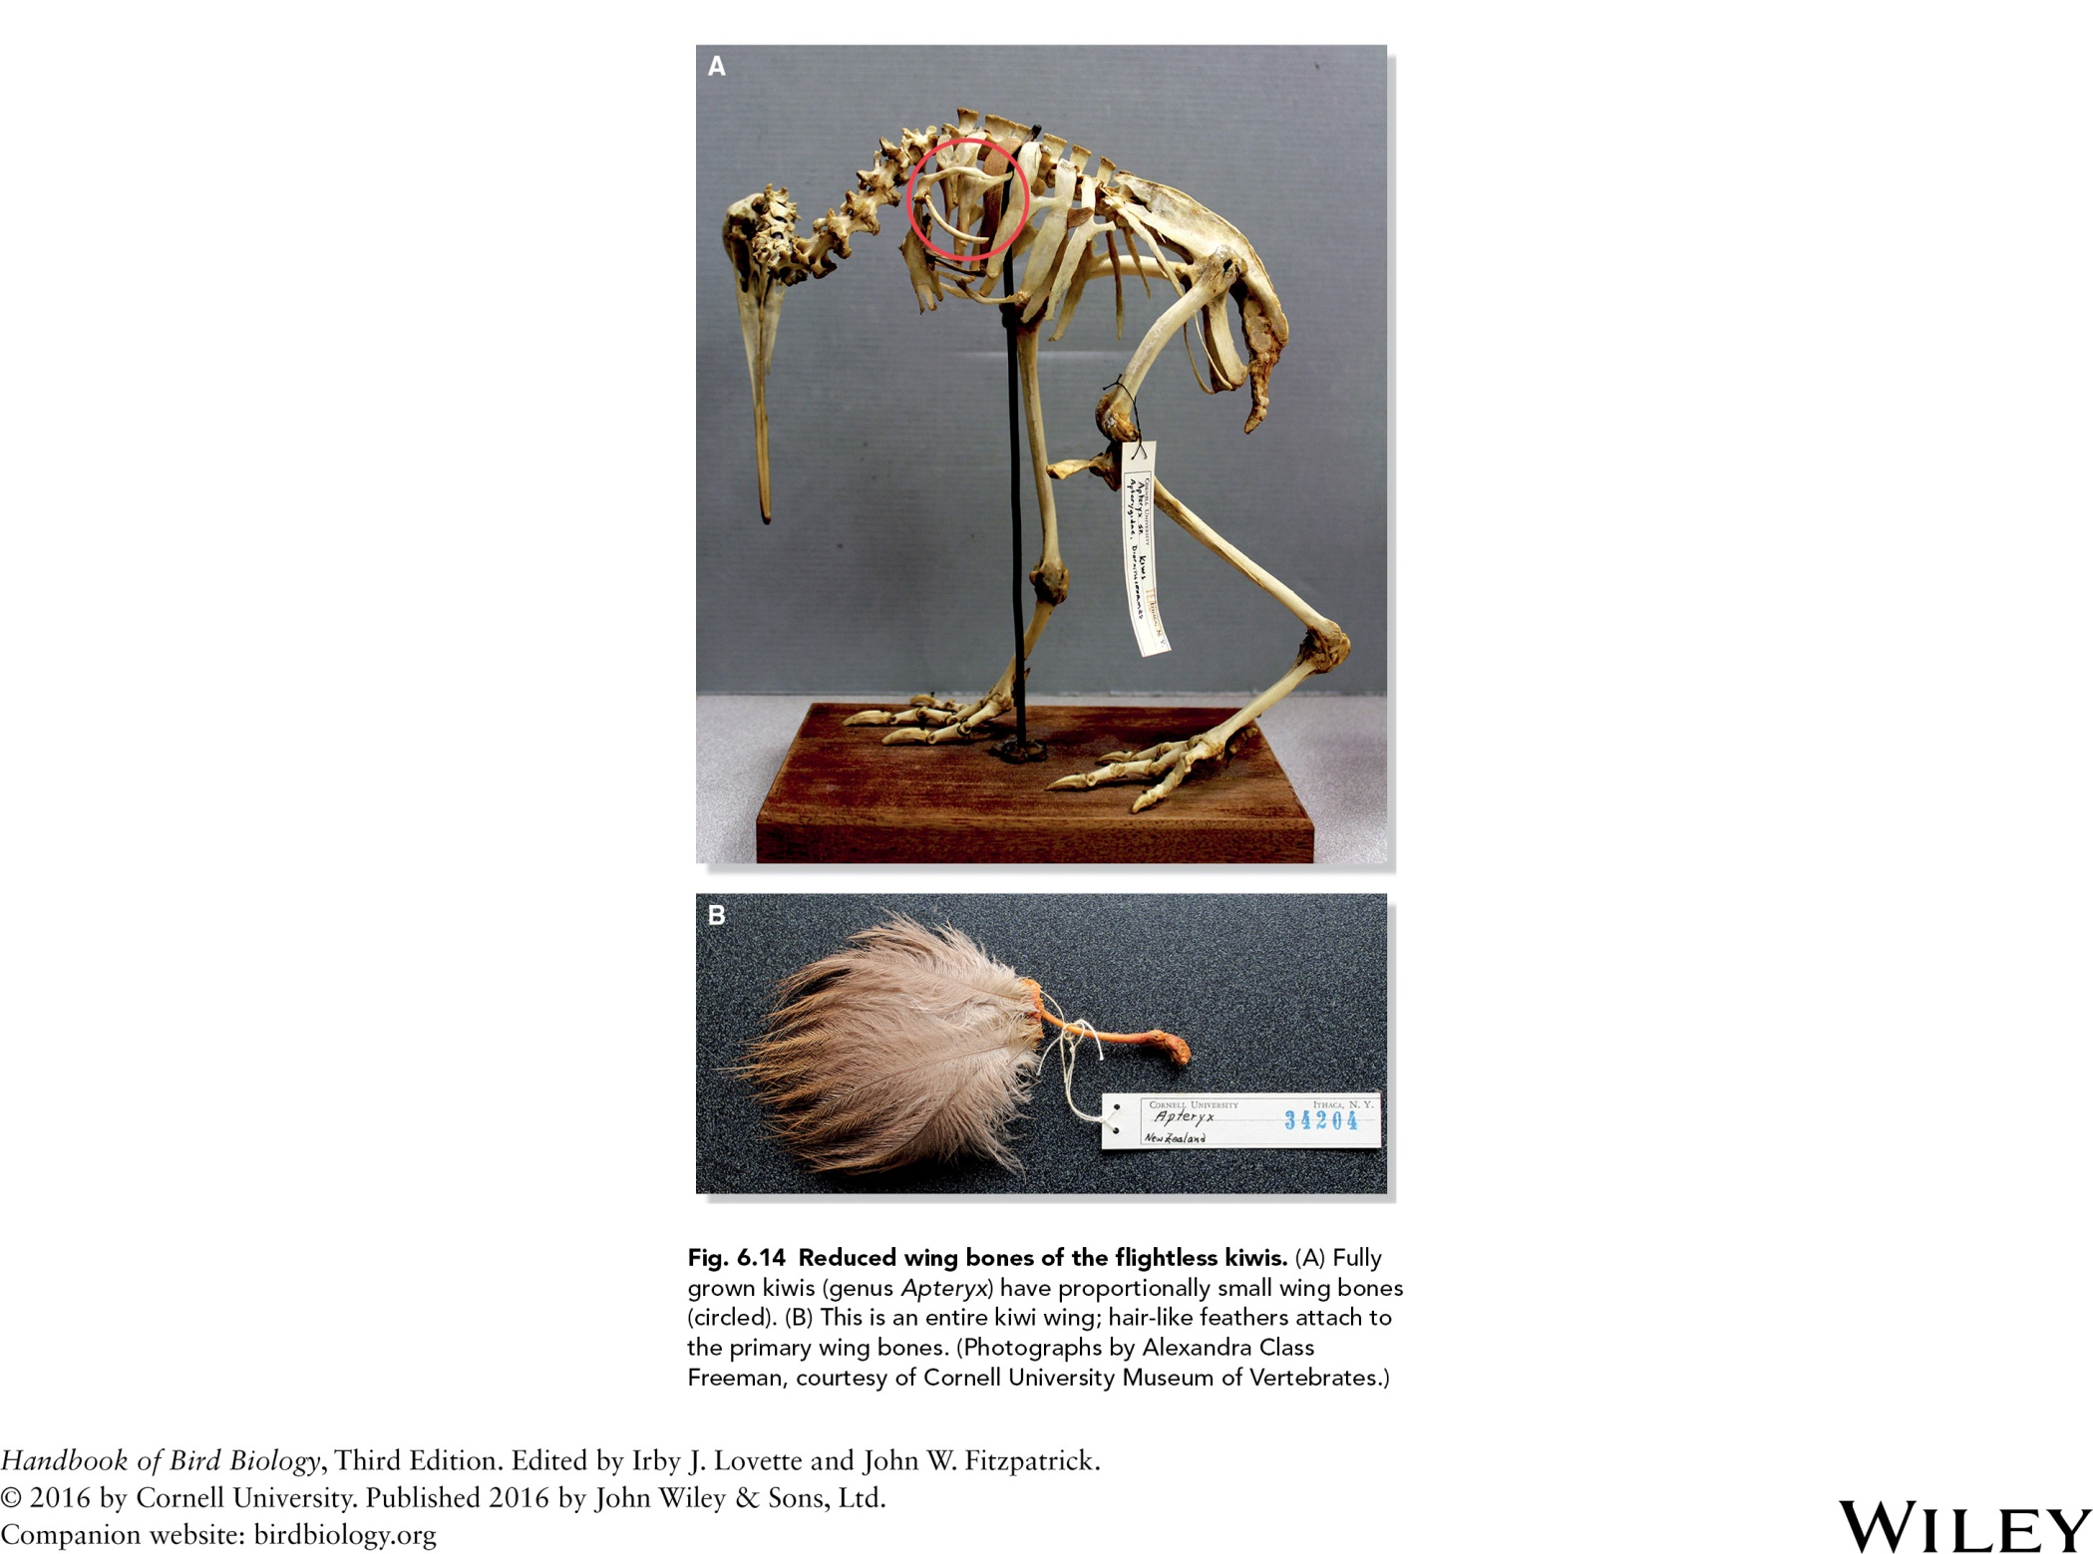

Slide 18
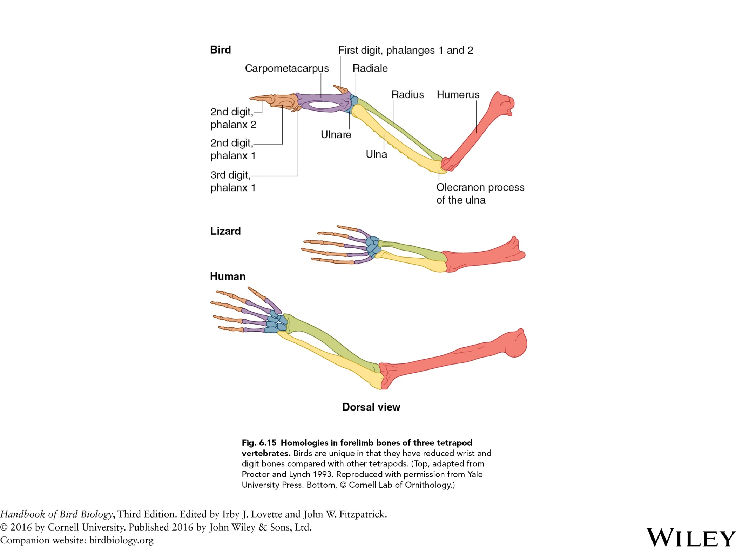

Slide 19
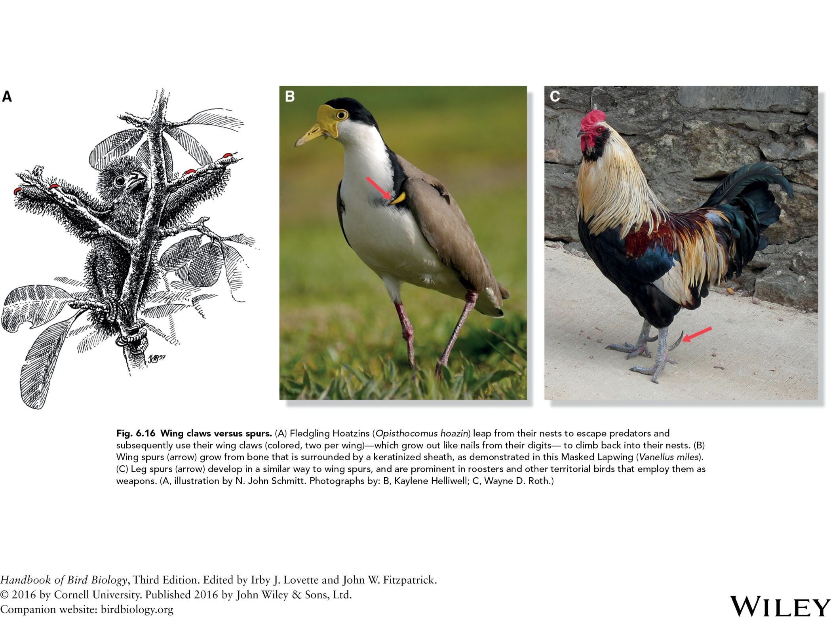

Slide 20
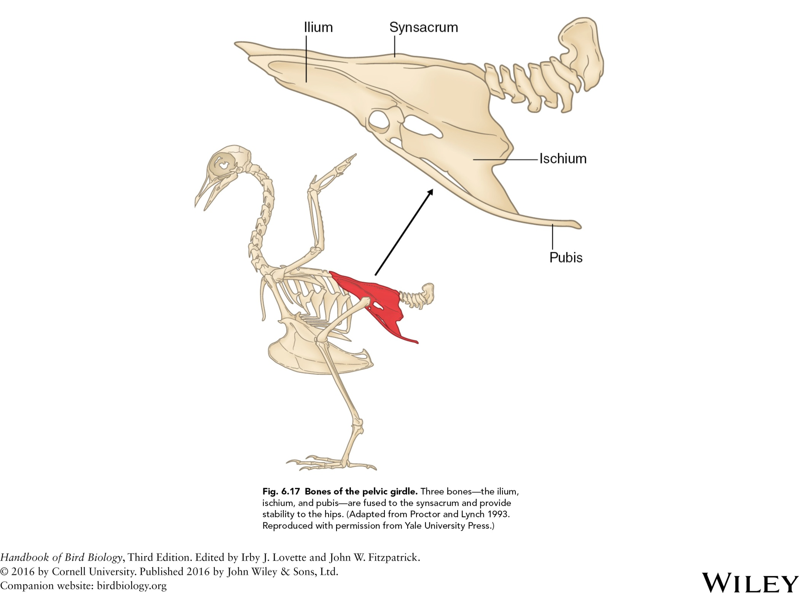

Slide 21
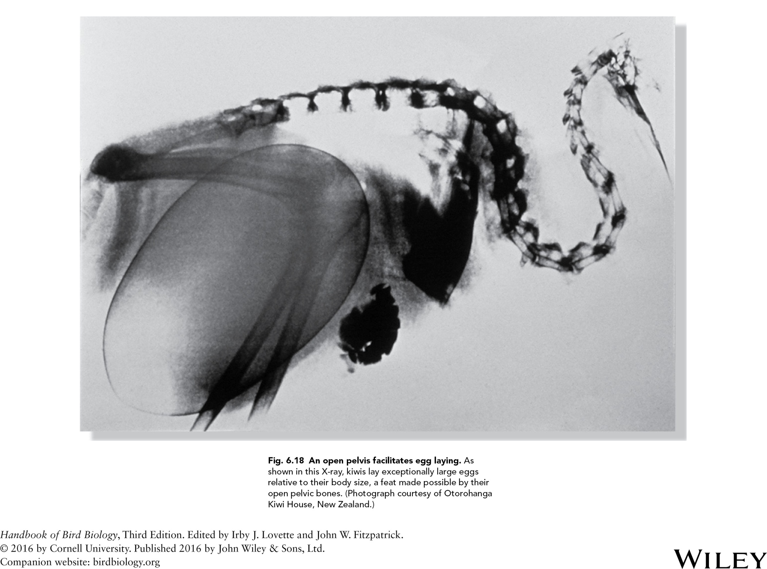

Slide 22
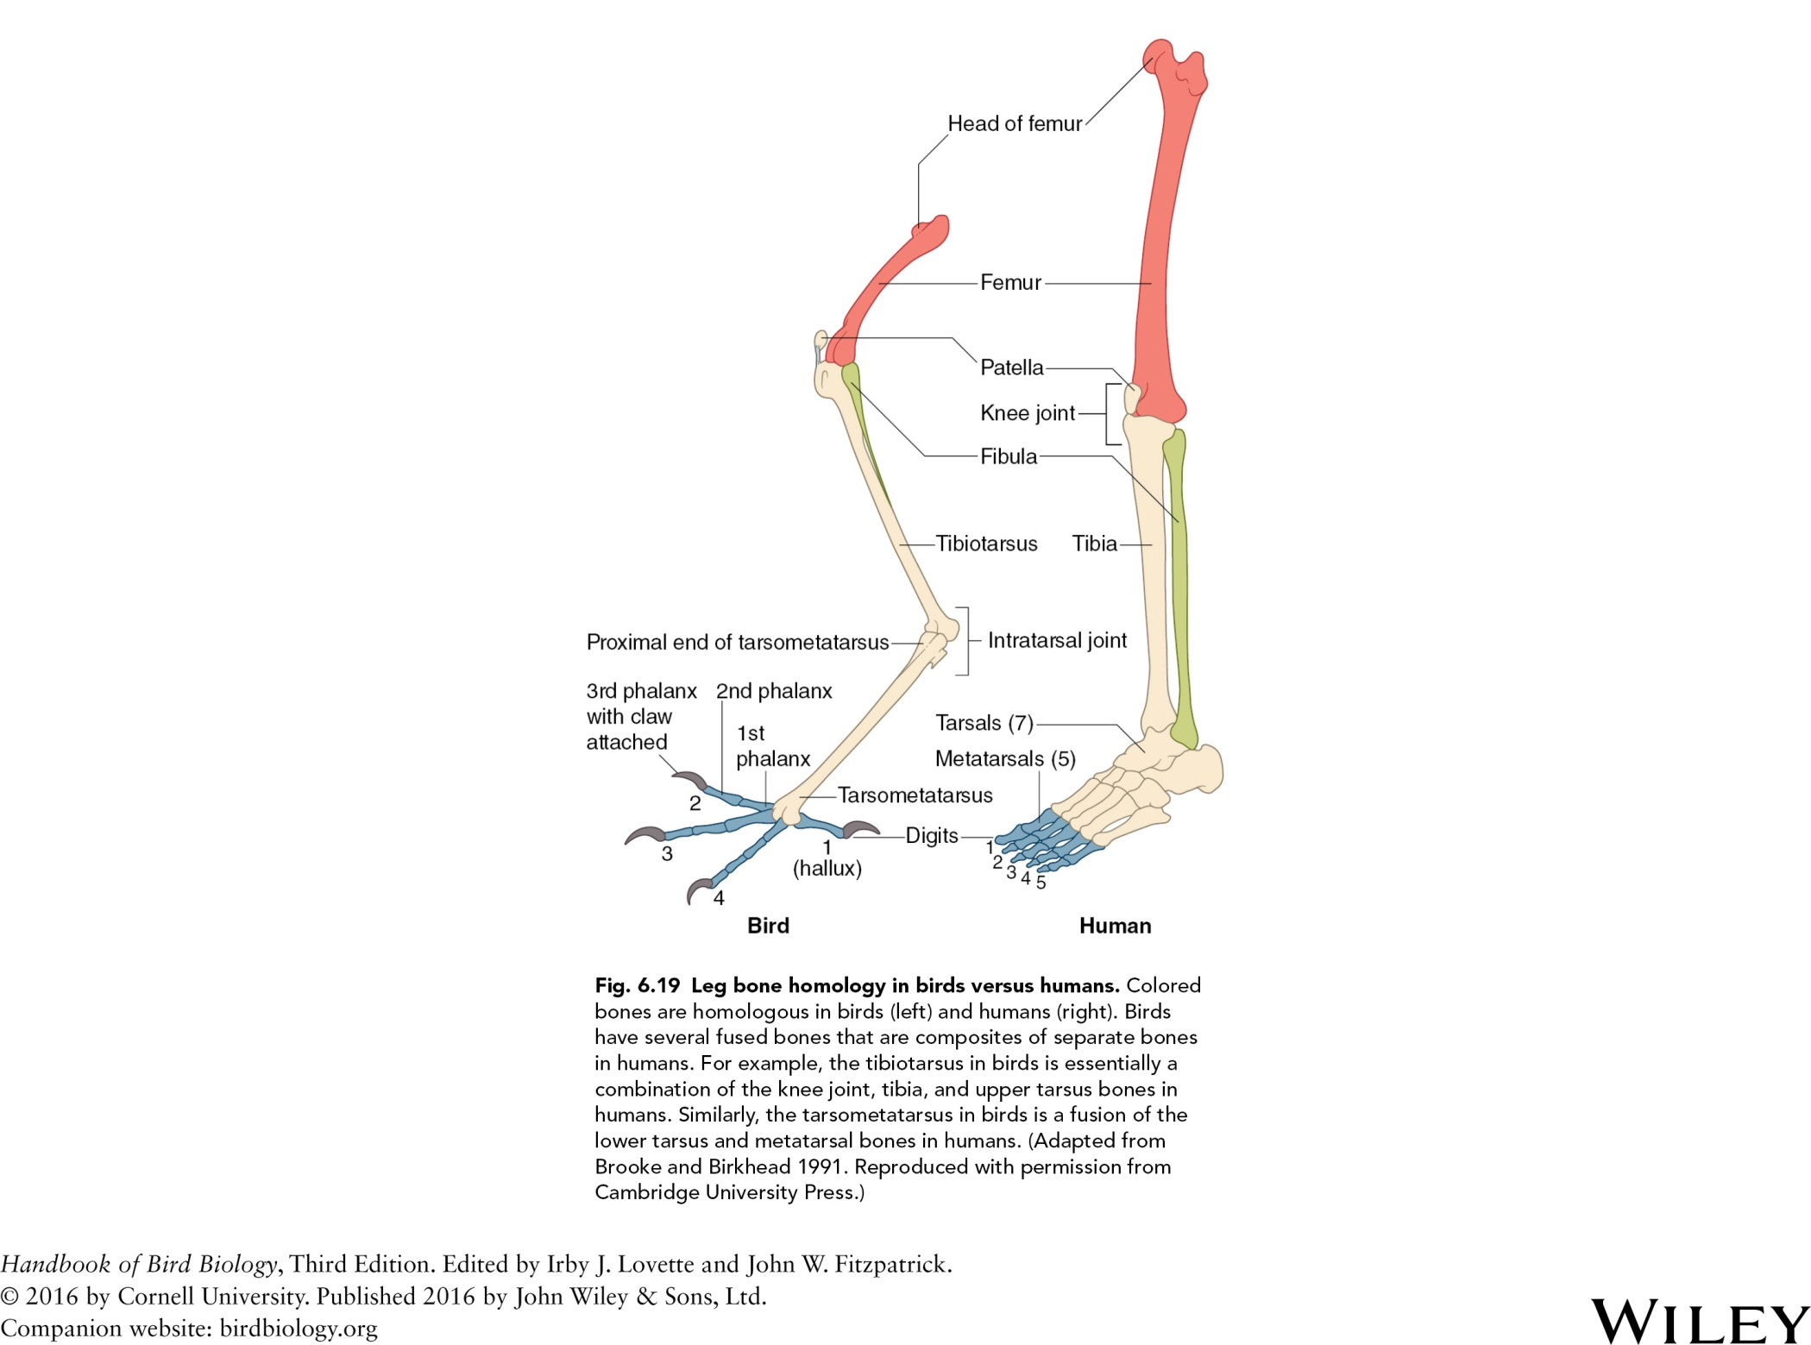

Slide 23
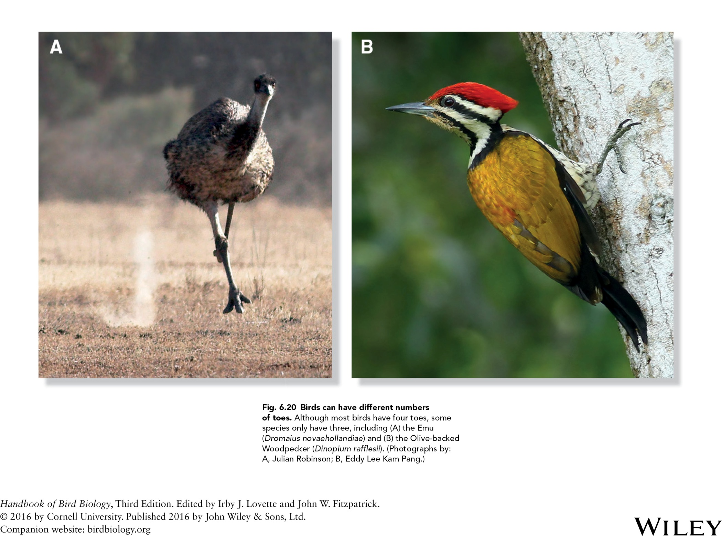

Slide 24
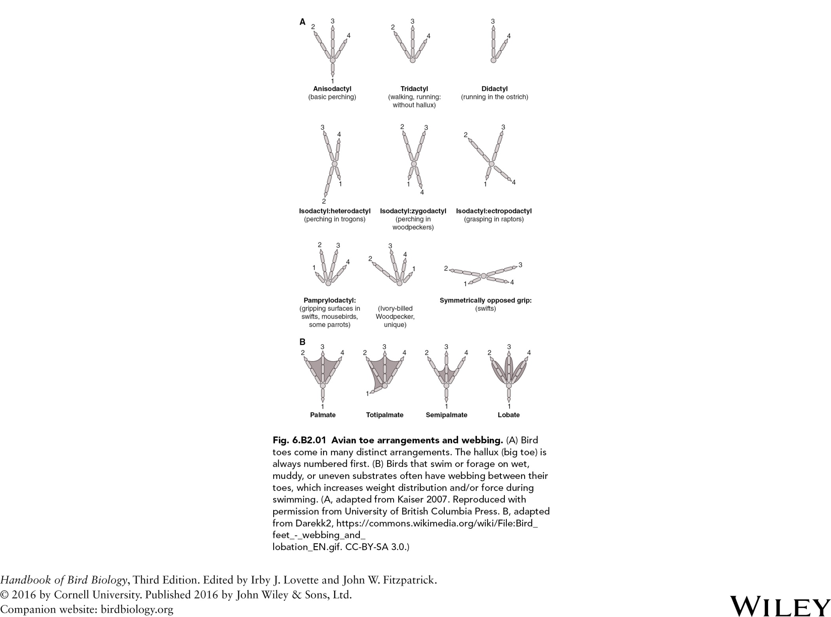

Slide 25
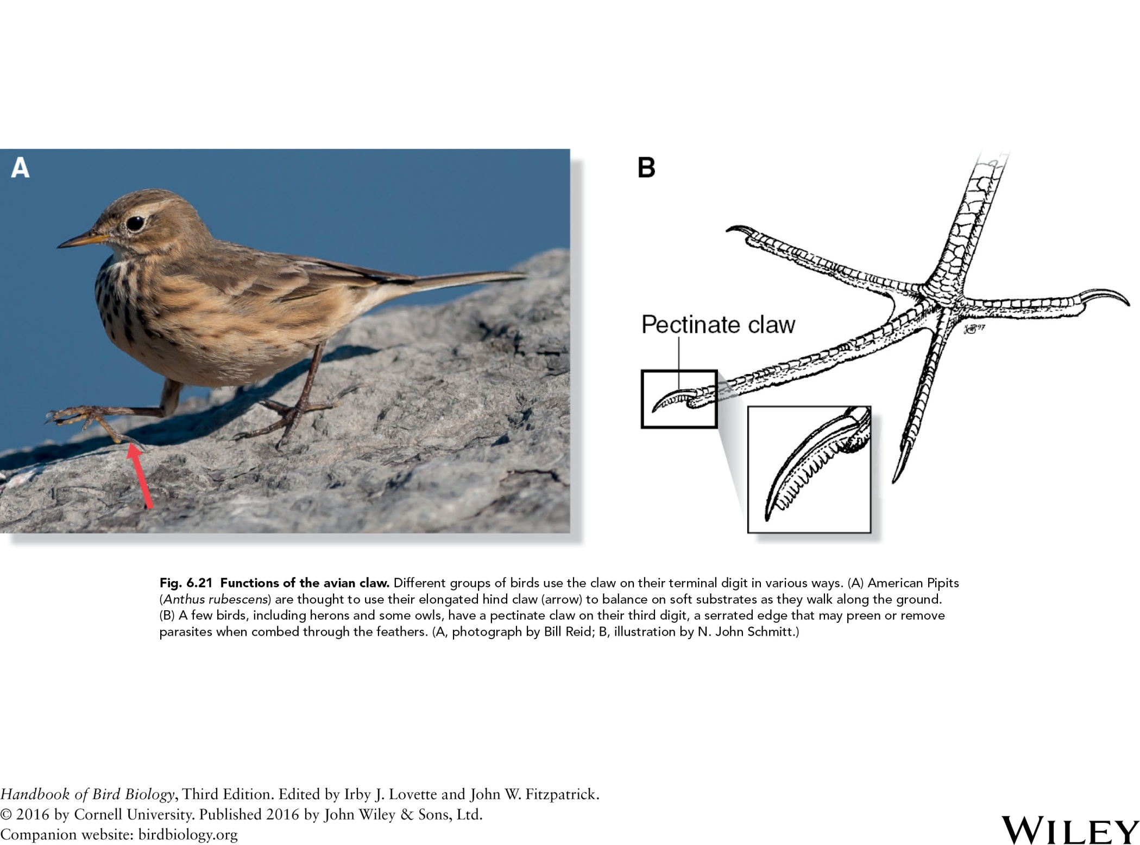

Slide 26
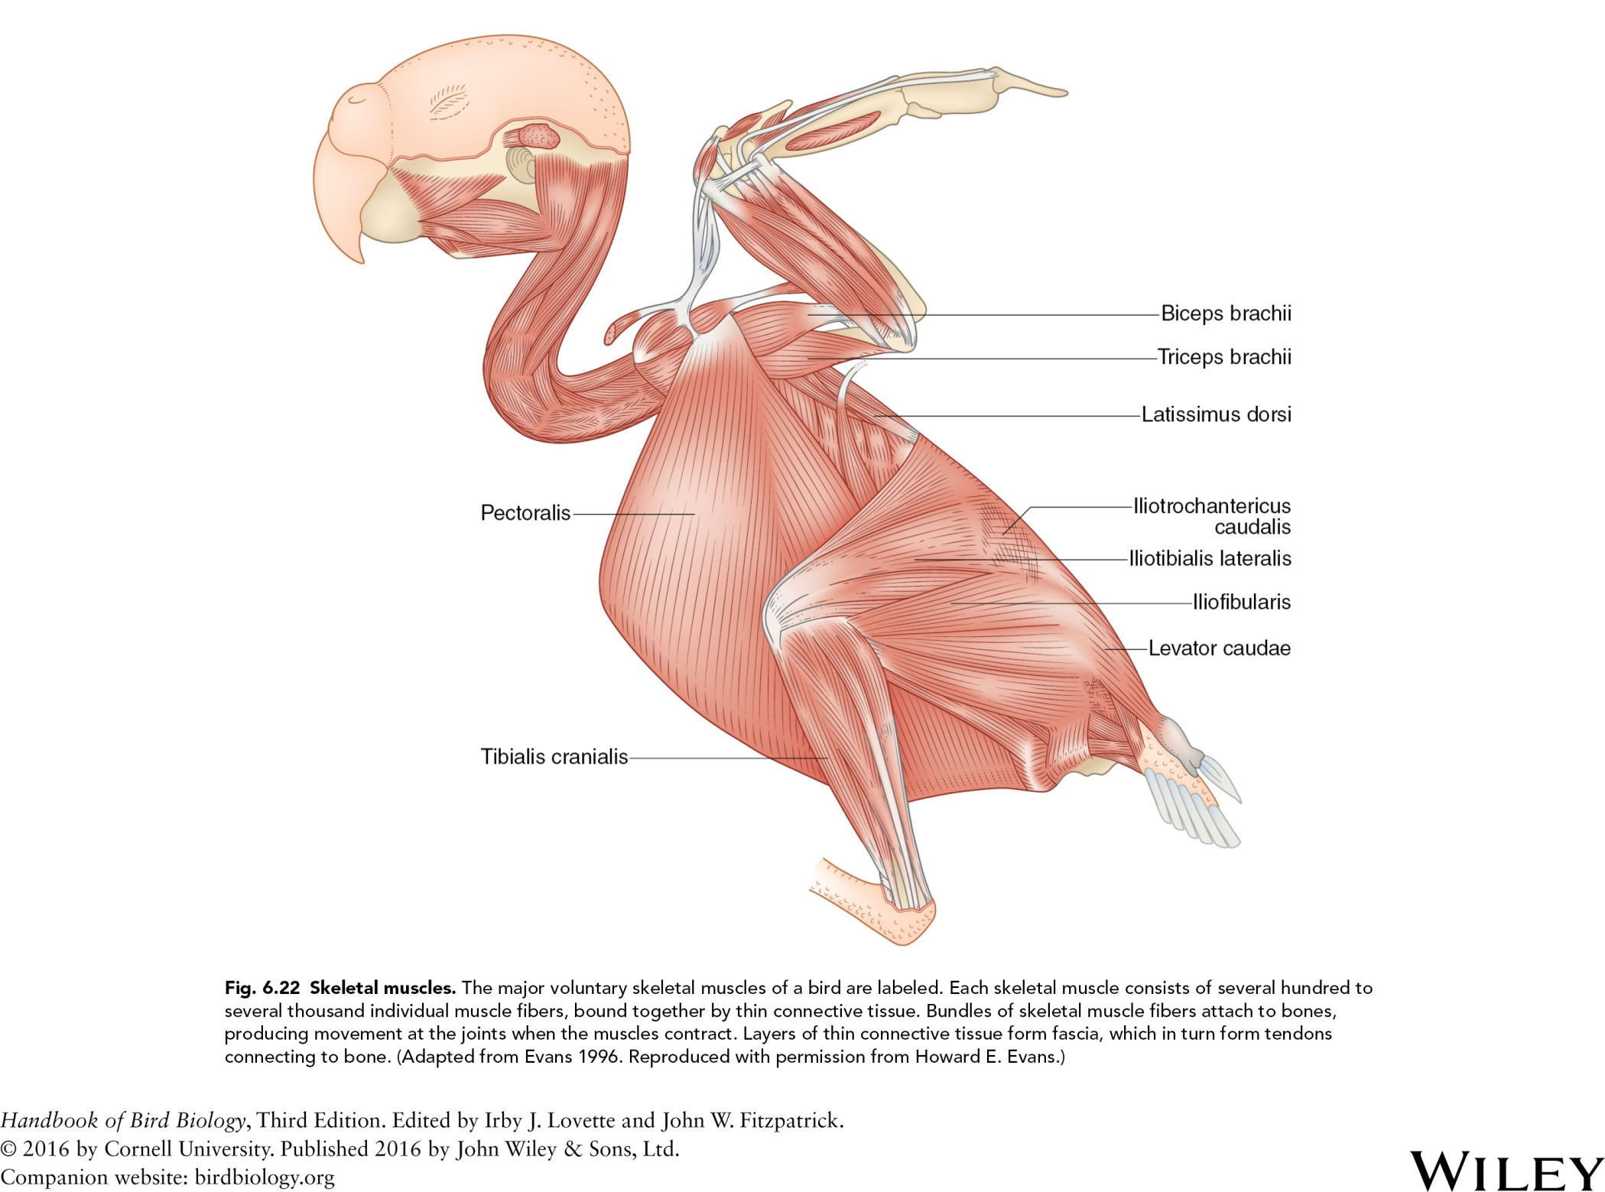

Slide 27
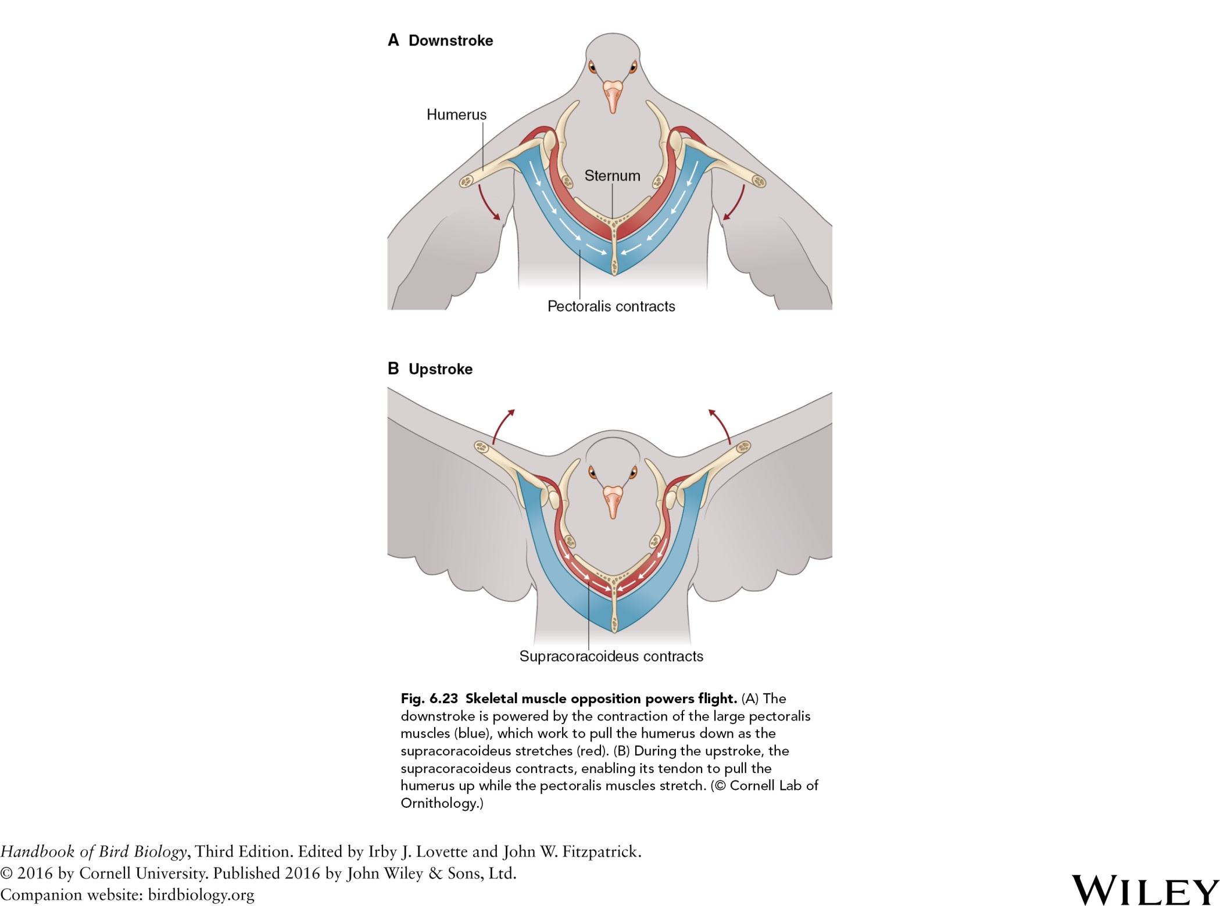

Slide 28
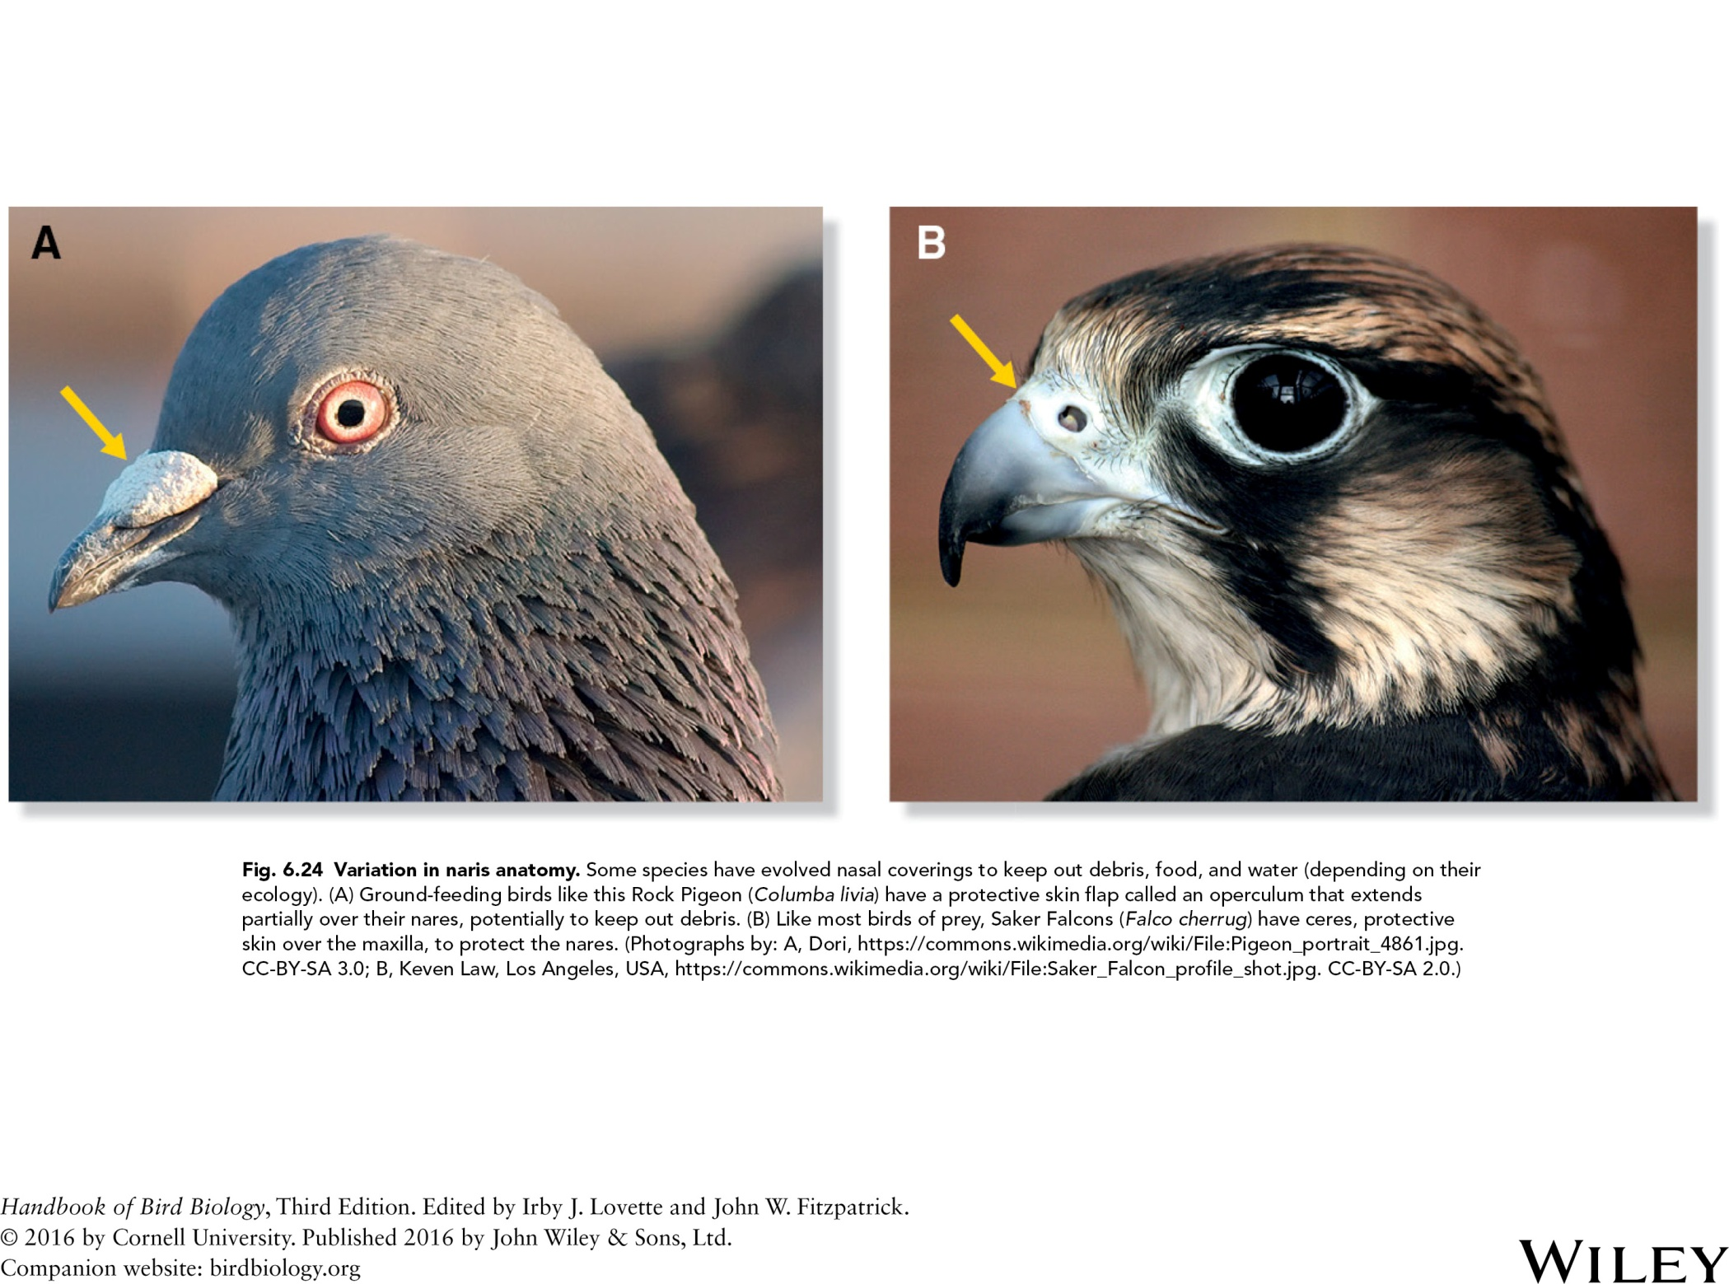

Slide 29
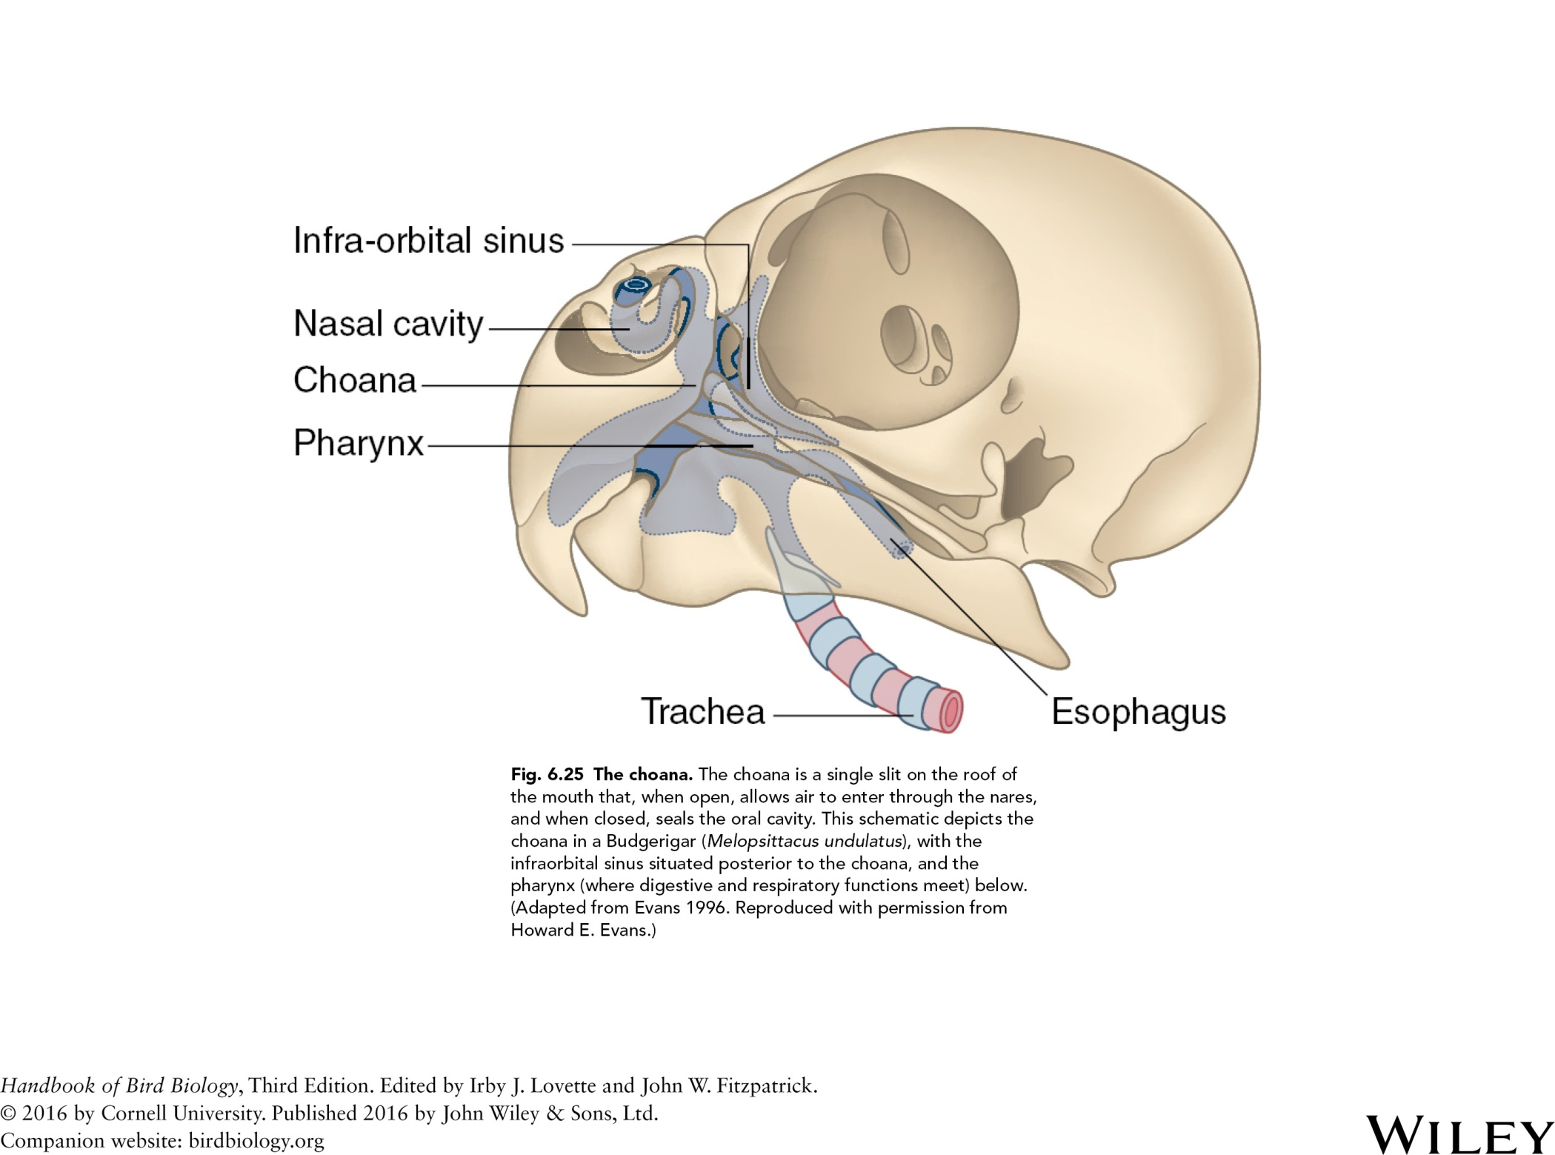

Slide 30
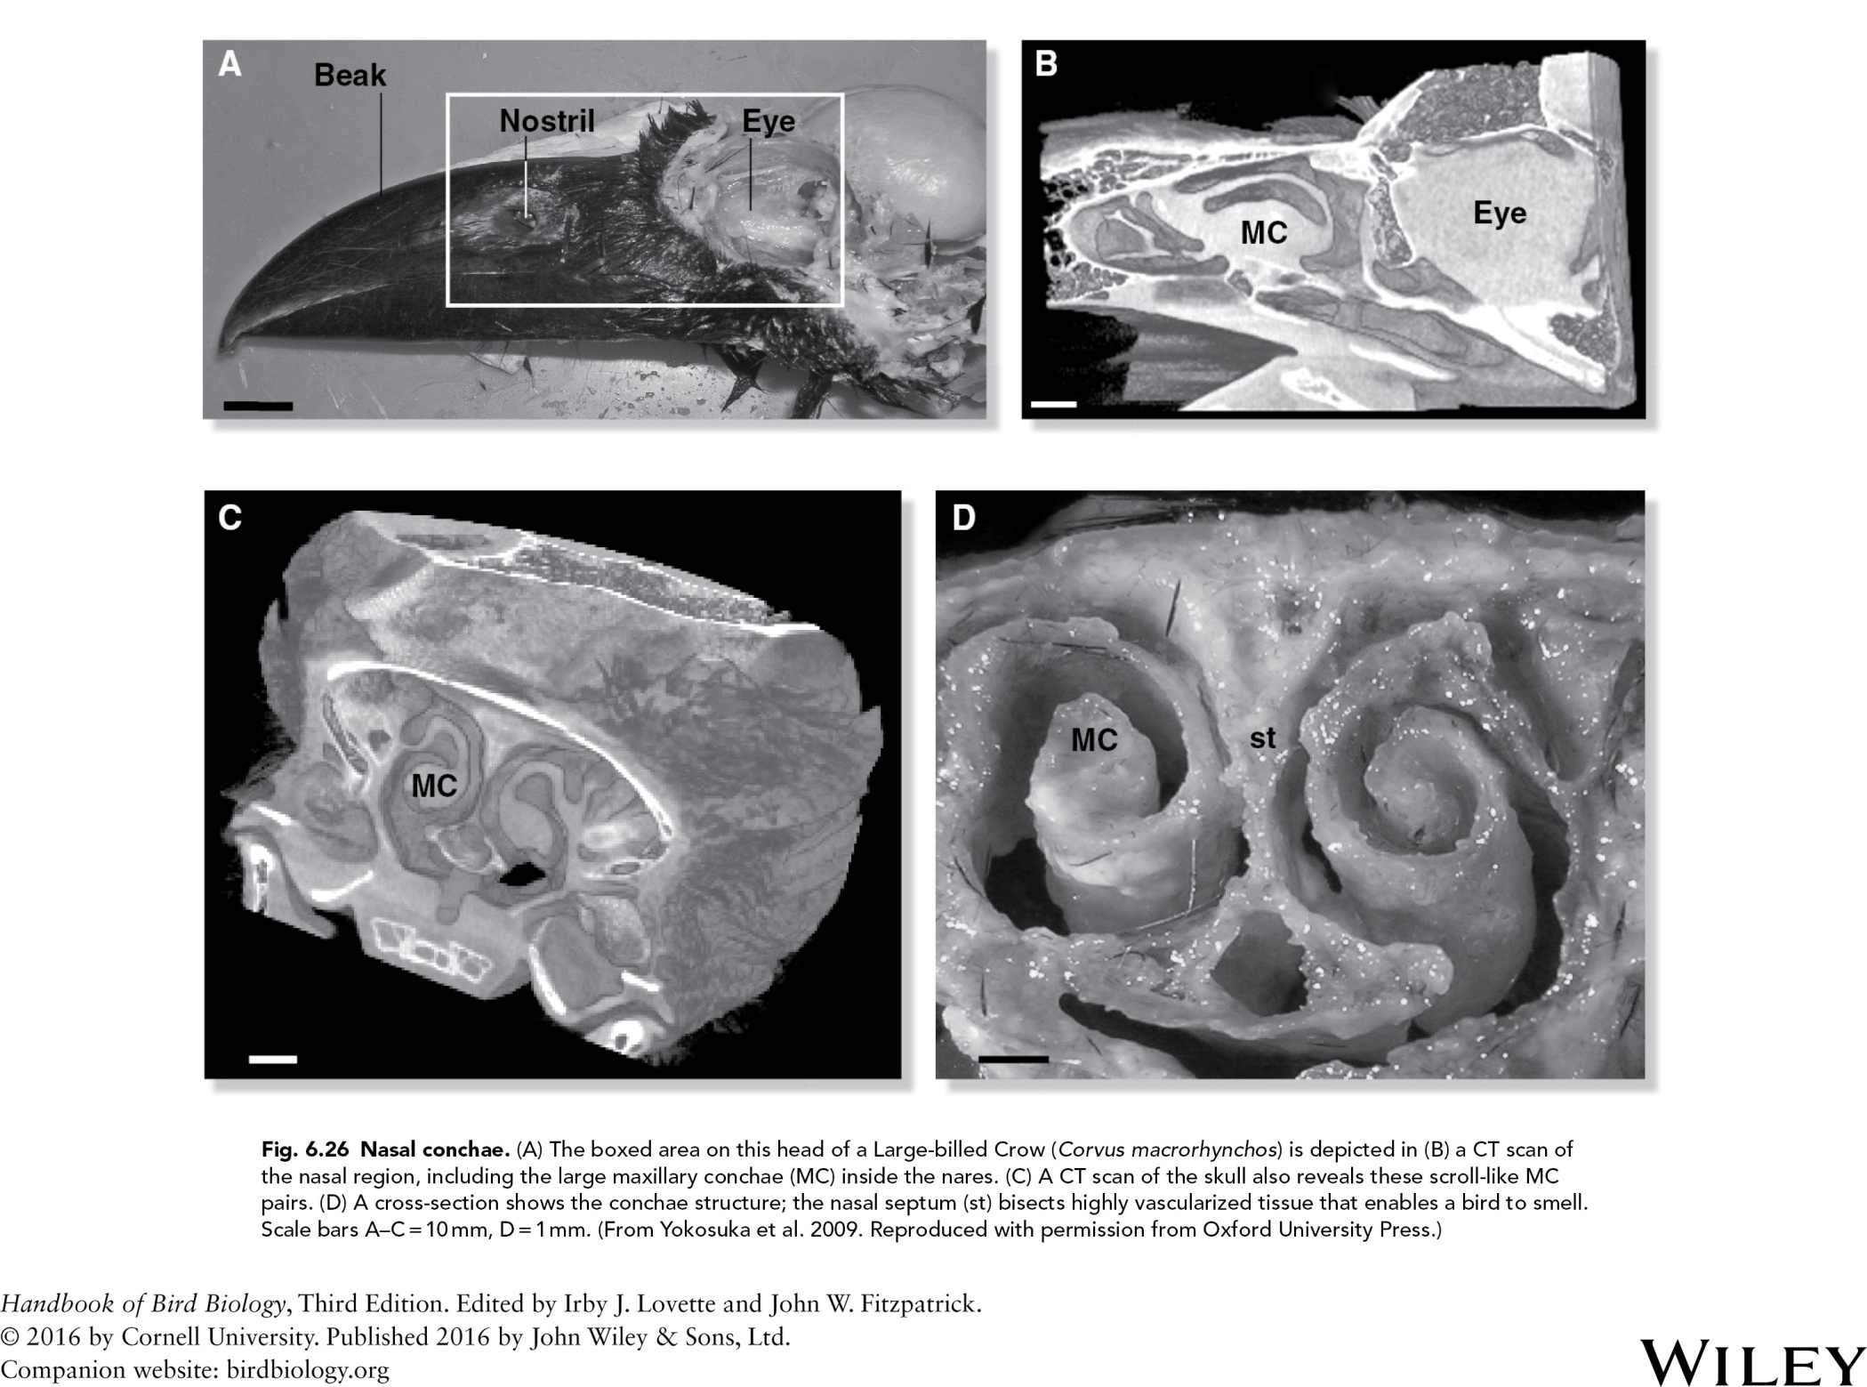

Slide 31
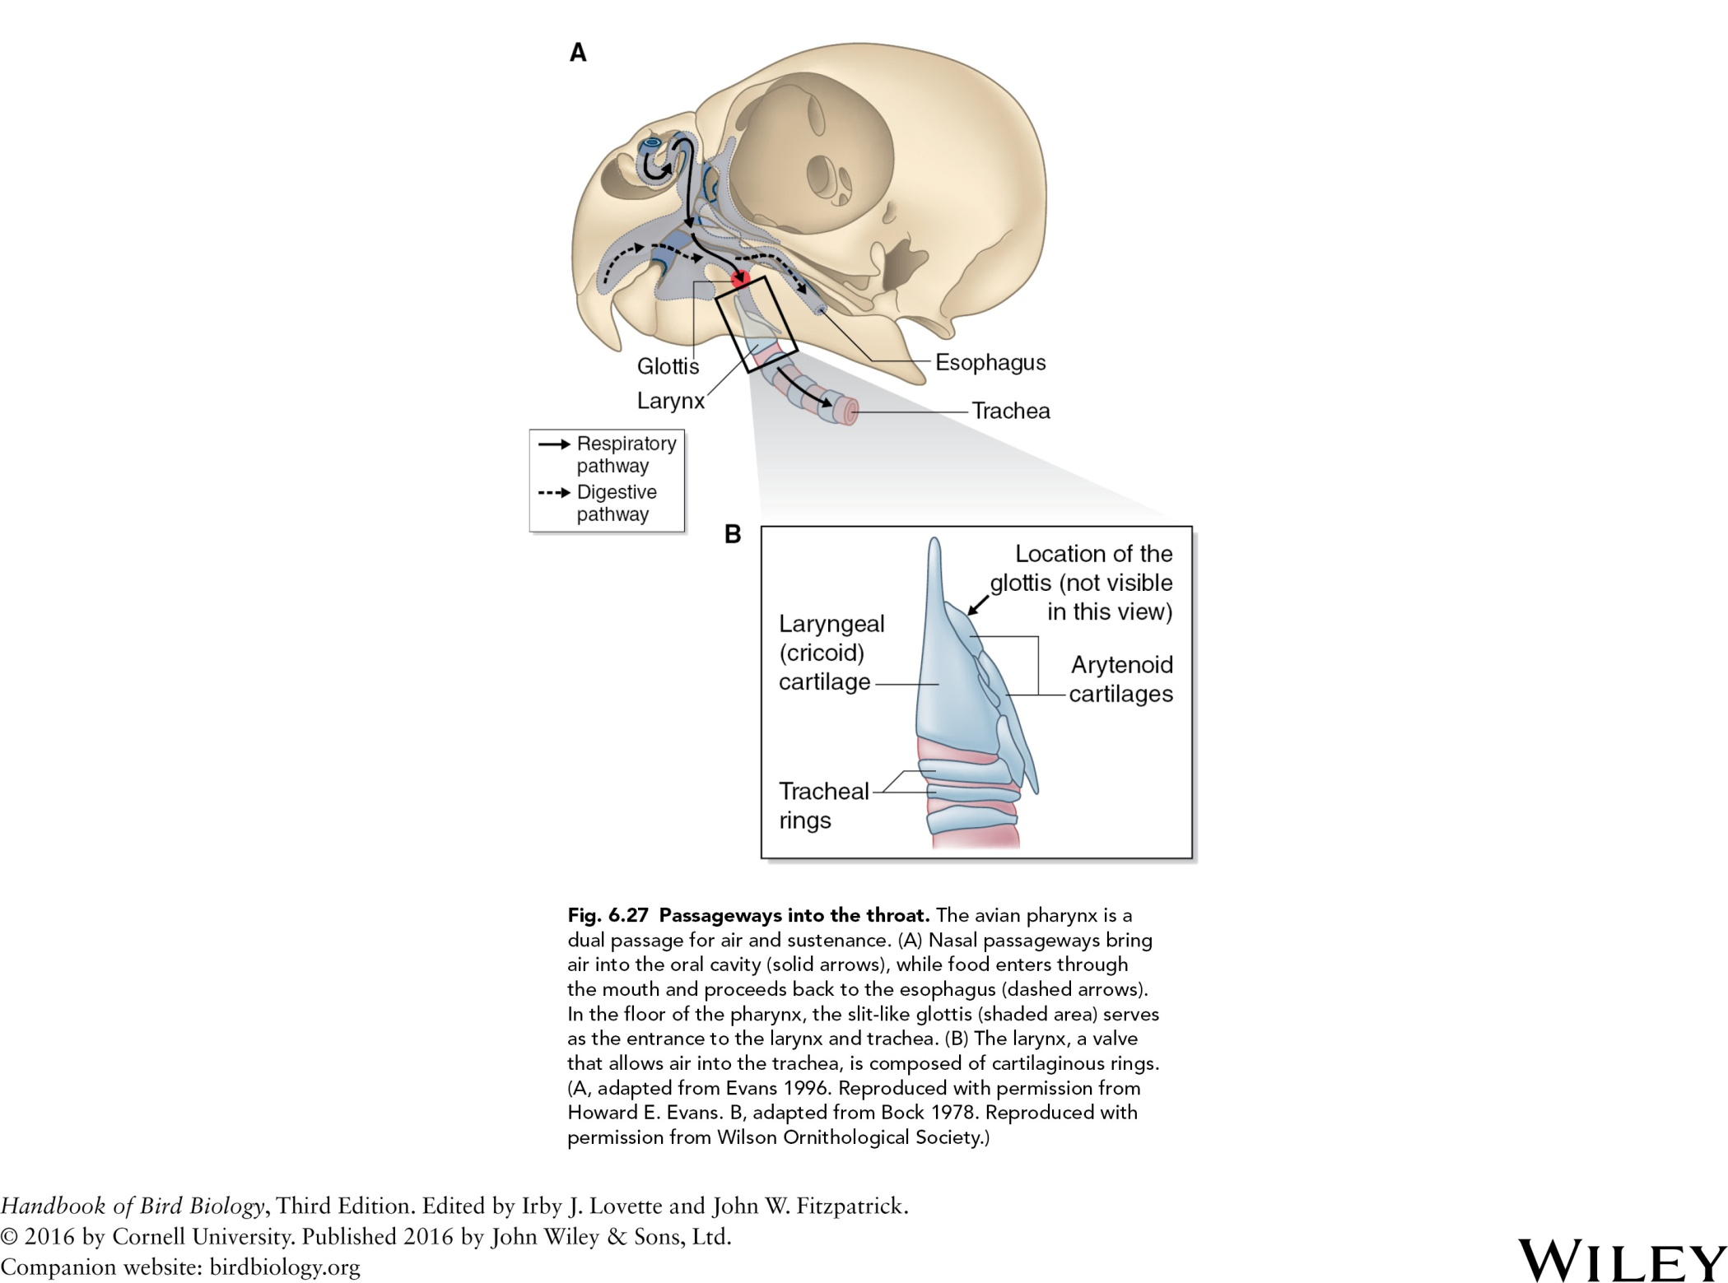

Slide 32
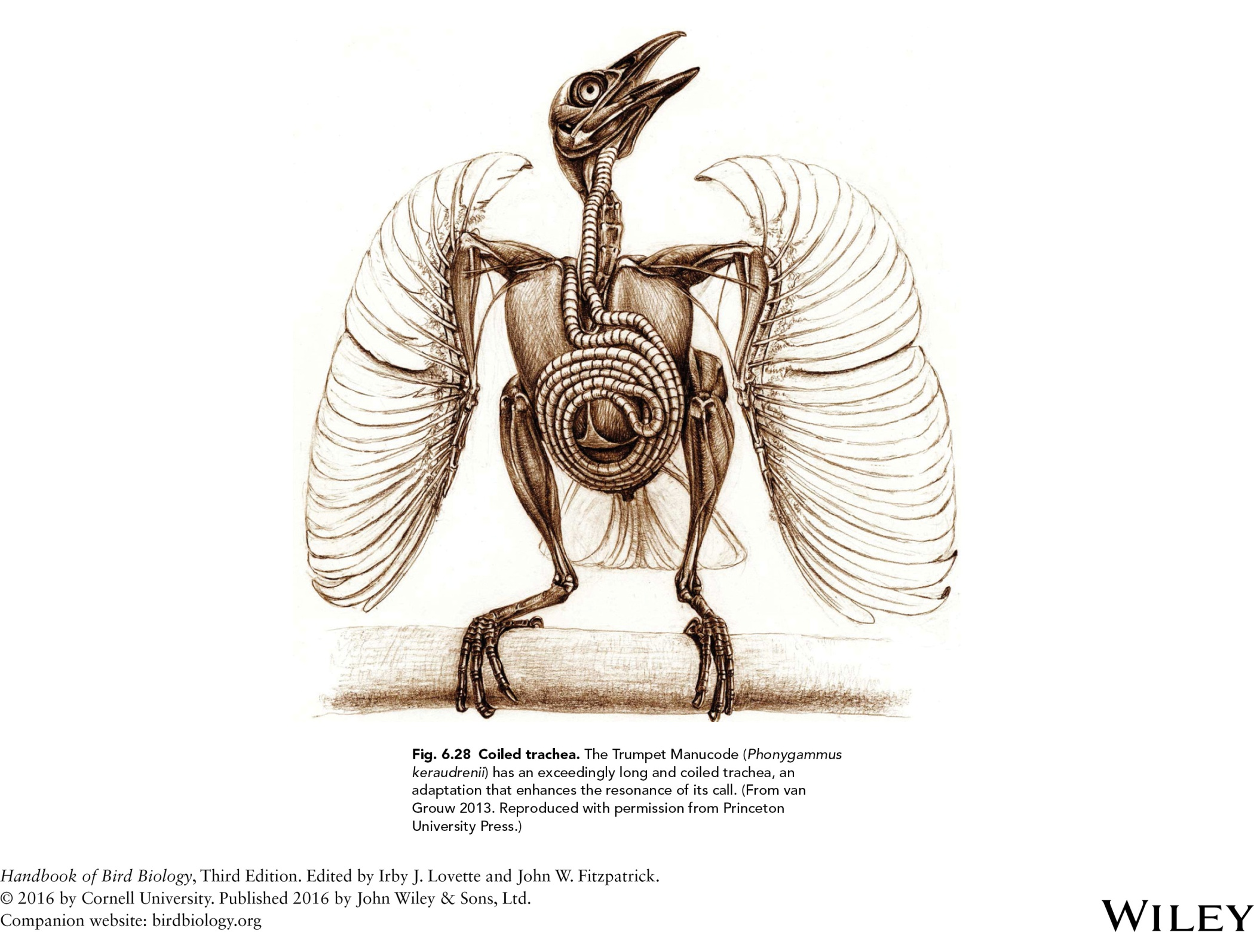

Slide 33
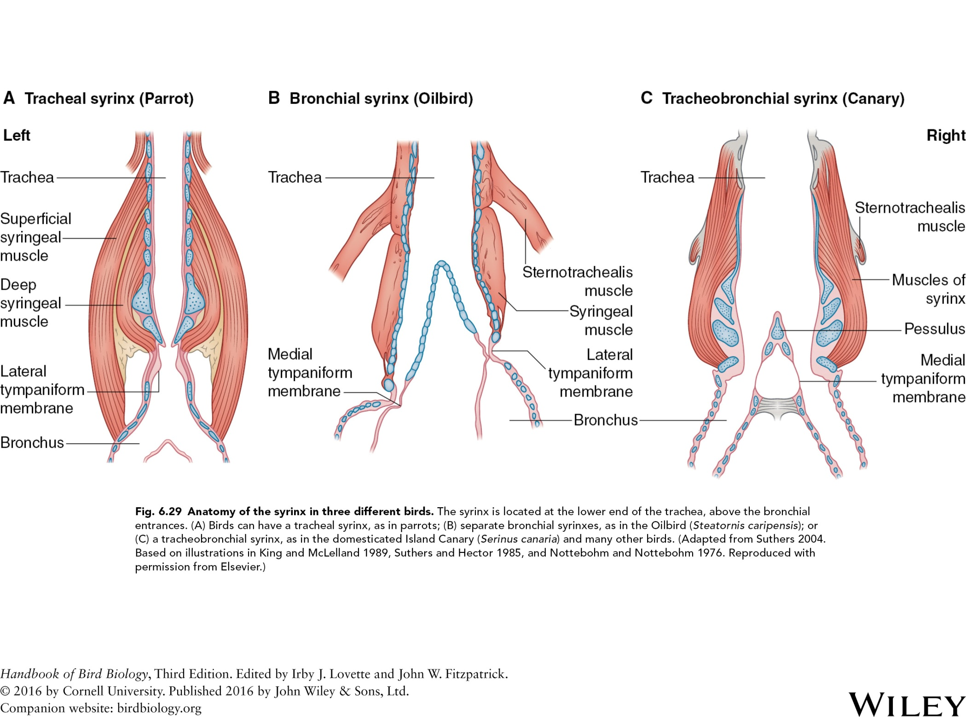

Slide 34
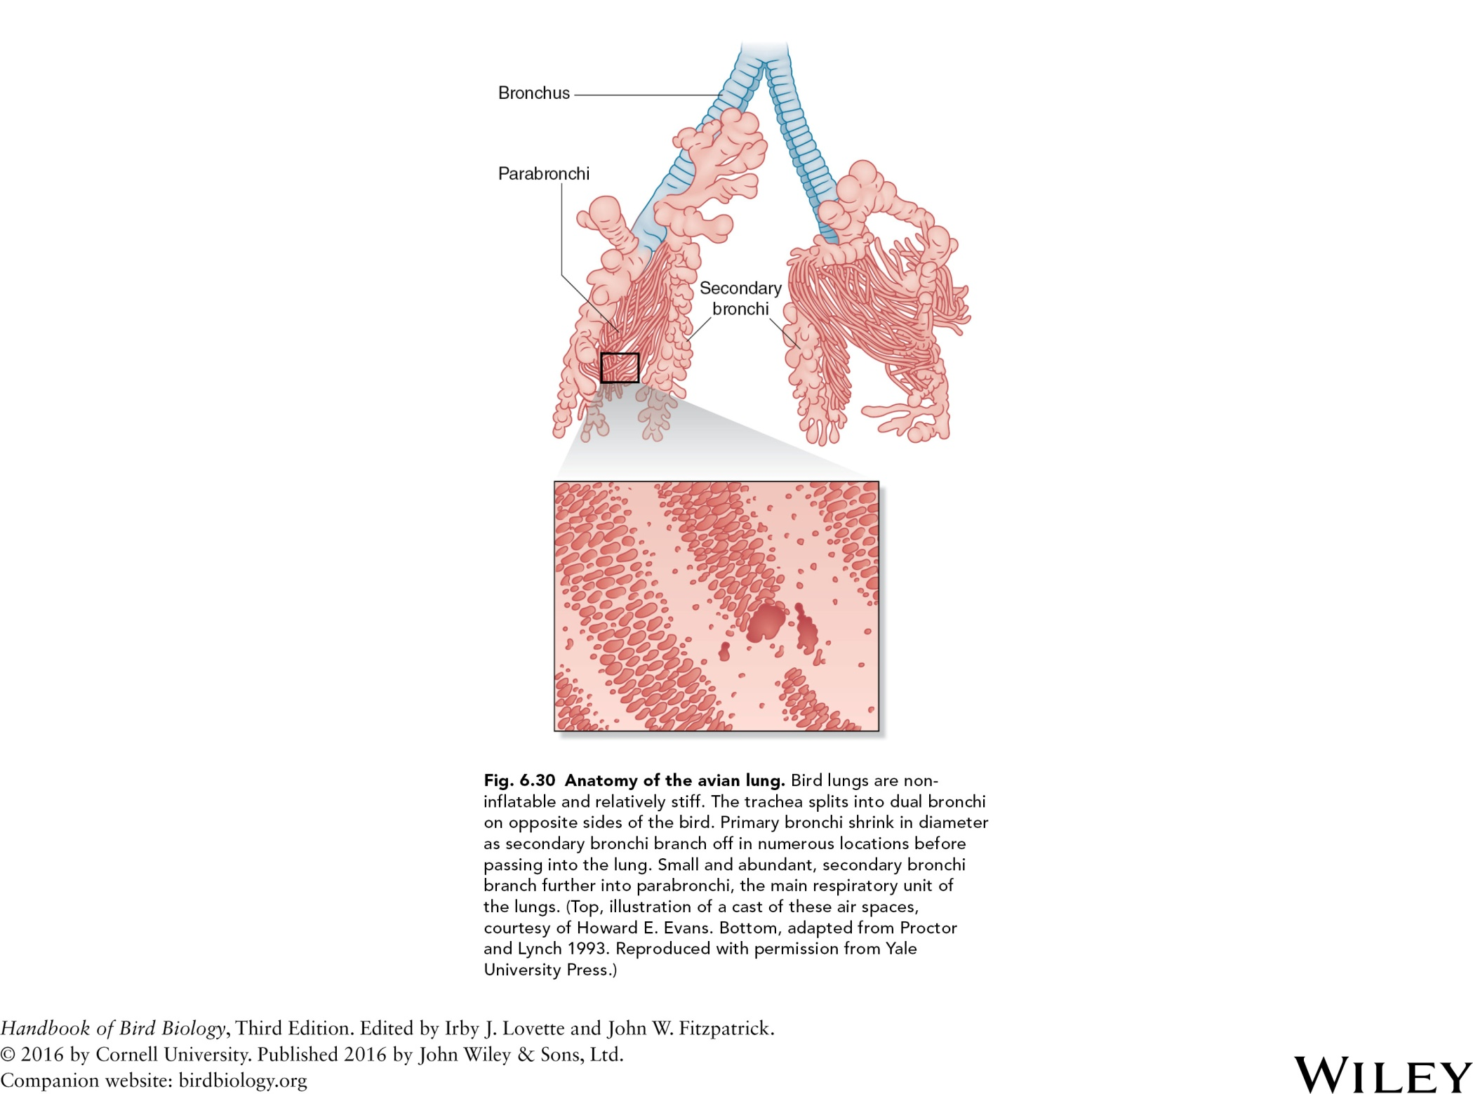

Slide 35
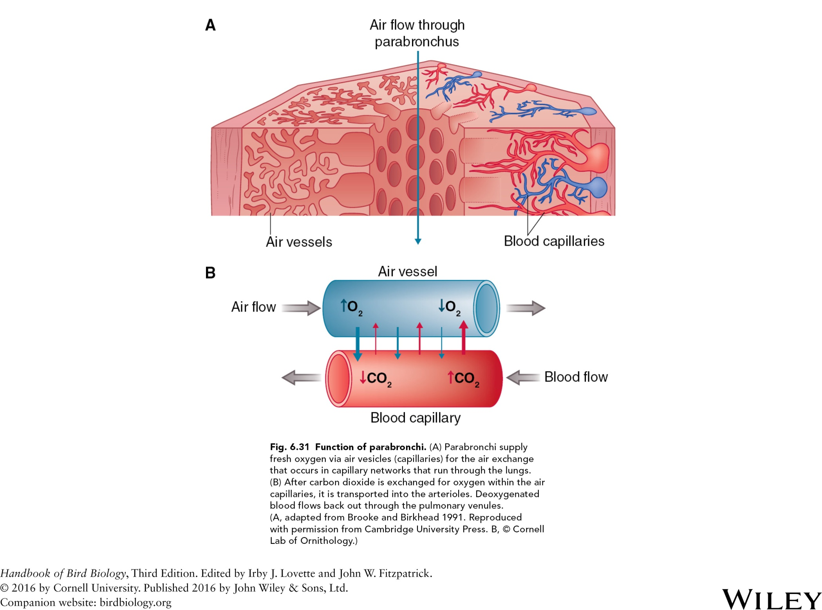
Fig. 6.31 Function of parabronchi. (A) Parabronchi supply
fresh oxygen via air vesicles (capillaries) for the air exchange
that occurs in capillary networks that run through the lungs.
(B) After carbon dioxide is exchanged for oxygen within the air
capillaries, it is transported into the arterioles. Oxygenated
blood flows back out through the pulmonary venules.
(A, adapted from Brooke and Birkhead 1991. Reproduced
with permission from Cambridge University Press. B, © Cornell
Lab of Ornithology.)

Slide 36
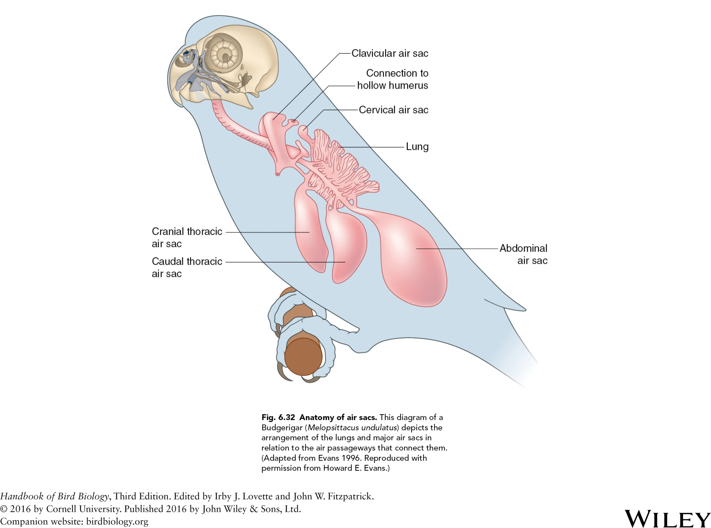

Slide 37
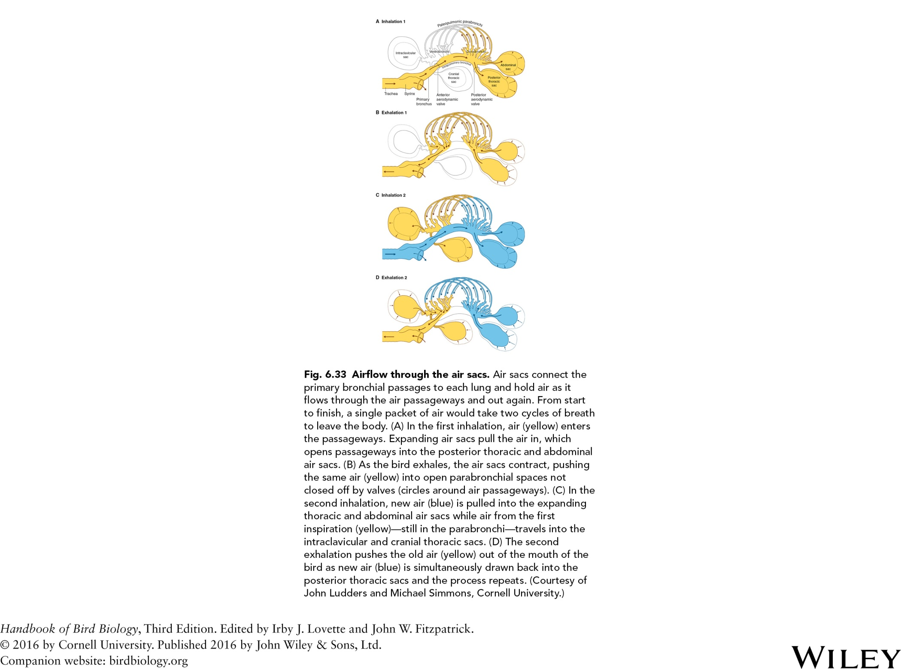

Slide 38
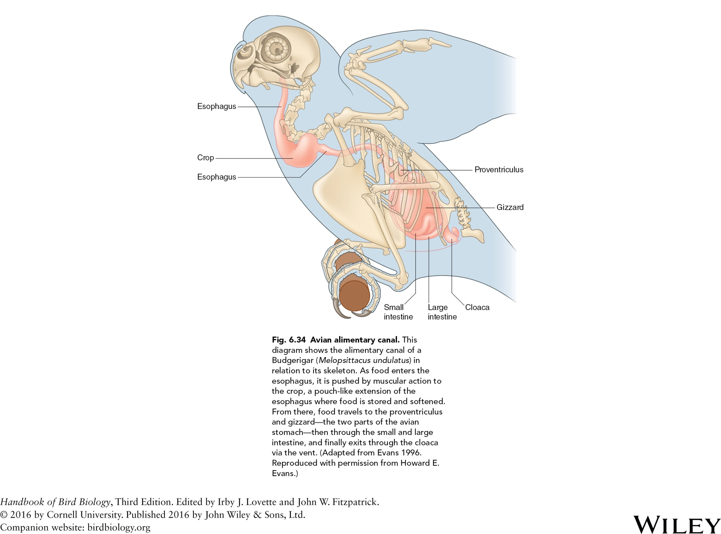

Slide 39
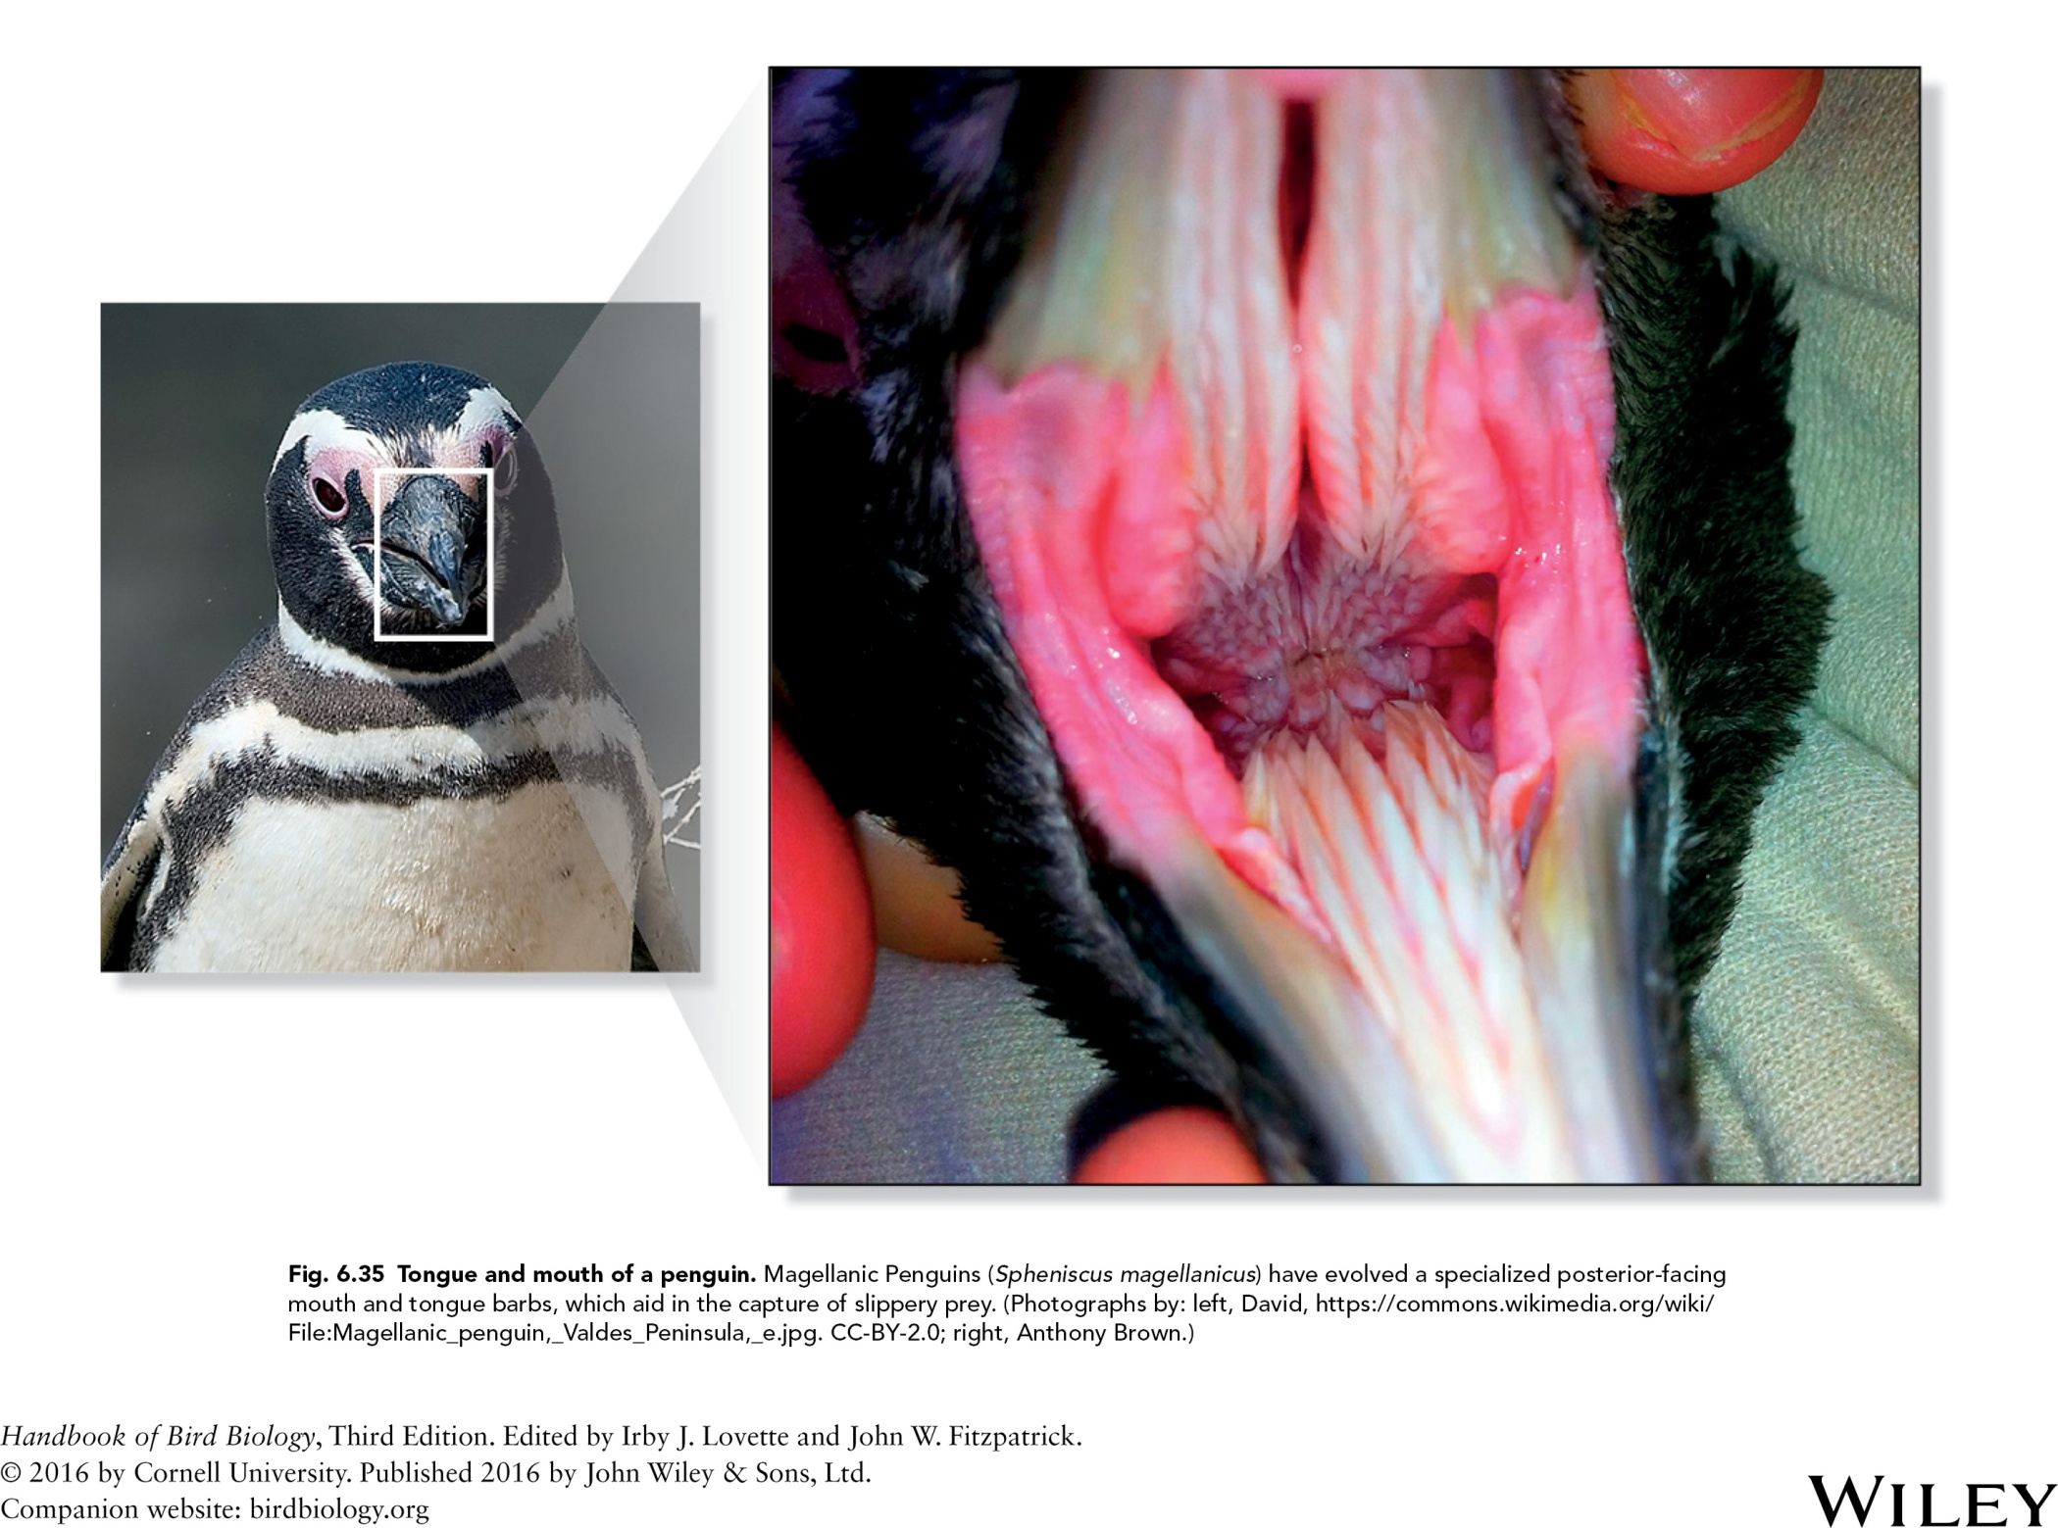

Slide 40
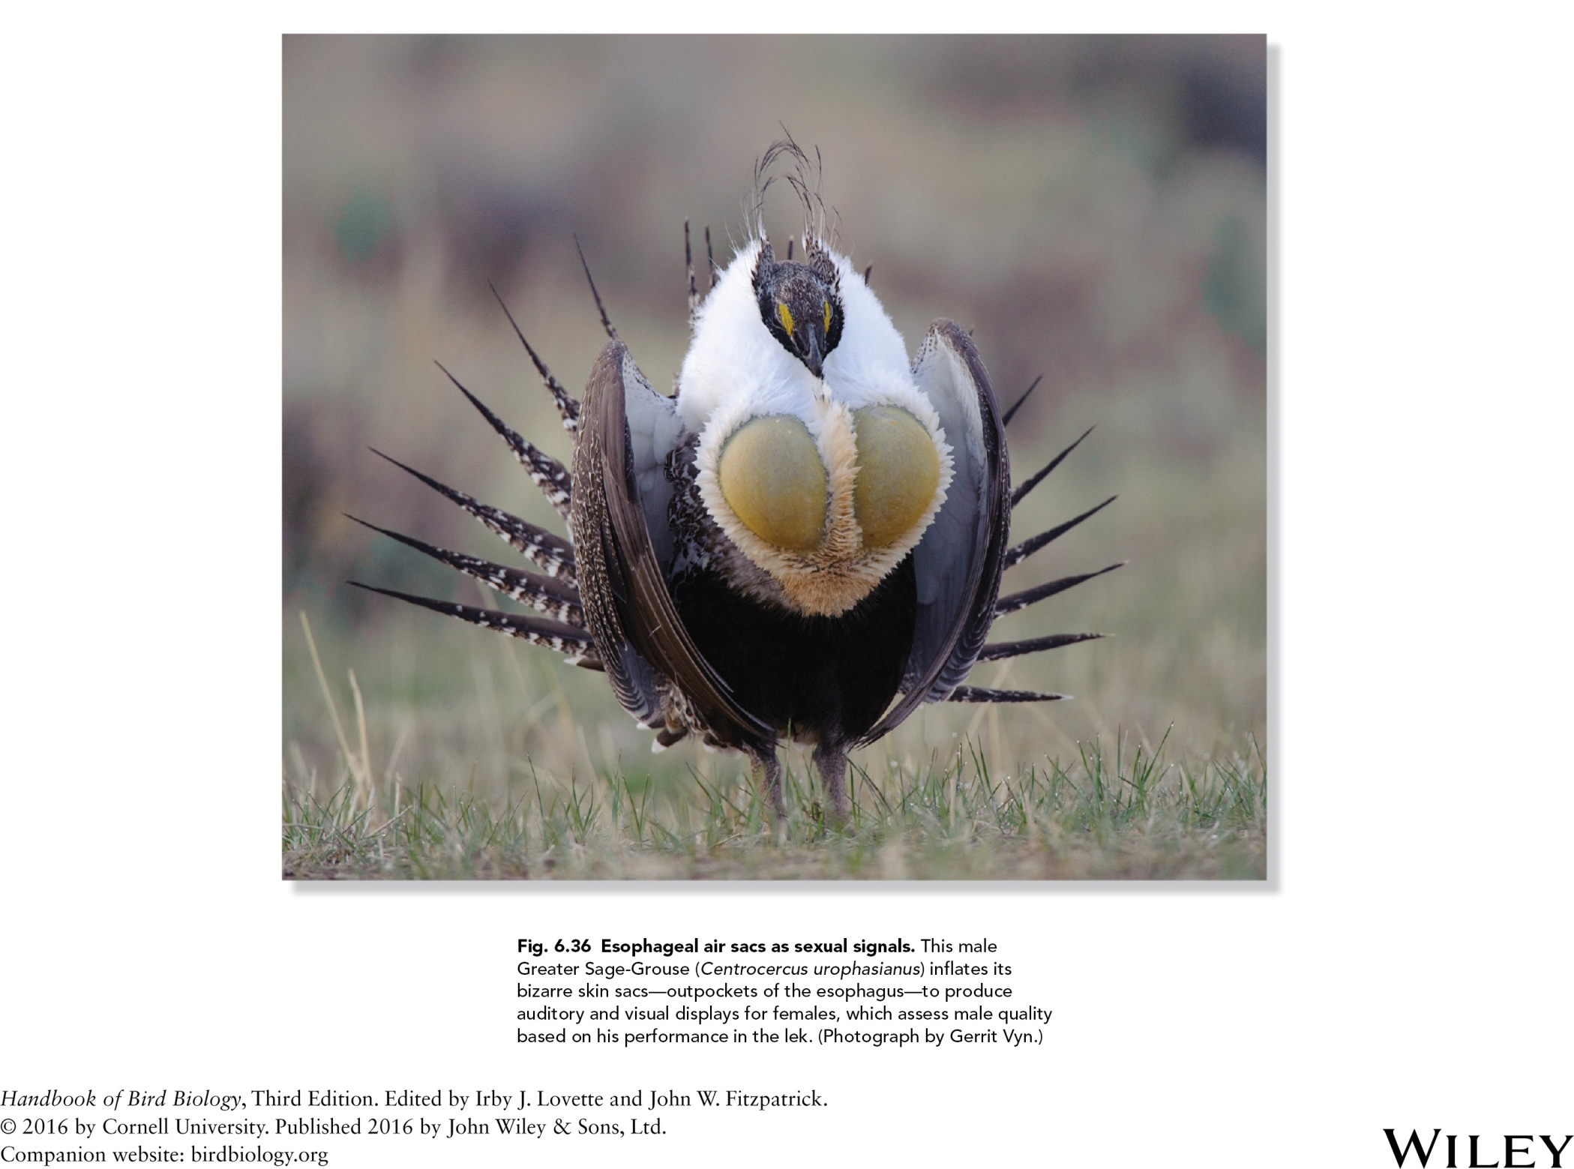

Slide 41
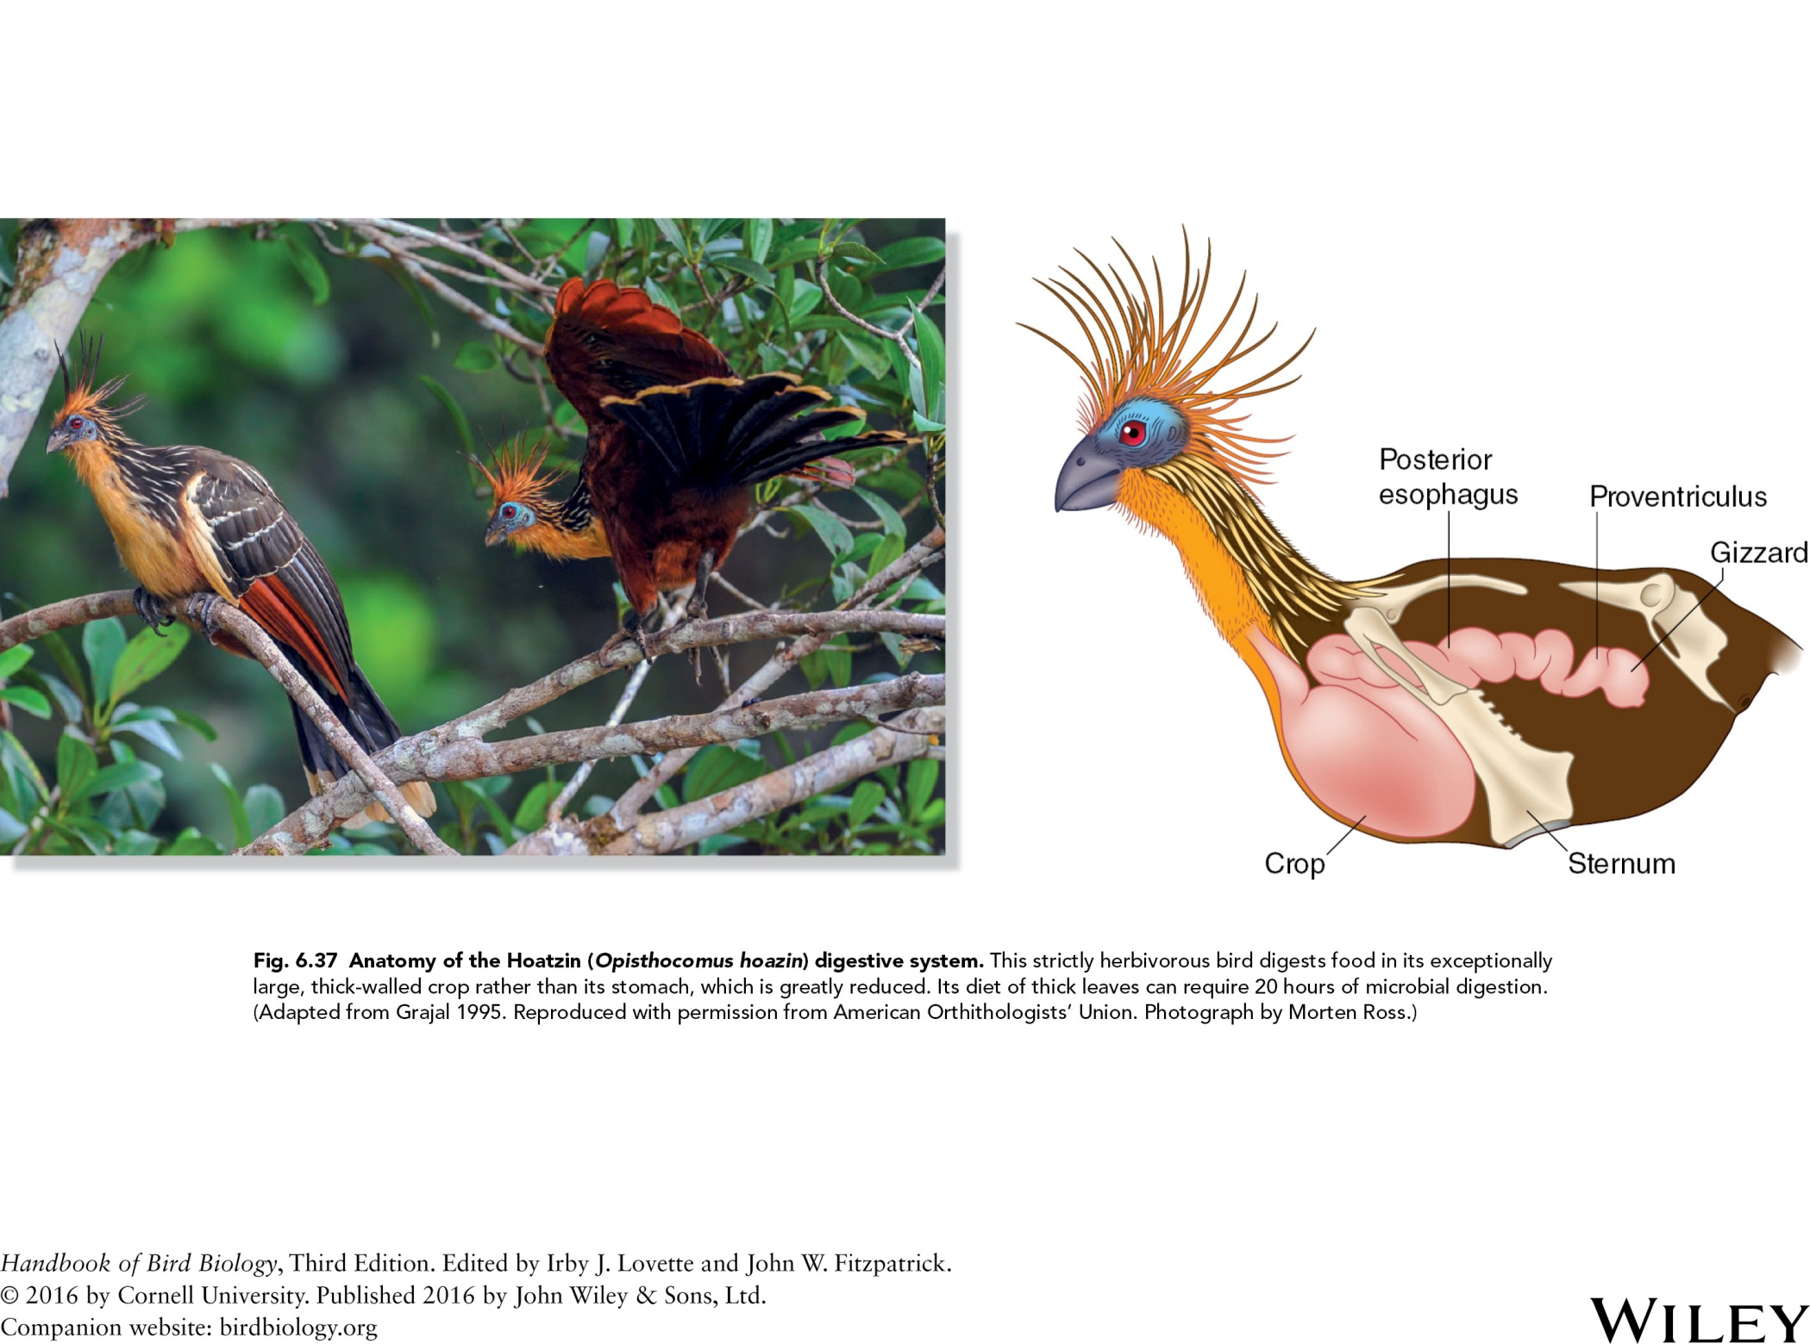

Slide 42
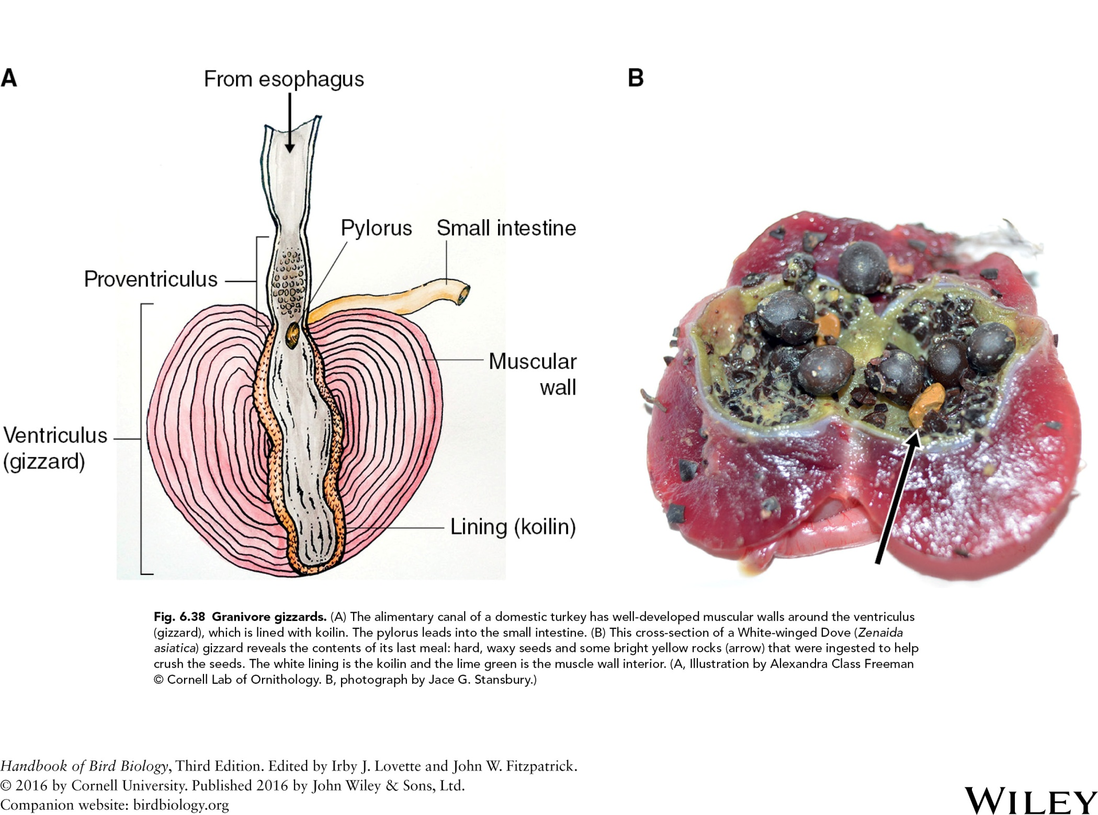

Slide 43
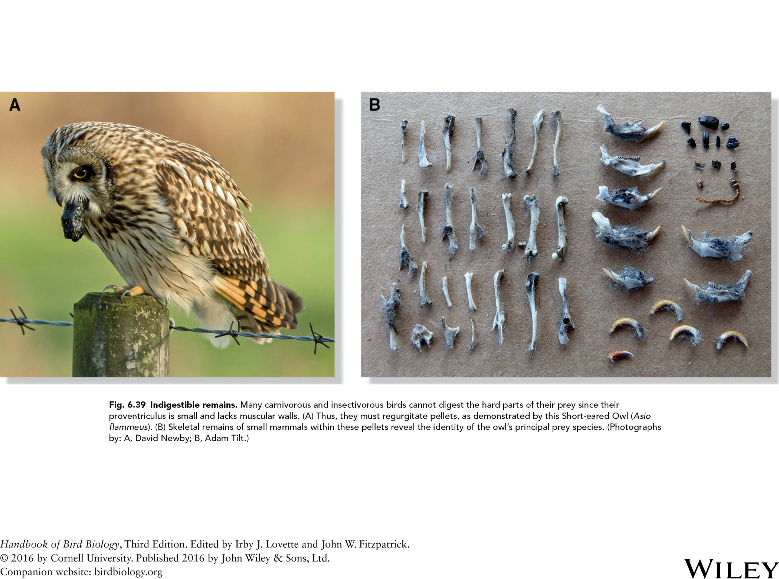

Slide 44
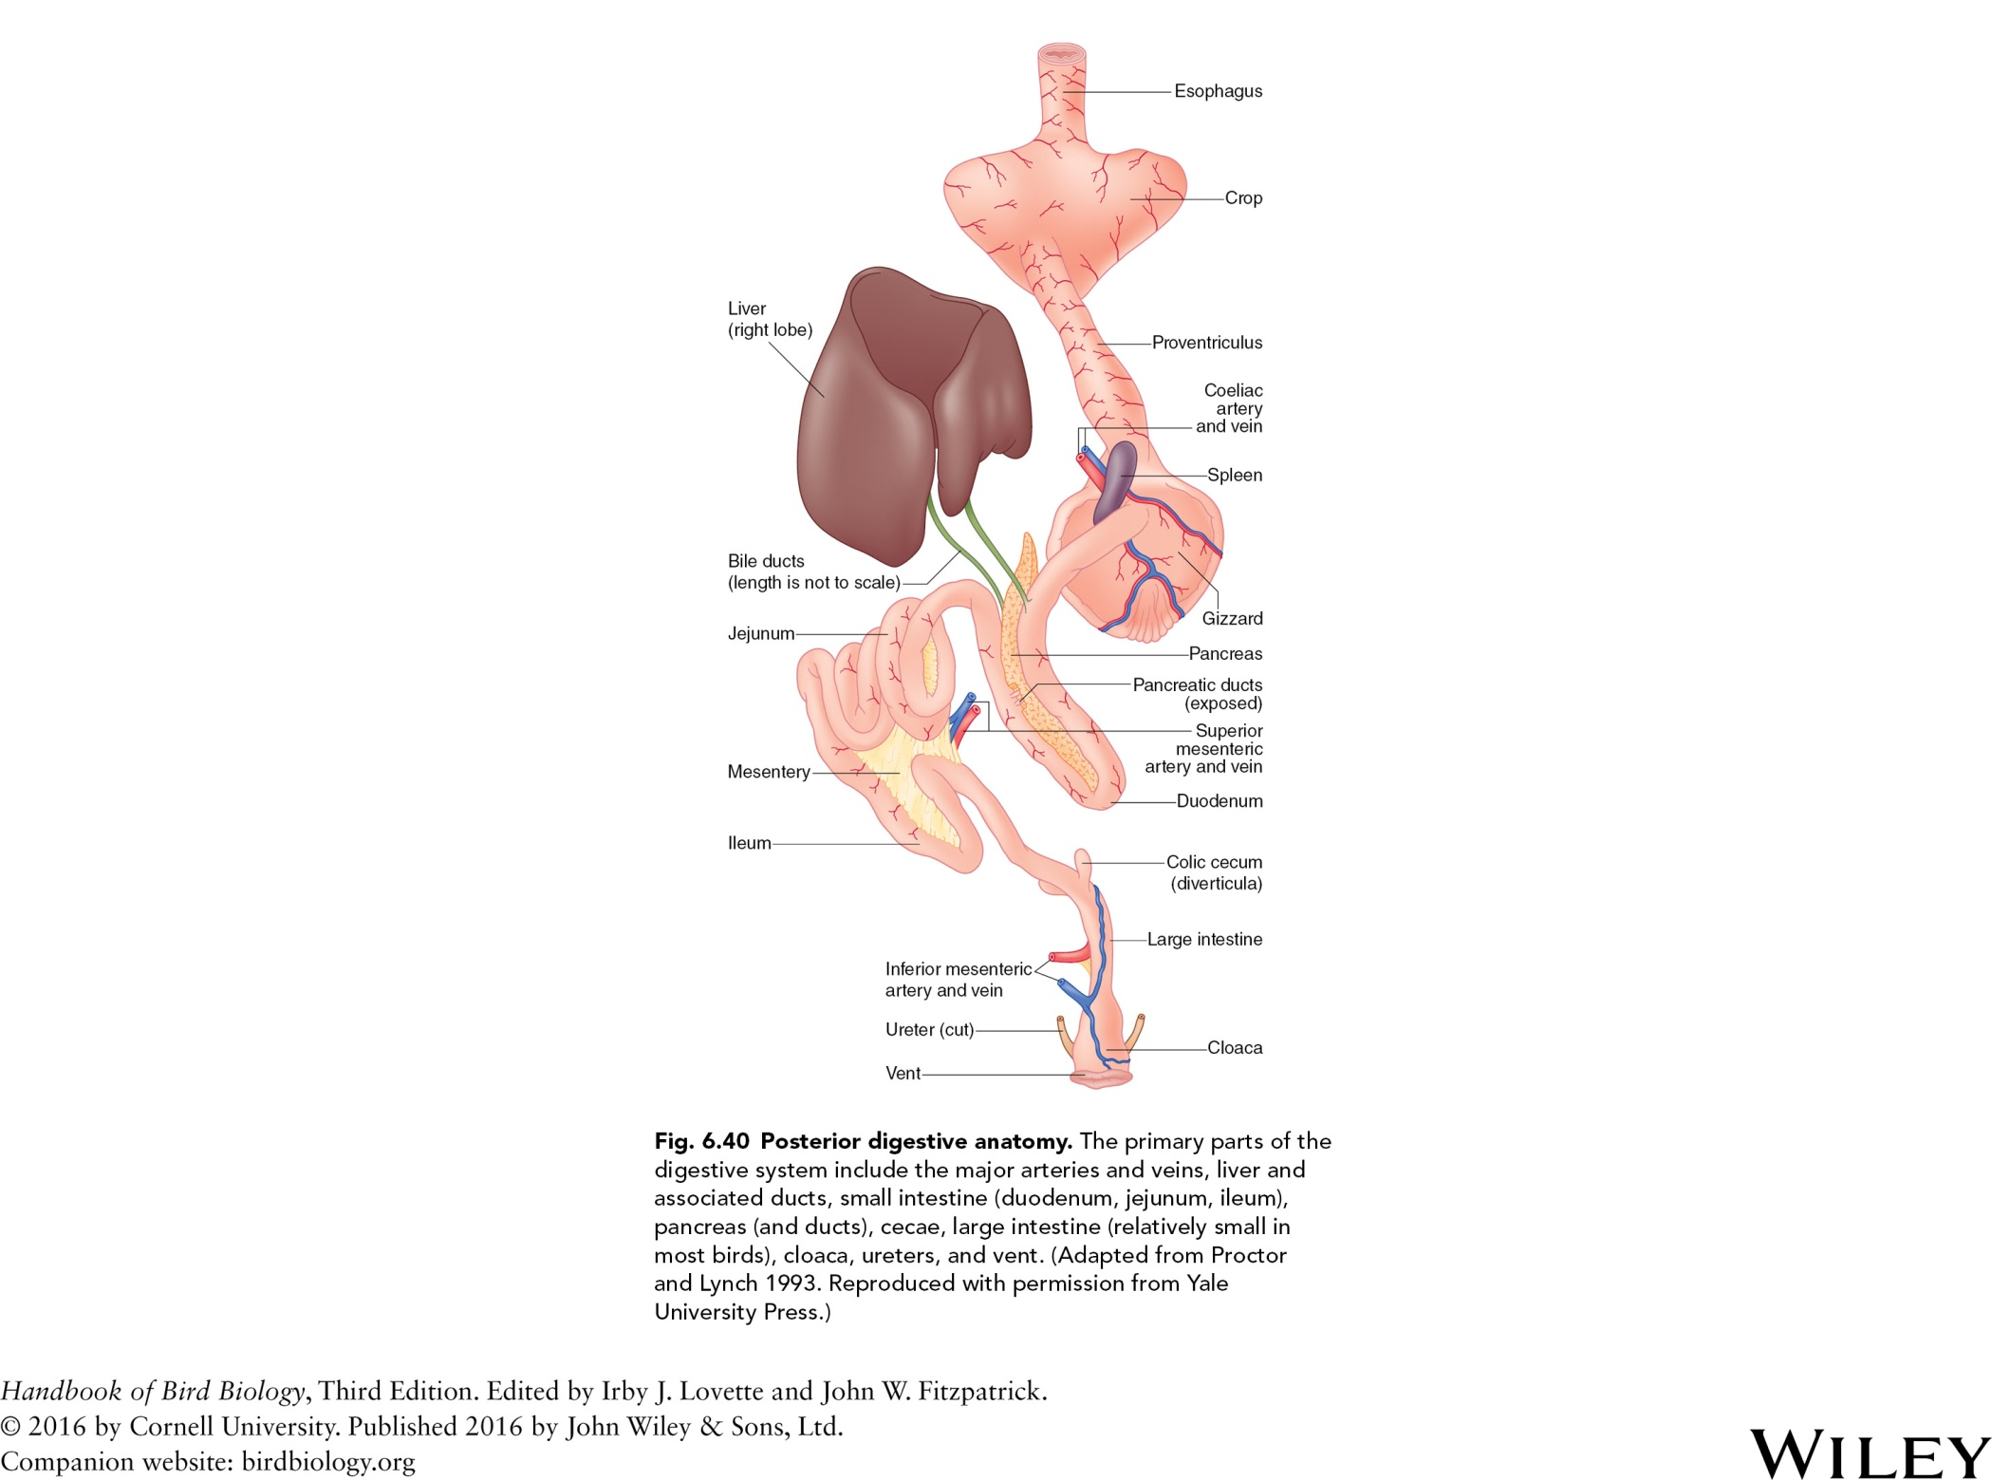
(diverticulum)
Fig. 6.40 Posterior digestive anatomy. The primary parts of the
digestive system include the major arteries and veins, liver and
associated ducts, small intestine (duodenum, jejunum, ileum),
pancreas (and ducts), ceca, large intestine (relatively small in
most birds), cloaca, ureters, and vent. (Adapted from Proctor
and Lynch 1993. Reproduced with permission from Yale
University Press.)

Slide 45
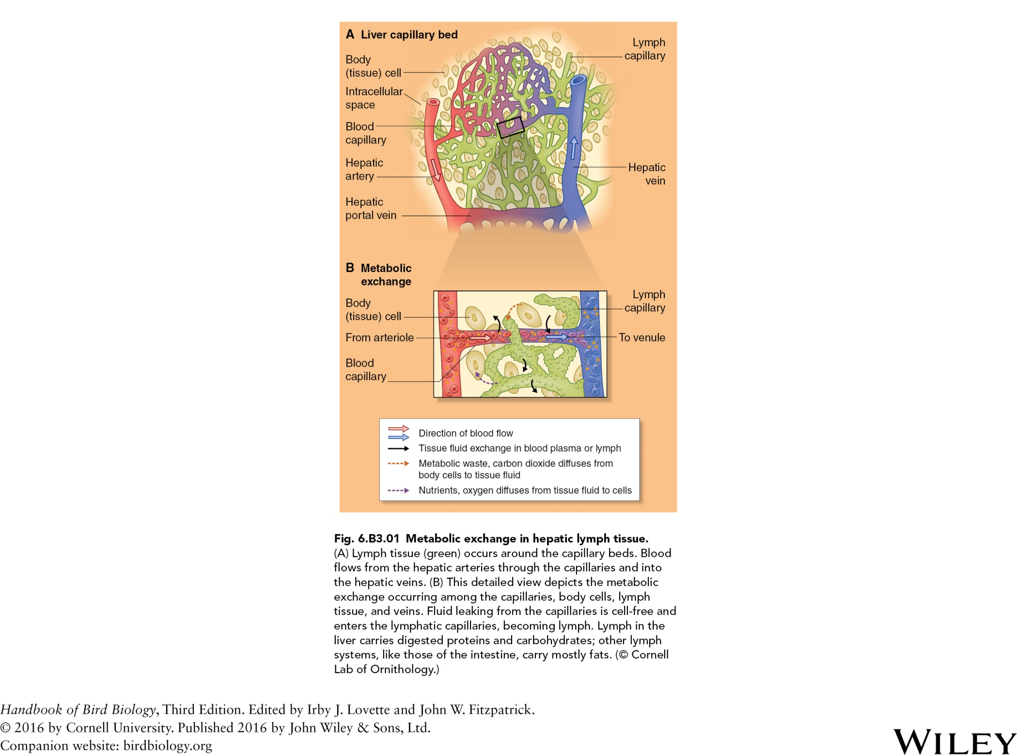

Slide 46
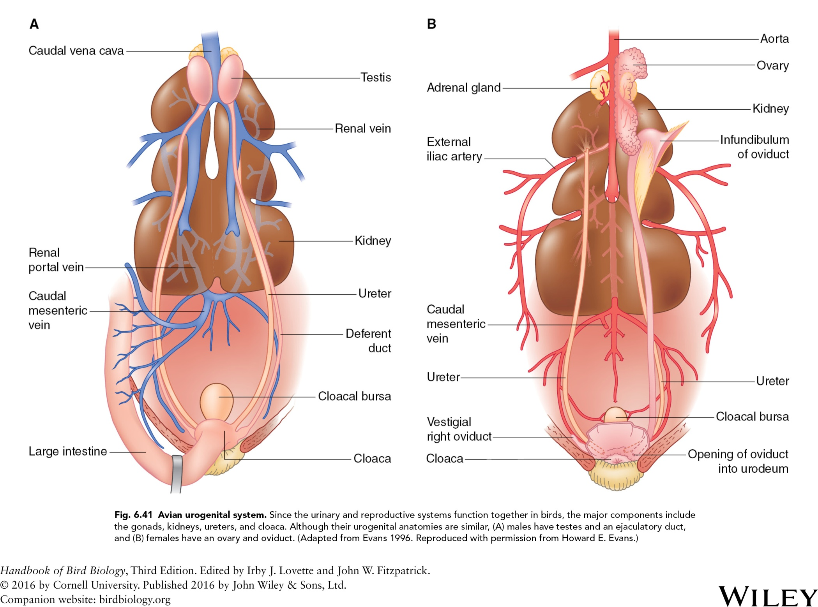
artery

Slide 47
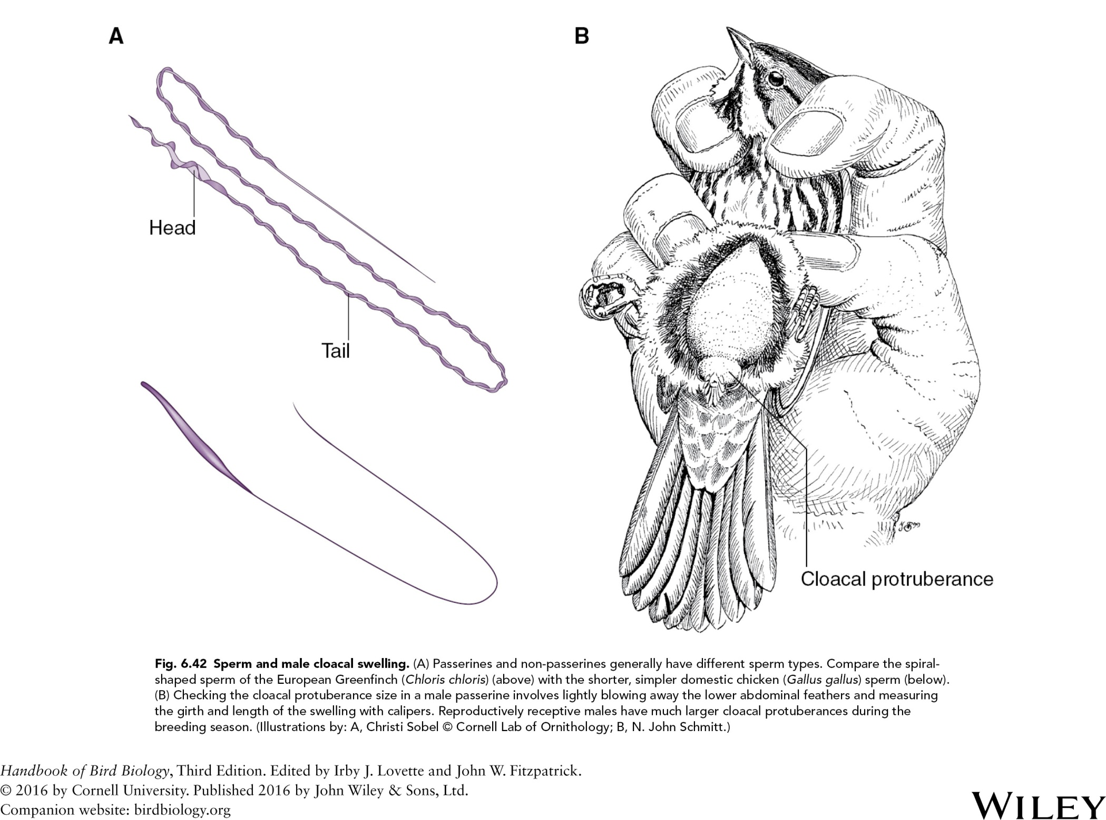

Slide 48
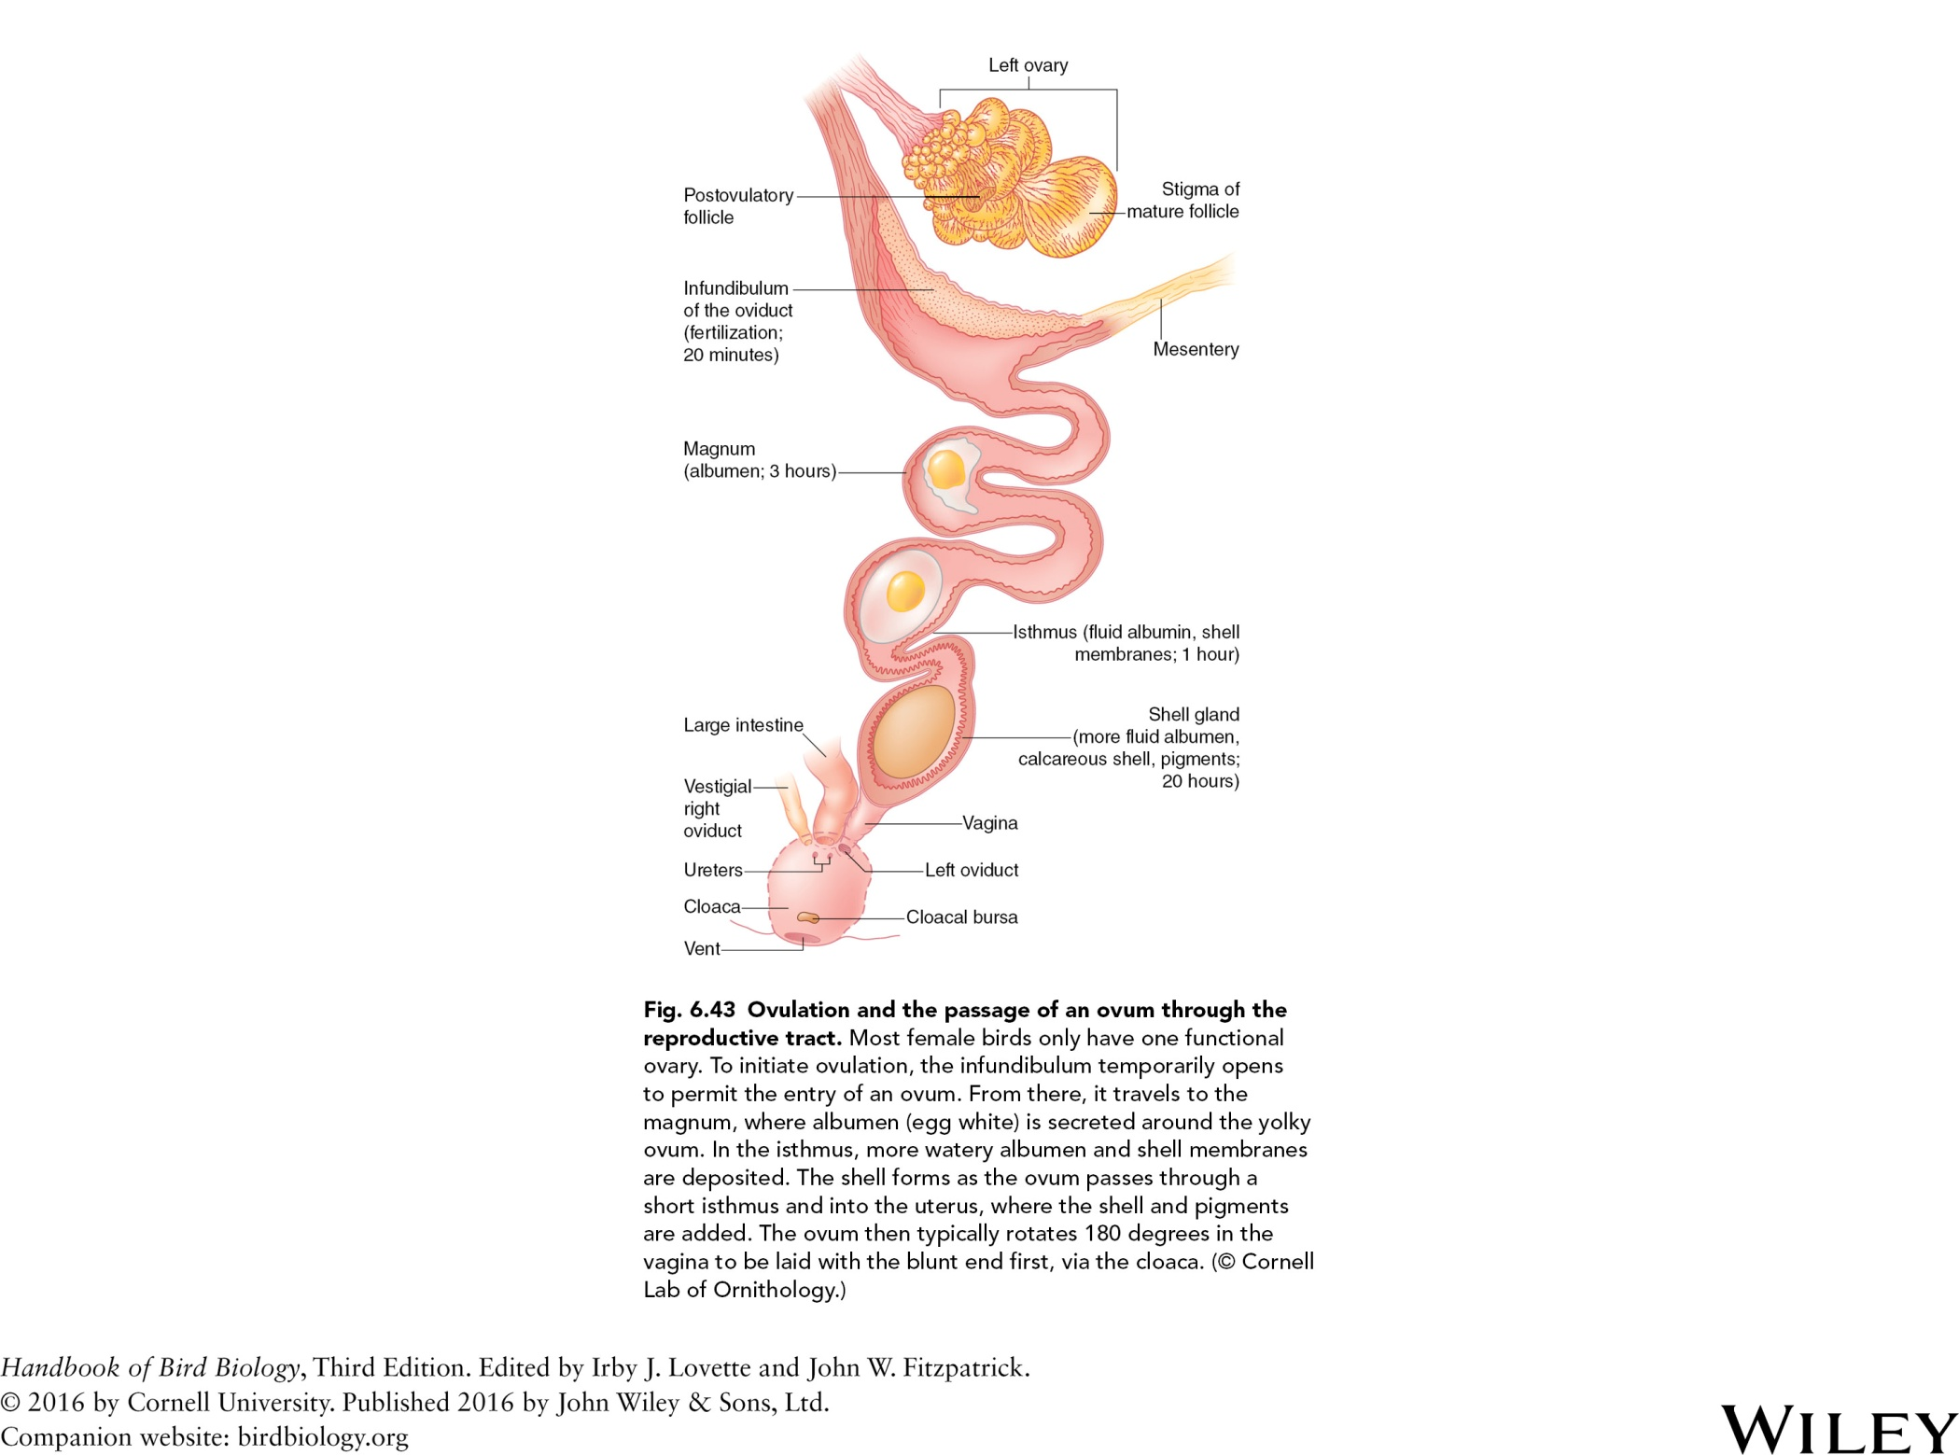

Slide 49
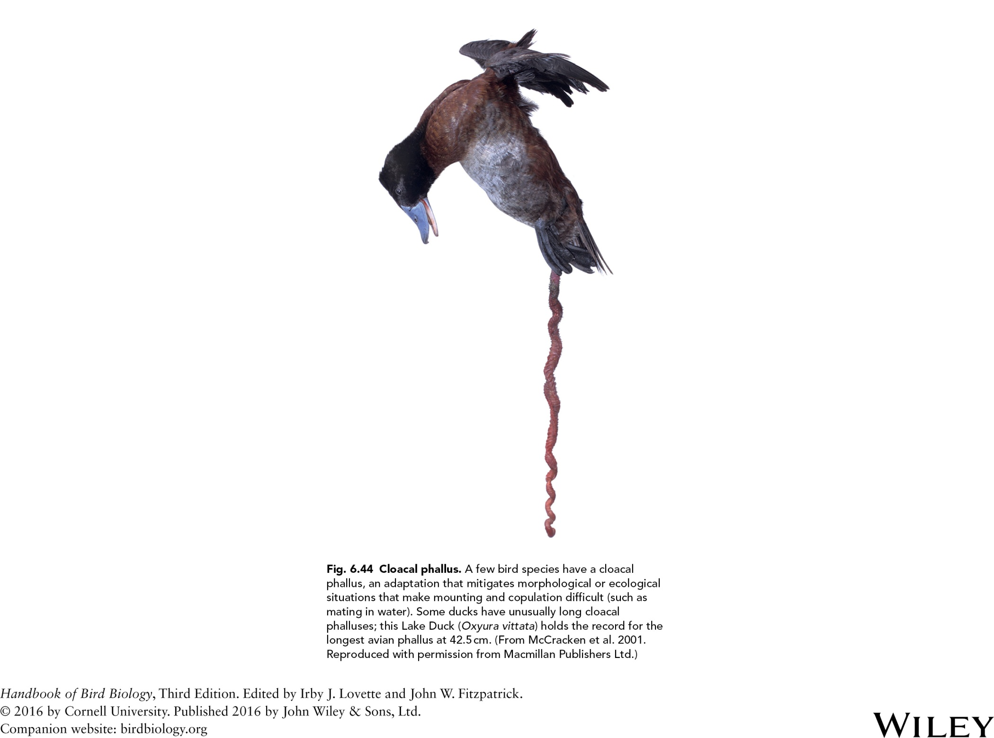

Slide 50
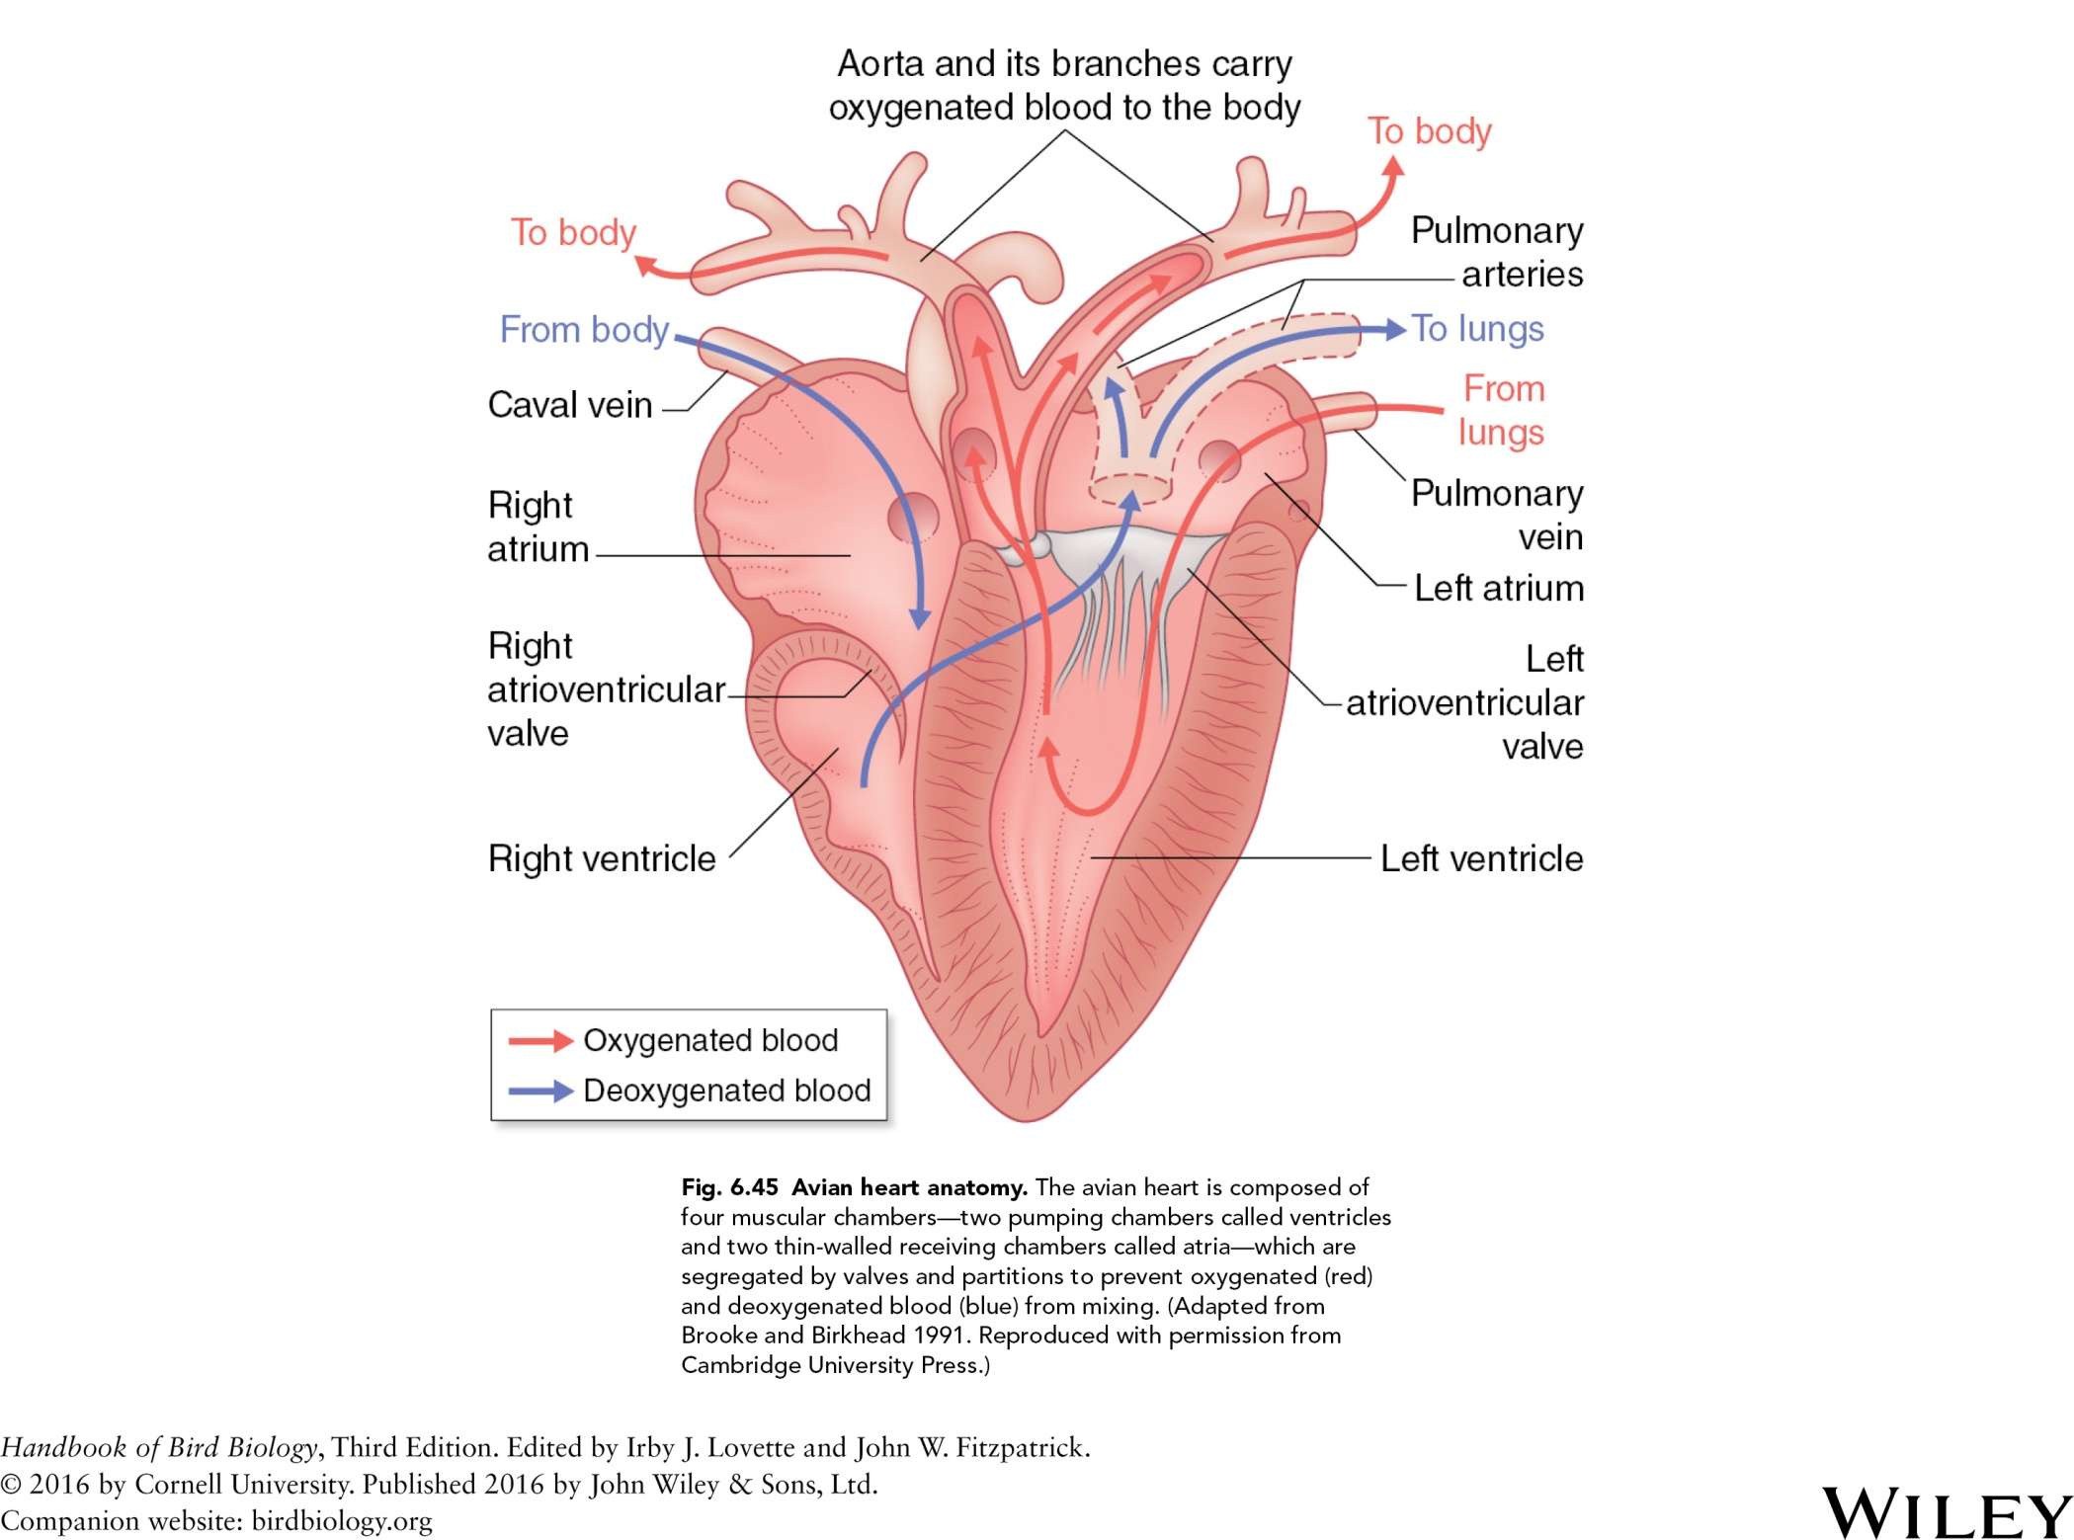

Slide 51


Slide 52


Slide 53


Slide 54


Slide 55

Fig. 6.49 Avian sympathetic nervous system. This diagram of
a Rock Pigeon (Columba livia) depicts the overlap between the
parasympathetic and sympathetic systems. Signals about sudden stressors or state changes around the organs are transferred from the parasympathetic ganglia to the parasympathetic trunk, through which they move up the spinal cord and to the brain. (Adapted from Proctor and Lynch 1993. Reproduced with permission from Yale University Press.)

Slide 56


Slide 57


Slide 58


Slide 59


Slide 60


Slide 61


Slide 62


Slide 63


