Slide 1
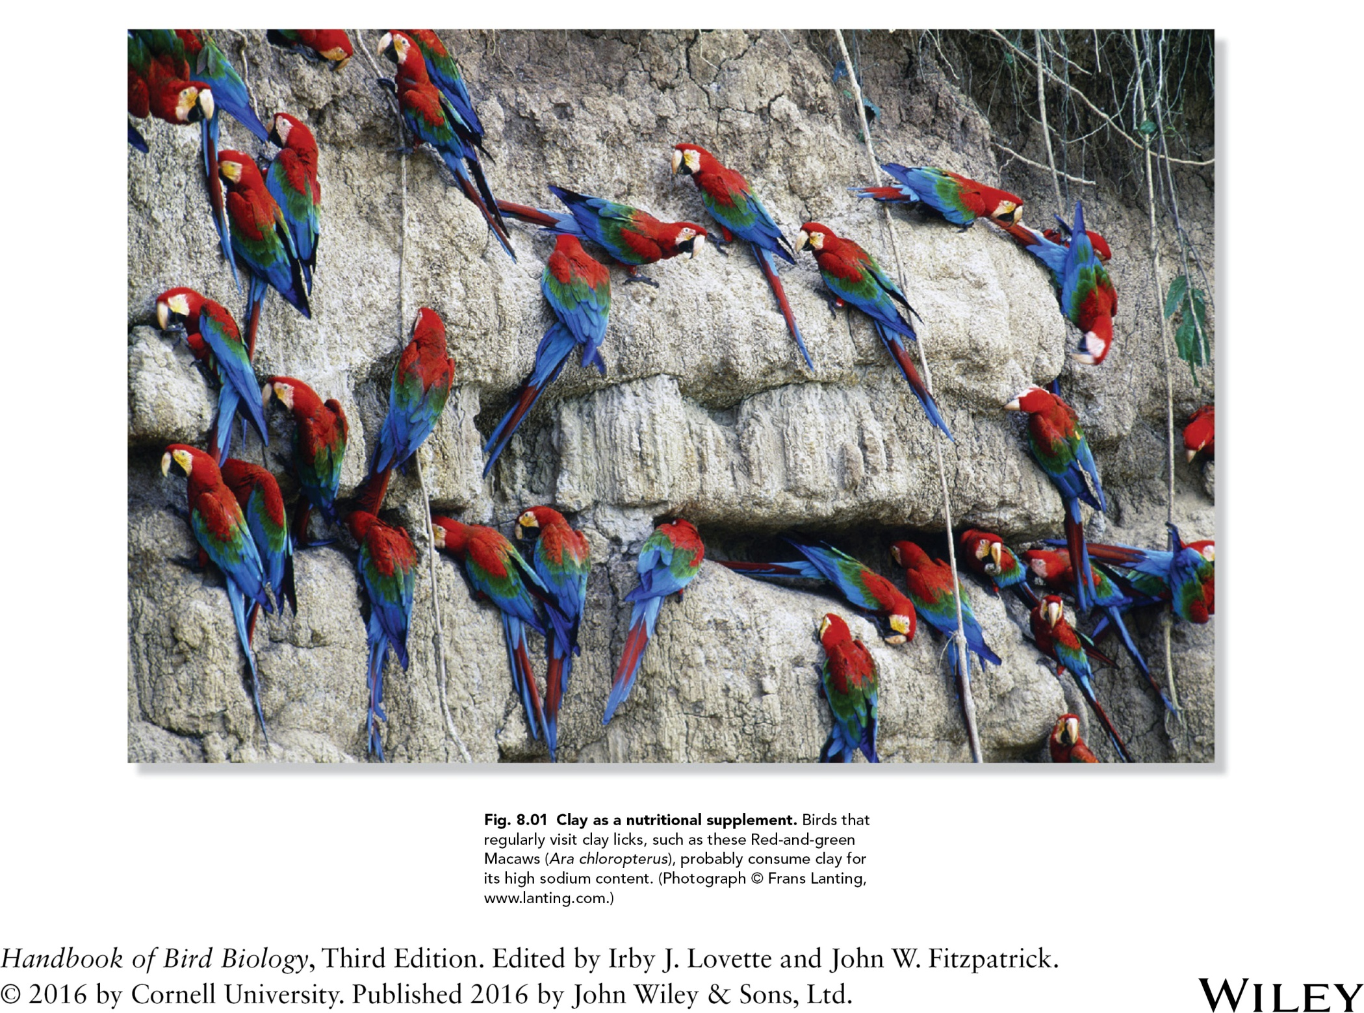

Slide 2
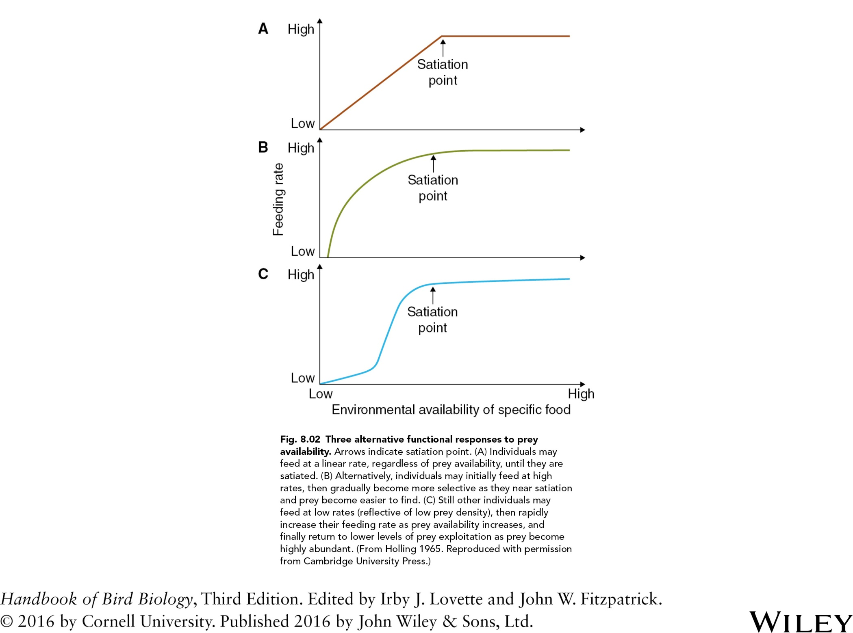

Slide 3
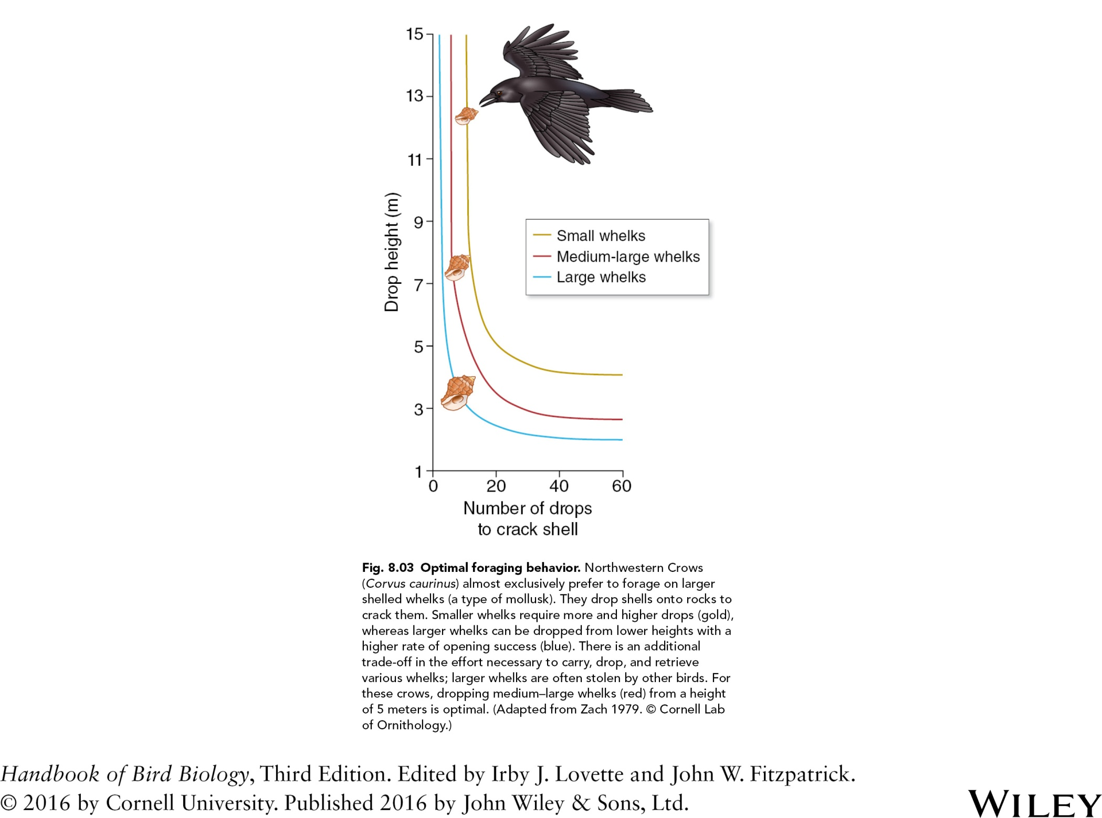

Slide 4
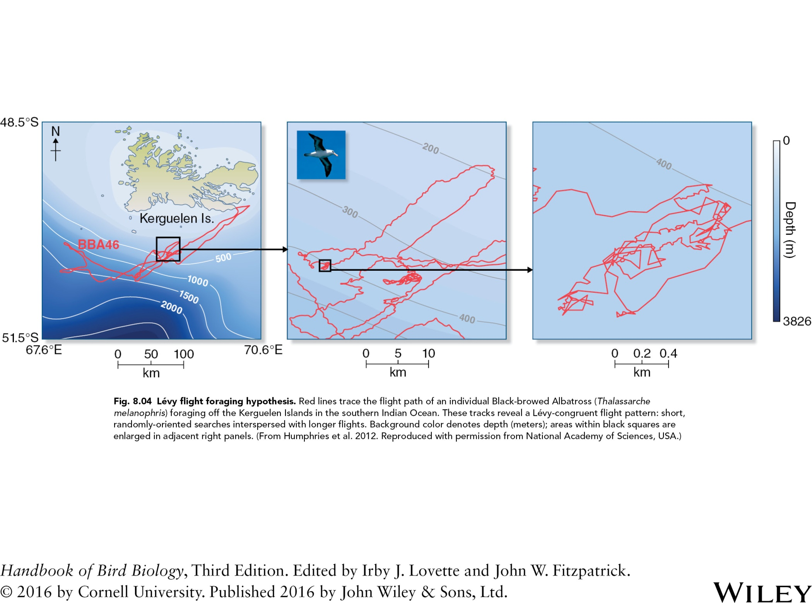

Slide 5
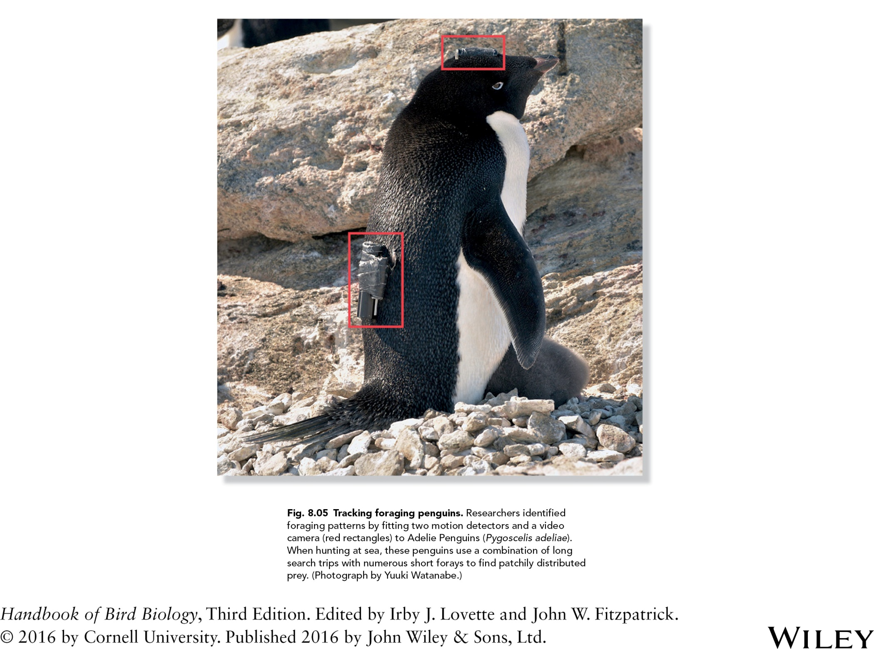

Slide 6
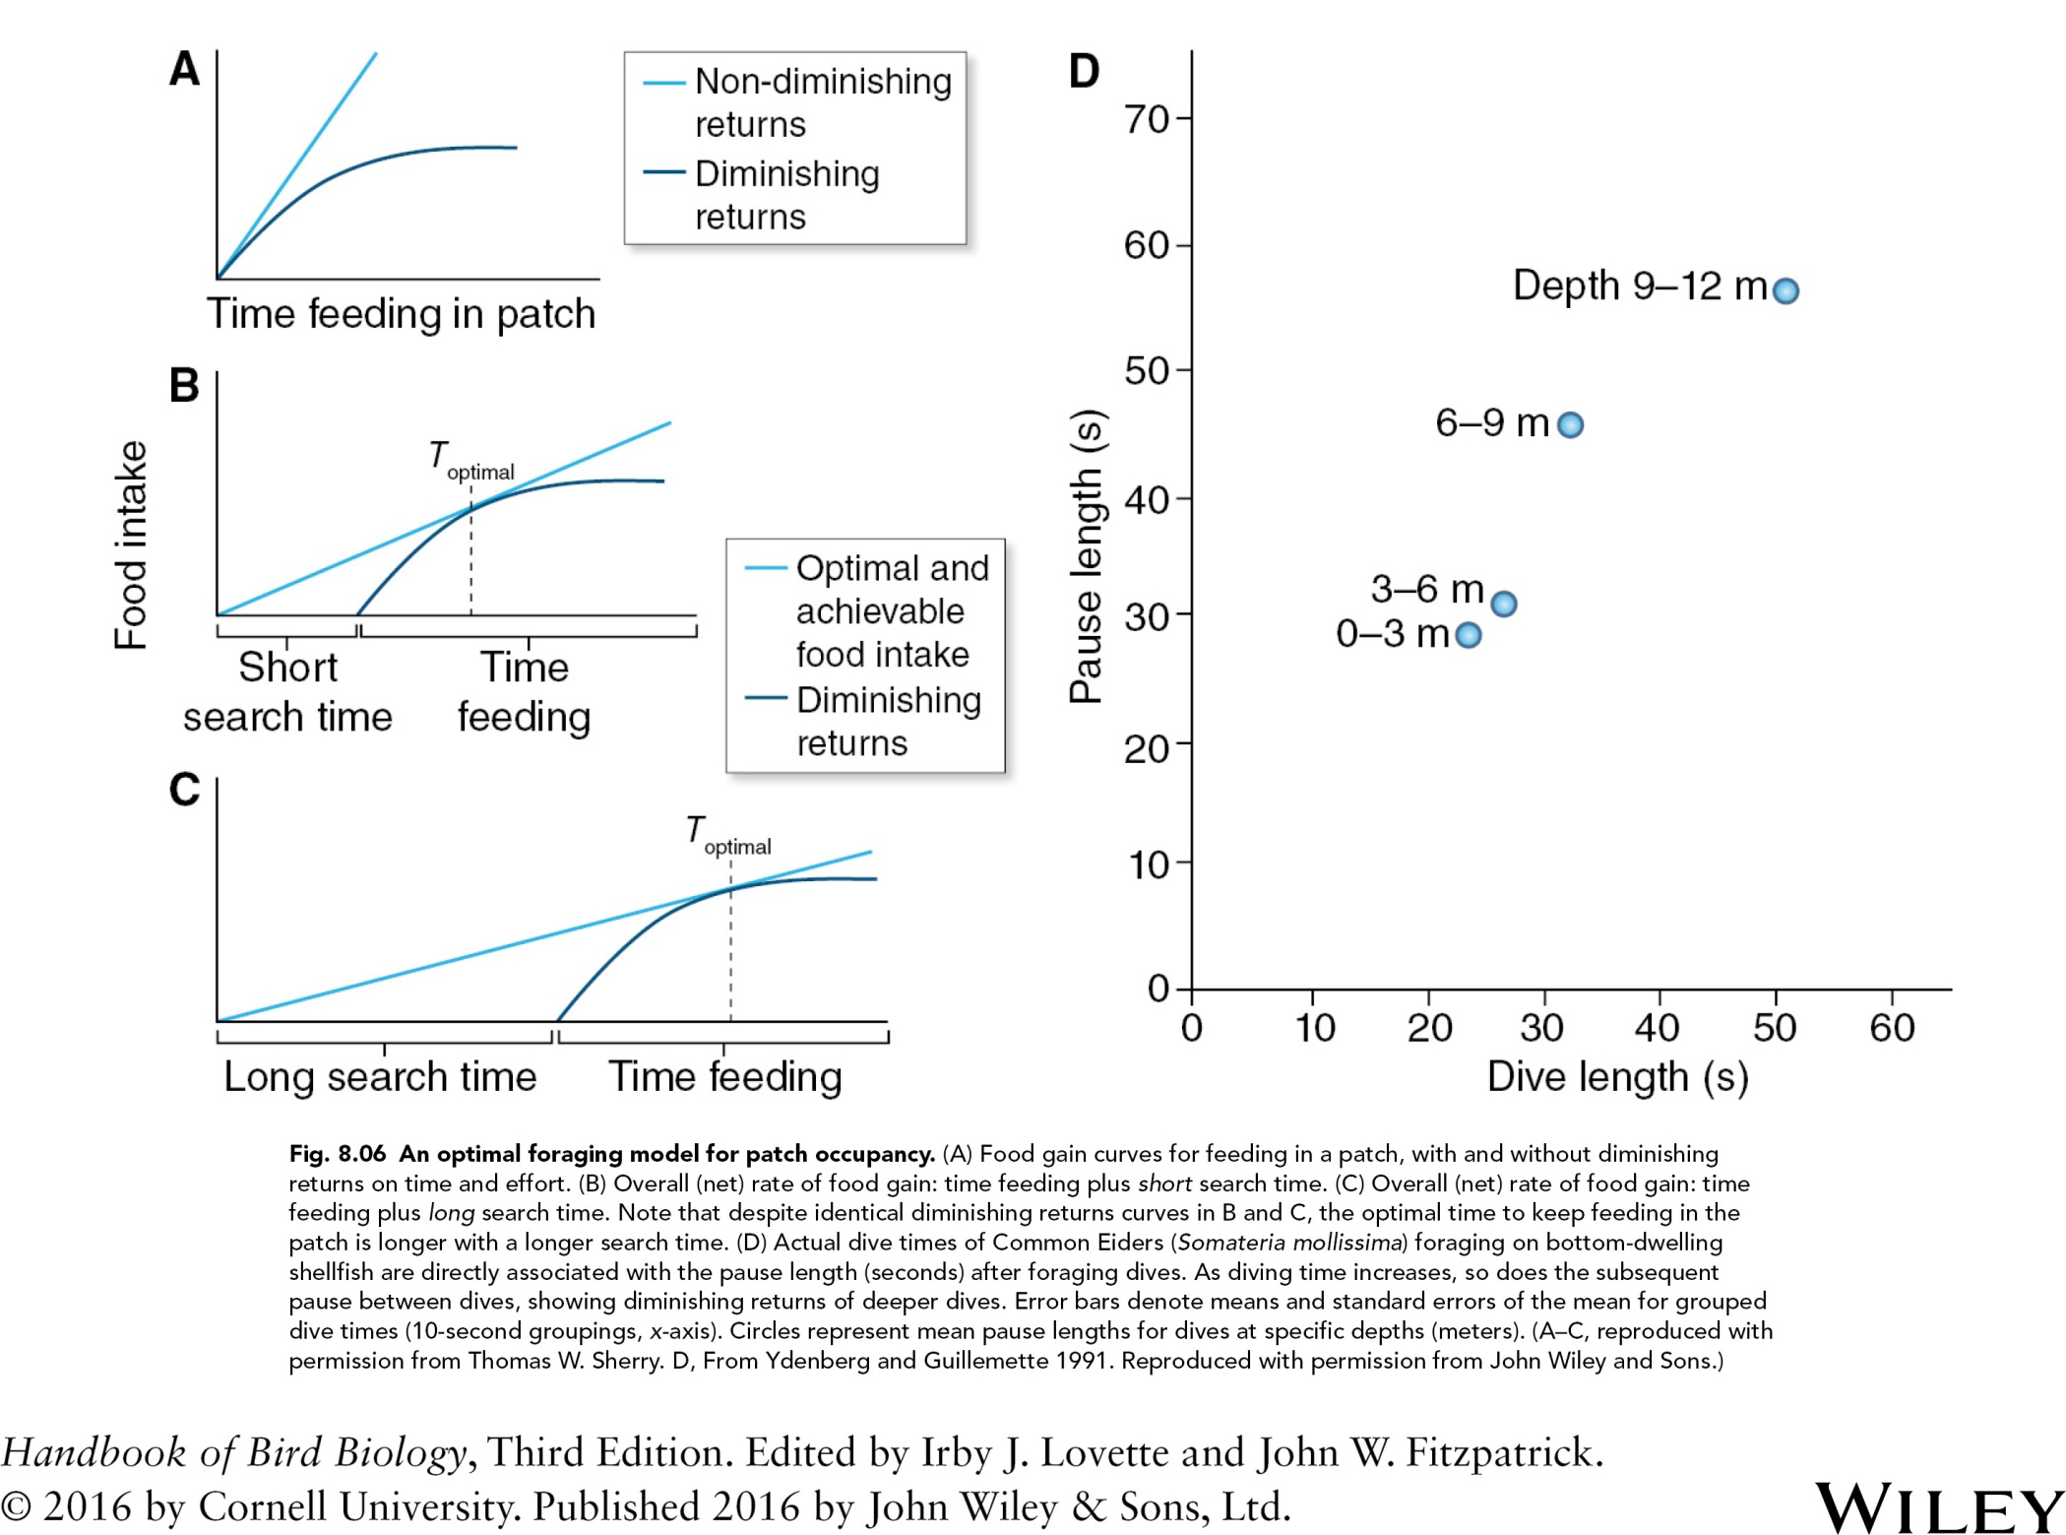
Fig. 8.06 An optimal foraging model for patch occupancy. (A) Food gain curves for feeding in a patch, with and without diminishing
returns on time and effort. (B) Overall (net) rate of food gain: time feeding plus short search time. (C) Overall (net) rate of food gain: time
feeding plus long search time. Note that despite identical diminishing returns curves in B and C, the optimal time to keep feeding in the
patch is longer with a longer search time. (D) Actual dive times of Common Eiders (Somateria mollissima) foraging on bottom‐dwelling
shellfish are directly associated with the pause length (seconds) after foraging dives. As diving time increases, so does the subsequent
pause between dives, showing diminishing returns of deeper dives. Circles represent mean pause lengths for dives at specific depths (meters). (A–C, reproduced with permission from Thomas W. Sherry. D, From Ydenberg and Guillemette 1991. Reproduced with permission from John Wiley and Sons.)

Slide 7
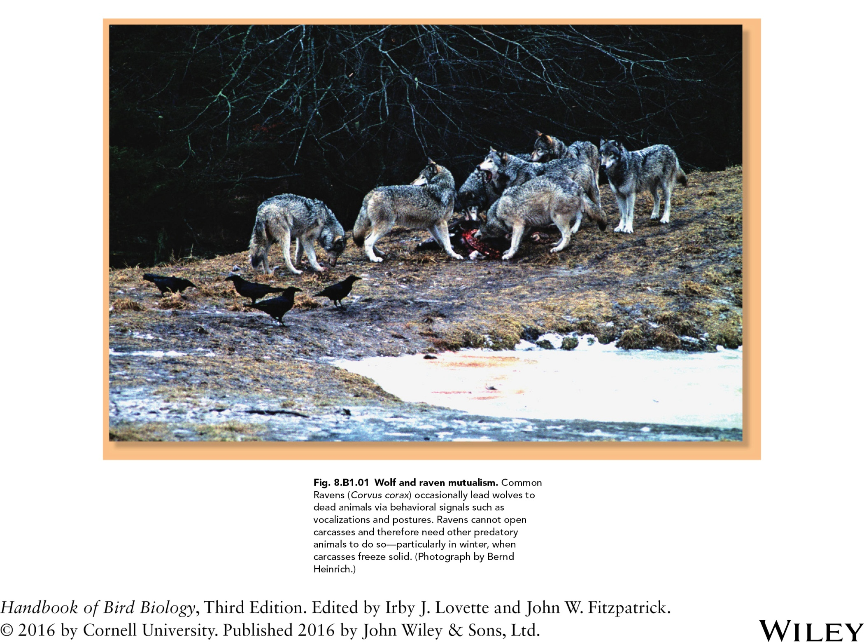

Slide 8
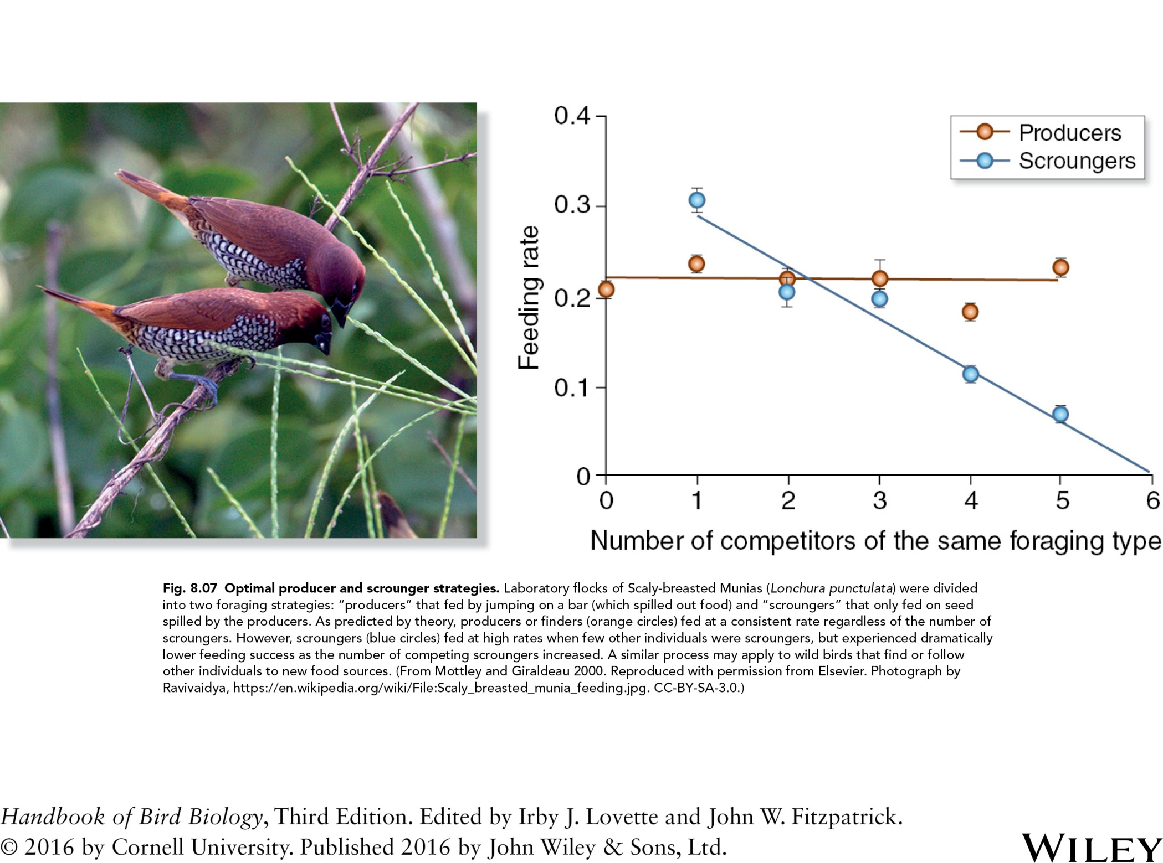

Slide 9
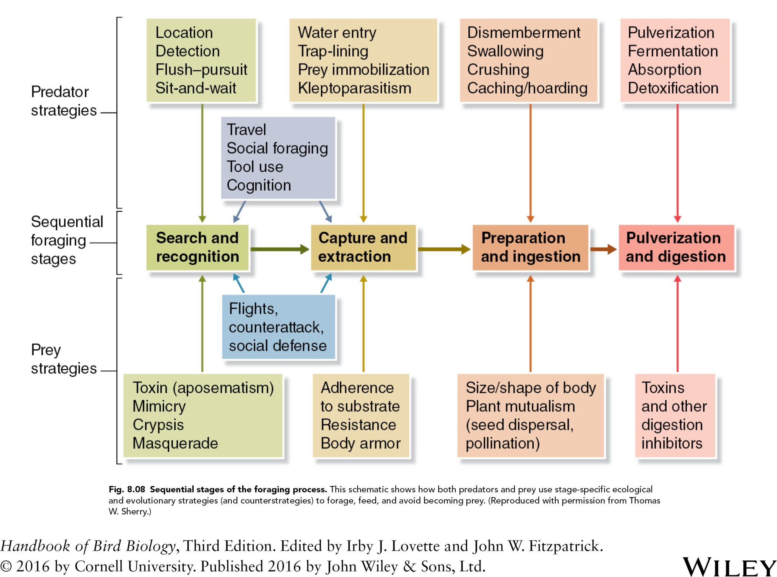

Slide 10
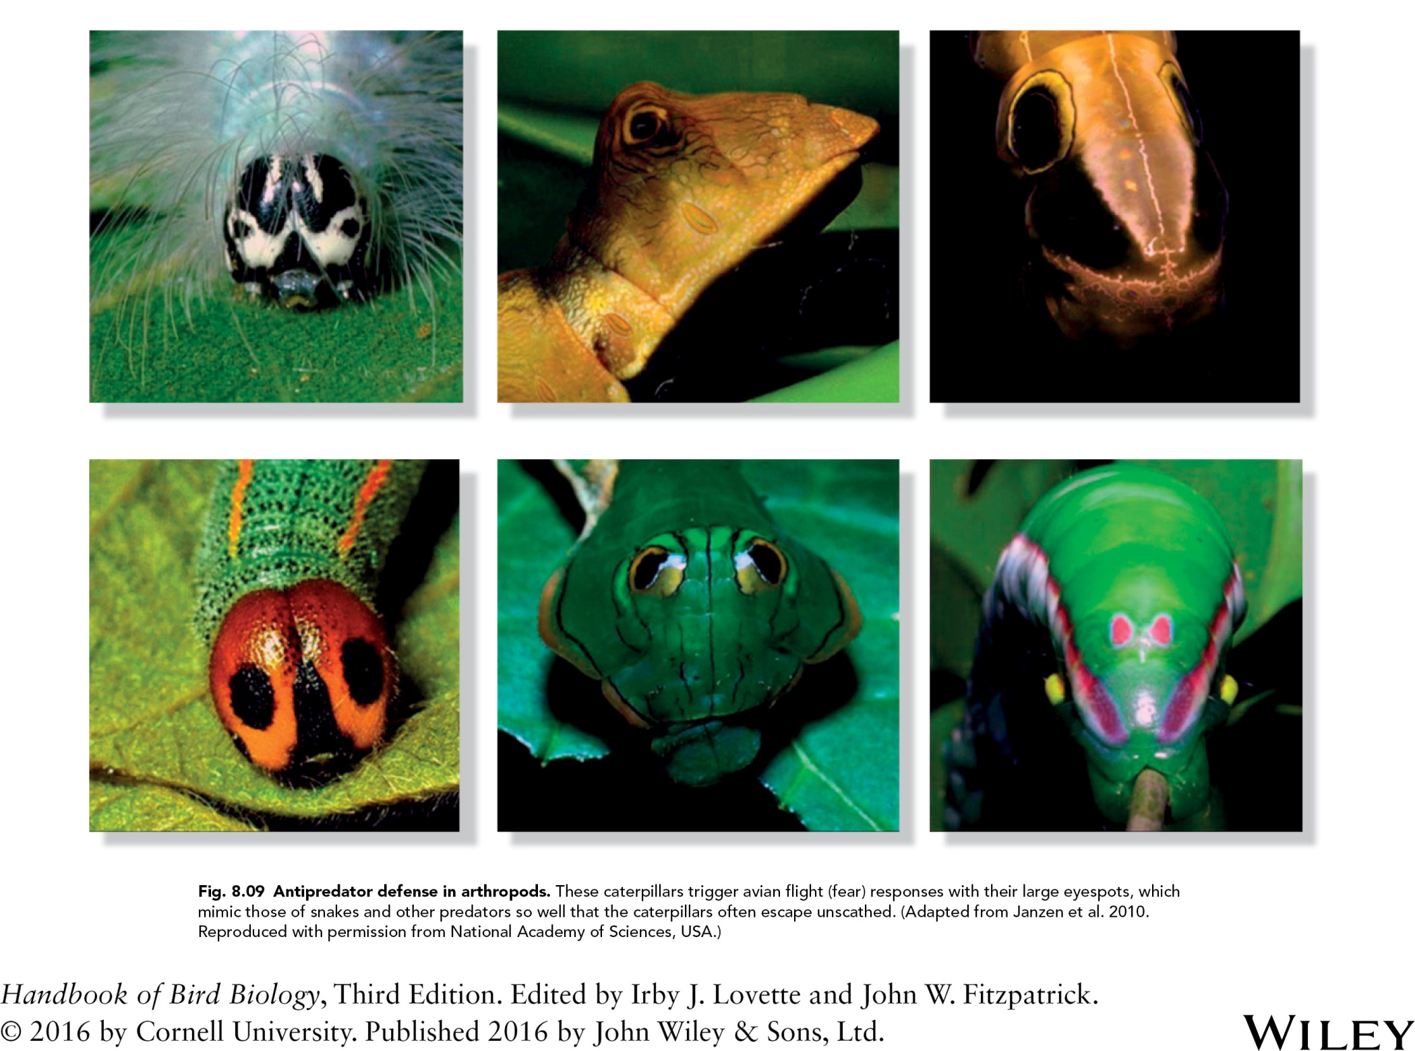

Slide 11
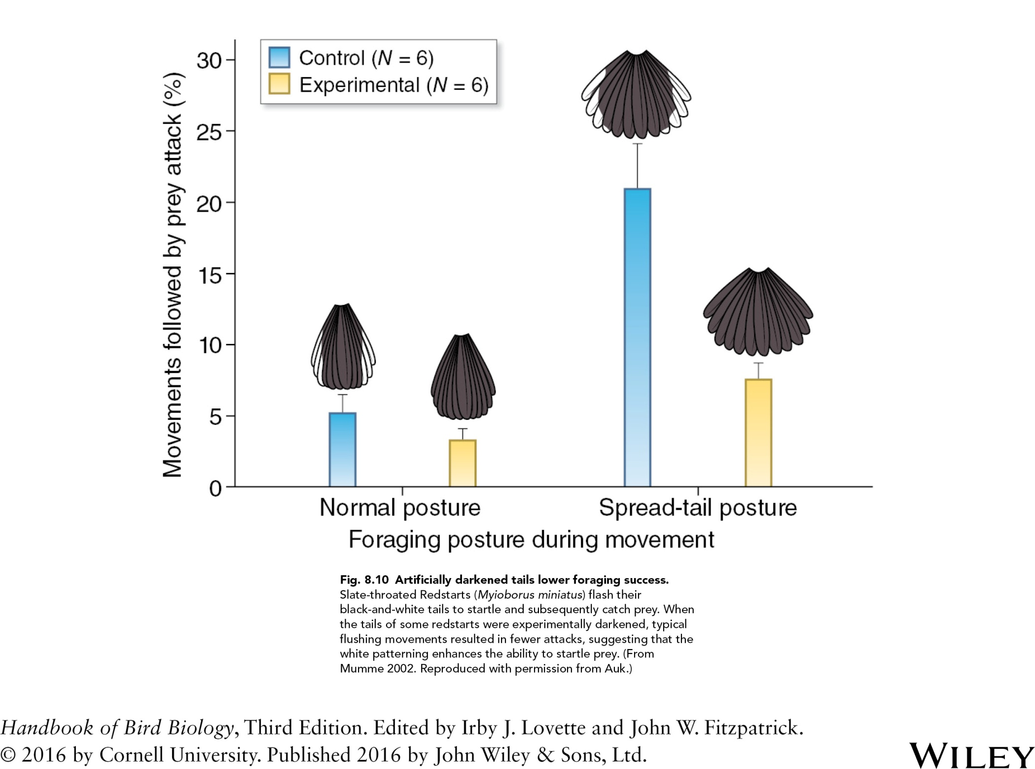

Slide 12
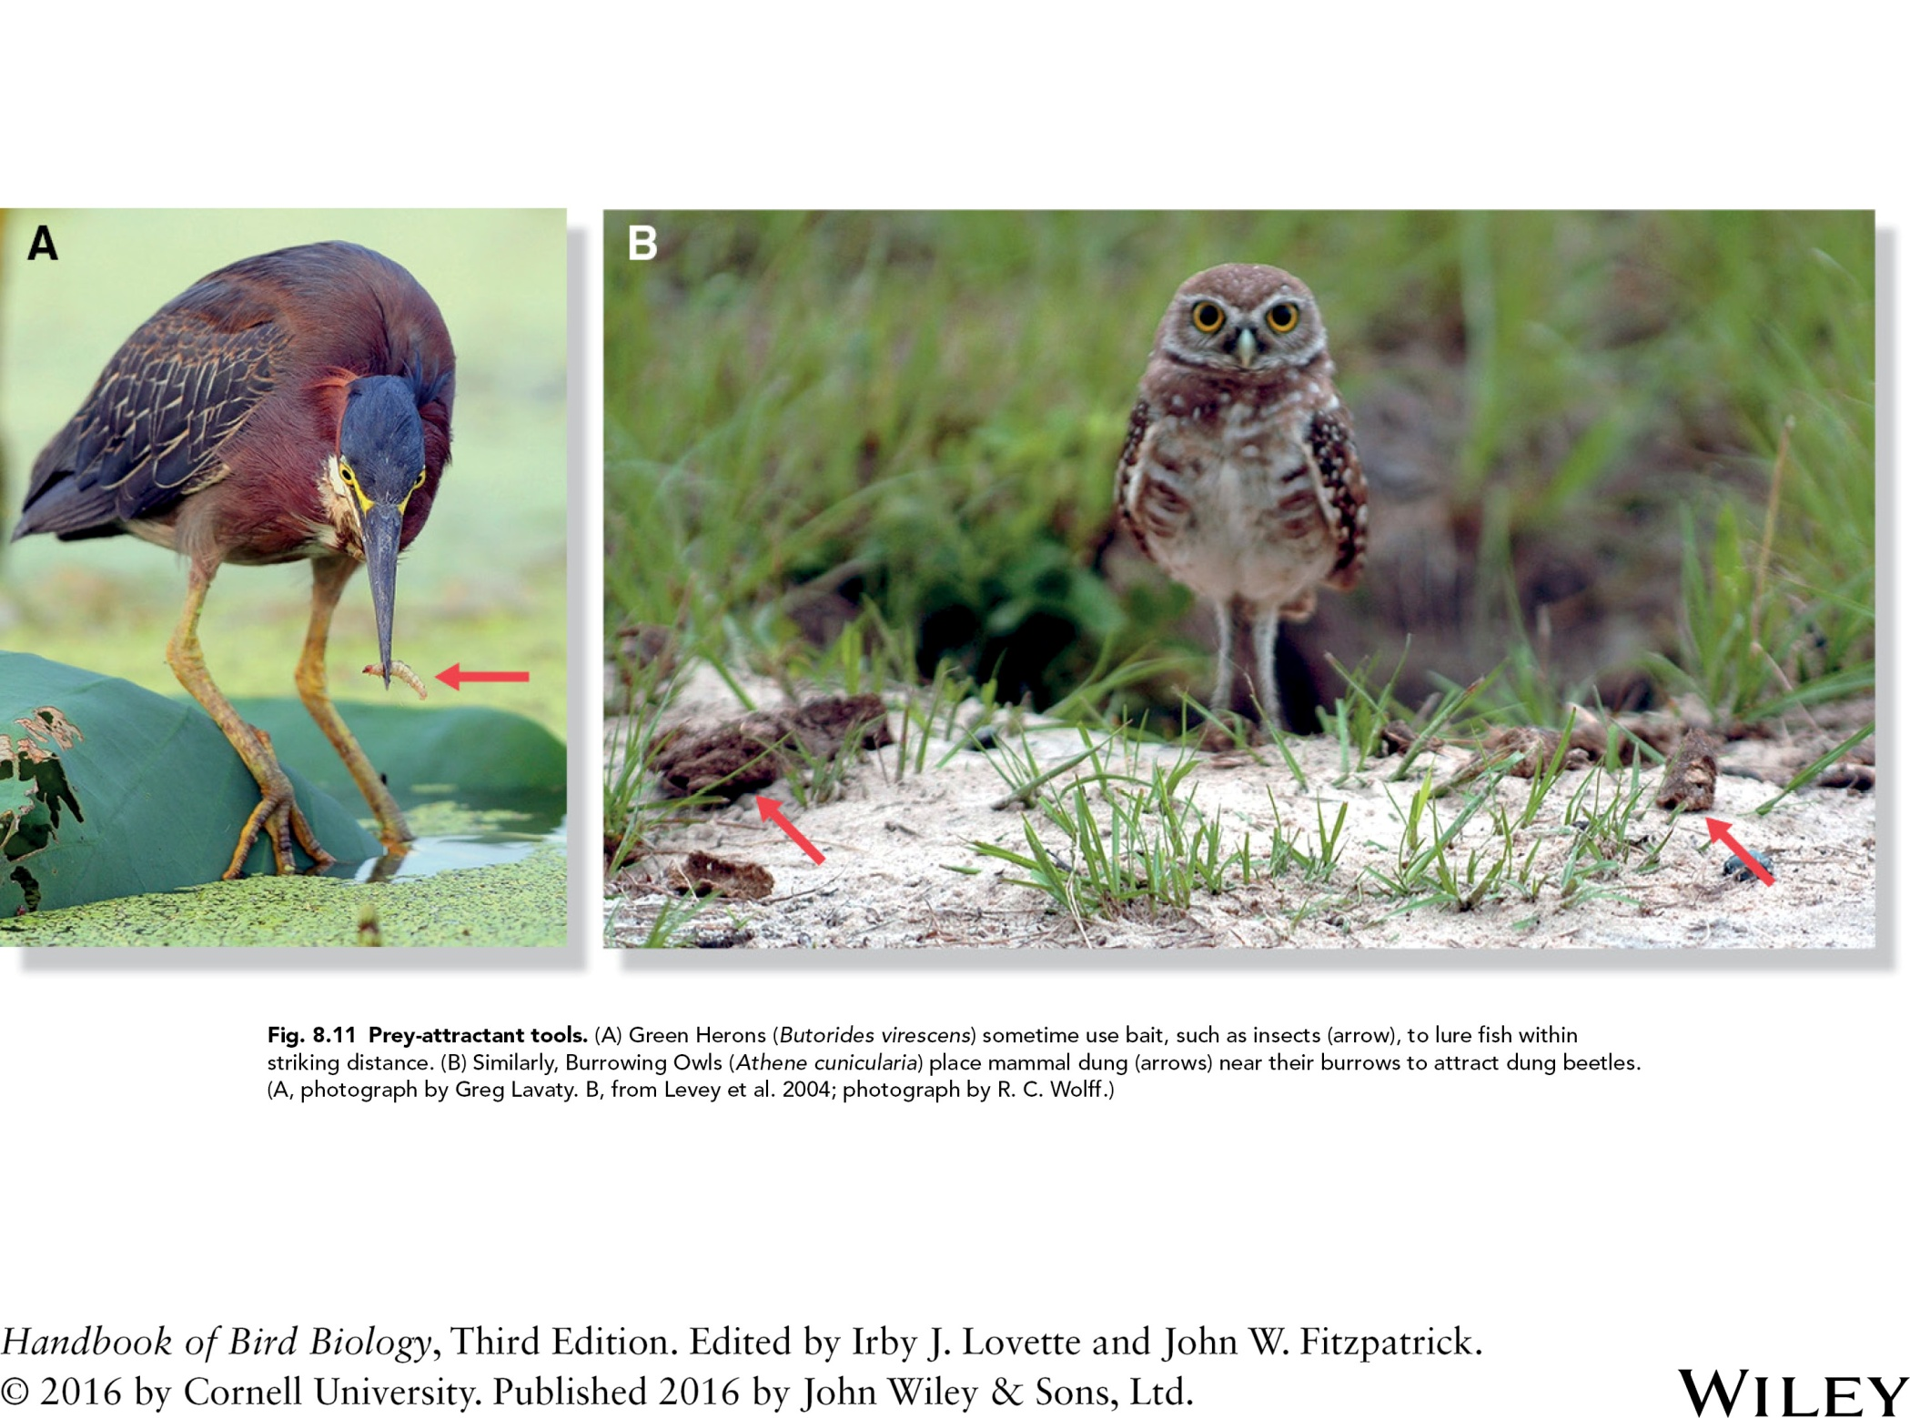

Slide 13
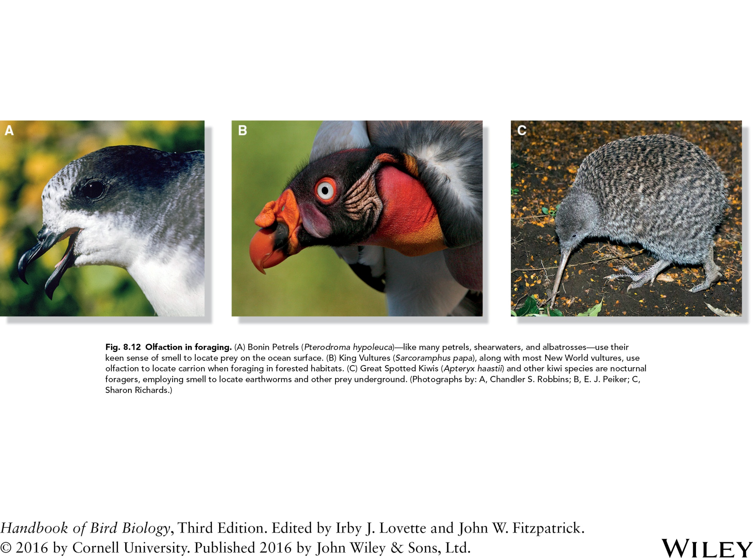

Slide 14
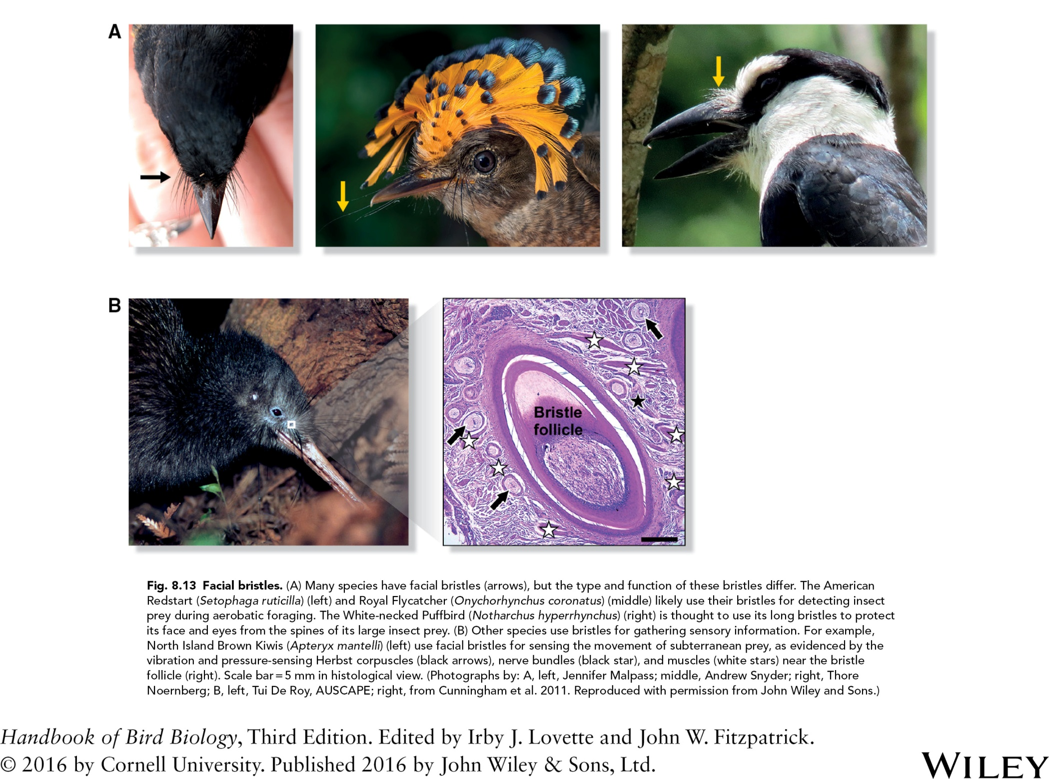
Fig. 8.13 Facial bristles. (A) Many species have facial bristles (arrows), but the type and function of these bristles differ. The American
Redstart (Setophaga ruticilla) (left) and Royal Flycatcher (Onychorhynchus coronatus) (middle) likely use their bristles for detecting insect
prey during aerobatic foraging. The White‐necked Puffbird (Notharchus hyperrhynchus) (right) is thought to use its long bristles to protect
its face and eyes from the spines of its large insect prey. (B) Other species use bristles for gathering sensory information. For example,
North Island Brown Kiwis (Apteryx mantelli) (left) use facial bristles for sensing the movement of subterranean prey, as evidenced by the
vibration and pressure‐sensing Herbst corpuscles (black arrows), nerve bundles (black star), and muscles (white stars) near the bristle
follicle (right). Scale bar = 5 μm in histological view. (Photographs by: A, left, Jennifer Malpass; middle, Andrew Snyder; right, Thore
Noernberg; B, left, Tui De Roy, AUSCAPE; right, from Cunningham et al. 2011. Reproduced with permission from John Wiley and Sons.)

Slide 15
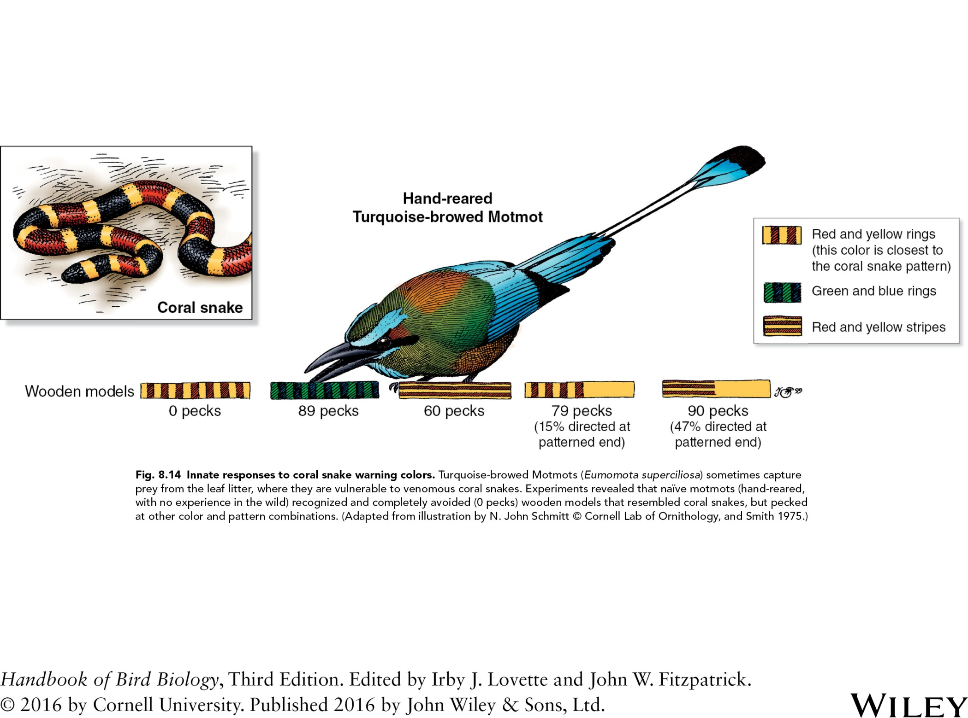

Slide 16
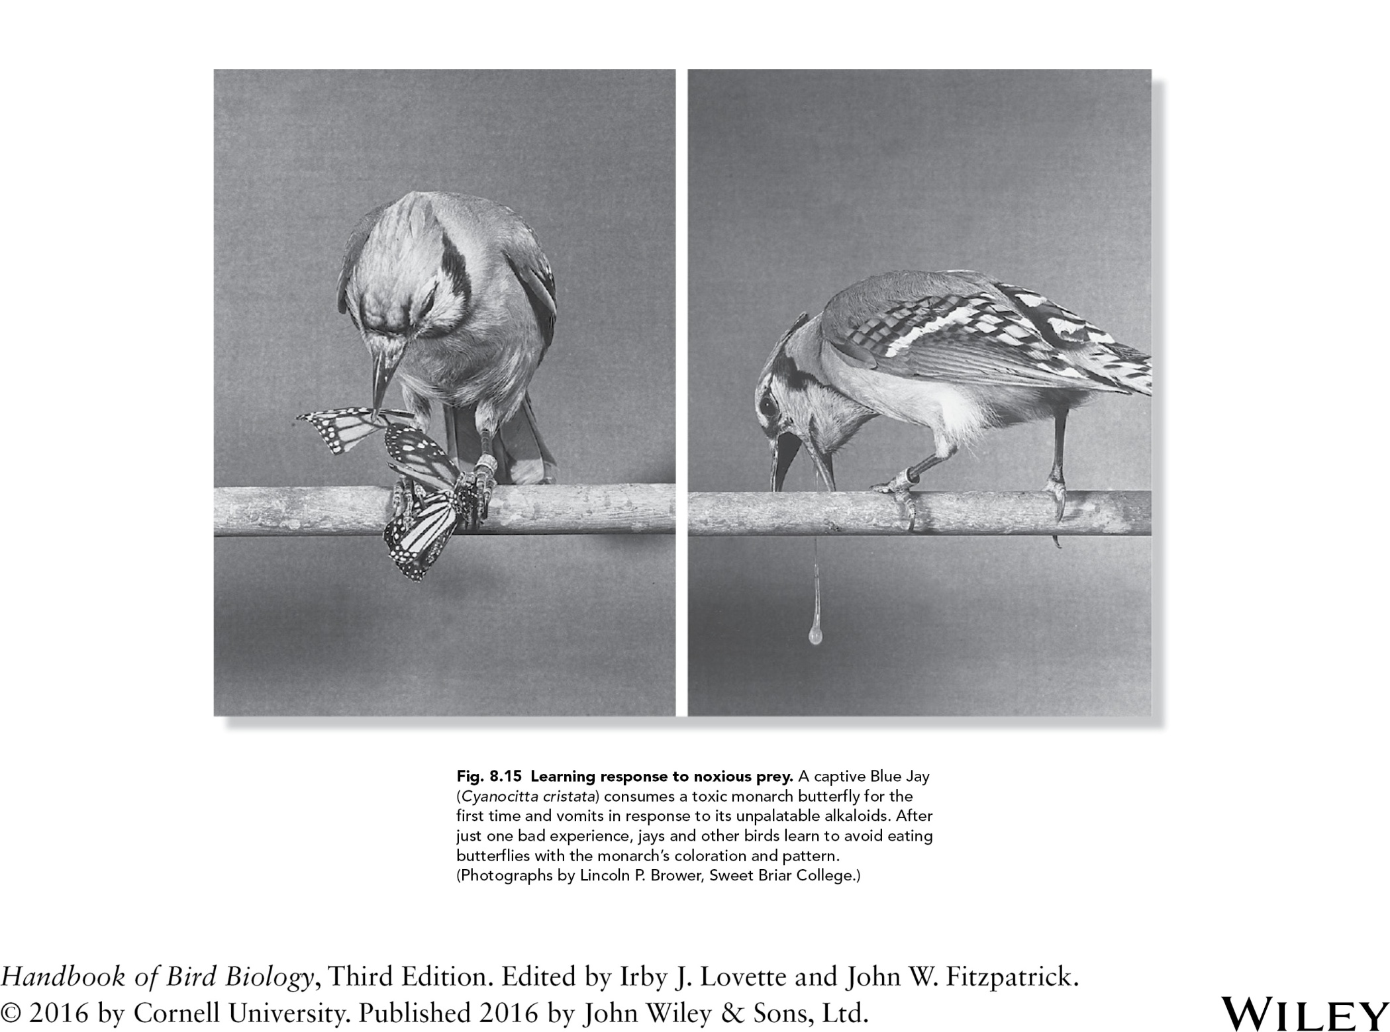

Slide 17
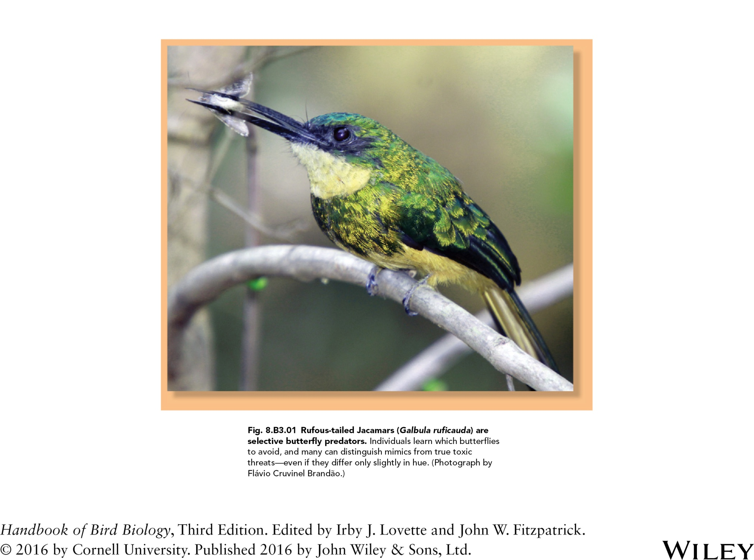

Slide 18
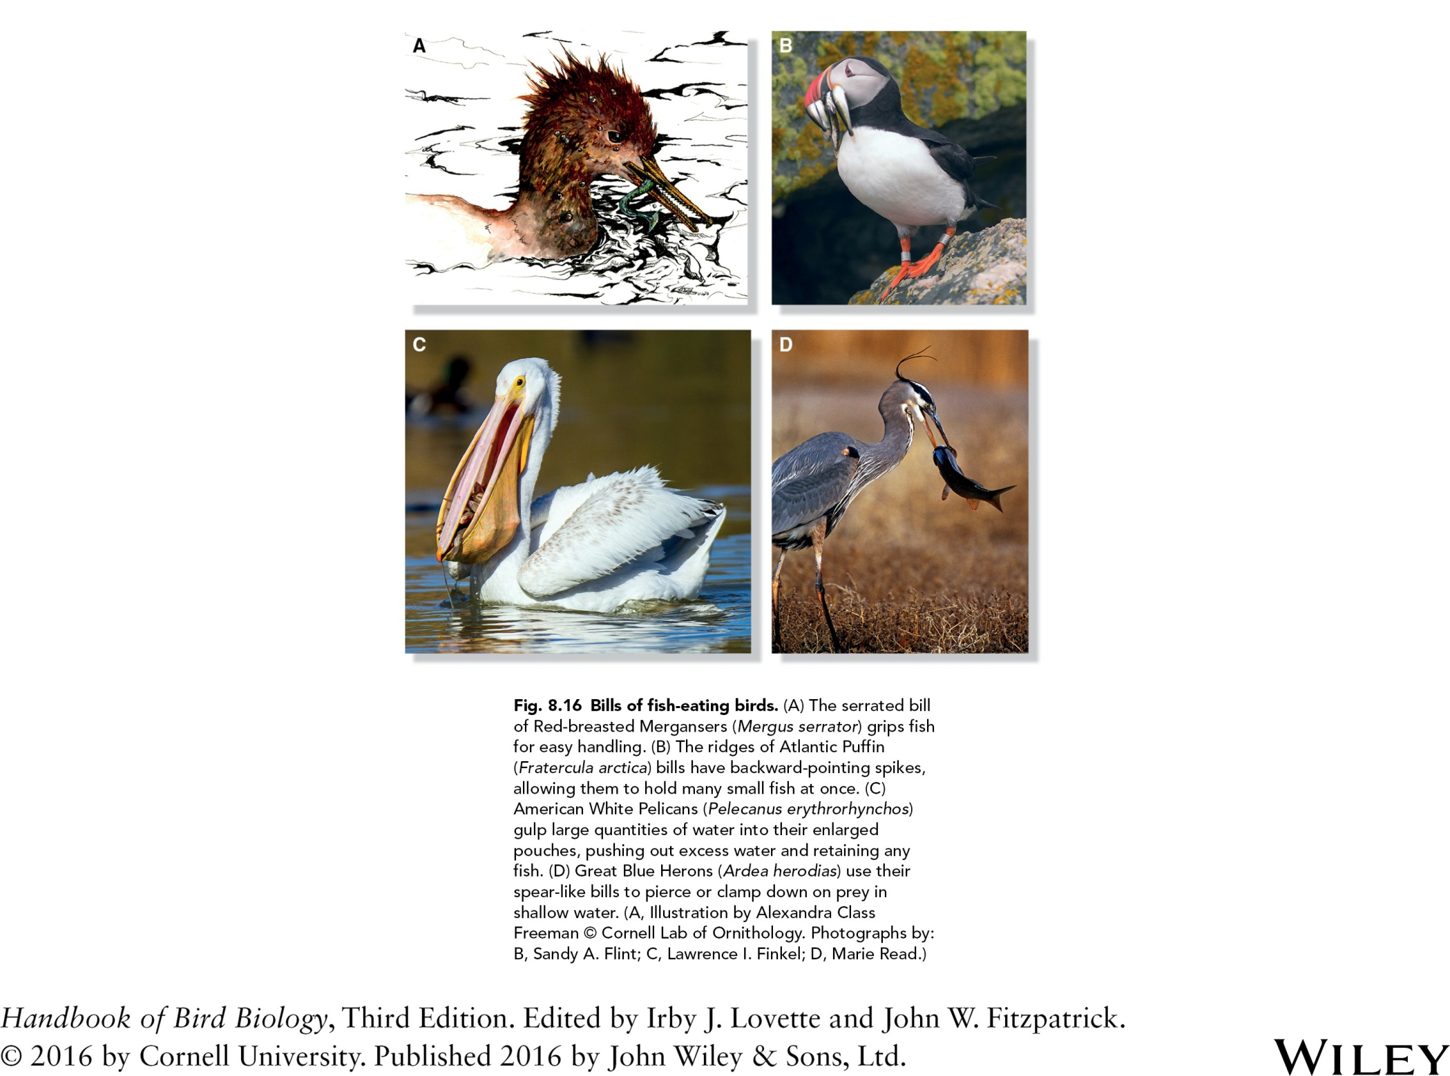

Slide 19
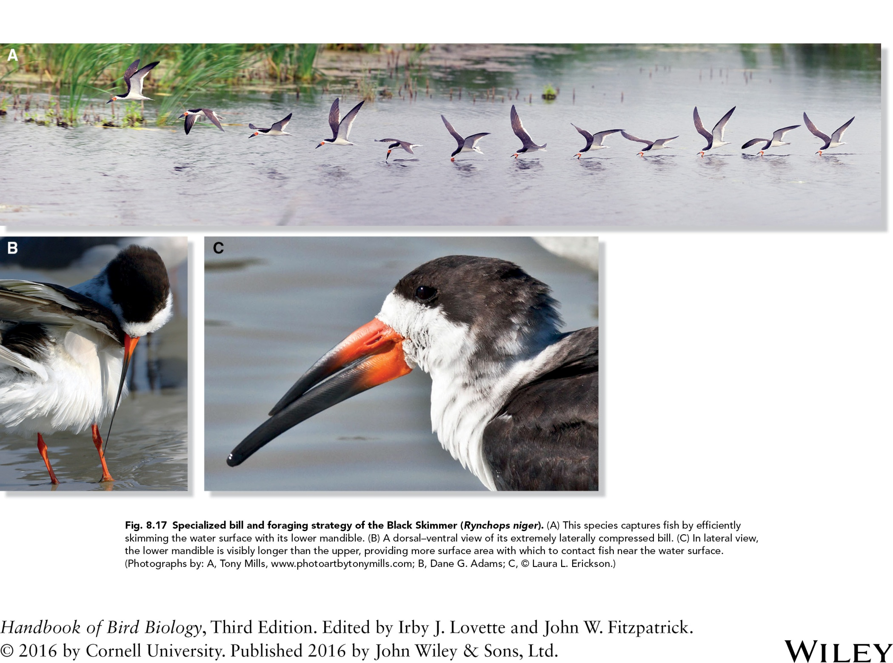

Slide 20
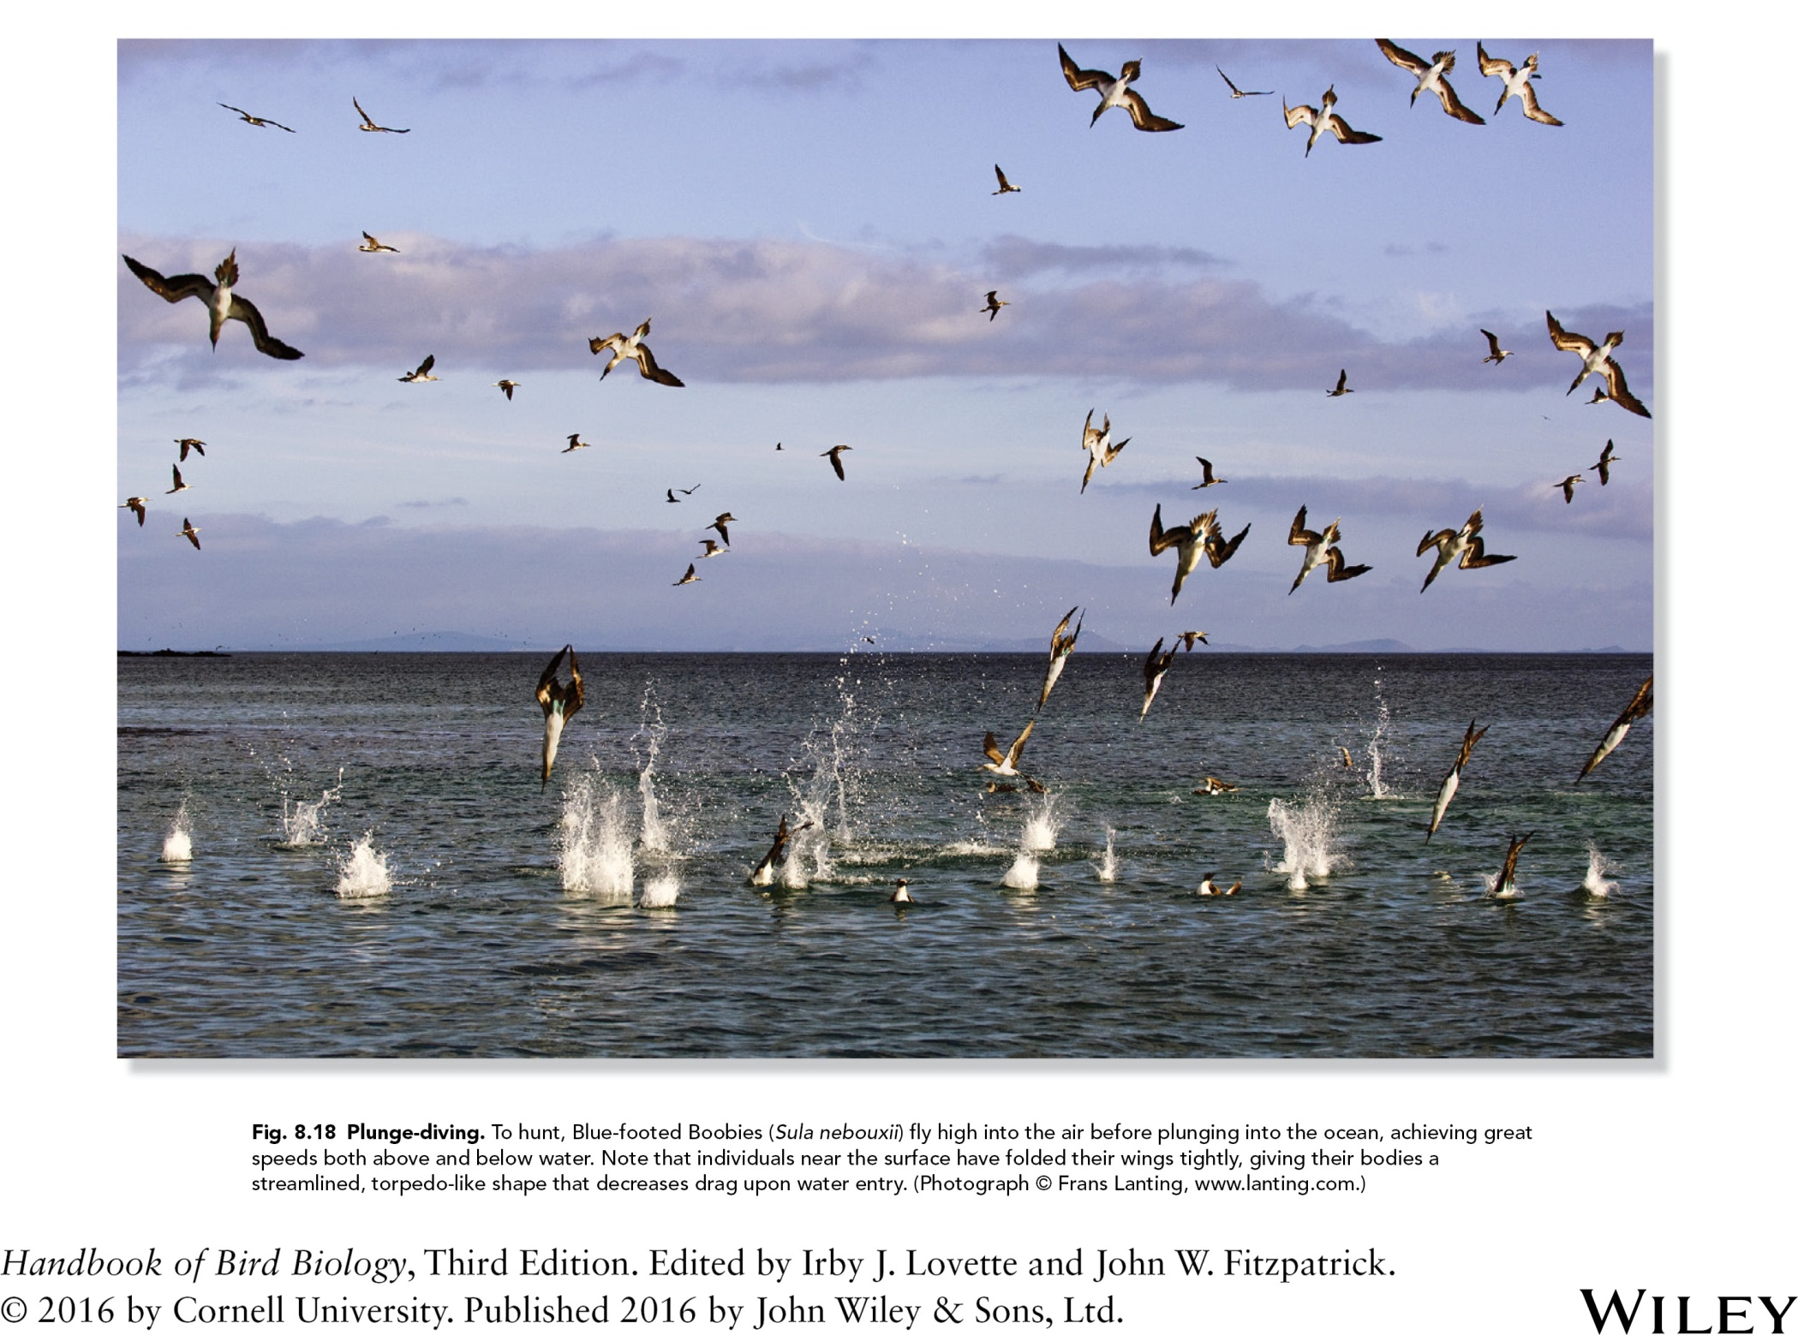

Slide 21
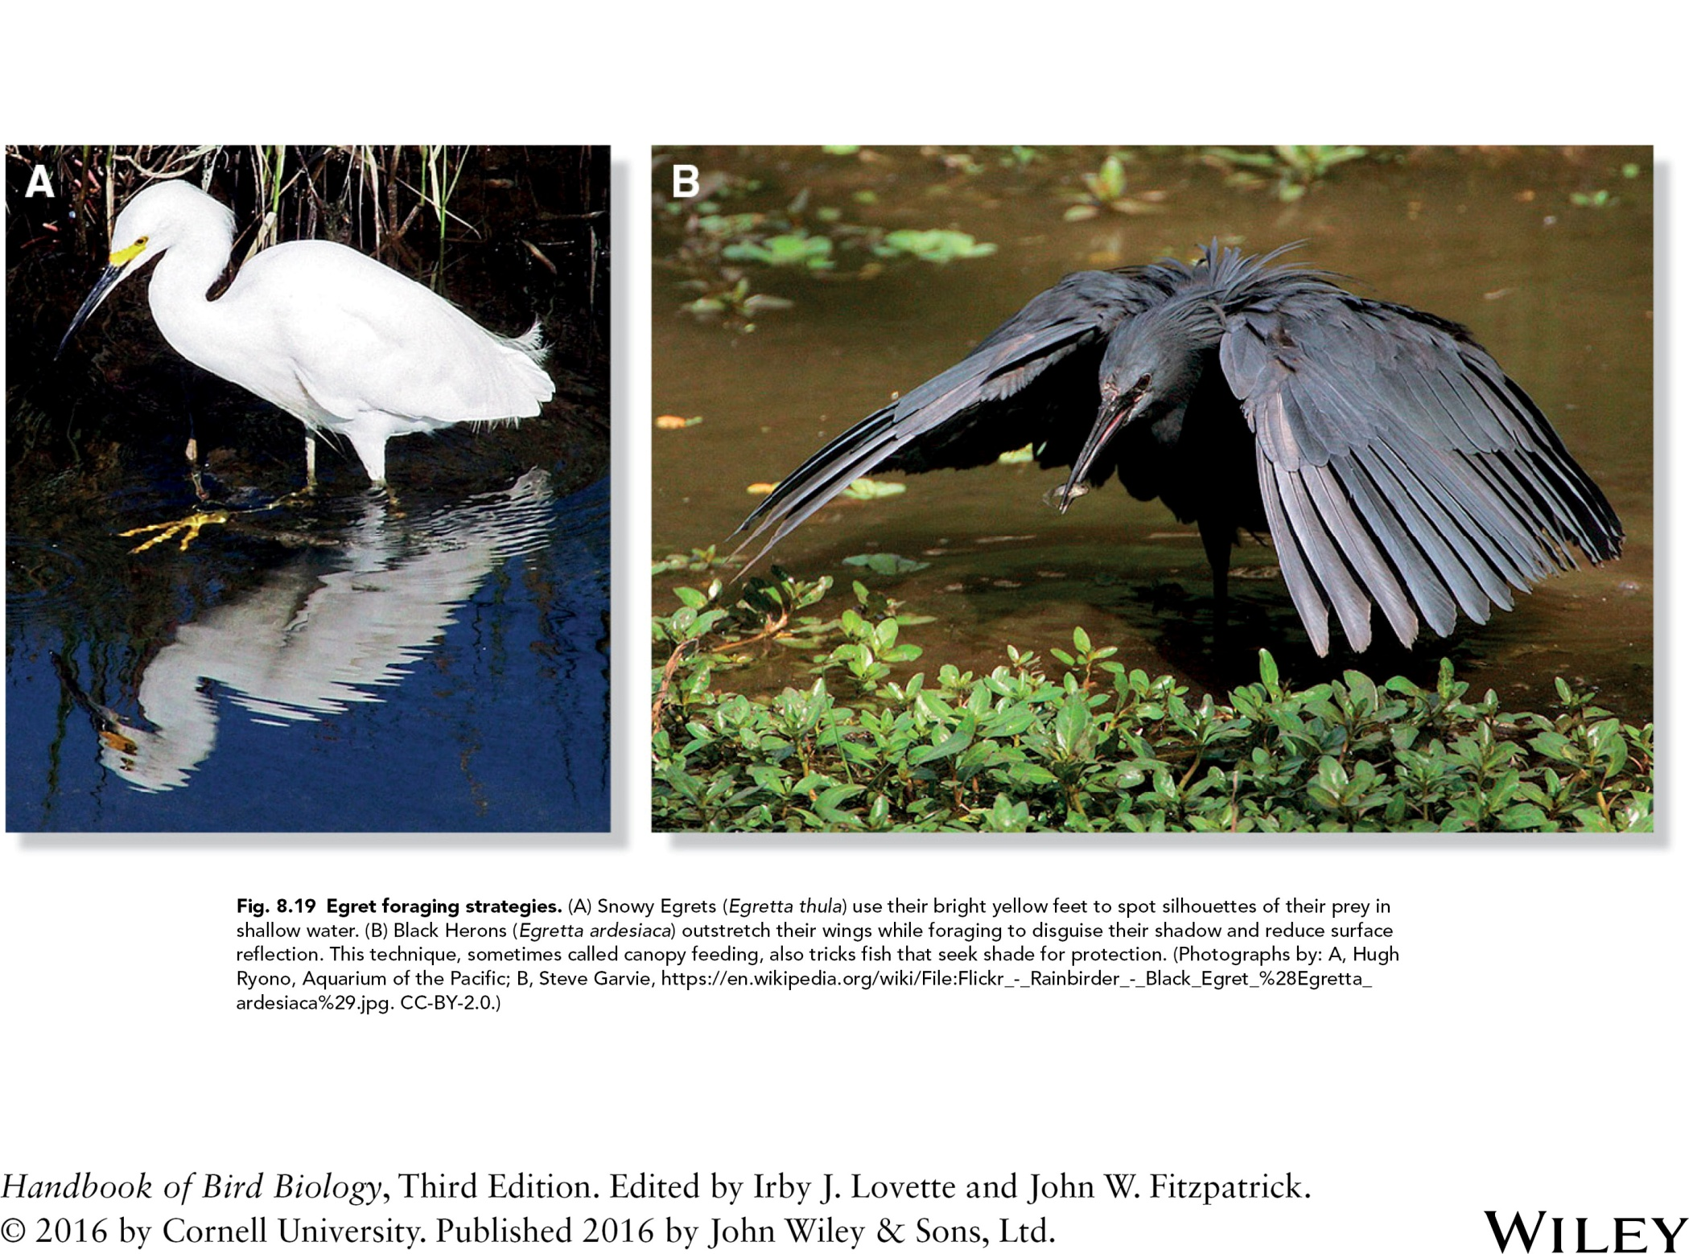

Slide 22
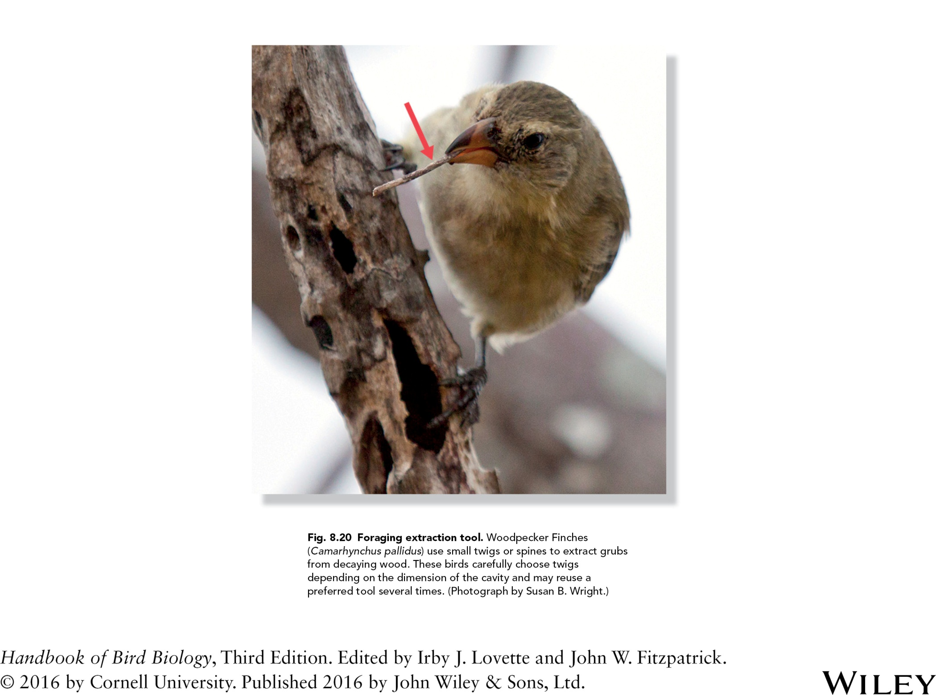

Slide 23
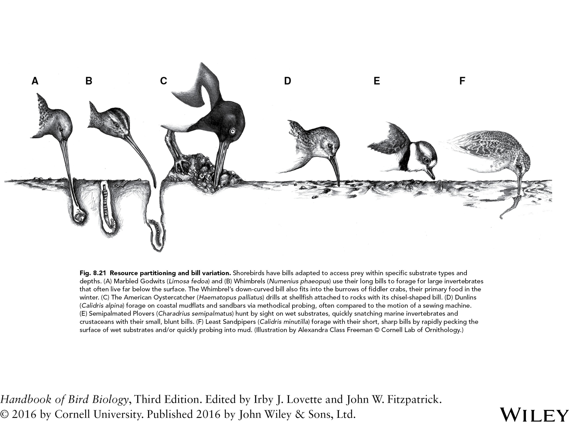

Slide 24
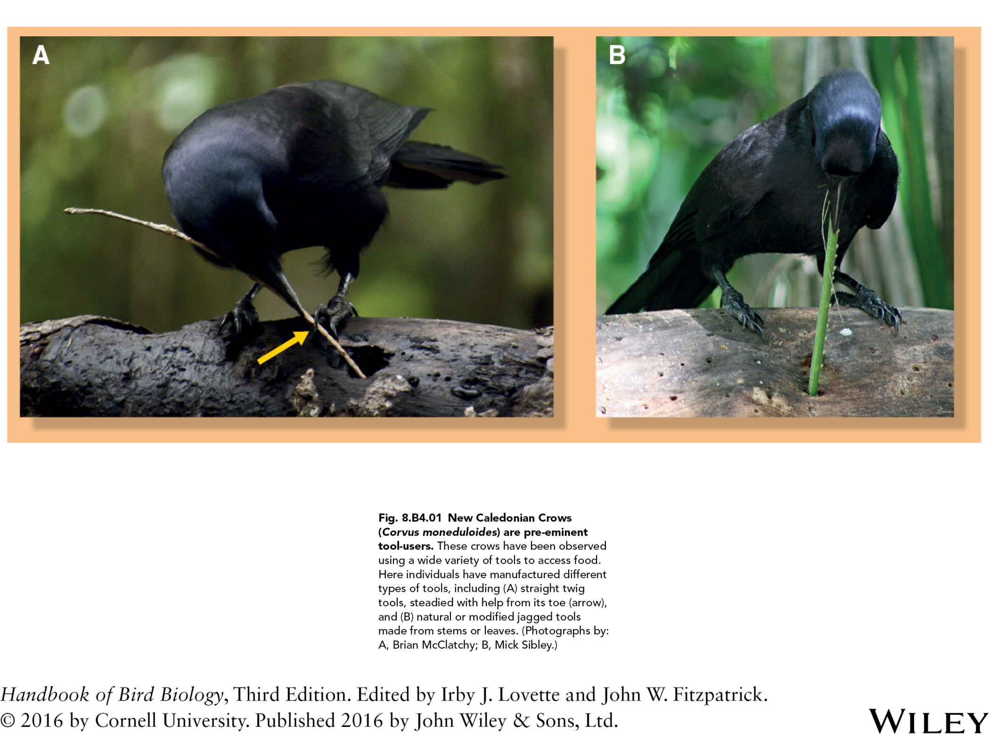

Slide 25
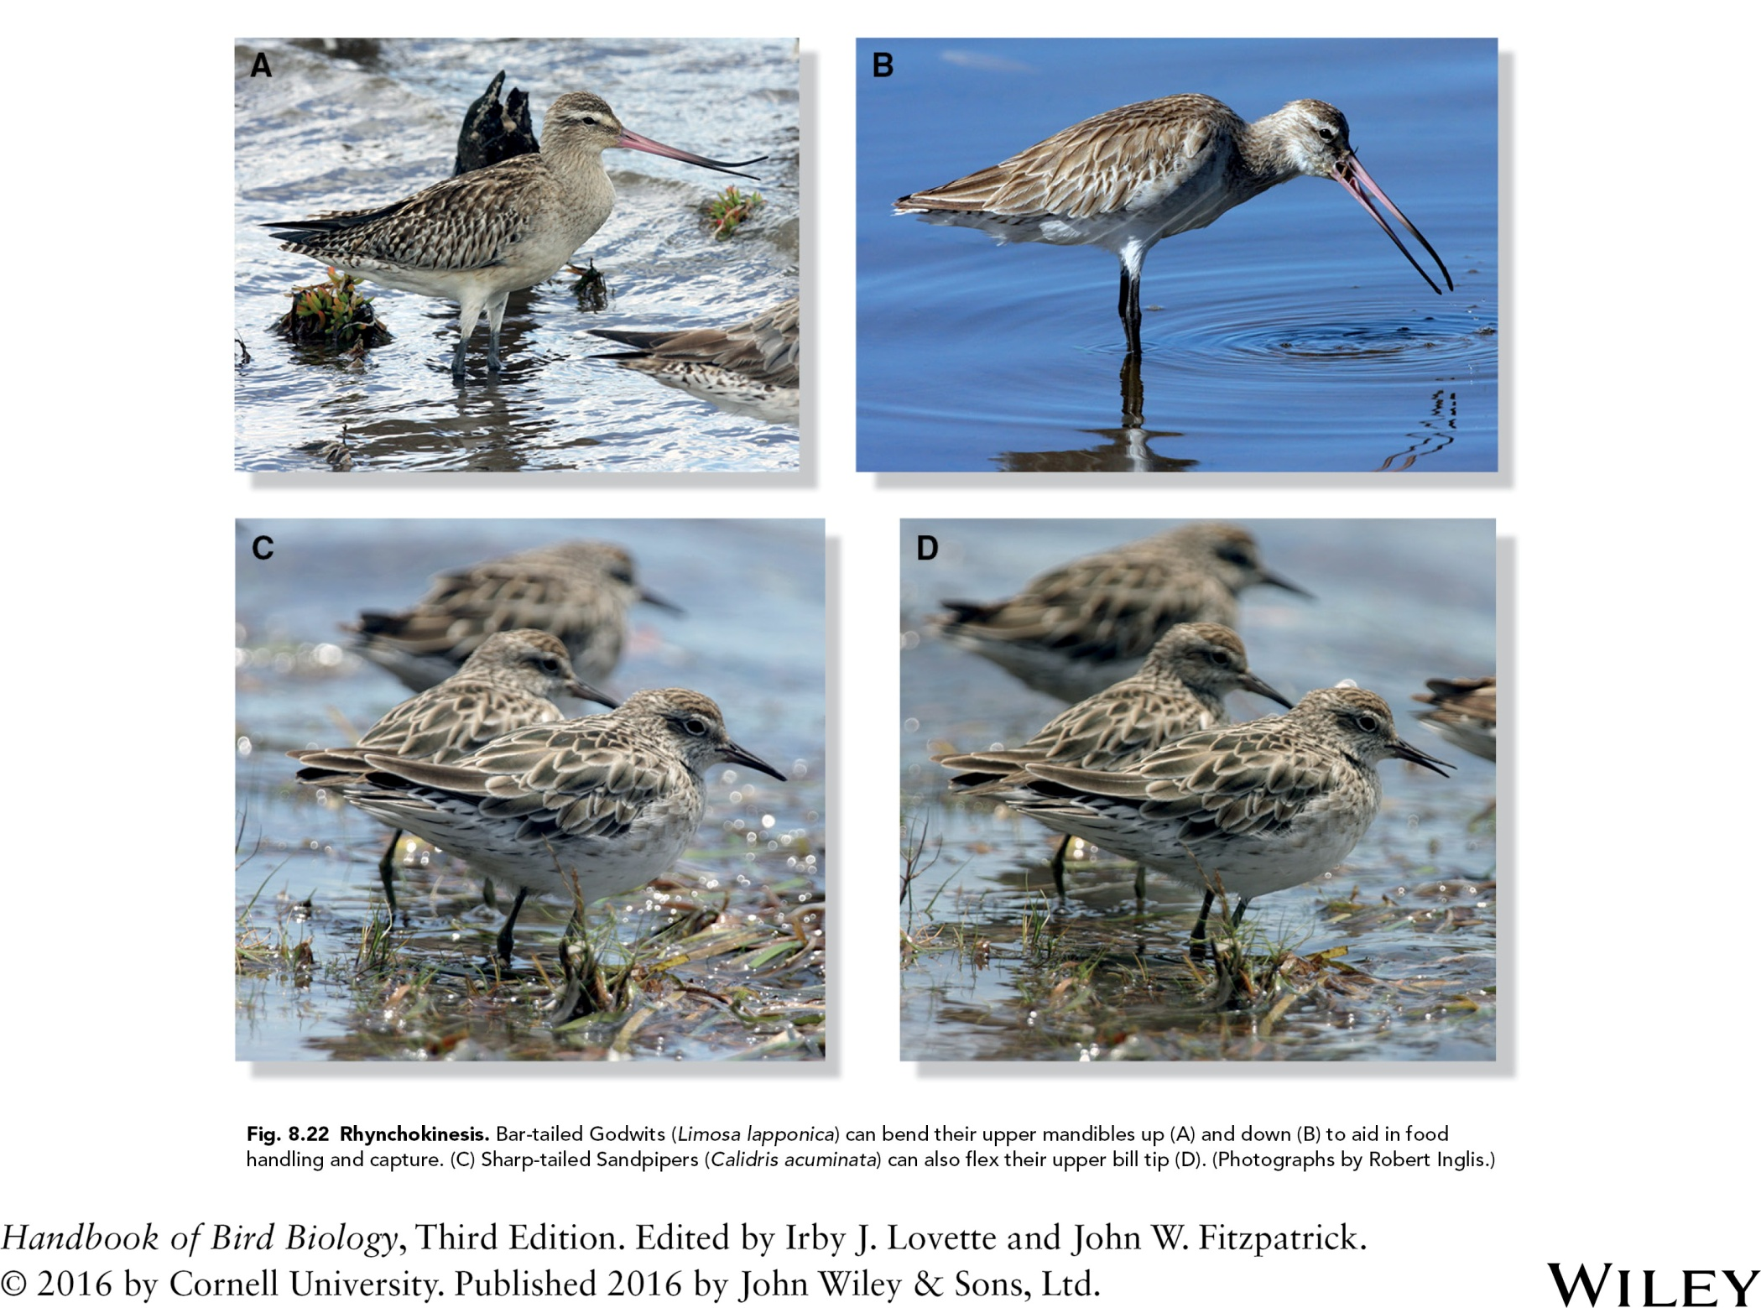

Slide 26
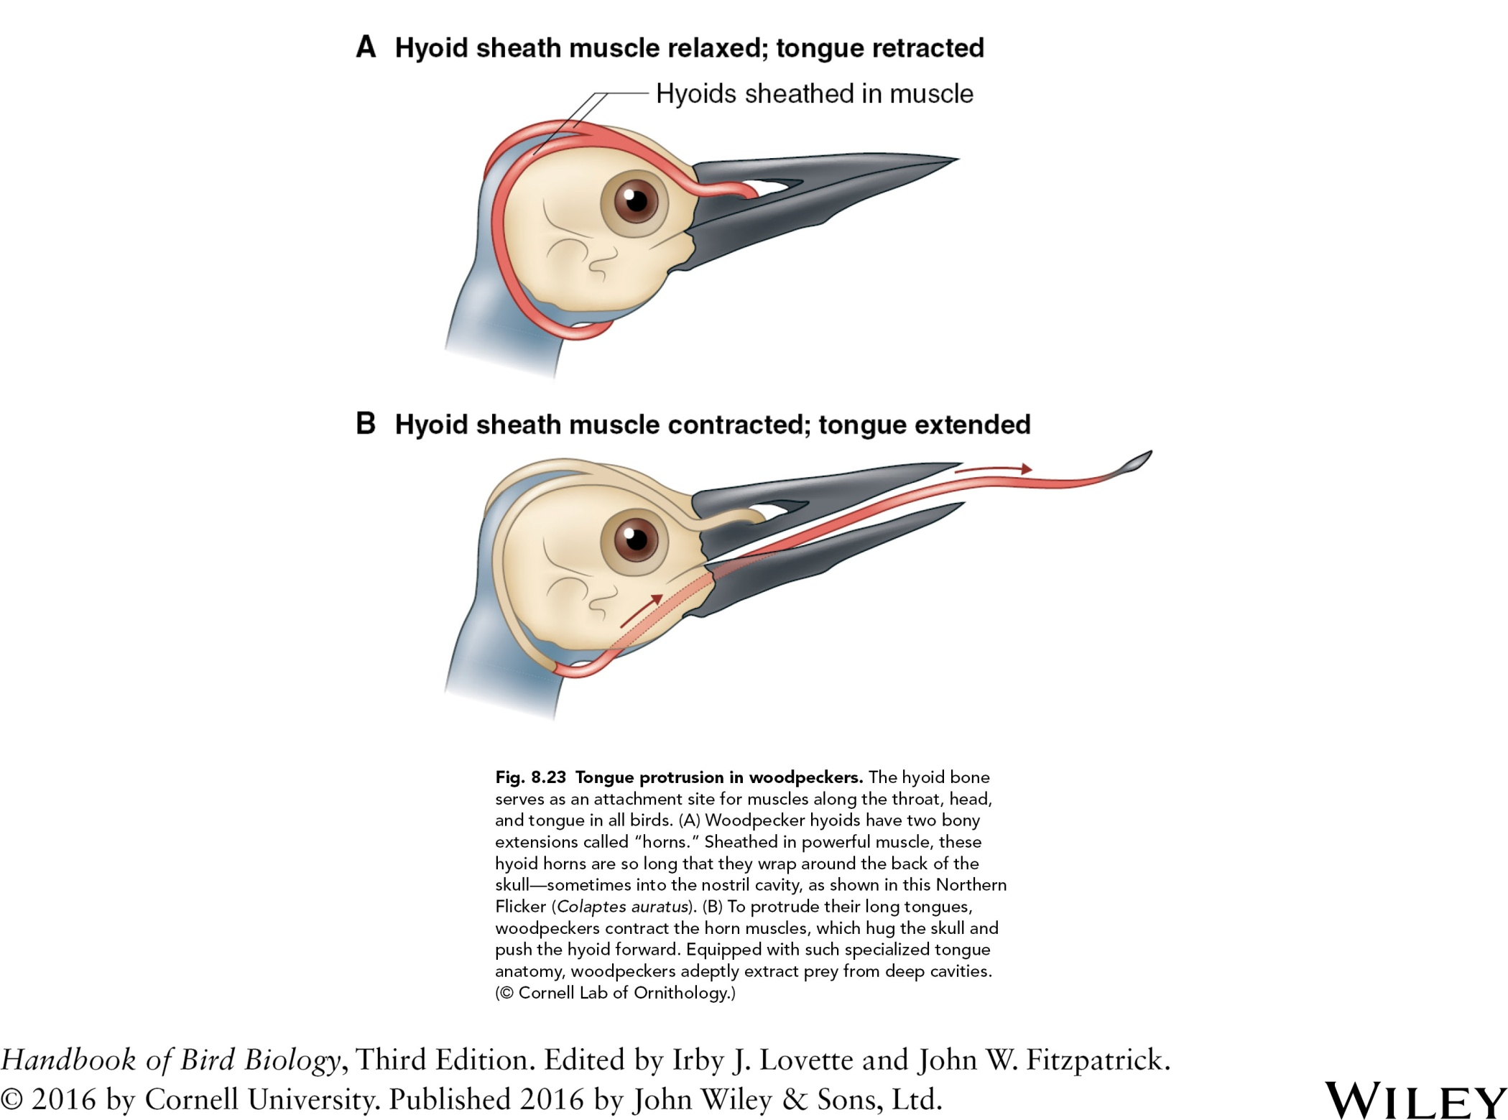

Slide 27
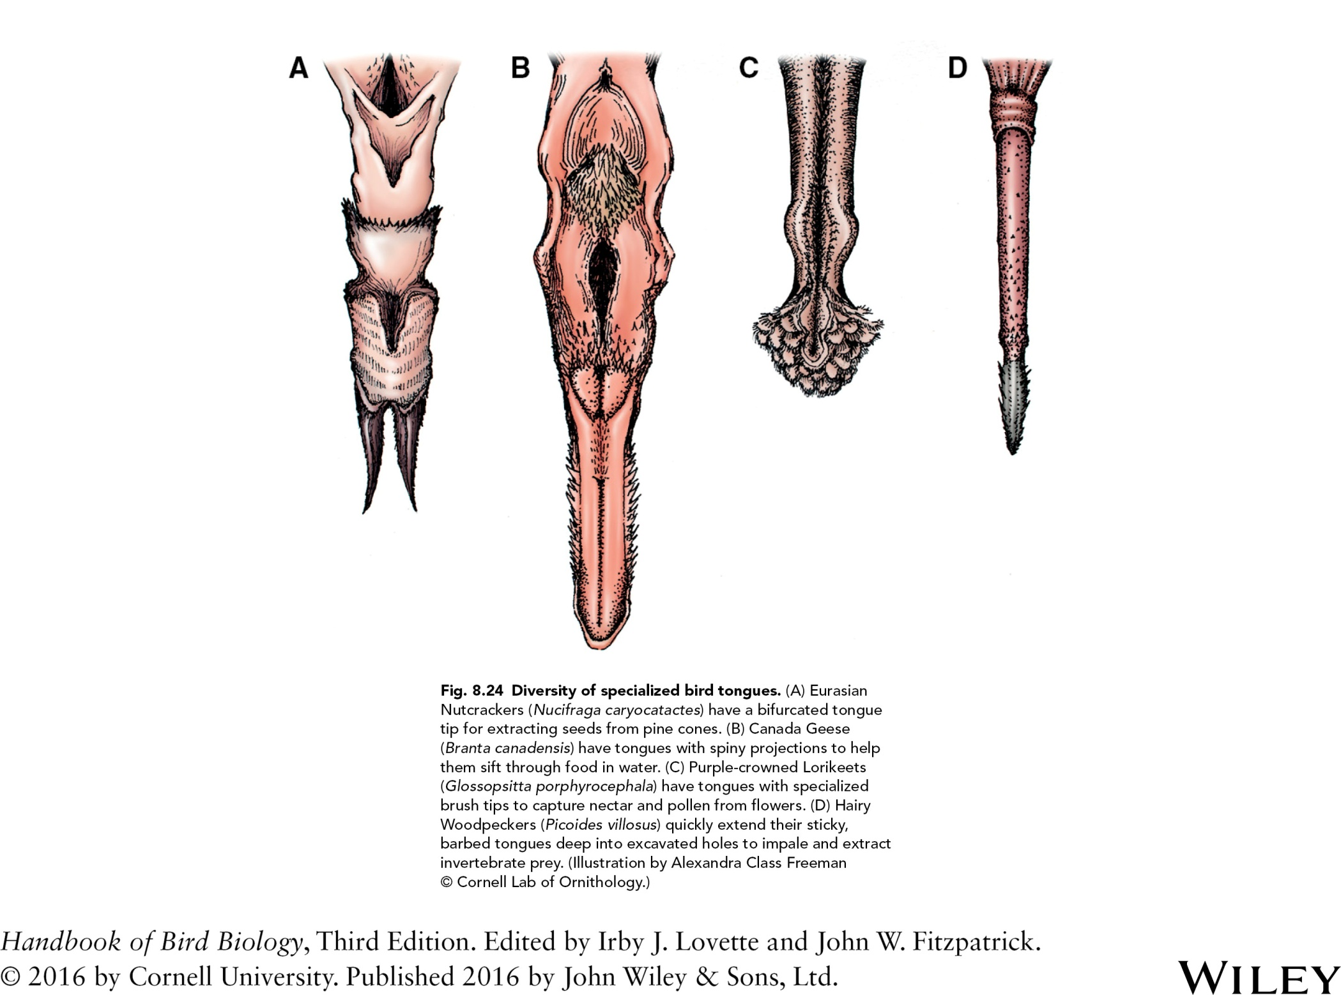

Slide 28
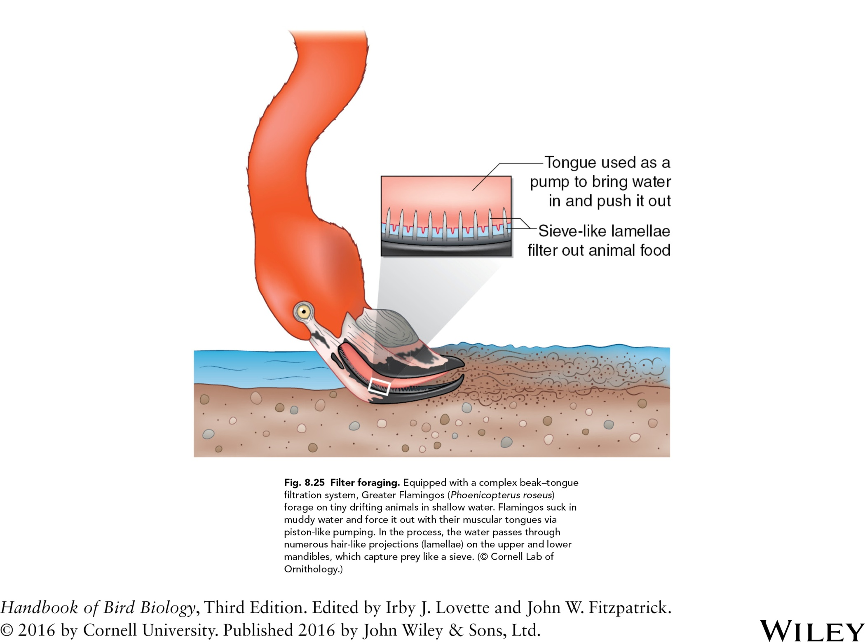

Slide 29
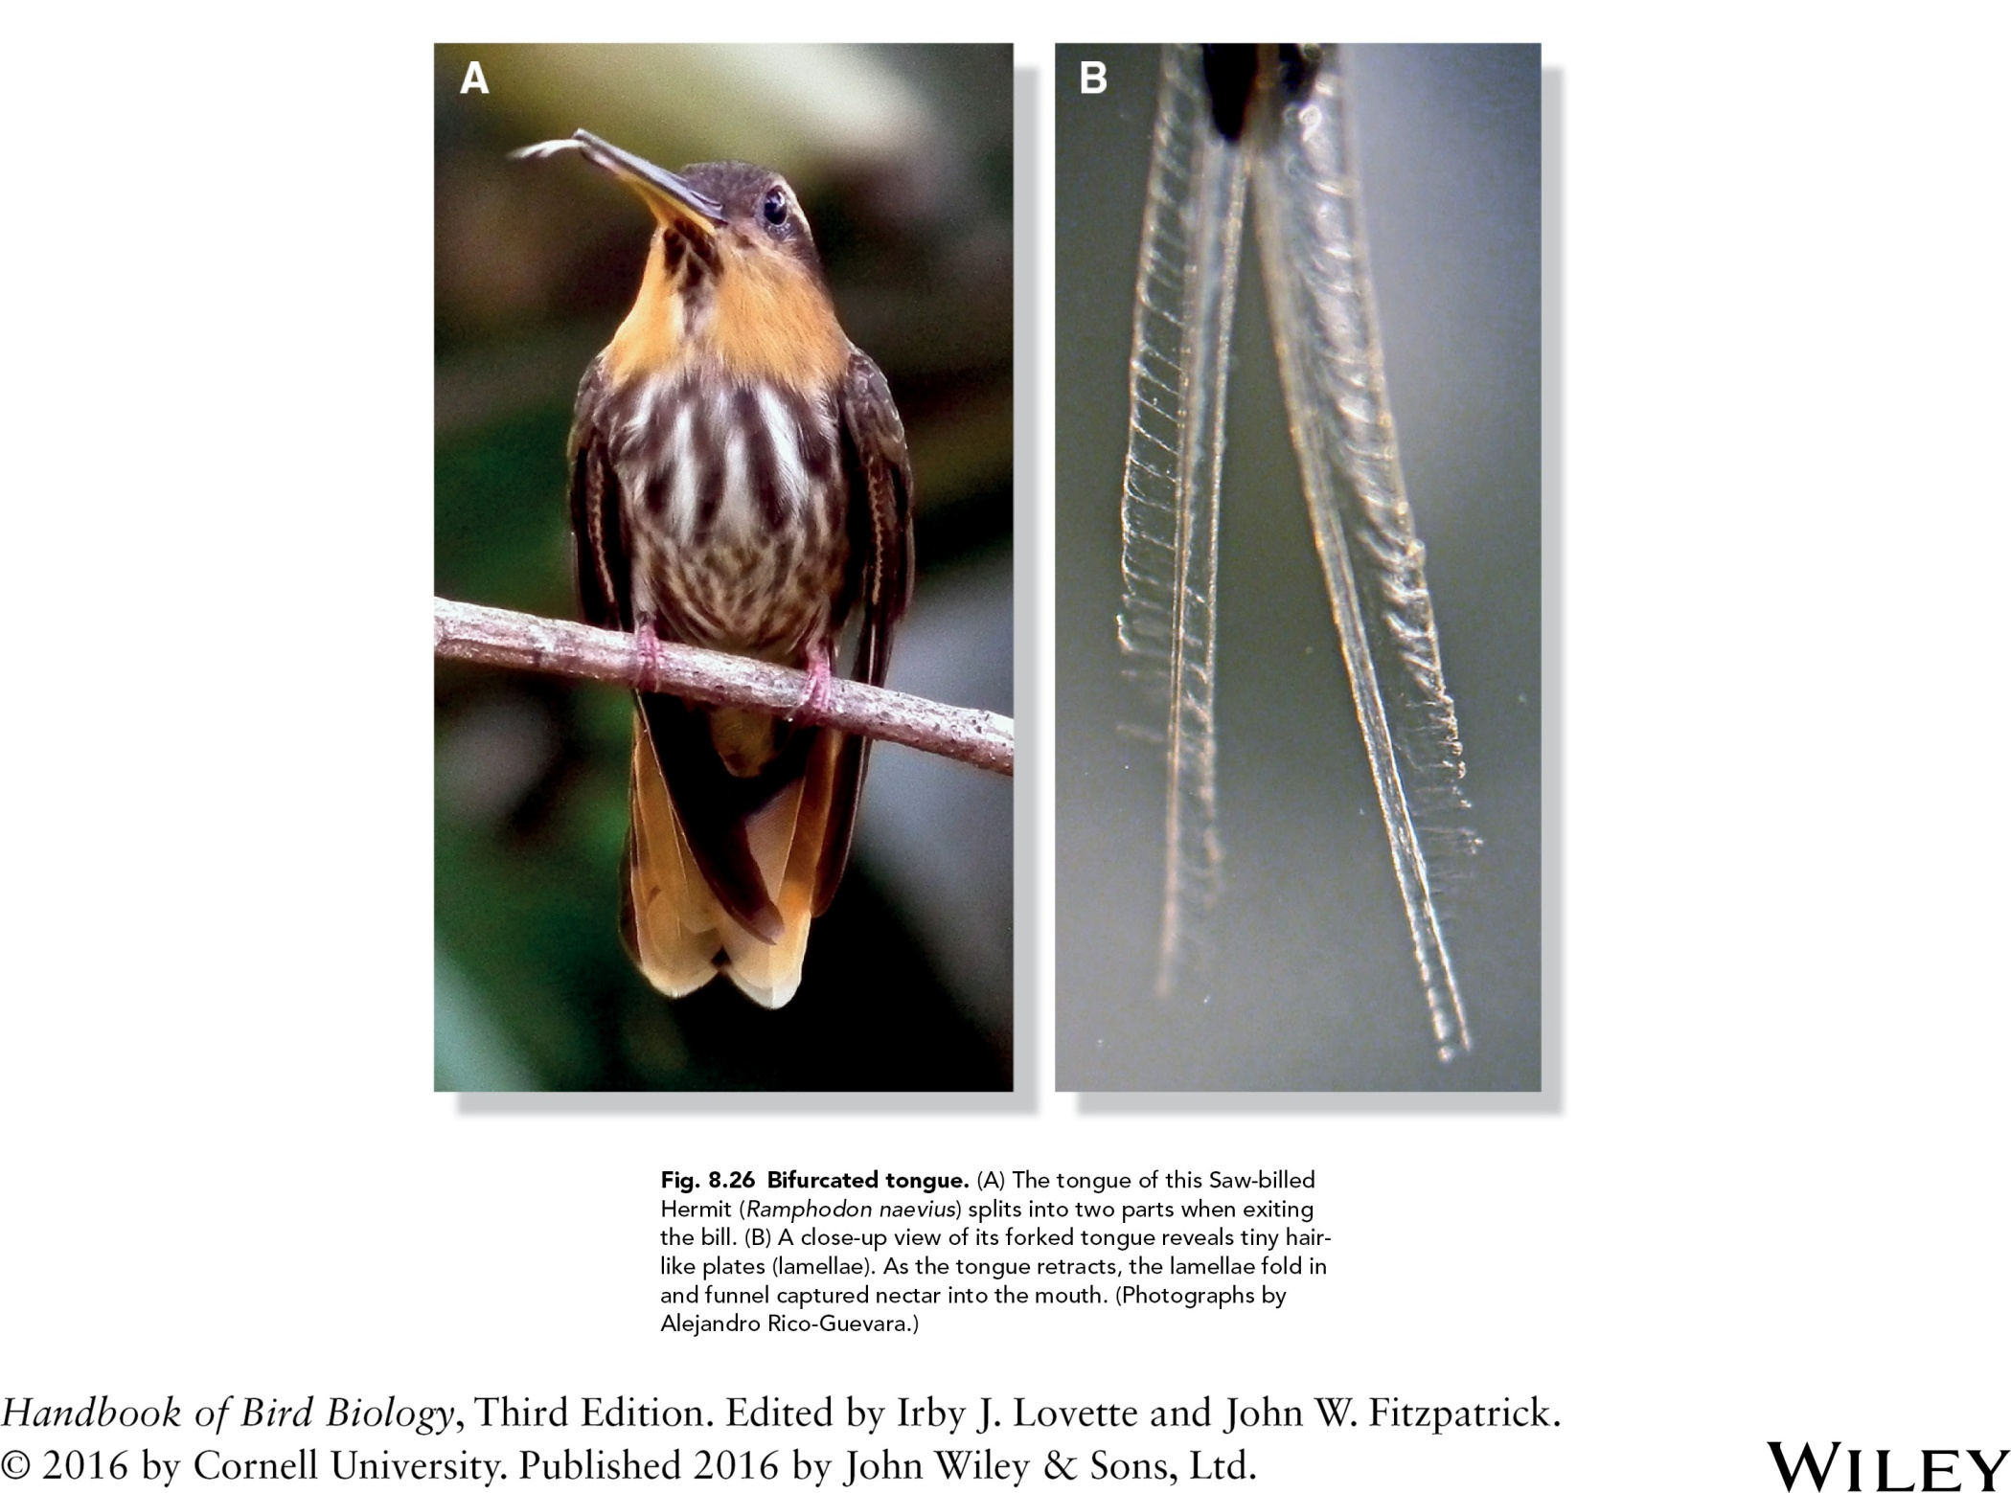

Slide 30
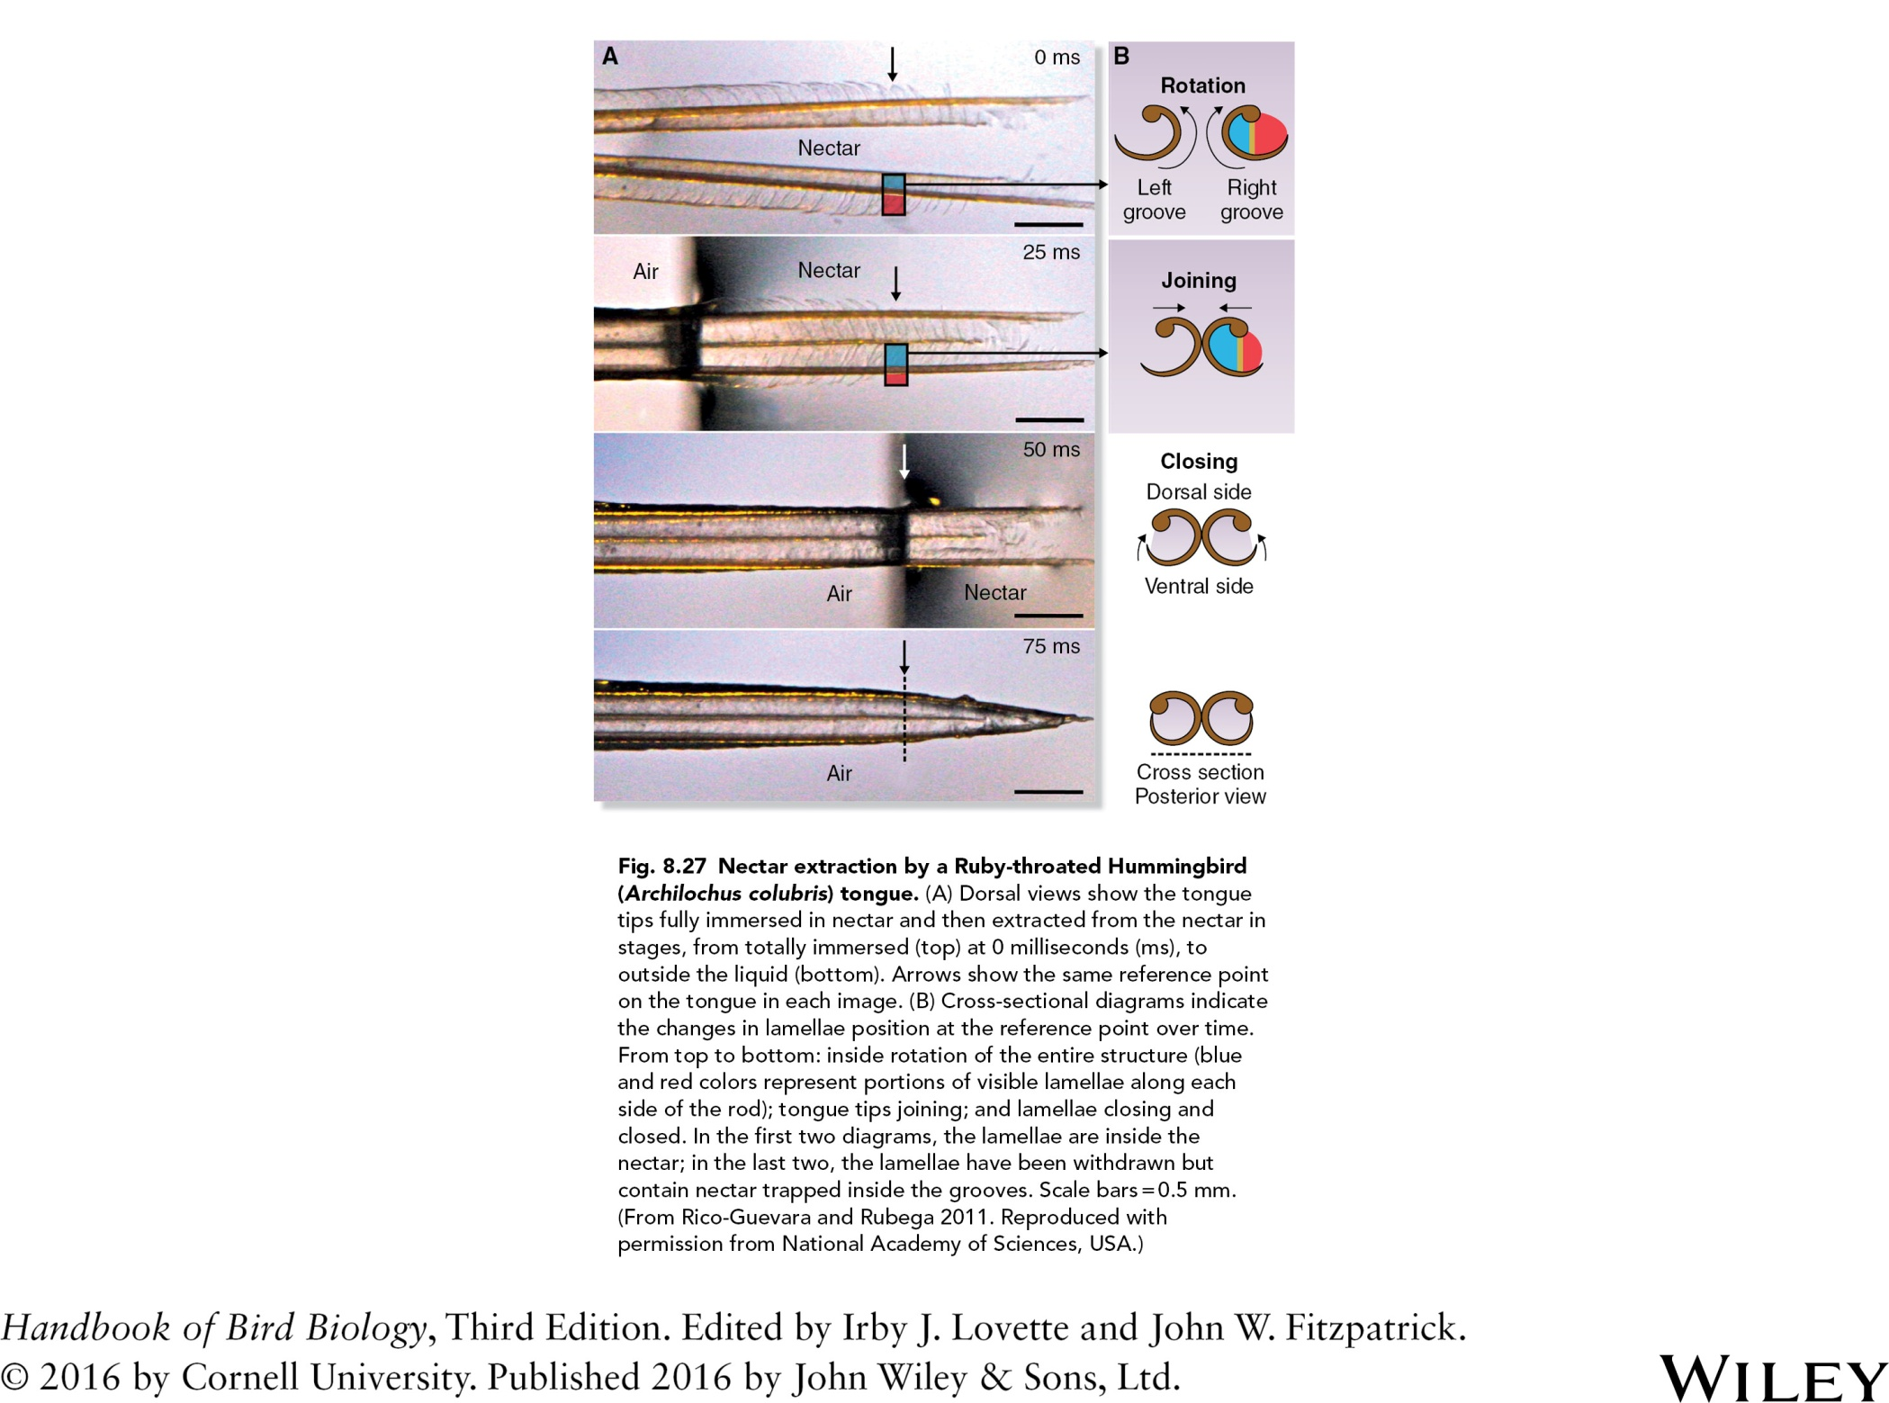

Slide 31
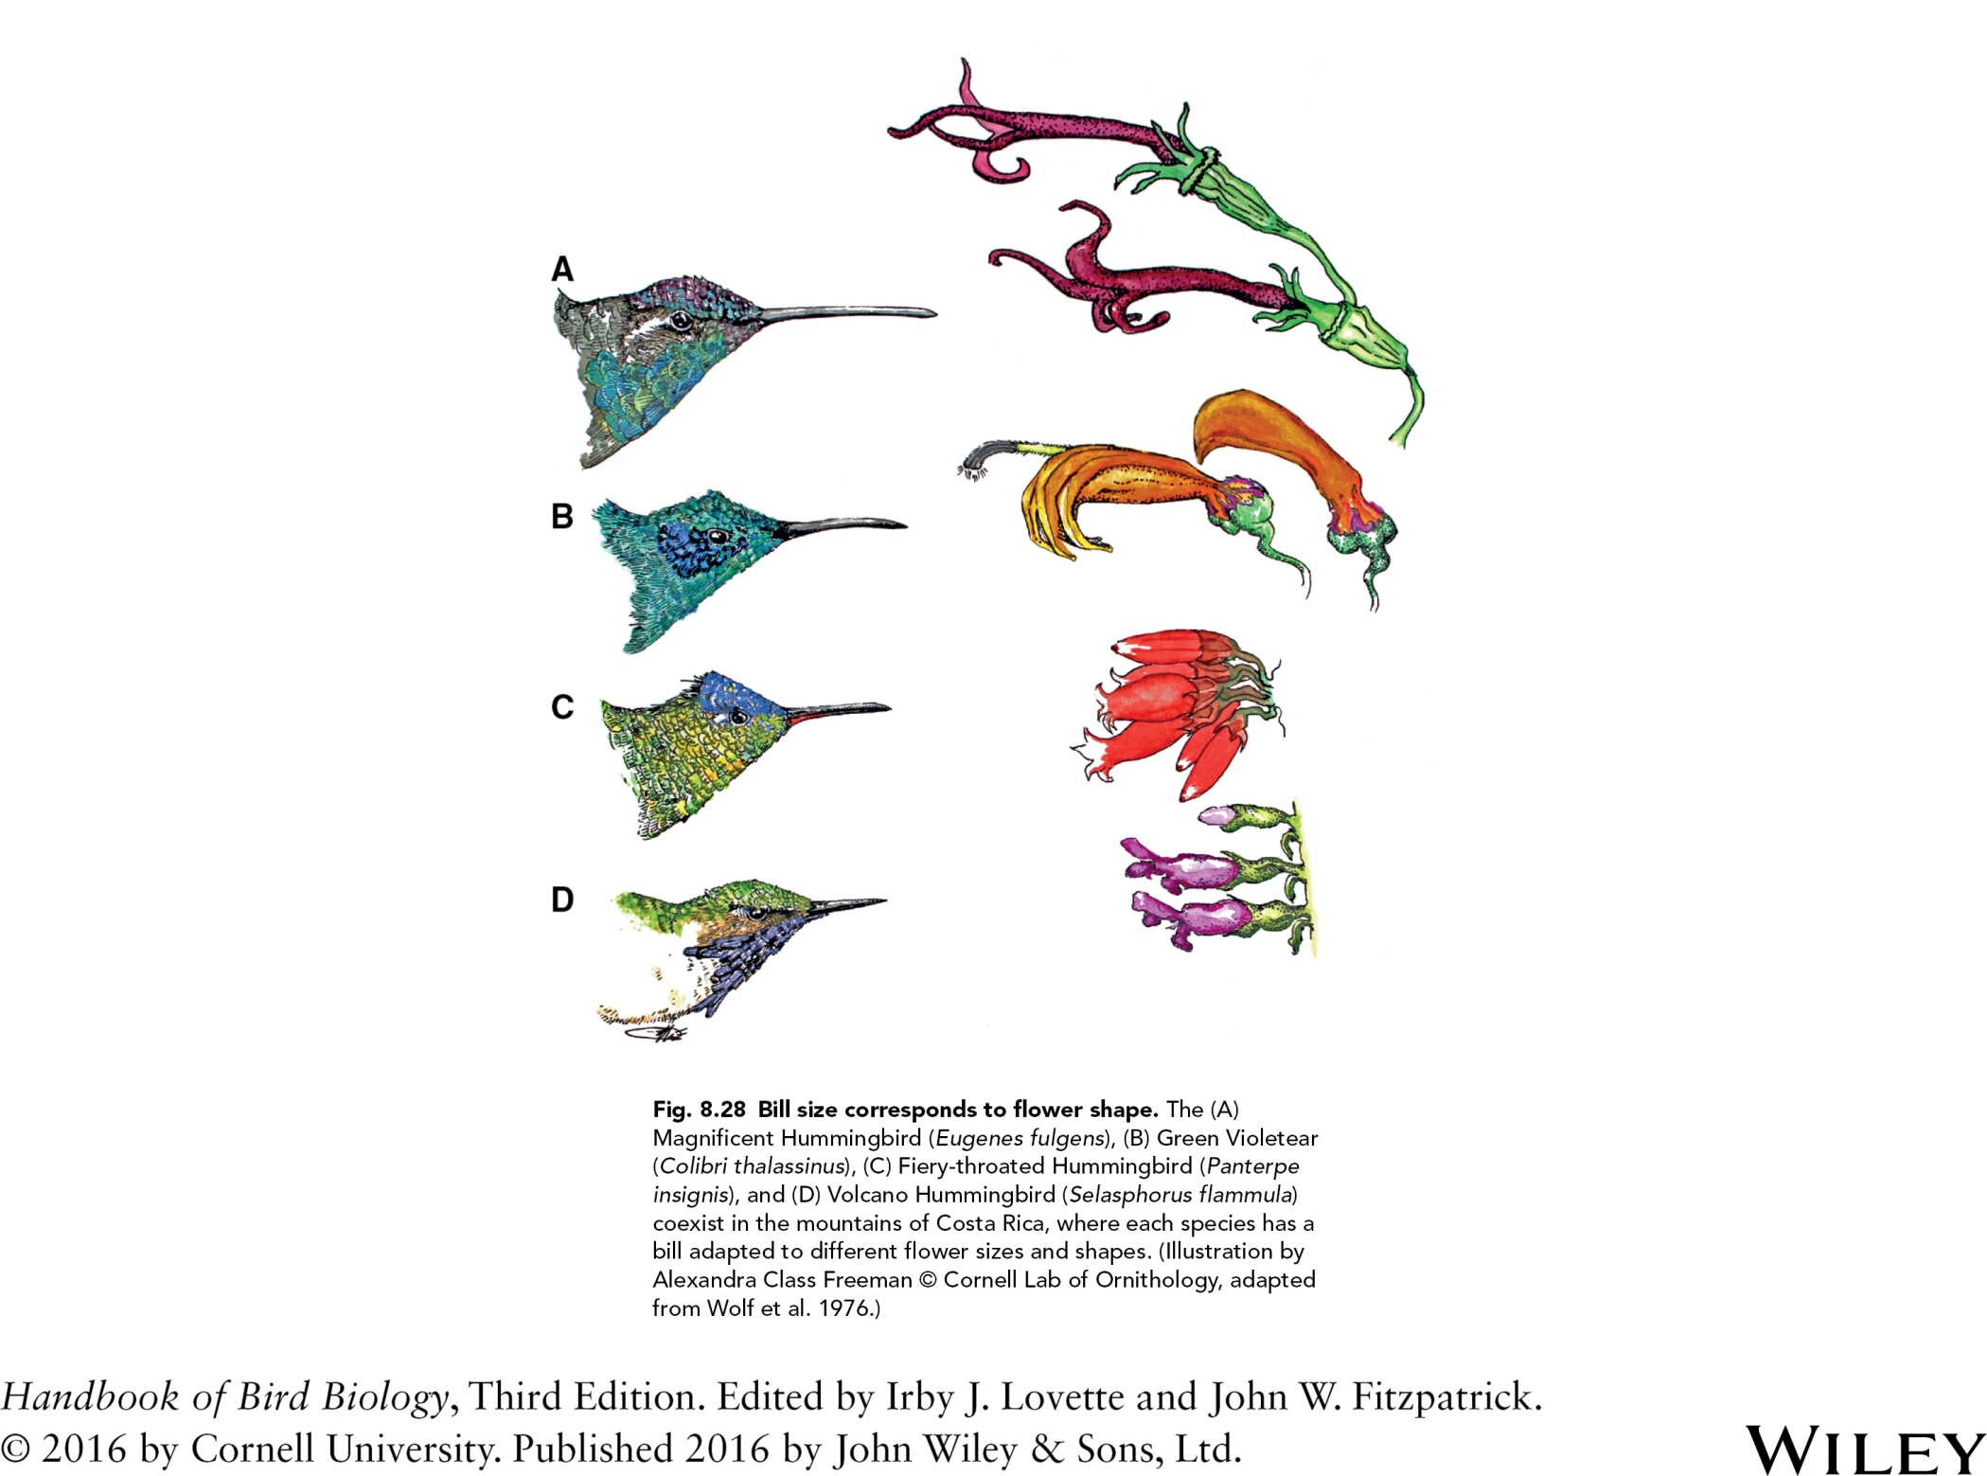

Slide 32
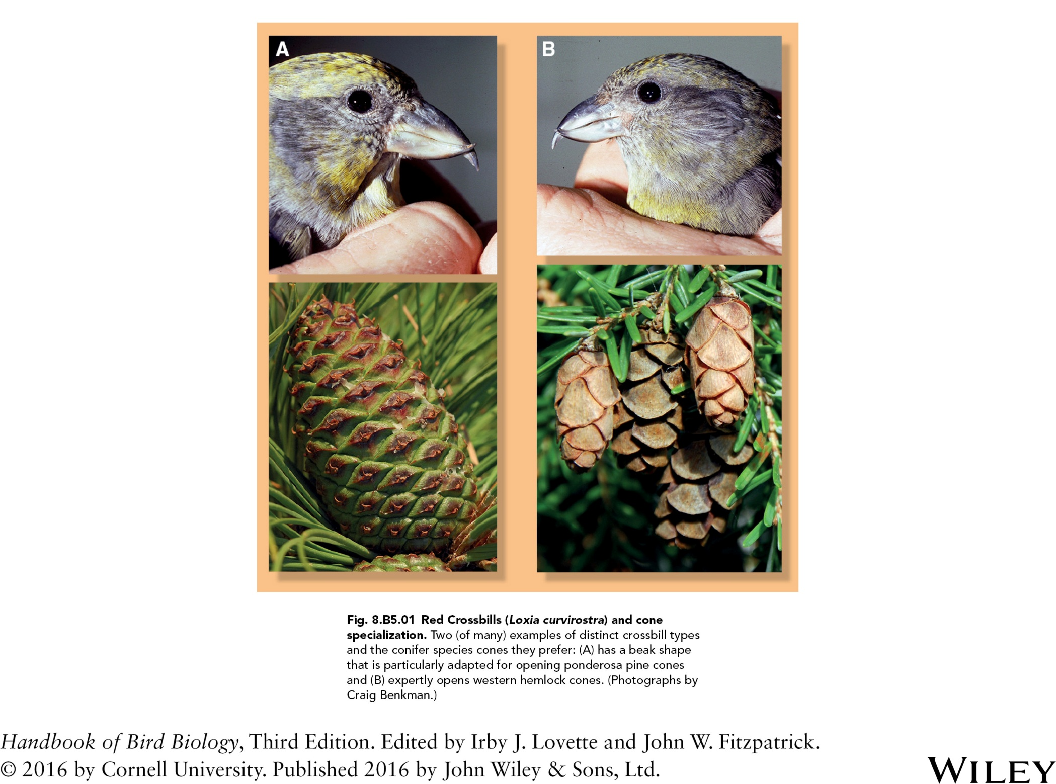

Slide 33
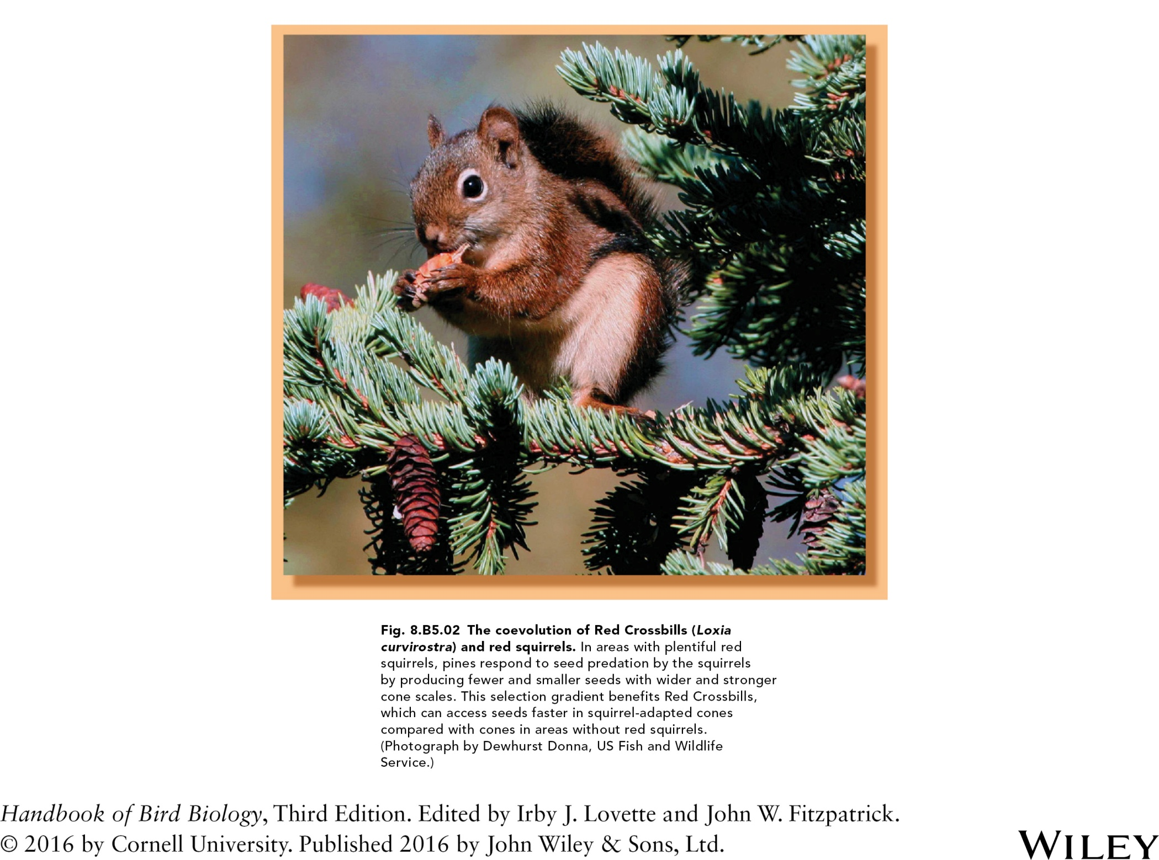

Slide 34
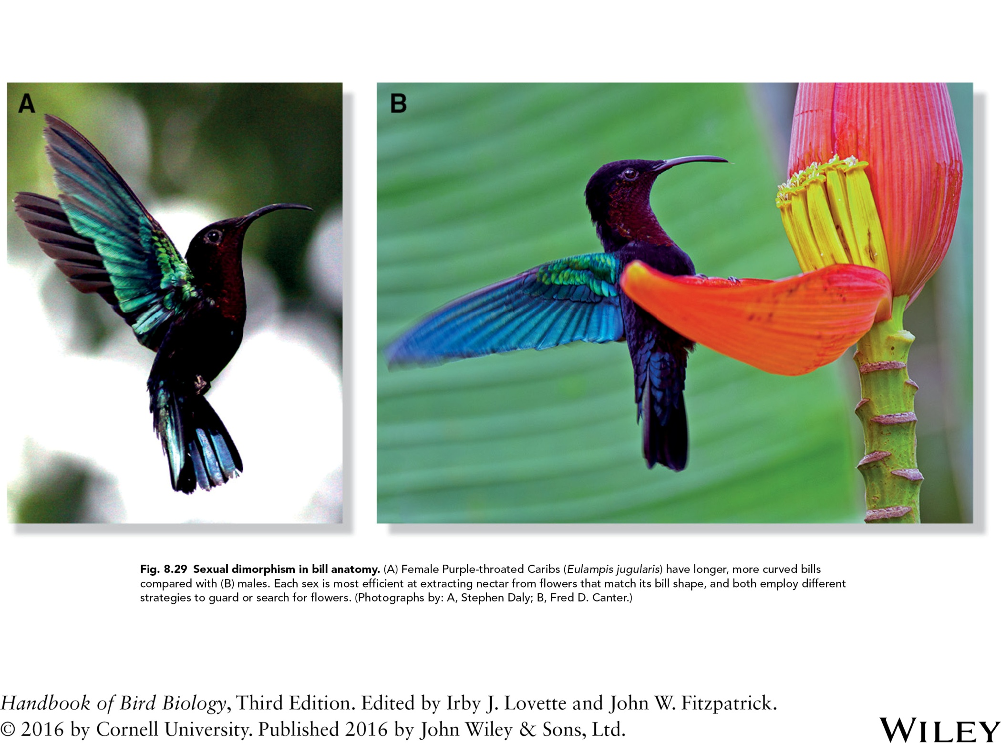

Slide 35
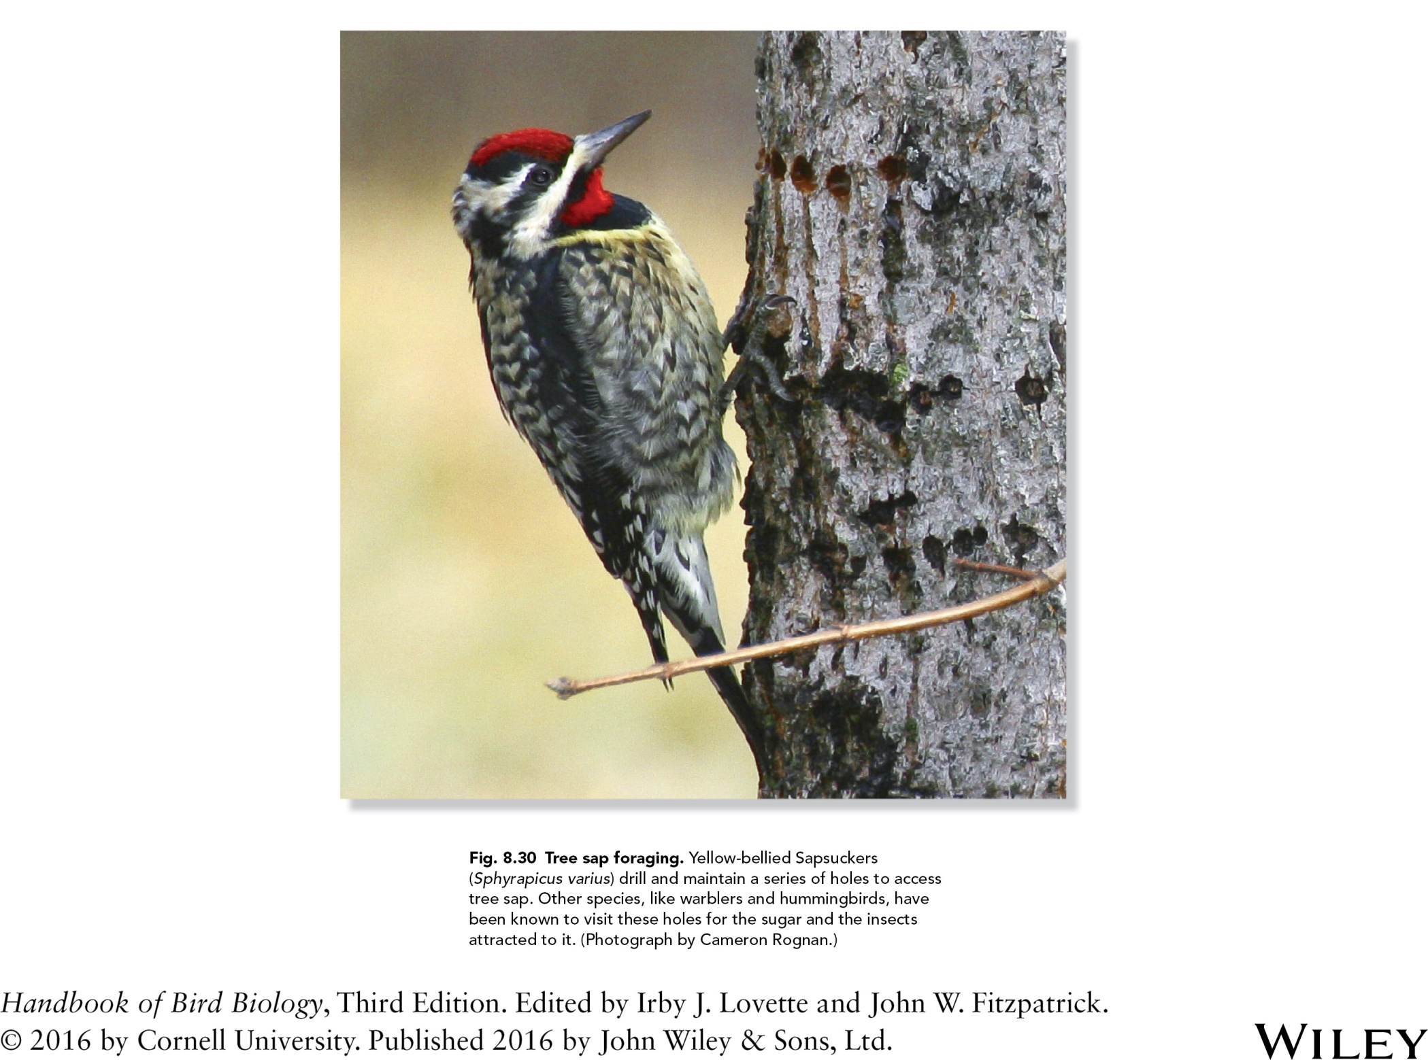

Slide 36
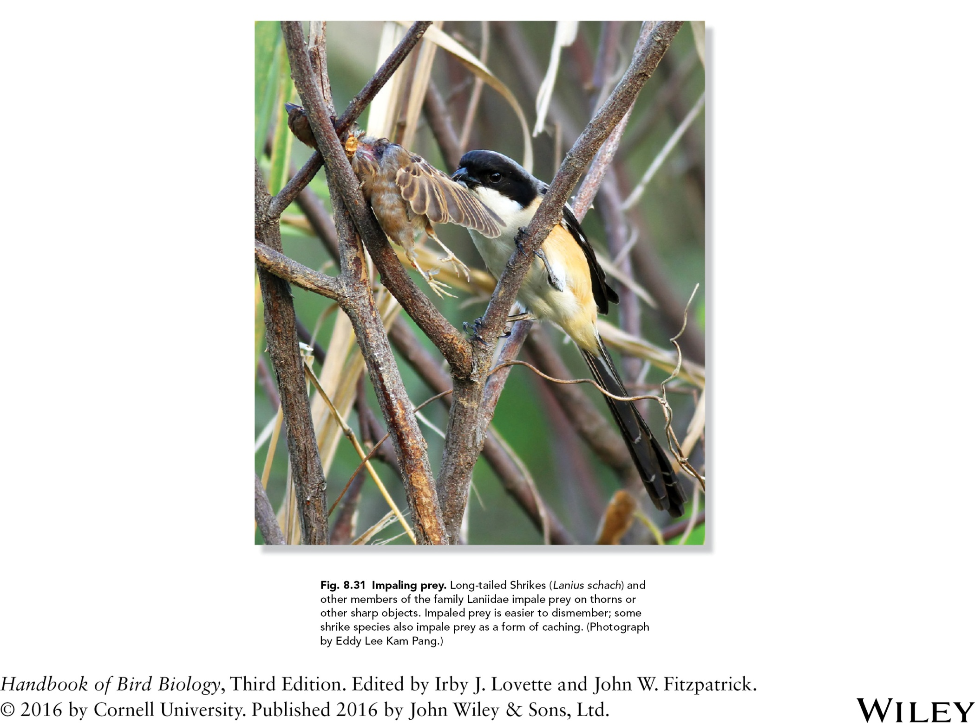

Slide 37
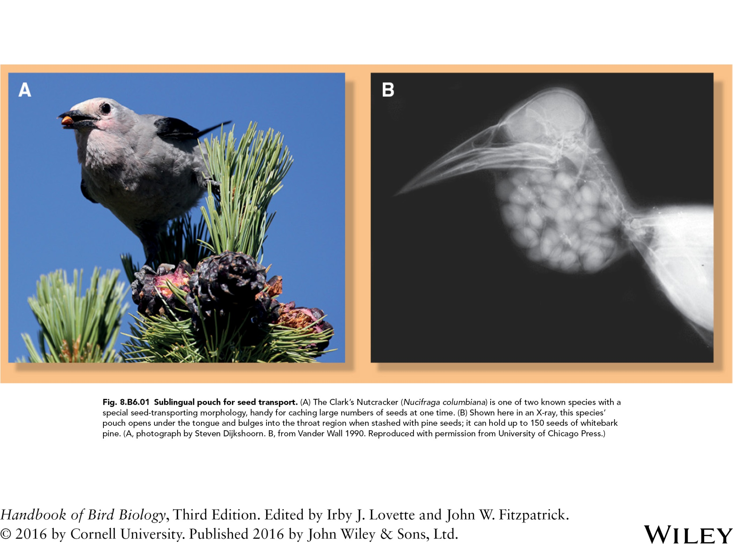

Slide 38
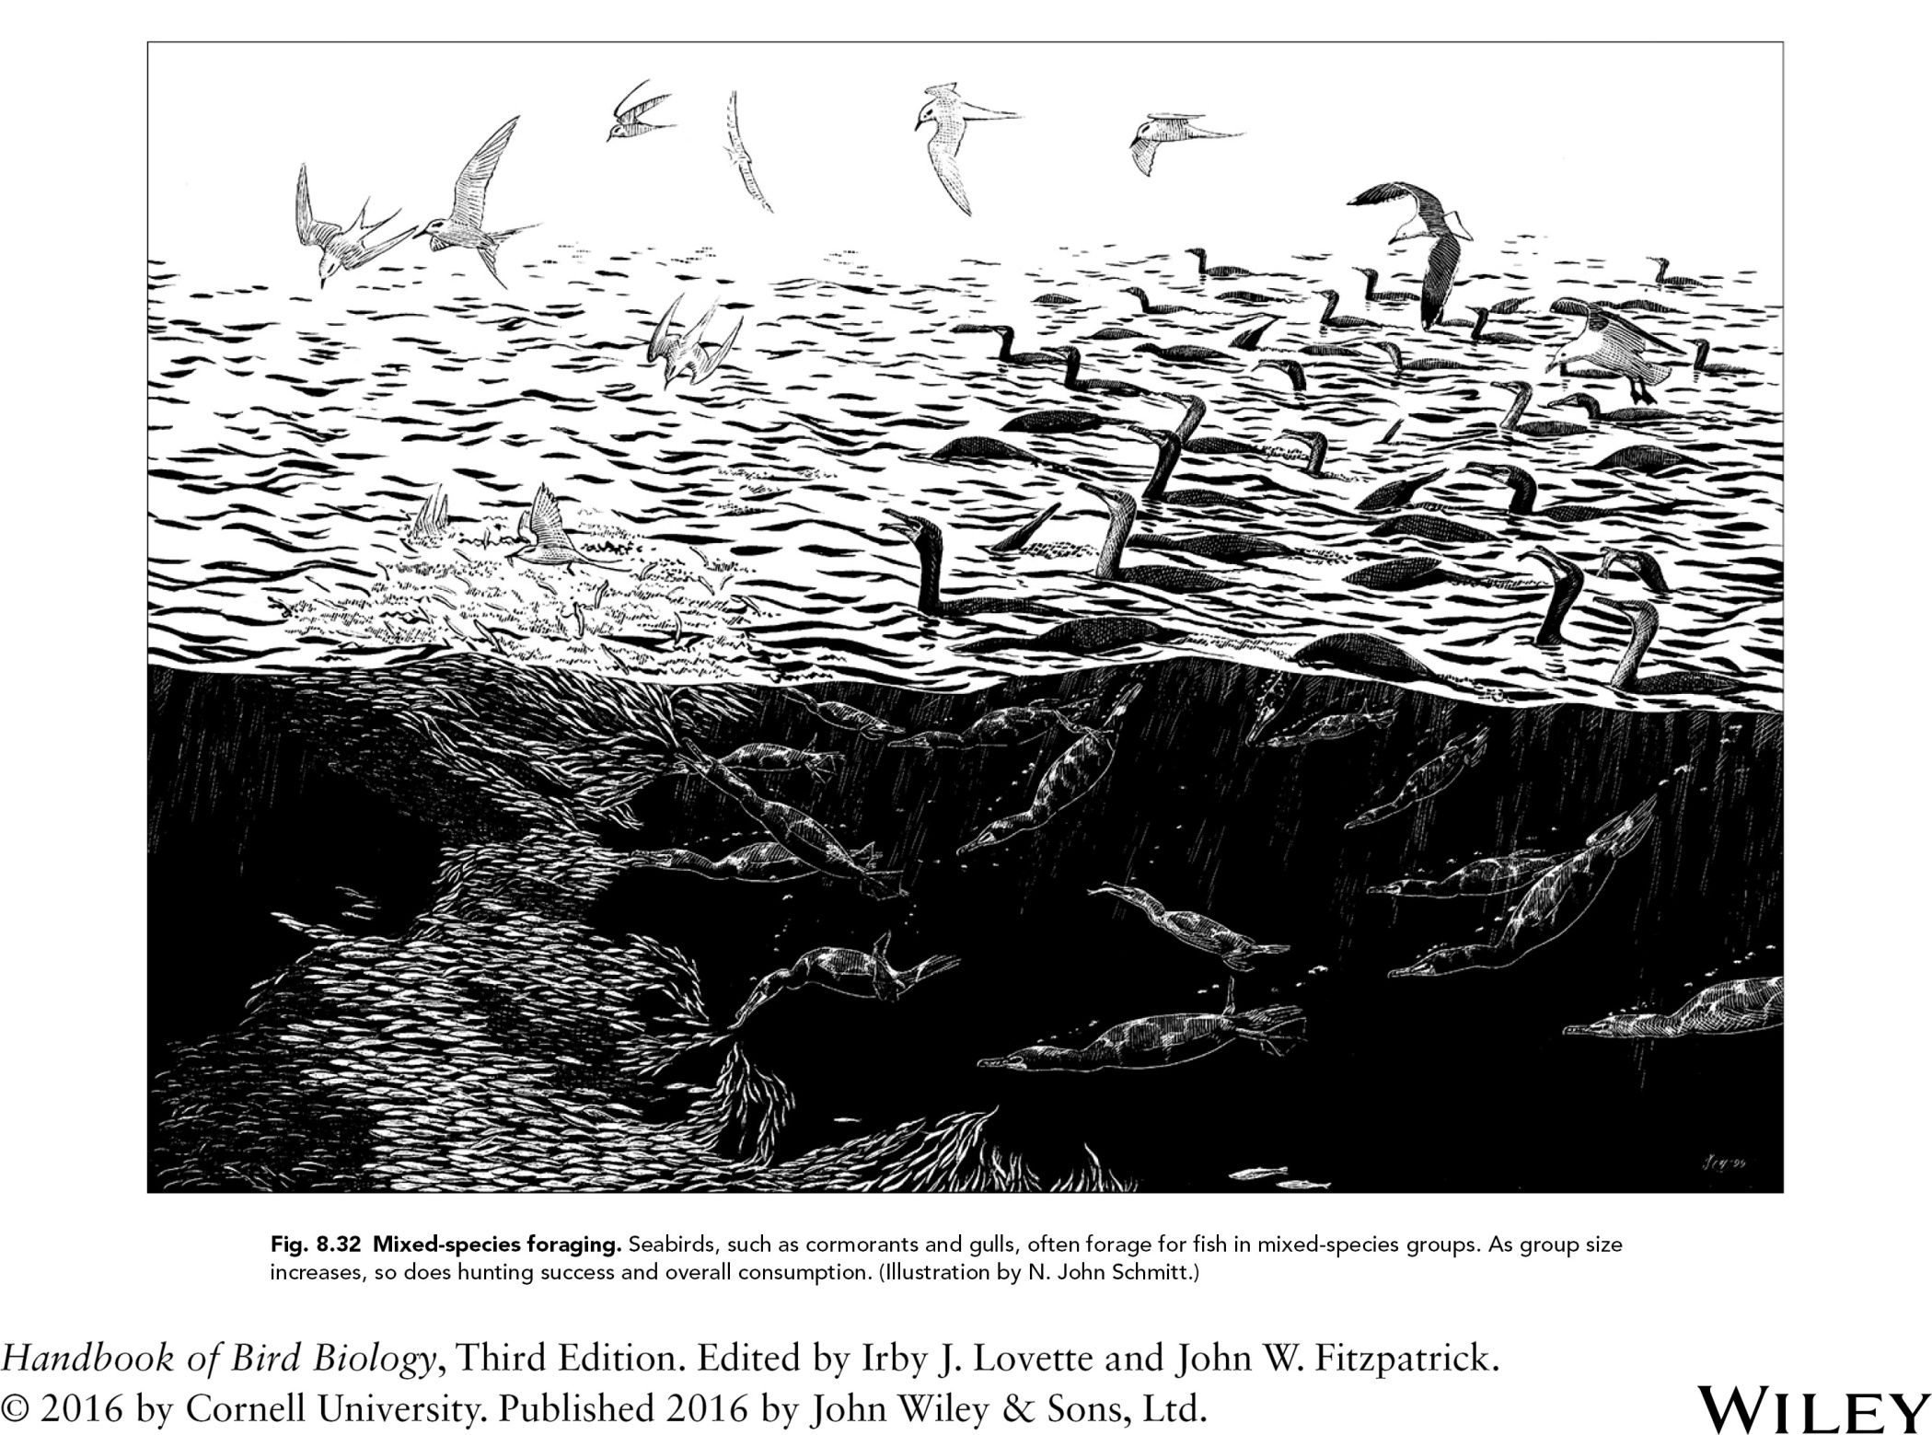

Slide 39
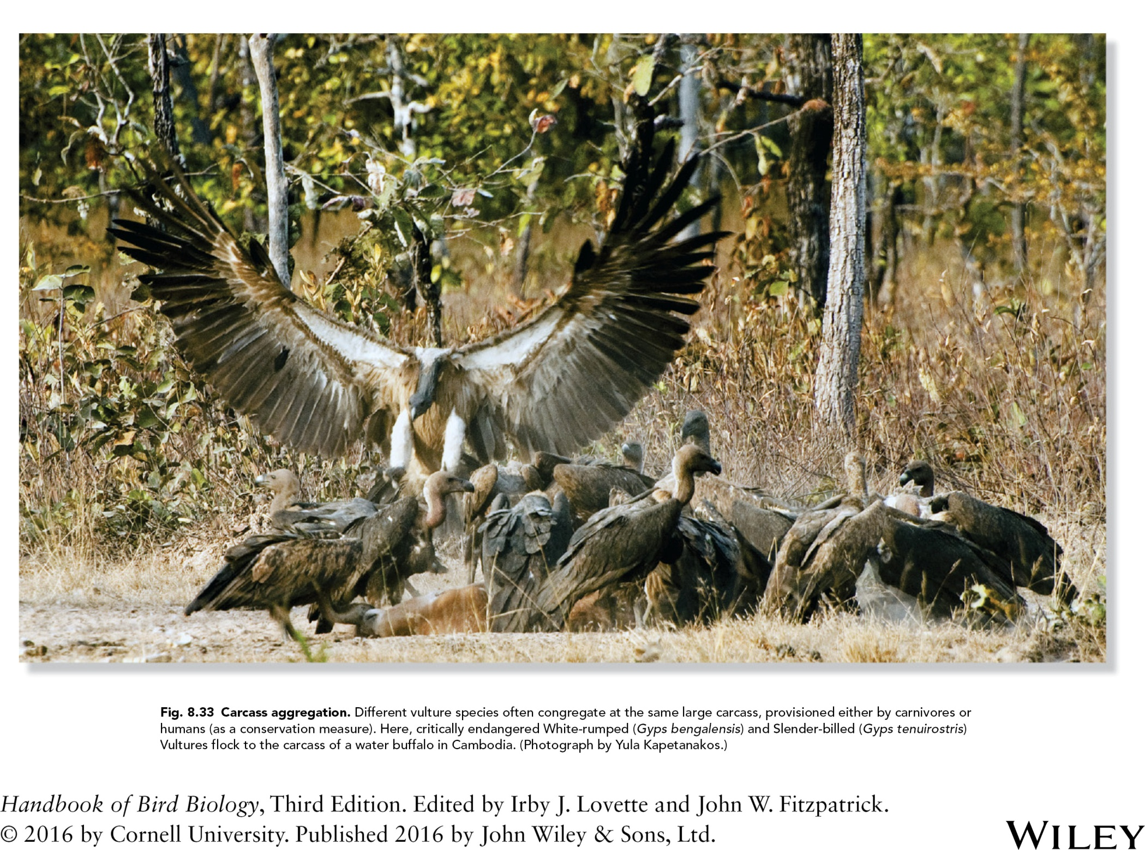

Slide 40
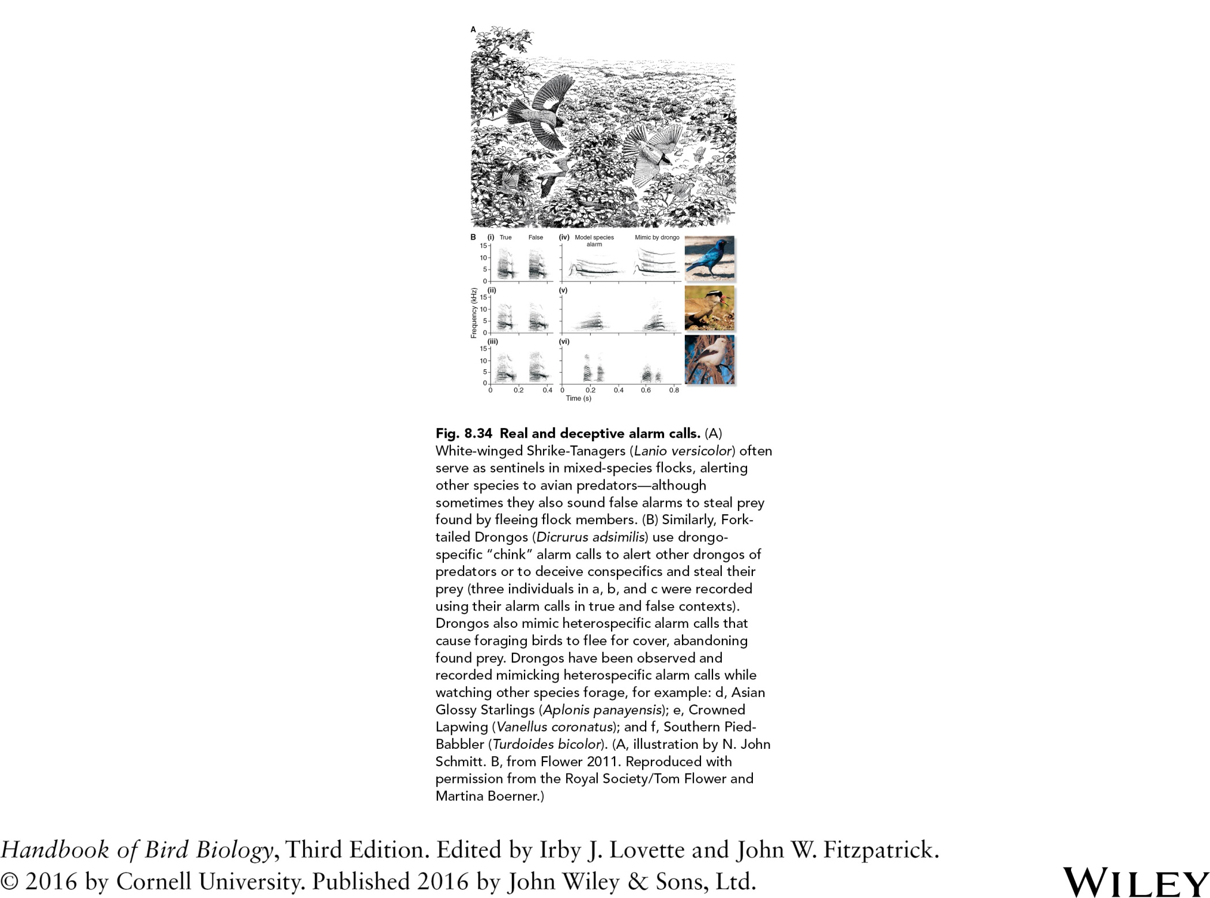
Fig. 8.34 Real and deceptive alarm calls. (A)
White‐winged Shrike‐Tanagers (Lanio versicolor)
often serve as sentinels in mixed‐species flocks,
alerting other species to avian predators—
although sometimes they also sound false alarms
to steal prey found by fleeing flock members.
(B) Similarly, Fork‐tailed Drongos (Dicrurus
adsimilis) use drongo‐specific “chink” alarm calls
to alert other drongos of predators or to deceive
conspecifics and steal their prey (three individuals
in i, ii, and iii were recorded using their alarm calls
in true and false contexts). Drongos also mimic
heterospecific alarm calls that cause foraging birds
to flee for cover, abandoning found prey. Drongos
have been observed and recorded mimicking
heterospecific alarm calls while watching other
species forage, for example: iv, Asian Glossy
Starlings (Aplonis panayensis); v, Crowned
Lapwing (Vanellus coronatus); and vi, Southern
Pied‐Babbler (Turdoides bicolor). (A, illustration
by N. John Schmitt. B, from Flower 2011.
Reproduced with permission from the Royal
Society/Tom Flower and Martina Boerner.)

Slide 41
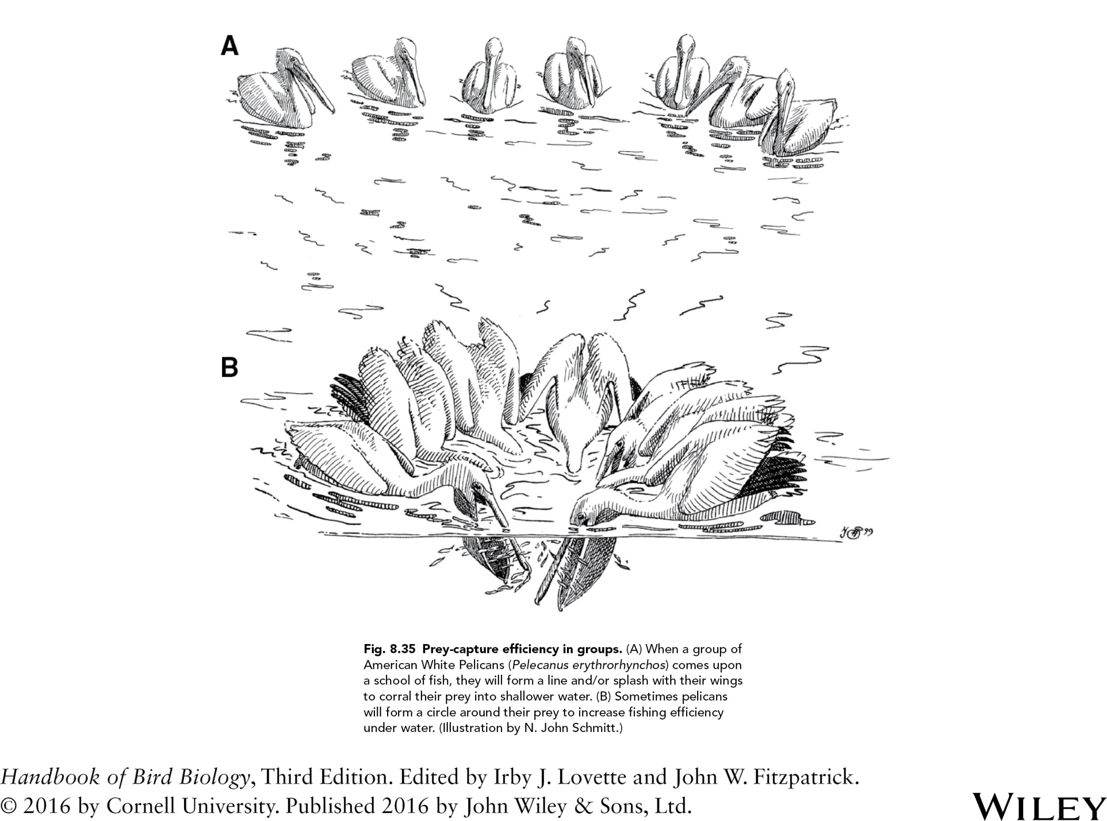

Slide 42
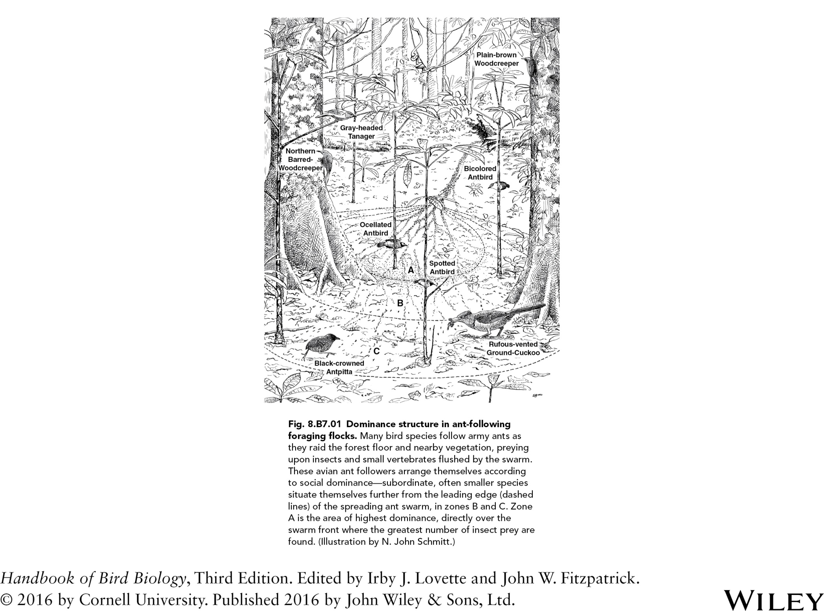

Slide 43
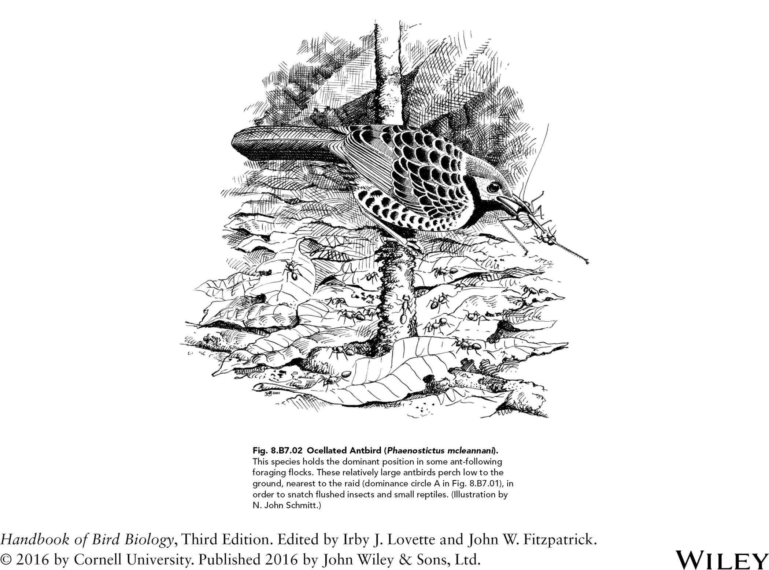

Slide 44
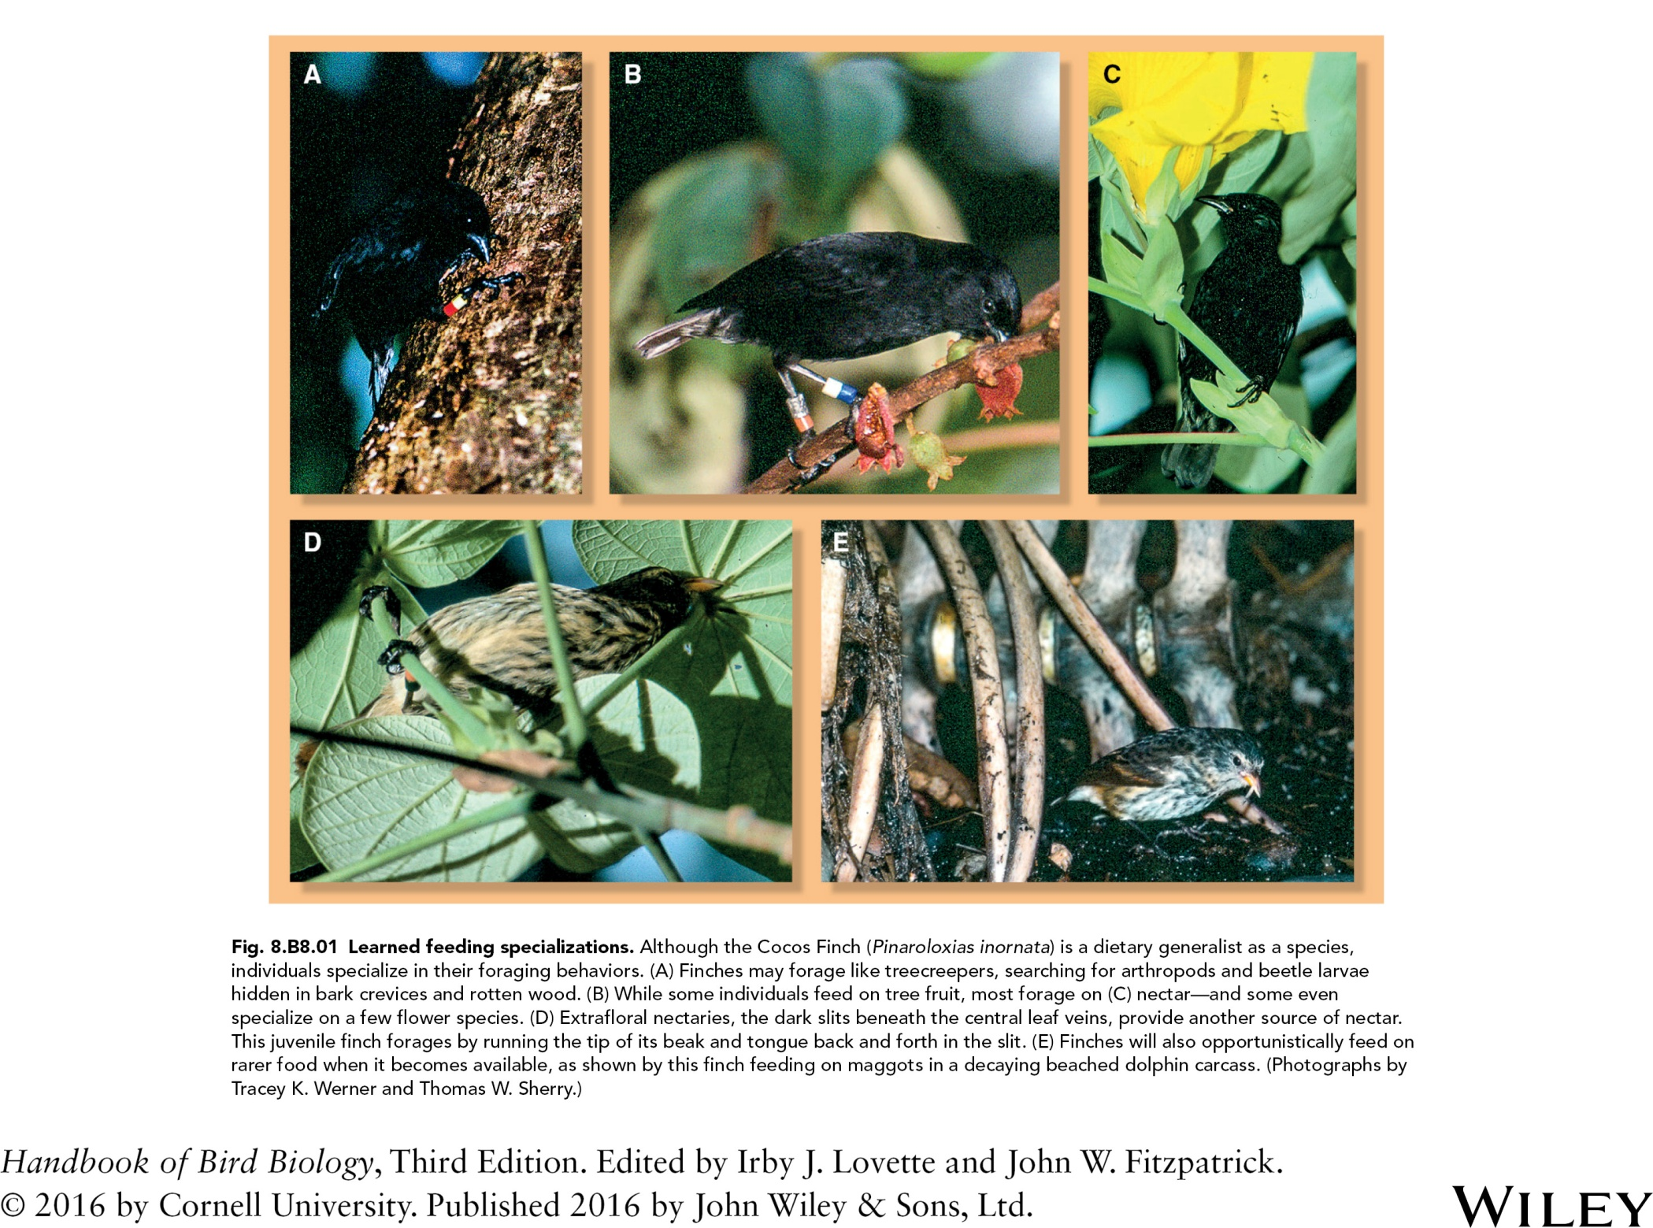

Slide 45
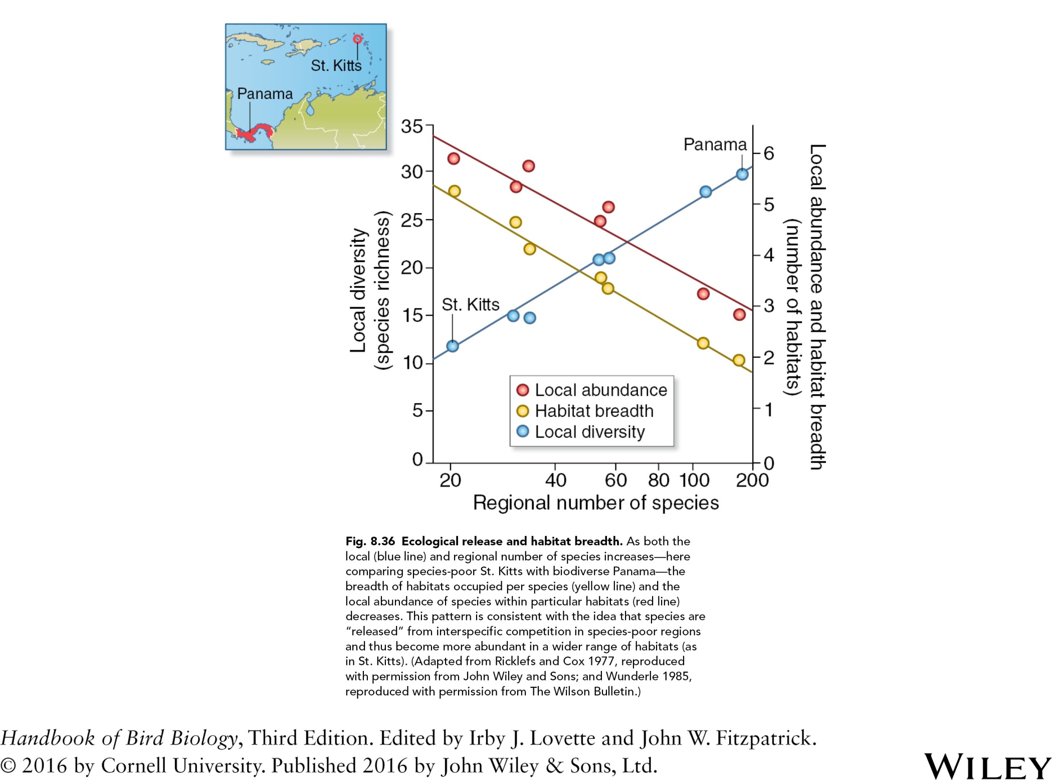

Slide 46
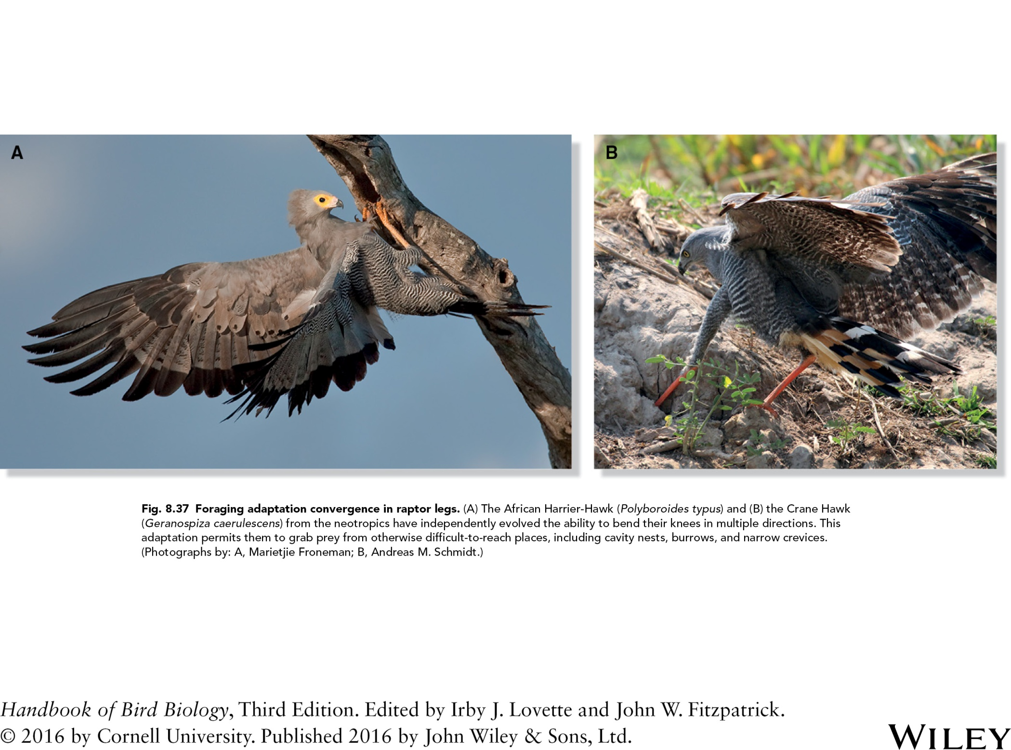
Fig. 8.37 Foraging adaptation convergence in raptor legs. (A) The African Harrier‐Hawk (Polyboroides typus) and (B) the Crane Hawk
(Geranospiza caerulescens) from the neotropics have independently evolved the ability to bend their leg joints in multiple directions. This
adaptation permits them to grab prey from otherwise difficult-to-reach places, including cavity nests, burrows, and narrow crevices.
(Photographs by: A, Marietjie Froneman; B, Andreas M. Schmidt.)

Slide 47
